Slide 1

Development and application of an algorithm to determine statistically-valid non-cytotoxic concentrations from imperfect in-vitro data sets
http://homoeopathyforwomen.blogspot.ch
Sunniva Förster EUSAAT Linz 2013
Notes:
Welcome to the very last session of the conference
I will talk about a benchmark algorithm that can be used to calculate non cytotoxic doses in in-vitro data

Slide 2
Outline
Short Introduction to the Benchmark Dose Concept
Application of the in vivo concept to in-vitro data
Why is there a need for a new tool?
Description of the algorithm
Analysis of stem cell in-vitro cytotoxicity data
How to use the tool: freely-accessible Web Application

Slide 3
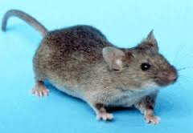


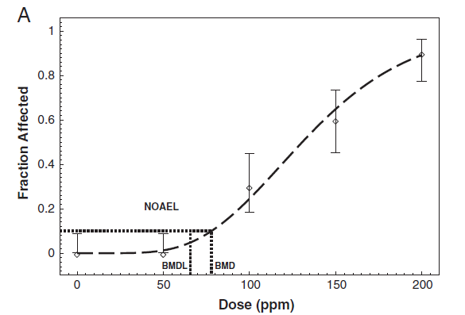
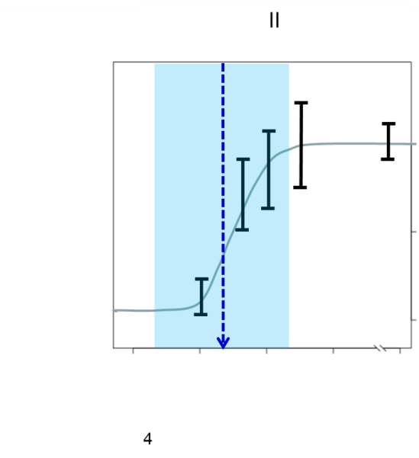
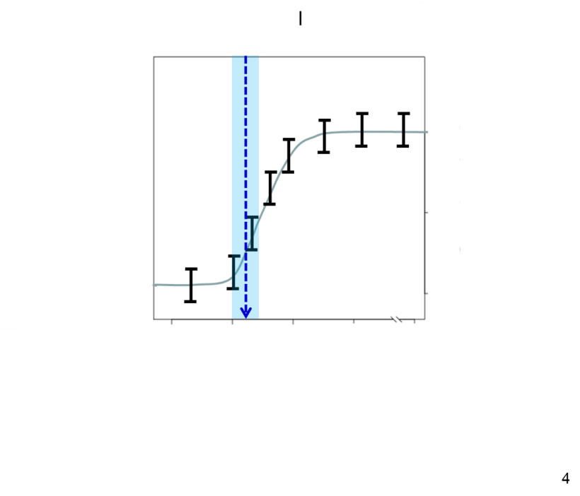
From NOAEL Concept to Benchmark Dose Concept
+
NOAEL: Highest data point
without adverse effect
BMR: Acceptable Risk (e.g 10%)
BMDL: Benchmark concentration at lower confidence limit
„Bad“ data
„Good“ data
BMDL
BMR
BMD
NOAEL
Modified from David et al., Toxicology and Applied Pharmacology, 2012
Extract more information use less mice!
Do not reward poor data!
Make studies comparable!
Notes:
it can appropriately account for variability
and uncertainty in the experimental results.

Slide 4
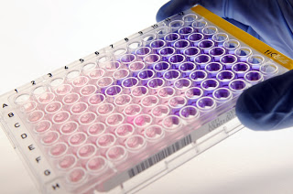
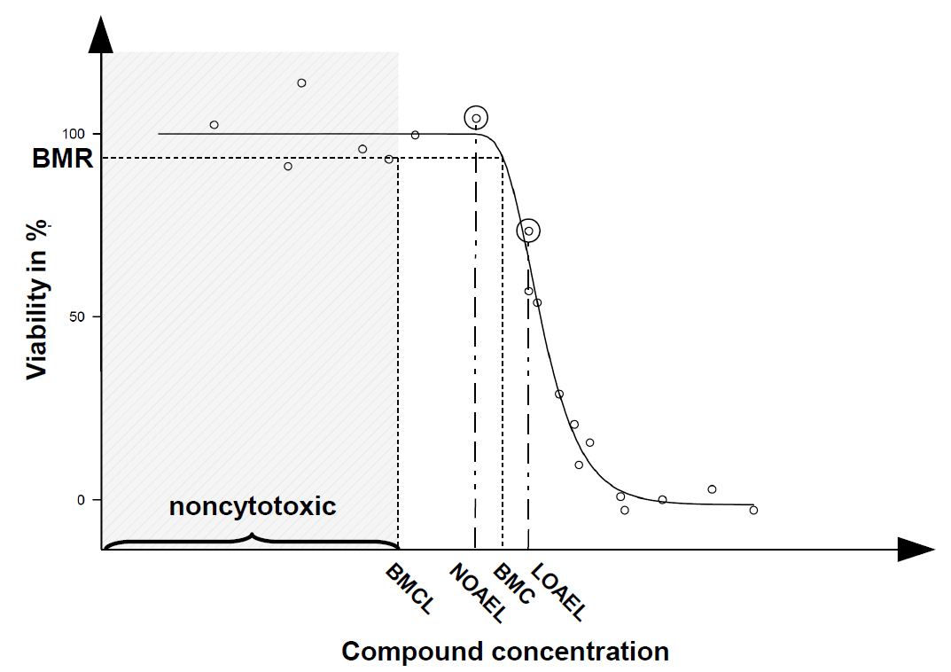
From Benchmark Dose Concept to in-vitro BMC
BMC10=EC10
Continous endpoint requires adaptations!

Slide 5
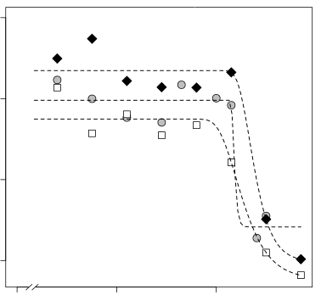
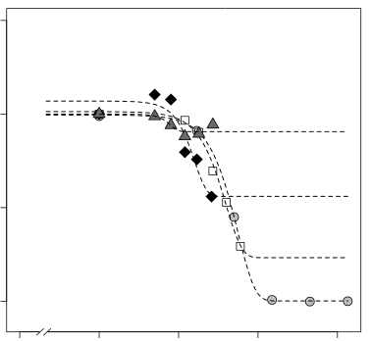
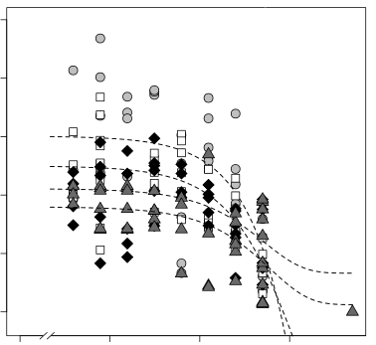
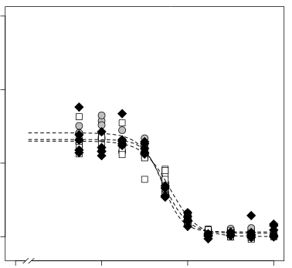
„Real-world“ imperfect datasets
100% viability
100% viability
Optimizing cDNA Phage Display for High-Throughput Biomarker Discovery
100% viability
100% viability

Slide 6
Why is there the need for a new tool?
The EPA strongly recommends using the Benchmark approach.
The BMCL is rarely used in in-vitro toxicology.
State of the art for in-vitro is to fit a four parameter log-logistic fit to the data and calculate the EC10.
This rewards low data quality.
Comparability between studies is still poor.

Slide 7

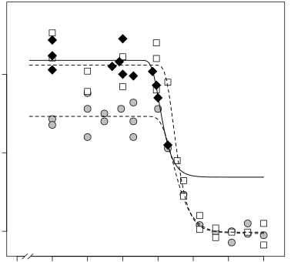

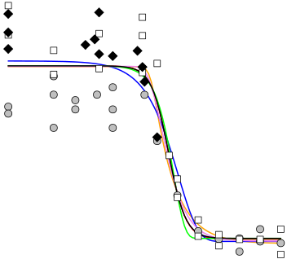











Algorithm of the Program - Part I
Machine readings (e.g. fluorescence)
Normalize individual datasets A,B,C to their respective untreated control
Pool datasets
Find best model for pooled data from all datasets
Fit best model from previous step
to individual datasets (A,B,C)

Slide 8
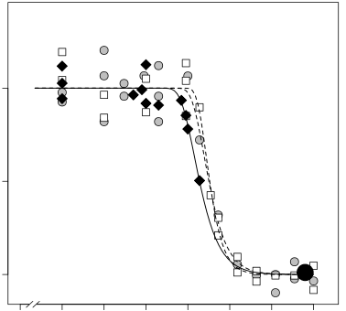
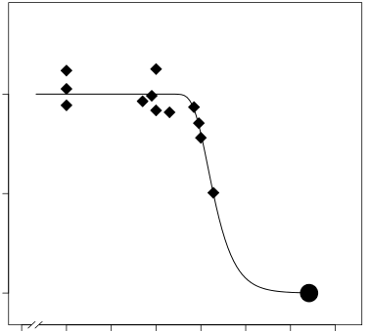
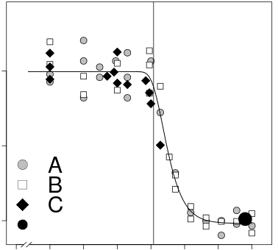




Algorithm of the Program – Part II
Each individual dataset covers full curve?
No
Add anchor point and
re-fit best model
Yes
Re-normalize each data set (A,B,C)
for hundred percent viability at low concentrations
Fit best model from above to
re-normalized pooled data
Calculate BMC/BMCL from
“best model”

Slide 9
Summary I
Algorithm deals with „offset“ of positive controls (100%viability).
Algorithm deals with lack of high concentration data (0%viability).
Algorithm deals with model uncertainty
Output (BMCL) measures data quality as poor data result in a lower BMCL at a given BMC.
Algorithm considers data across different experiments.

Slide 10
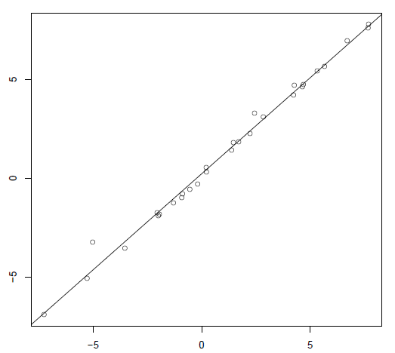
Are all previous publications using the EC10 wrong?
Spearman=0.997
The BMCL15 correlates linear to the EC10 used in many publications.
The BMCL15 is a more appropriate measure because it takes data quality in account!
Log EC10
Log BMCL15

Slide 11
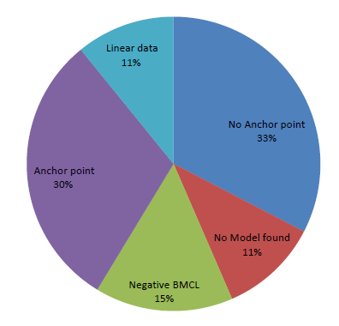
Analysis of 46 datasets from ESNATS stem cell assays
No Anchor point necessary for 15 high quality data sets.
Anchor point made BMC calculation possible for 14 incomplete data sets.
For 12 data sets no model was found or the BMCL was negative.
5 were linear in the testet concentration range

Slide 12
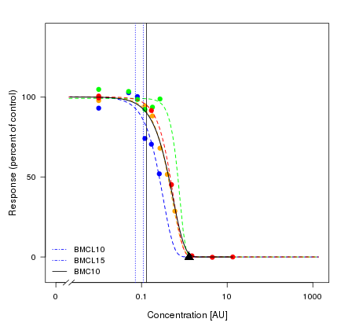
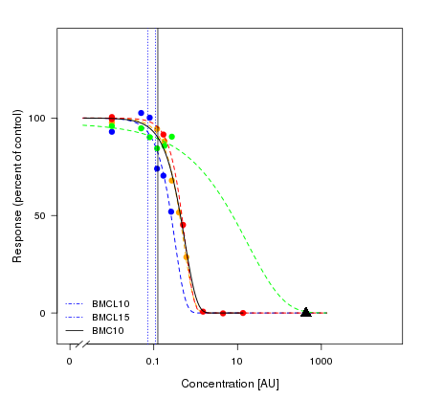
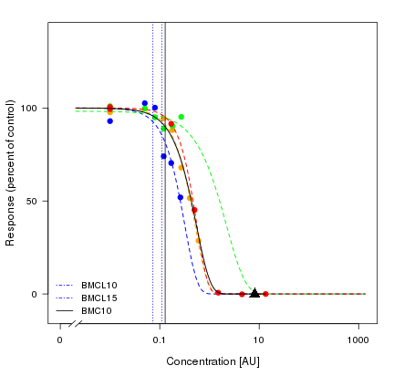
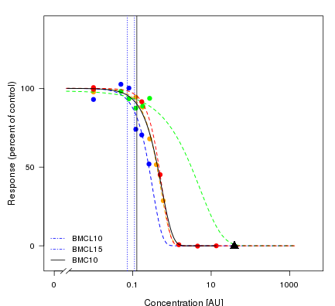
Influence of anchor point selection on BMC
Example Data
Hundred different positions of the anchor point are tested
It is tested if the position of the anchor point influences the BMC or the confidence interval (BMCL).
If the position does not matter it is statistically valid to use it for fitting purposes.

Slide 13
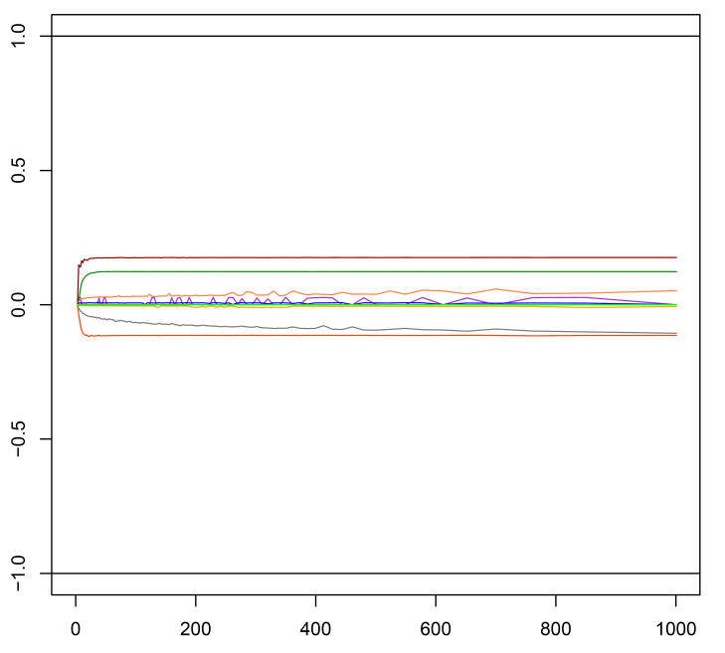
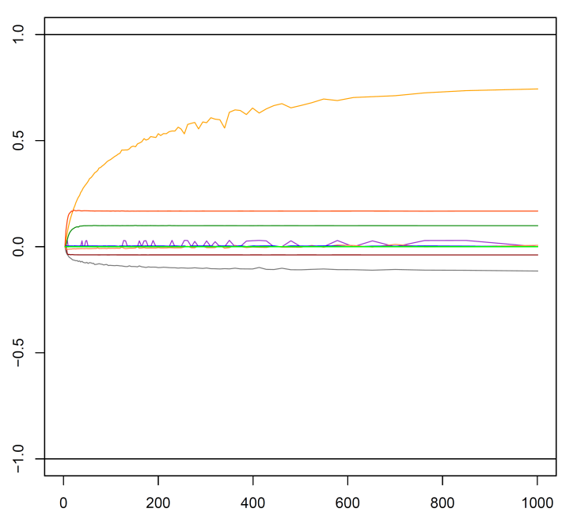


Influence of the anchor point on the fit
$$\frac{BMCx}{BMC1}$$
$$\frac{BMCUx−BMCLx}{BMCU1−BMCL1}$$
Relative BMC [AU]
Relative CI change[AU]
Position of anchor point [EC50*80*x]
Position of anchor point [EC50*80*x]
The is BMC not changed
The CI is not changed
Rule: An Anchor point is set at EC50*80 or the highest concentration*80 if no EC50 can be calculated.

Slide 14
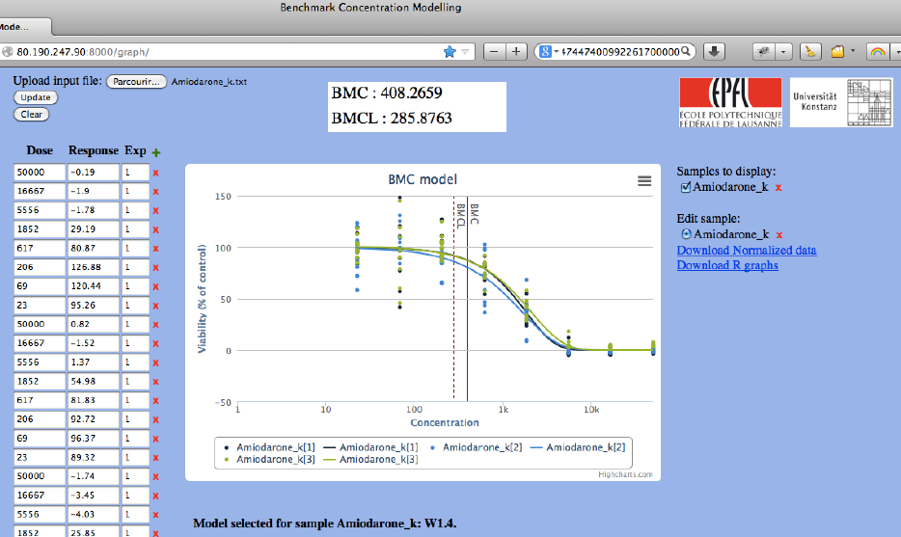
Web Application

Slide 15
Summary
Problems that can be solved
Can compensate for wrong control measurements
Can predict missing toxic data
BMCL15 can be used for microarray experiments
Best model for data is fitted
No need to install Software
Limitations of the Algorithm
Cannot compensate all faulty and missing data
More than two data point necessary to define the non-toxic range
At least one out of three experiments should cover the toxic range (>70% toxicity) otherwise data will be considered linear.

