Slide 1
ISPyB for BioSAXS

Slide 2
Why ISPyBB
Introduction of BioSAXS sample changer and move to BM29 (mid 2012): Up to 100 buffer/sample/buffer measurements in an 8 h shift
Need for consistent logging, off-site experiment planning tool
SEC-SAXS (since late 2012): Relatively large datasets, no “viewer” available
Need for an easy to use “data browser” Extend ISPyB for use in BioSAXS

Slide 3
Short History of ISPyBB
2012: Beginning of the project
April 2013: IspyBB in production for “static” measurements
January 2014: SEC-SAXS in production
Late 2015: The beginnig of ExiSAXS
January 2017: ExiSAXS in testing

Slide 4
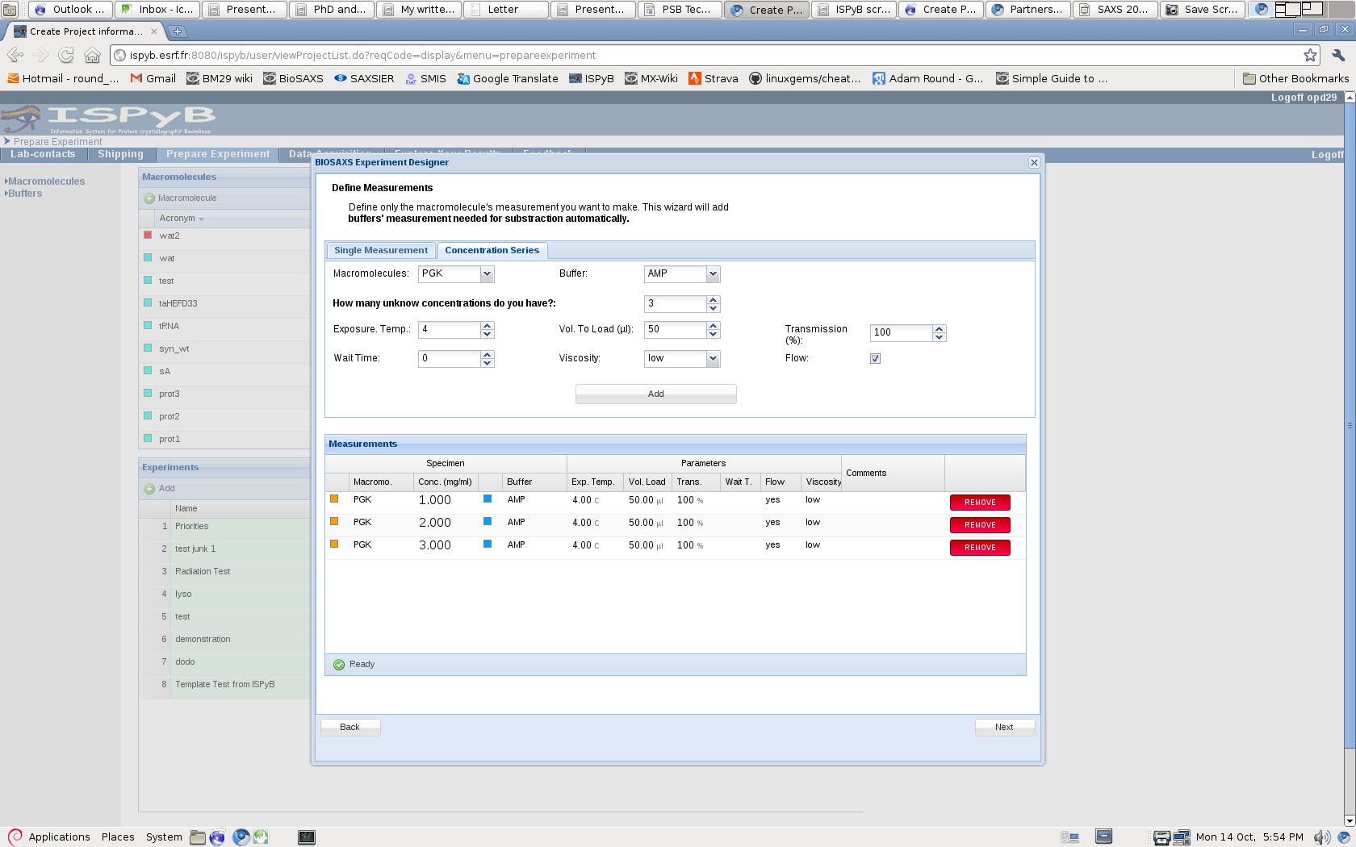
Improved feedback for experimental preparation

Slide 5
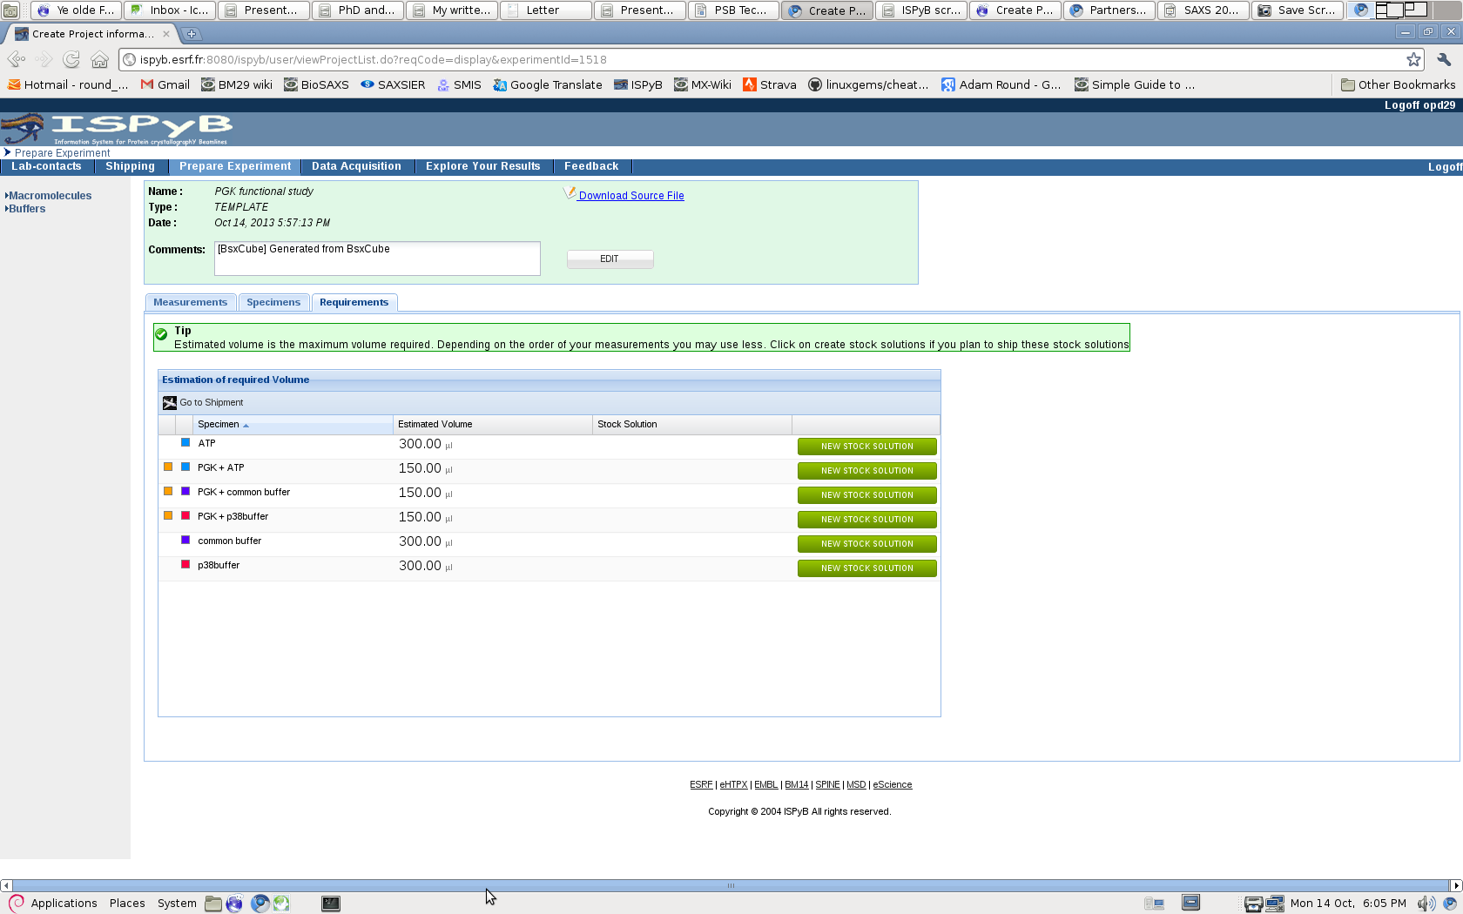
Improved feedback for experimental preparation
Shipments: Automated generation of shipping labels

Slide 6
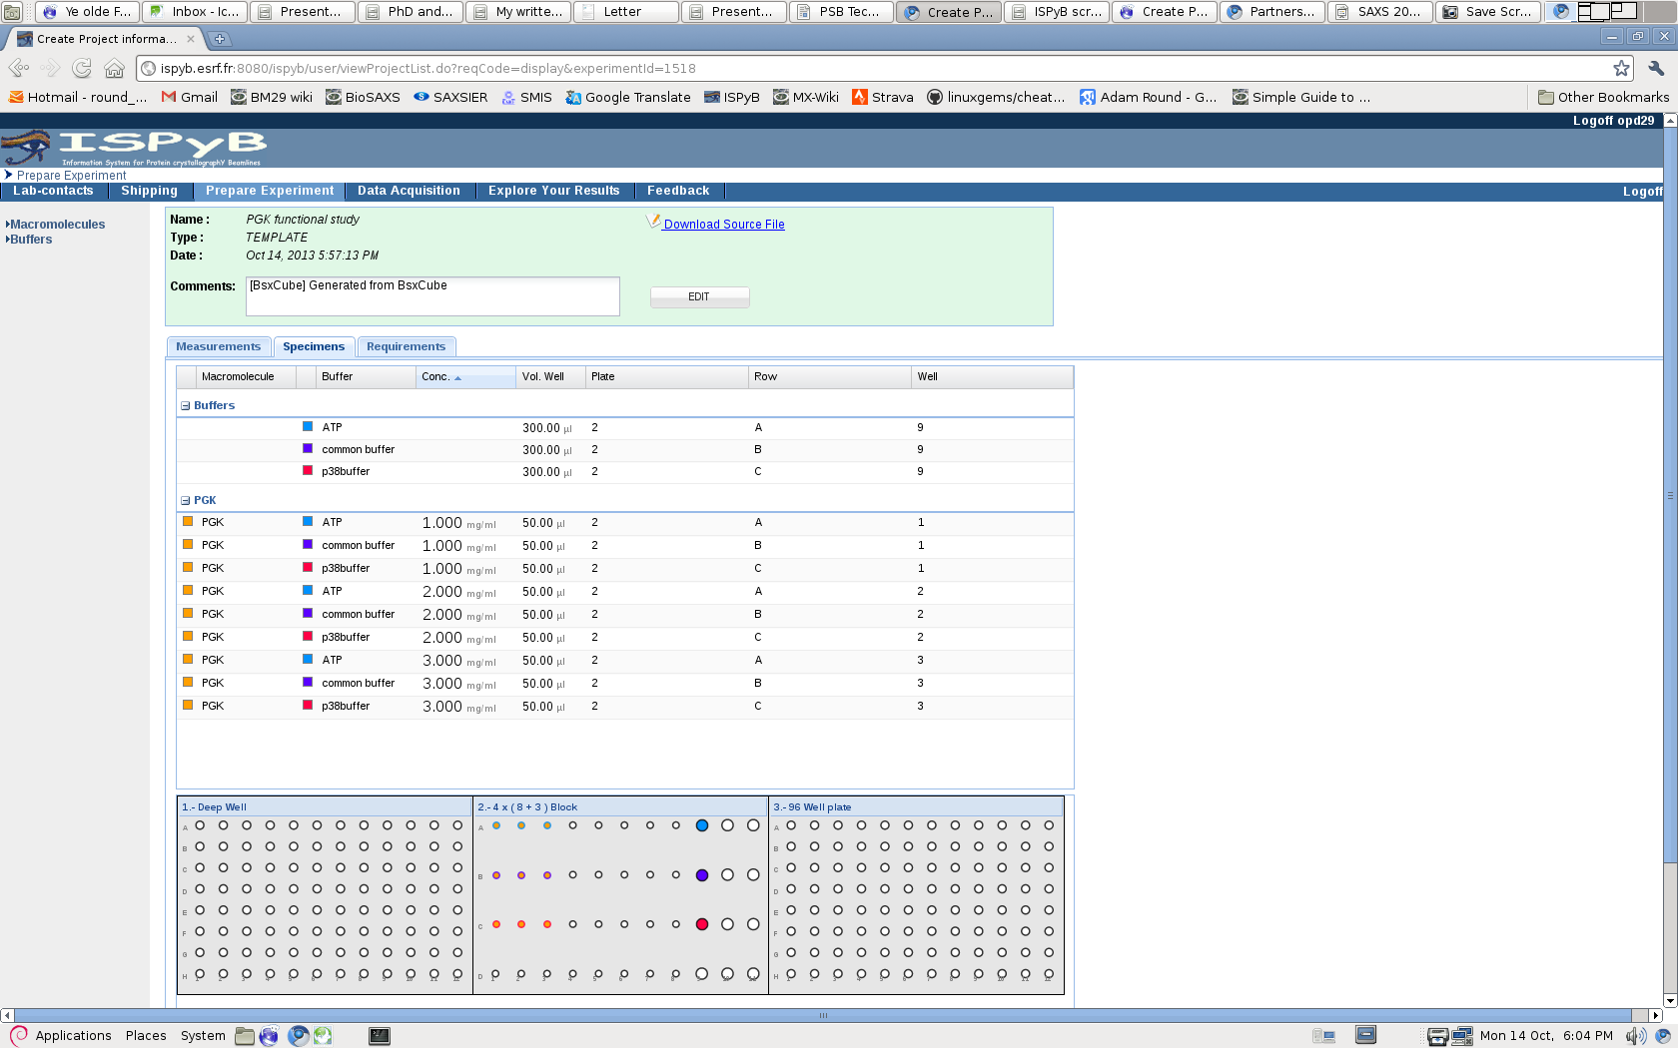
Improved feedback for experimental preparation

Slide 7
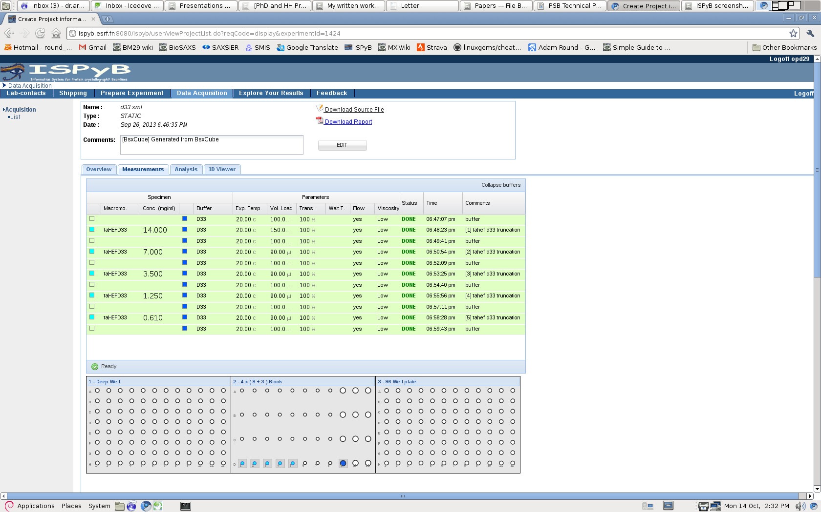
Improved feedback with ISPYB

Slide 8
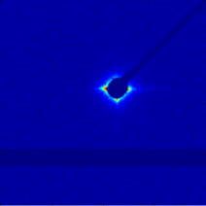
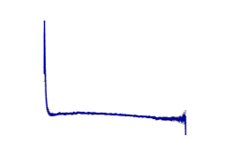
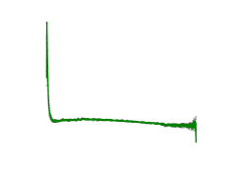
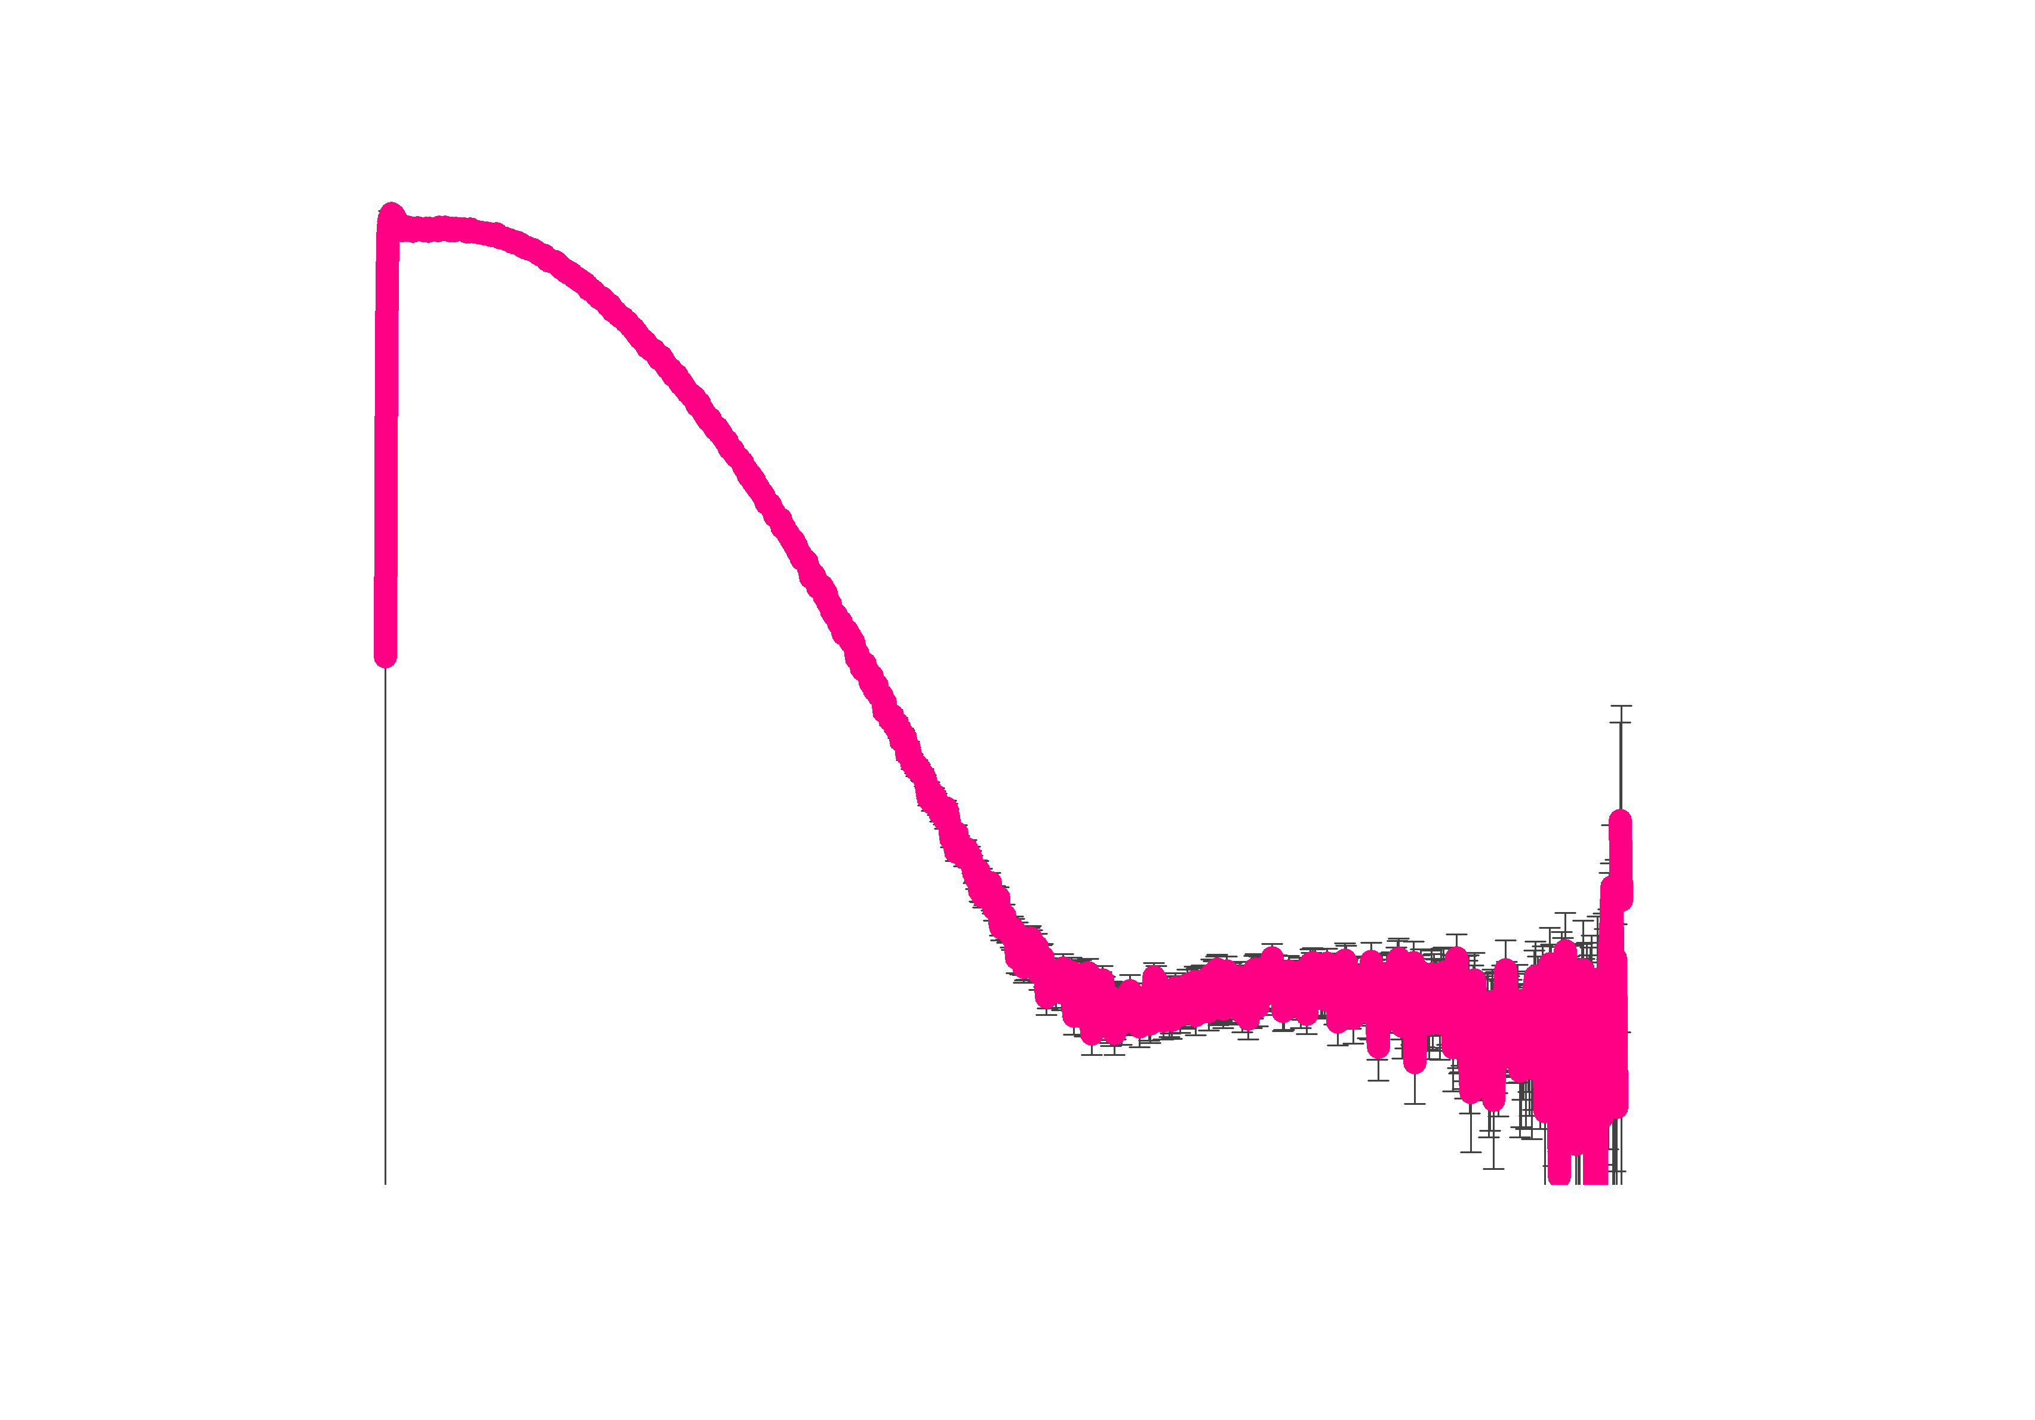
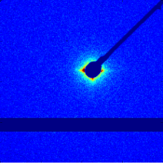
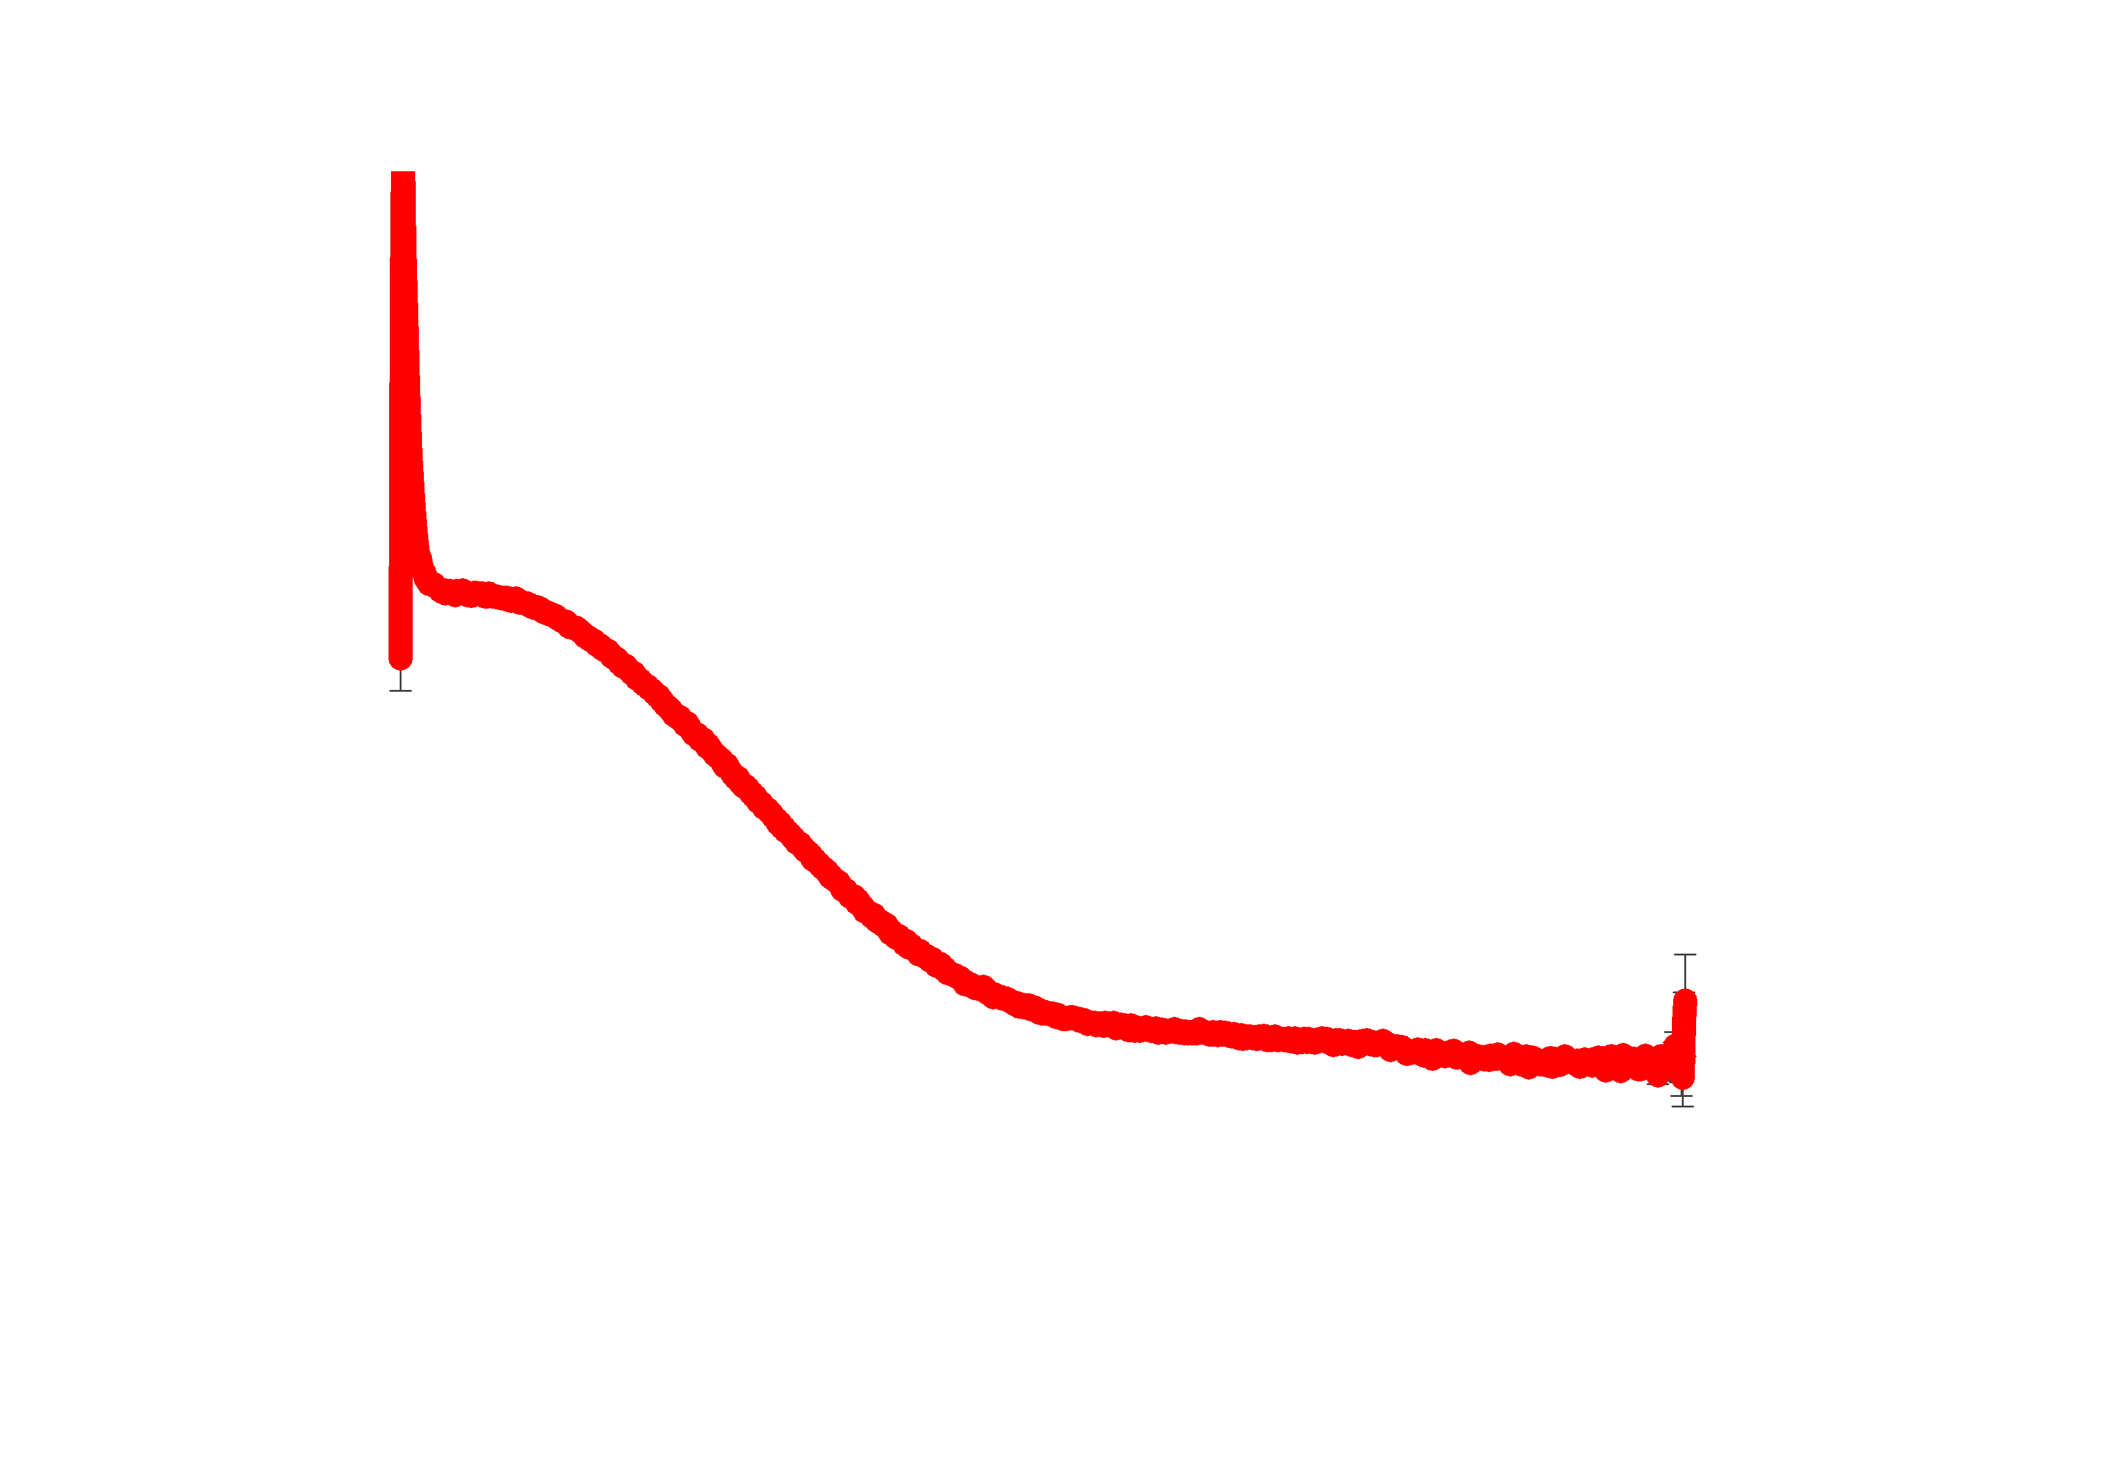
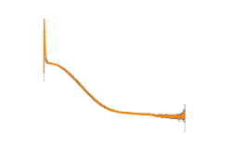
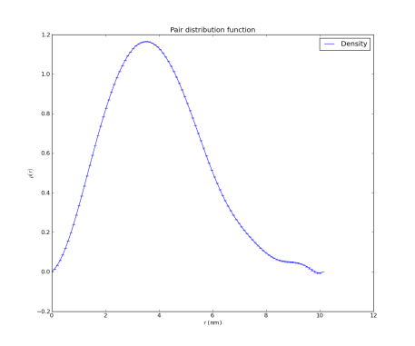
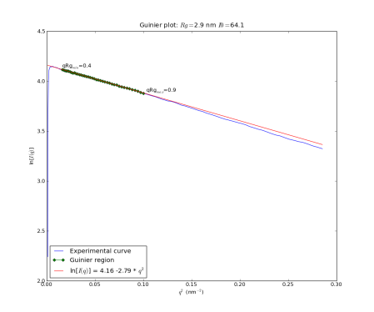
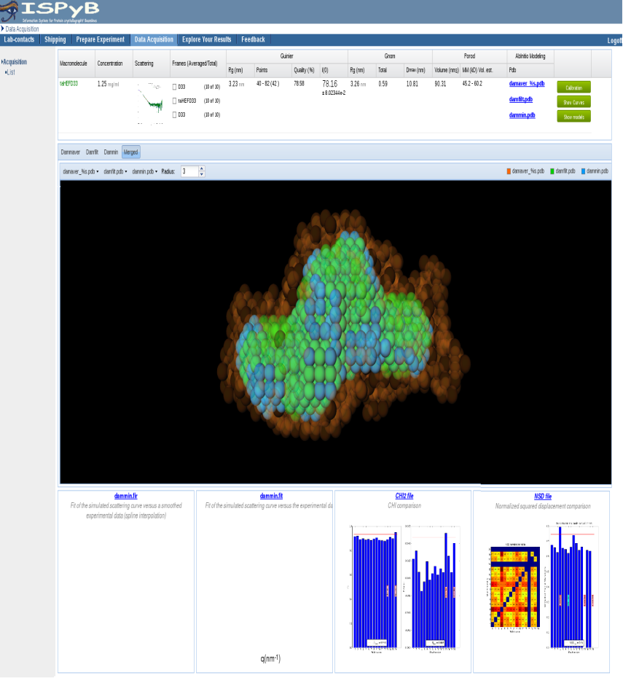
Data Processing - EDNA
1
2 x 10
Select
Average
pyFai
Subtract
10
autorg
dammif
damaver
dammin
datgnom

Slide 9
Data Processing - EDNA
N Frames, concentration
Compare to 1st frame using datcmp
p
< 0.01
≥ 0.01
Discard
Average
Averaged file
Buffer before & sample
Buffer after?
yes
AutoSub
no
Subtracted file
SAXSAnalysis
ISPYB
Notes:
smartmerge

Slide 10
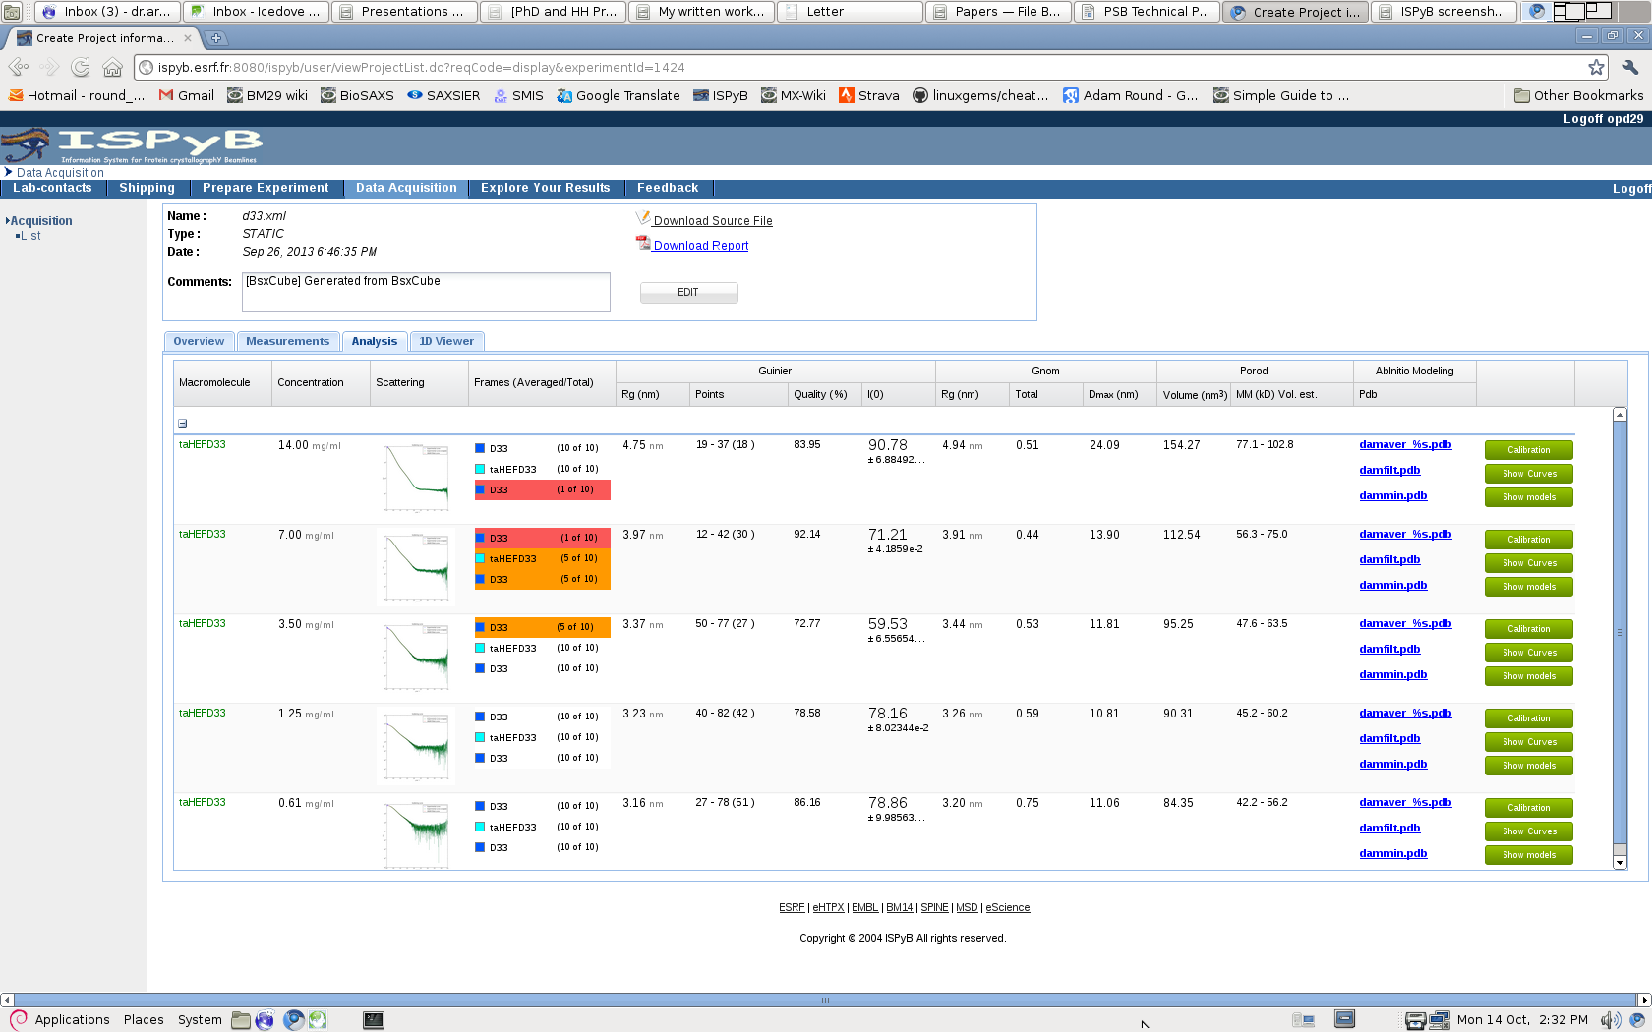
Improved feedback with ISPYB
+ Download options

Slide 11
Data Processing - EDNA
Gnom output file
8 dammif runs
χ
above cutoff
discard
below cutoff
Pairwise supcomb
above cutoff
nsd
discard
below cutoff
damaver
damfilt
damstart
dammin
ISPYB
Notes:
modeling

Slide 12
Improved feedback with ISPYB

Slide 13
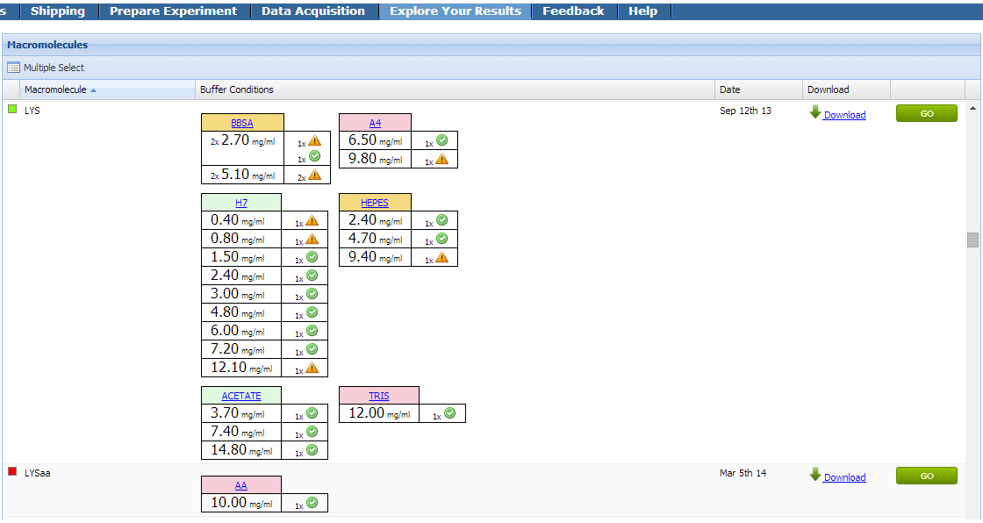
Improved feedback with ISPYB

Slide 14
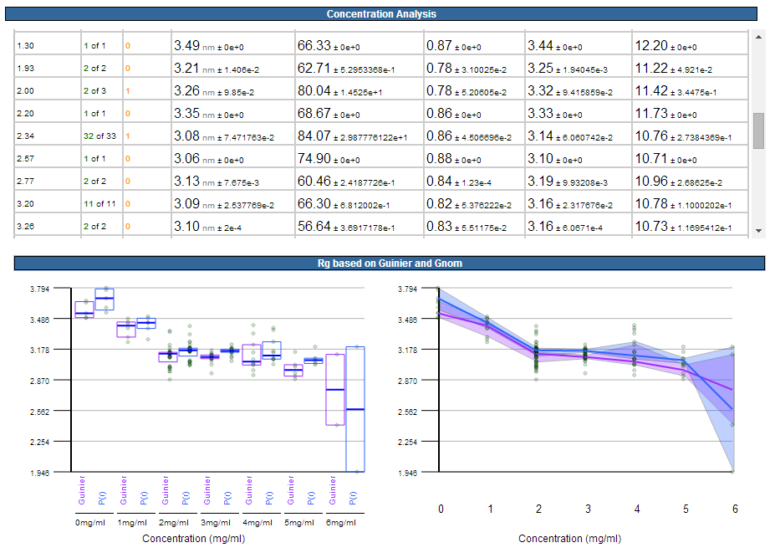
Improved feedback with ISPYB

Slide 15
Data Processing - EDNA
1 buffer
e.g. frame 1-456
Select
Average
1000
pyFai
Subtract
544
544 samples
autorg
datgnom
dammif
damaver
dammin
autorg
4
peak finder
4
544

Slide 16
Data Processing - EDNA
Single frame
Compare to 1st frame using datcmp
Peak detection
< 0.01
p
≥ 0.01
SAXSAnalysis
First time?
Include in Buffer
Averaged buffer
Subtract buffer
Subtracted file
AutoRg
HDF5 file
ISPYB
Notes:
smartmerge

Slide 17
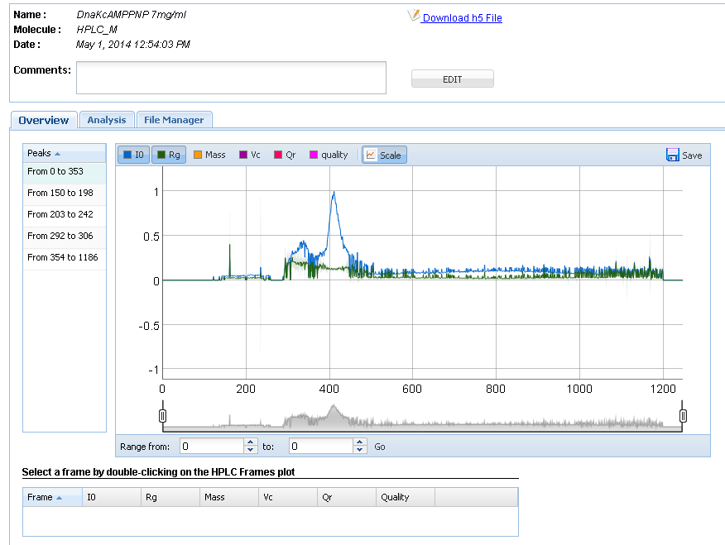
HPLC - ISPyB OVERVIEW
Run information
Run overview

Slide 18
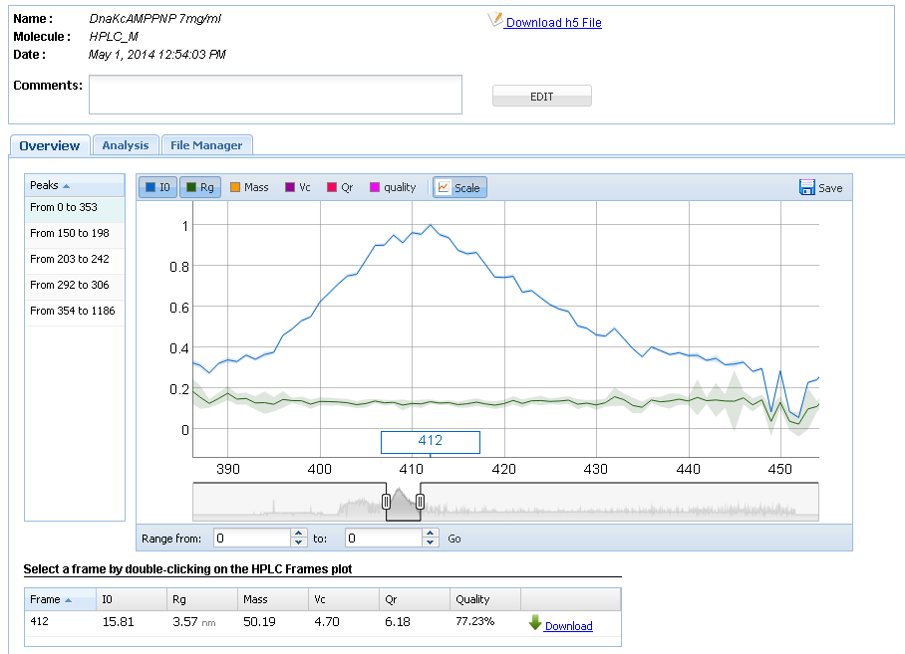
HPLC - ISPyB OVERVIEW
Robust R_{G}
Select single frame
Forward scattering
Radius of gyration
Mass estimate

Slide 19
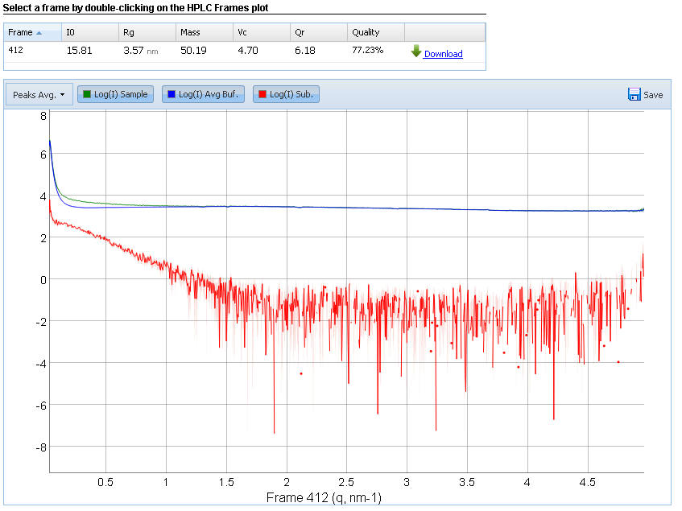
HPLC - ISPyB OVERVIEW
Check buffer & signal

Slide 20
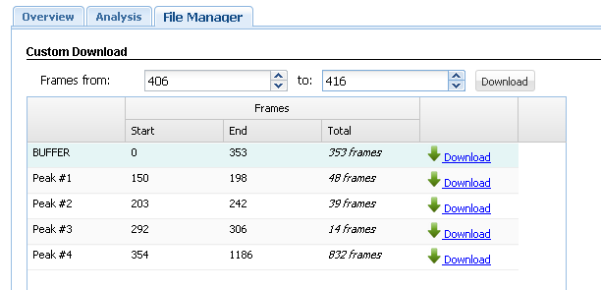


HPLC - ISPyB OVERVIEW
Buffer
1d curves of frames
averaged 1d curves of peaks #1 -#4
1d curves corrected for buffer
Zip file

Slide 21
Current status
In continuous use at the beamline and in users’ home laboratories
BUT: no development of new UI features EXI
How to deal with reprocessing?

Slide 22
EXI for BioSAXS

Slide 23
EXI?
EXI = Extended ISPyB
Separates database and UI
New GUI
Much faster access
Will replace the ISPyB UI, new features only added to EXI

Slide 24
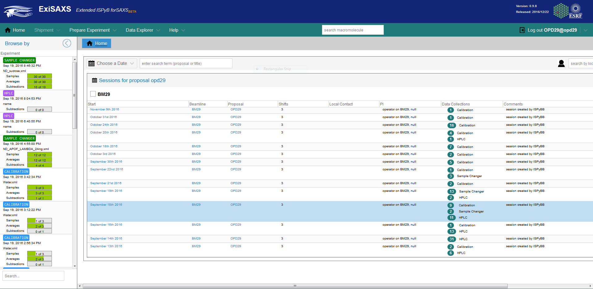
New look and feel

Slide 25
New look and feel

Slide 26
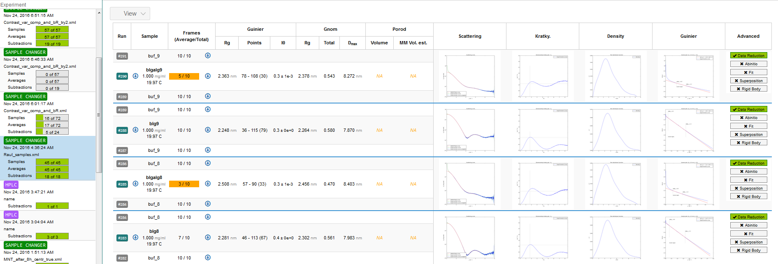
New look and feel

Slide 27
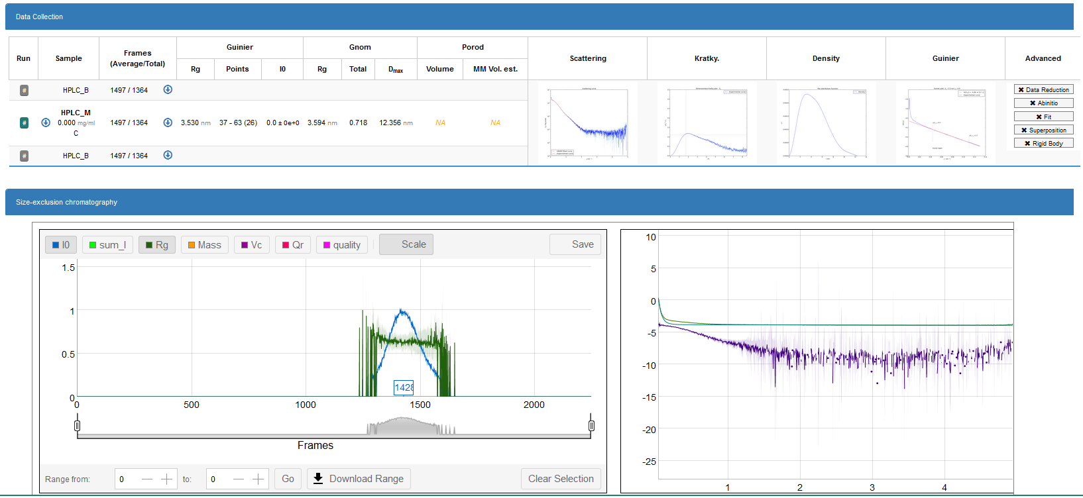
New look and feel

Slide 28


Personalized accounts
More flexible user account system: Log in as proposal: Log in as local contact:

Slide 29
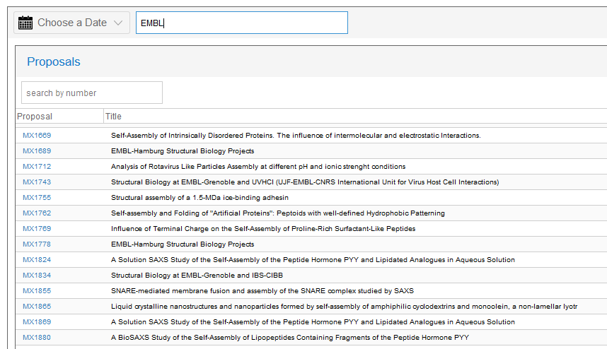
New features for managers/LCs/…

Slide 30

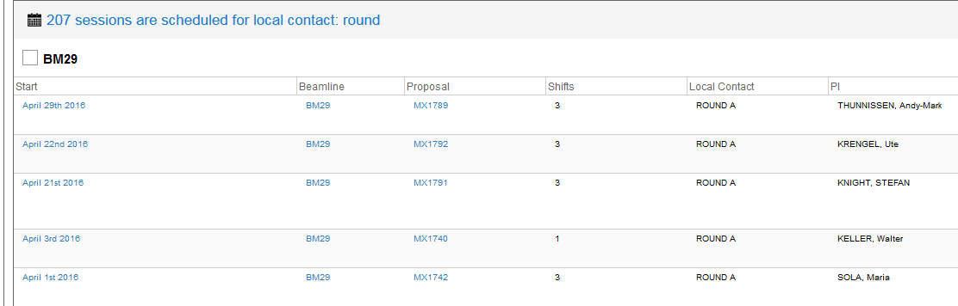
New features for managers/LCs/…

Slide 31
Current status
In development, accessible from outside ESRF
Some features of ISPyB GUI not yet available
Future developments
Completely replace ISPyB UI
Integrate tools for reprocessing
Possibly extend to other web-based BioSAXS / structural biology services
MX
HTX Lab

Slide 32






Acknowledgments
Alejandro de Maria Antolinos
Adam Round & Petra Pernot
All BM29 LCs and users
GRENOBLE

