Slide 1
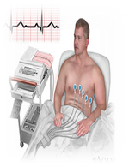
MKU
School of Medicine
MBMP 1323 : Cardiovascular Physiology I
Topic: Cardiac Arrhythmias
By J. Alfred, BSc, MSc, MA, PhD cont.
Email: alfredjuma2015@yahoo.com

Slide 2

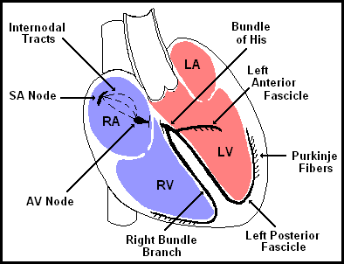

Slide 3
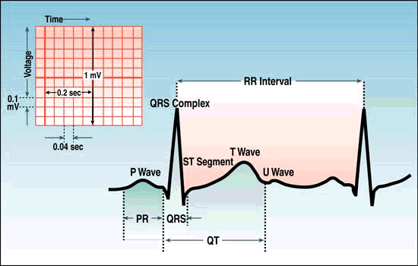
Rhythm
Sinus
  Originating from SA node
  P wave before every QRS
  P wave in same direction as QRS

Slide 4

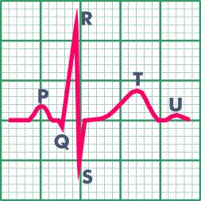

Slide 5
Interpretation
Develop a systematic approach to reading EKGs and use it every time
The system we will practice is:
  Rate
  Rhythm (including intervals and blocks)
  Axis
  Hypertrophy
  Ischemia

Slide 6
Rate
Rule of 300- Divide 300 by the number of boxes between each QRS = rate
Number of big boxes | Rate
1 | 300
2 | 150
3 | 100
4 | 75
5 | 60
6 | 50

Slide 7


www.uptodate.com
(300 / 6) = 50 bpm

Slide 8
Rate
HR of 60-100 per minute is normal
HR > 100 = tachycardia
HR < 60 = bradycardia

Slide 9
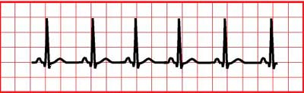
Normal Sinus Rhythm
Regular
Single p-wave precedes every QRS complex
P-R interval is constant and within normal range
P-P interval is constant

Slide 10
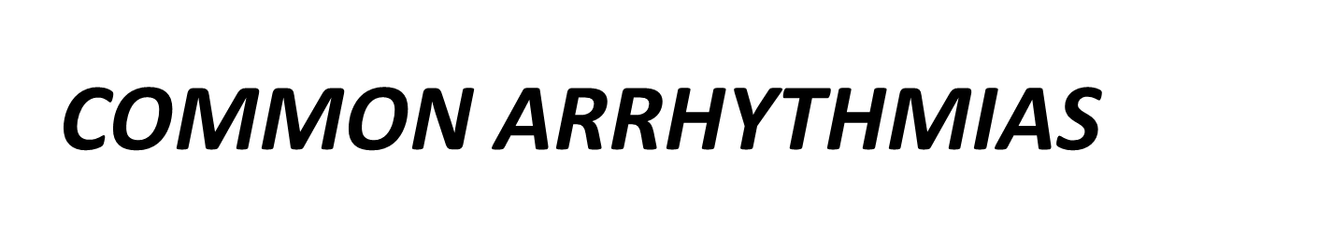
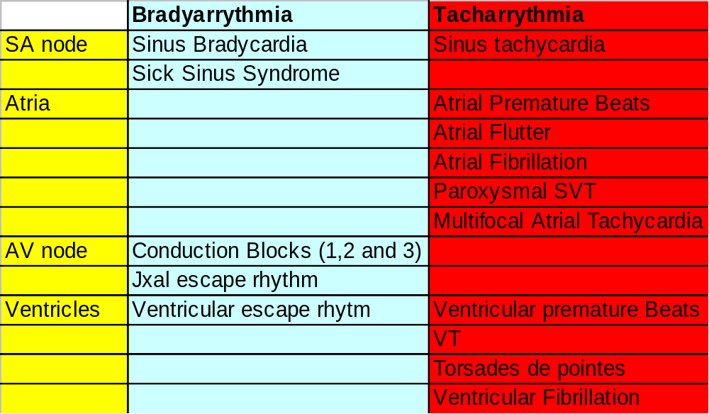

Slide 11
Differential Diagnosis of Tachycardia
Tachycardia | Narrow Complex | Wide Complex
Regular | ST SVT Atrial flutter | ST w/ aberrancy SVT w/ aberrancy VT
Irregular | A-fib A-flutter w/ variable conduction MAT | A-fib w/ aberrancy A-fib w/ WPW VT

Slide 12
Causes of Cardiac Arrhythmias
Abnormal rhythmicity of the pacemaker
Shift of the pacemaker from the sinus node to another place in the heart
Blocks at different points during the spread of the impulse through the heart
Abnormal pathways of impulse transmission through the heart
Spontaneous generation of spurious impulses in almost any part of the heart

Slide 13
Causes of Cardiac Arrhythmias
Rate above or below normal
Regular or irregular rhythm
Narrow or broad QRS complex
Relation to P waves

Slide 14
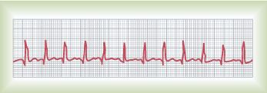
Abnormal Sinus Rhythm
Tachycardia: an increase in the heart rate
  Heart rate > 100 beats per minute
  Causes:
    Increased body temperature
    Sympathetic stimulation
    Drugs: digitalis
    Inspiration

Slide 15
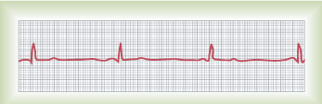
Abnormal Sinus Rhythm
Bradycardia:
  Slow heart rate < 60 beats per minute
  Causes:
    Parasympathetic stimulation
    Expiration

Slide 16
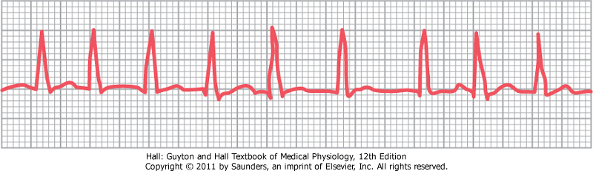
Abnormal Cardiac Rhythms that Result from Impulse Conduction Block
Sinoatrial Block
  Blockasde of the S-A node impulse before entering atrial muscle
Cessation of P wave
Causes:
  Ischemia of the S-A node
  Compression of the S-A node by scar formation
  Inflammation of the S-A node
  Strong vagal stimulation

Slide 17
Abnormal Cardiac Rhythms that Result from Impulse Conduction Block
A-V Block
  When impulse from the S-A node is blocked
  Causes:
    Ischemia of the A-V node
    Compression of the A-V node by scar formation
    Inflammation of the A-V node
    Strong vagal stimulation

Slide 18
Types of the A-V Block
First degree block
Second degree block
Third degree block

Slide 19
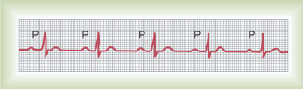
Types of the A-V Block
First degree block
  Prolong P-R interval (0.2 seconds)

Slide 20
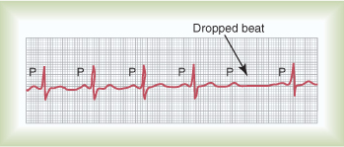
Types of the A-V block
Second Degree Block
P-R interval > 0.25 second
Only few impulses pass to the ventricles
→ atria beat faster than ventricles
→“dropped beat” of the ventricles

Slide 21
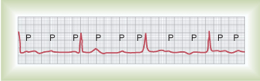
Types of the A-V block
Third degree block (complete)
Complete dissociation of P wave and QRS waves
Ventricle escape from the influence of S-A node
Atrial rate is 100 beats/min
Ventricular rate is 40 beats/min
Stokes-Adams Syndrome: AV block comes and goes

Slide 22
Premature contractions
Premature contractions, extrasystoles, or ectopic beat result from ectopic foci that generate abnormal cardiac impulses (pulse deficit)
Causes:
  Ischemia
  Irritation of cardiac muscle by calcified foci
  Drugs like caffeine
Ectopic foci can cause premature contractions that originate in:
  The atria
  A-V junction
  The ventricles

Slide 23
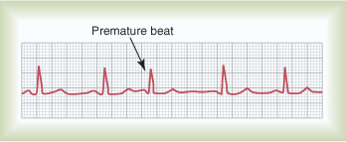
Premature Atrial Contractions
Short P-R interval depending on how far the ectopic foci from the AV node
Pulse deficit if there is no time for the ventricles to fill with blood
The time between the premature contraction and the succeeding beat is increased (Compensatory pause)

Slide 24
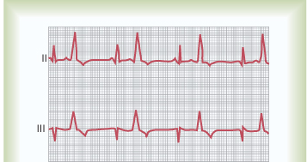
Premature Ventricular Contractions (PVCs)
Prolong QRS complex because the impulses are carried out with myocardial fibers with slower conduction rate than Purkinje fibers
Increase QRS complexes voltage because QRS wave from one ventricle can not neutralize the one from the other ventricle
After PVCs, the T wave has an electrical potential of opposite polarity of that of the QRS because of the slow conduction in the myocardial fibers, the fibers that depolarizes first will repolarize first
Causes: drugs, caffeine, smoking, lack of sleep, emotional irritations

Slide 25
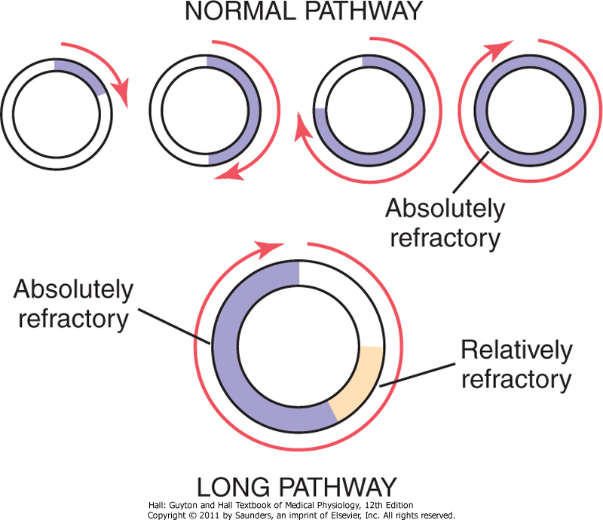
Ventricular Fibrillation
The most serious of all arhythmias
Cause: impulses stimulate one part of the ventricles, then another, then itself. Many part contracts at the same time while other parts relax (Circus movement)

Slide 26
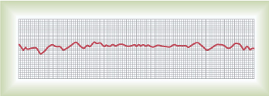
Ventricular Fibrillation
Causes: sudden electrical shock, ischemia
  Tachycardia
  Irregular rhythm
  Broad QRS complex
  No P wave

Slide 27
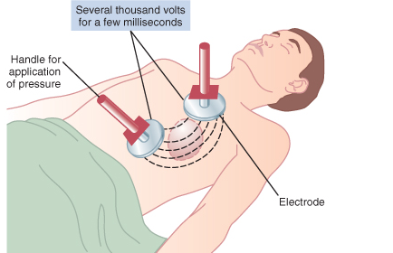
Ventricular Fibrillation
Treatment : DC shock

Slide 28
Atrial Fibrillation
Same mechanism as ventricular fibrillation. It can occur only in atria without affecting the ventricles
It occurs more frequently in patients with enlarged heart
The atria do not pump if they are fibrillating
The efficiency of ventricular filling is decreased 20 to 30%
No P wave, or high frequency of low voltage P wave
Treatment: DC shock

Slide 29
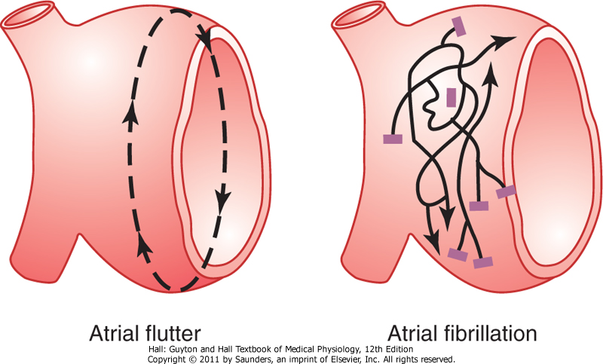
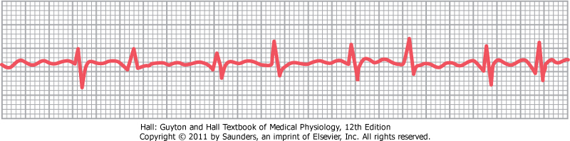
Atrial Flutter
A single large wave travels around and around in the atria
The atria contracts at high rate (250 beats/min)
Because one area of the atria is contracted and another one is relaxed, the amount of blood pumped by the atria is slight
The refractory period of the AV node causes 2-3 beats of atria for one single ventricular beat 2:1 or 2:3 rhythm

Slide 30
Ischemia and the ECG
One of the common uses of the ECG is in acute assessment of chest pain
Cause: restriction of blood flow to the myocardium, either:
  Reversible: angina pectoris
  Irreversible: myocardial infarction
Ischemia → injury → infarction

Slide 31
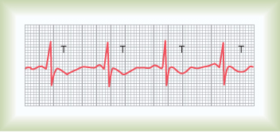
Reversible ischemia
  Inverted T wave
ST segment depression

Slide 32
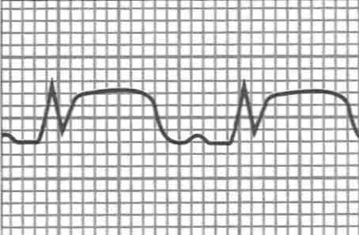
Myocardial Infarction
Complete loss of blood supply to the myocardium resulting in necrosis or death of tissue
ST segment elevation
Deep Q wave

Slide 33
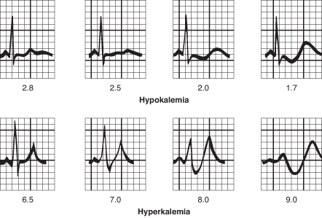
Potassium and the ECG
Hypokalemia:
  flat T wave
Hyperkalemia:
  Tall peaked T wave

Slide 34
For further readings and diagrams:
Textbook of Medical Physiology by Guyton & Hall
Chapter 10 (Cardiac Arrhythmias and their Electrocardiographic Interpretation)

