Slide 1
SDS-PAGE

Slide 2
PROTEINS
Proteins are molecules that are charged and folded to give them a specific shape.
There are four levels of protein structure; primary, secondary, tertiary and quaternary structure.
Therefore proteins are complex molecules and when trying to separate them using electrophoresis one must factor in all these facts.

Slide 3
ELECTROPHORESIS
Electrophoresis is the movement of charged particles along a gel or fluid under an electric field.
Electrophoresis of positively charged particles (Cations) is known as cataphoresis while that of negatively charged (Anions) particles is referred to as anaphoresis.
Electrophoresis can separate molecules such as proteins, DNA and RNA based on their size and this can be done using polyacrylamide gel electrophoresis (PAGE).

Slide 4
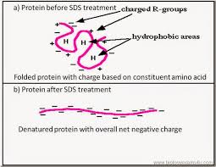
SEPARATION OF PROTEINS BY ELECTROPHORESIS
Proteins as indicated are charged and have different shapes and sizes.
Sodium Dodecyl Sulphate (SDS) is an anionic detergent that causes proteins to have a net negative charge and a linear shape.
SDS binds to the protein molecule in equal proportion to its molecular mass.

Slide 5
SDS-PAGE
Sodium dodecyl sulphate- polyacrylamide gel electrophoresis (SDS-PAGE) utilizes SDS to denature proteins and polyacrylamide gel as a support medium.
The proteins in an SDS-PAGE gel are separated based on their molecular mass only because charge to mass ratio is the same.
All proteins move towards the positively charged electrode (Anode) since they are all negatively charged and linear.

Slide 6
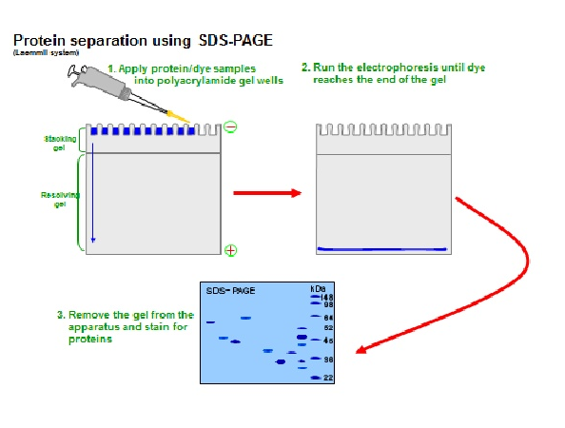
SDS-PAGE

Slide 7
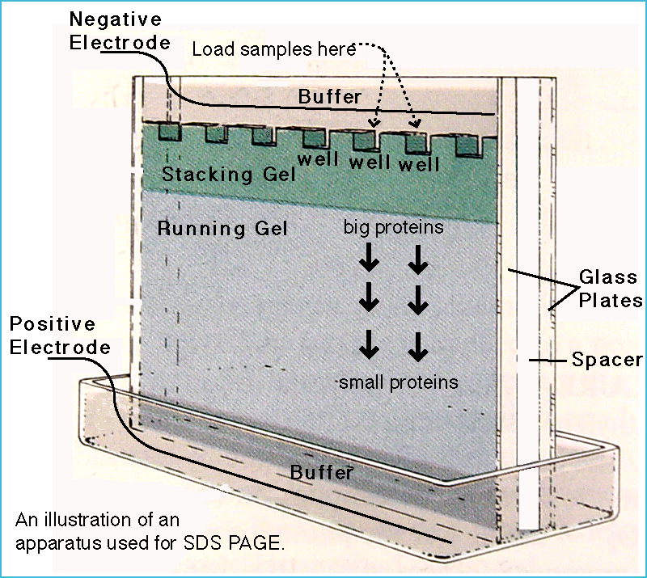
SDS-PAGE SET UP
Two gels are usually cast both polyacrylamide gels cast between glass plates.
The lower layer is usually responsible for the actual separation of polypeptides by size
The upper stacking gel is important for sweeping up proteins in a sample between two moving boundaries so they are compressed into micrometer thin layer into the separating gel
Sample buffer also contains an ionisable tracking dye, usually bromophenol blue, that allows the electrophoretic run to be monitored, and sucrose or glycerol, which gives the sample solution density thus allowing the sample to settle easily through the electrophoresis buffer to the bottom when injected into the loading well.
Ammonium persulfate and TEMED are involved in gel polymerization.
Visualization of proteins after running SDS-PAGE is done using coomassie and then destained using acetic acid.
In some cases silver stain (Silver nitrate) can be used in place of coomassie

Slide 8
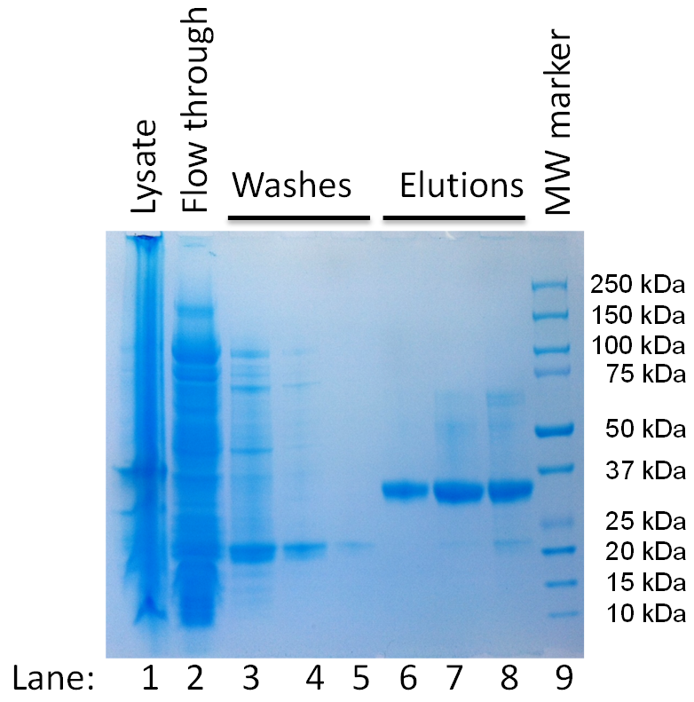
SDS-PAGE RESULTS

Slide 9
IMPORTANCE OF SDS-PAGE
Protein separation by SDS-PAGE can be used to estimate the molecular mass of protein
It can be used to determine the relative abundance of major proteins in a sample
It can be used to determine the distribution of proteins among fractions

