Slide 1
Qualitative tests of lipids 2

Slide 2
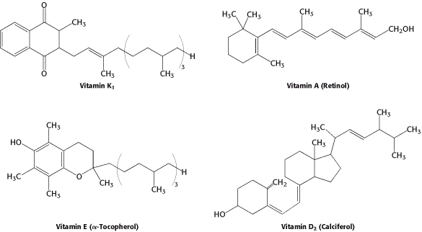
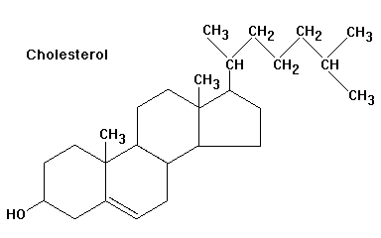
Derived lipids .
They are substances that are soluble in lipid or derived from the lipids by hydrolysis; for examples, cholesterol and fat soluble vitamins.

Slide 3
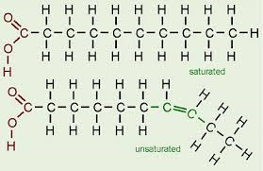
Fatty Acids Classification a-saturated fatty acids
Saturated fatty acids have no double bonds ,side chian are
a)Short chain
From 4 to 10 Carbon atoms ,and present as liquid in room Temp. e.g acetic acid and butyric acid
a)Long chain:
More than 10 Carbone atoms, present in solid at room Temp. e.g. Palmatic (16) acid and Stearic(18) acid

Slide 4
Unsaturated fatty acids
have one or more double bonds between carbon atoms,side chain has at least one doublebond.
a)Essential Fatty acids:
b)Non essential Fatty acids:
Can be synthesized in the body: Oleic acid
linolenic acid18-C, 3 double bond (ω-3)
Linoleic acid 18-C, 2 double bond (ω-6)

Slide 5
1-Copper acetate test
This test is used to distinguish between oil or neutral fat and fatty acid saturated and unsaturated.
Principle: The copper acetate solution does not react with the oils (or fats), while saturated and unsaturated fatty acids react with copper acetate to form copper salt.
Copper salt formed in the case of unsaturated fatty acids can only be extracted by petroleum ether.

Slide 6
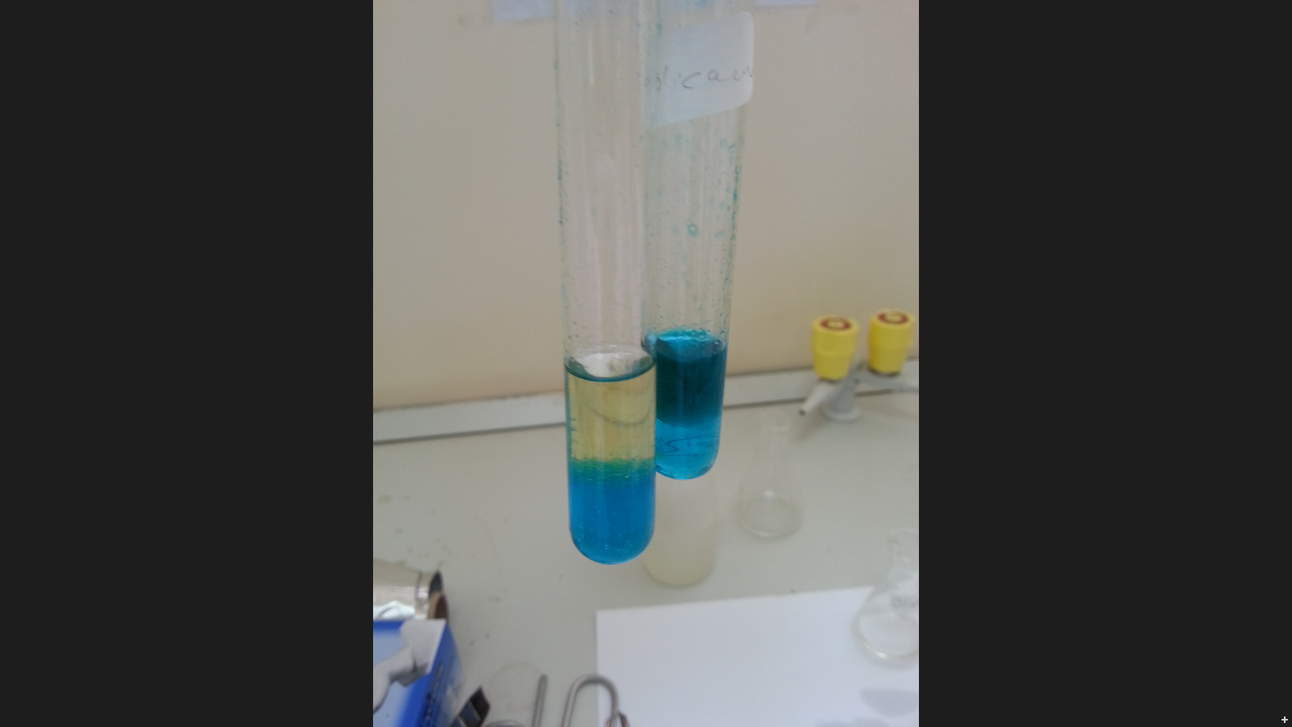

Copper acetate test
olive oil: notice that petroleum ether upper lay containing the dissolved oil and appears colorless, aqueous solution remains blue in the bottom.
oleic acid the upper layer of petroleum ether becomes green as a result of copper oleate. The lower layer becomes less in blue.
petroleum ether and dissolved oil
copper acetate
copper oleate in the petroleum ether
copper acetate

Slide 7
Method
Take two test tubes add 3 ml of petroleum ether and an equal volume of a solution of copper acetate.
Add 0.5 ml of each sample in each tube
Shake the tube and leave it for some time.
Result:
Comments | Observation | Tube
 |  | Olive oil
 |  | Oleic acid

Slide 8
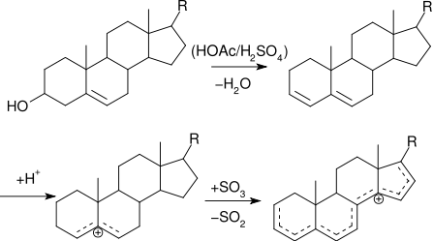
2-Qualitative estimation of Cholesterol by Liebermann - Burchard Test
Principle:
Liebermann - Burchard Test , is a chemical estimation of cholesterol, the cholesterol is react as a typical alcohol with a strong ,concentrated acids; the product are colored substances.
Acetic anhydride are used as solvent and dehydrating agents, and the sulfuric acid is used as dehydrating and oxidizing agent .
A positive result is observed when the solution becomes red or pink , then purple , blue, and finally bluish –green color.

Slide 9
Method
Dissolve a few crystals of cholesterol in 2 ml of chloroform in a dry test tube
Now add 10 drops of acetic anhydride
Add 2 to 3 drops of conc. sulfuric acid
Record your result
Comments | Observation | Tube
 |  | Cholesterol
 |  | Olive Oil

Slide 10
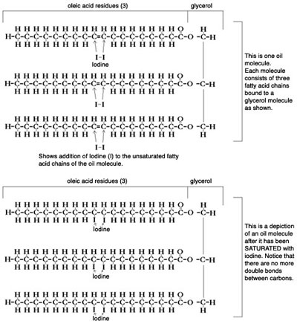
Unsaturation Test:
Principle:
All neutral fats usually oils containing glycerides contain unsaturated fatty acids. To determine the degree of unsaturation of oils an iodine test can be used. Through halogenation of iodine the unsaturated fatty caid can be converted to a saturated fatty acid by breaking one part of the double bond and forming single bonds with iodine. If the fat contains more unsaturated fatty acids, it will take up more iodine. The unsaturated fatty acid will then be referred to as a iodoalkane or organoiodine compound. The iodine value will detrmine the degree of unsaturation. Higher iodine value will represent a higher degree of unsaturation

Slide 11
Method:
Huble's test
This test is used to detect the degree of unsaturation in oil or fat. Huble’s reagent reacts with alcoholic solution of iodine that contains some mercuric chloride. During the reaction, the violet colour of iodine fades away if the oil or fat is unsaturated. If the oil or fat is saturated, the violet colour of iodine does not fade away.
Equally into 4 flask Add 10 ml of Chloroform then 10 drops of Hub’s iodine reagent ,the chloroform shows pink color due to presence of iodine.
To one test flask add the oil sample drop by drop shaking the tube vigorously for about 30 seconds after addition of each until the pink color is discharged and count the number of drops.
The pink color is discharged fully owing to the taking up of iodine by the unsaturated fatty acids of the oil and fully dispelled once all the pink color is complete.
Compare unsaturation , it should be remembered that more the number of drops required to discharge the pink color, the less is the unsaturation.

Slide 12
Results:
Sample | Number of drops added from the sample | Conclusion
Mustard oil
coconut oil
olive oil
saturated fat

Slide 13
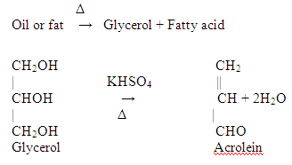
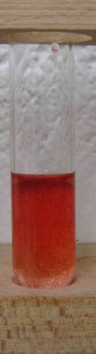
Acrolein test
The "acrolein test" is used to detect glycrol or fats
Most lipid are found in the form of triglycerides, an ester formed from glycerol and fatty acids.
Principle:
When a fat is heated strongly in the presence of a dehydrating agent such as KHSO4, the glycerol portion of the molecule is dehydrated to form the unsaturated aldehyde, acrolein CH2=CH-CHO ,
which can be distinguished by its irritating acrid smell and as burnt grease.
Other way to detect lipids is by dye Sudan IV (general dye for lipid ), which produce red color with lipid.

Slide 14
Translucent Spot test
Fats and oils have higher boiling points so at room temperature they cannot absorb enough heat to evaporate. When fat or oil is place on a sheet of paper, it diffracts light. The diffracted light can pass from one side of the paper to another side and produces a translucent spot.

Slide 15
Solubility test
Oils and fats are soluble in organic solvents like, chloroform, alcohol etc. but are insoluble in water.

