Slide 1
MUSCLES
Dr. Mbira

Slide 2
Skeletal muscle
Derived from paraxial mesoderm which forms somites and these in turn form sclerotome and dermatomyotome.
Sclerotome forms the skeleton while the dermatomyotome part gives rise to the muscles of the axial skeleton and the limbs.
The myotome divides into 2 segments; epimere/epiaxial division and hypomere/hypaxial division. This division occurs by the 5th week.
The epimere is formed from the dorsomedial portion of the myotome while hypomere is formed from the dorsolateral portion of the myotome and is usually much larger.
Concurrently, developing spinal nerves divide into 2, a dorsal ramus for the epimere and a ventral ramus for the hypomere.

Slide 3
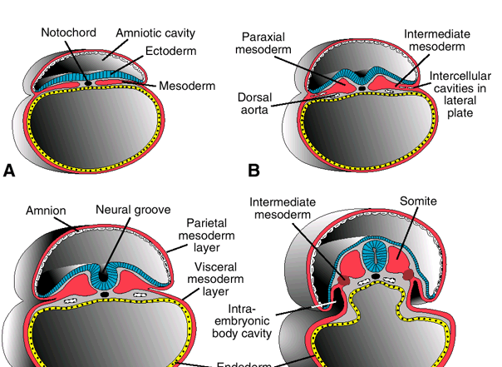

Slide 4
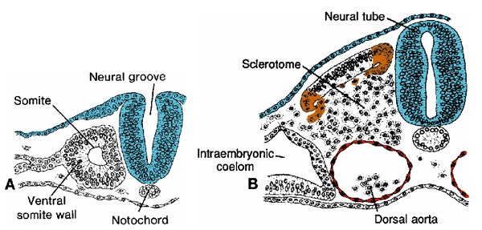

Slide 5
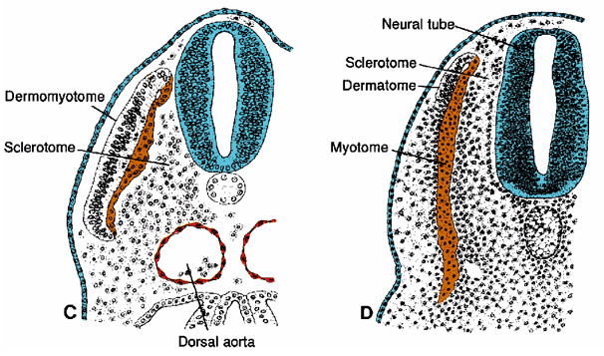

Slide 6
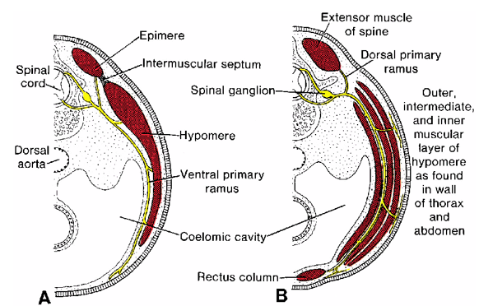

Slide 7
In the body wall, the hypomere divides into 3 layers of muscle that form the intercostal muscles in the thoracic wall and 3 layers of muscle in the abdominal wall.
Ventrally in the centre arises a longitudinal column of muscles which become the rectus abdominis muscles in the abdomen and the strap muscles in the neck but disappear in the chest in the region of the sternum.

Slide 8
In the limb buds, the mesoderm that forms the hypomere(dorsolateral mesoderm) will form mesenchyme that will also form the muscles of the limbs.
As the limb bud grows, the mesoderm will condense and align itself as mesenchyme around the growing skeletal structures accompanied by nerves also.
Thus there will be muscles on both the sides of the skeleton to give rise to flexors, extensors, adductors, abductors etc and the accompanying nerves.

Slide 9
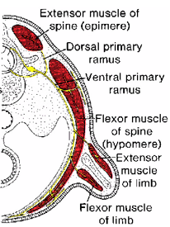

Slide 10
Skeletal craniofacial musculature is derived from somitomeres and occipital somites.
These include muscles in the tongue and extraocular muscles.
However, muscles of the pharynx, larynx and facial expression are derived from pharyngeal arches.

Slide 11
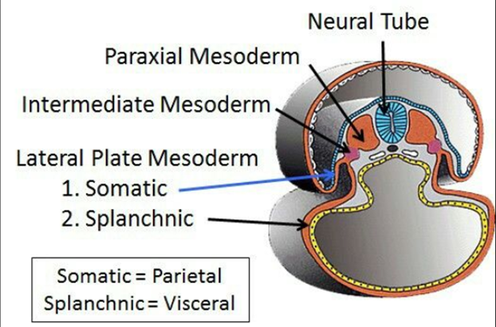
Cardiac muscle
Develops from splanchnic mesoderm surrounding the developing heart.

Slide 12
The mesoderm condenses into mesenchyme just like in skeletal muscle, and eventually forms myoblasts which adhere to one another to form intercalated discs.
Just like skeletal muscle, the cells lengthen to form myofibrils but they do not fuse. A few of these myofibrils differentiate later to form purkinje fibres which are part of the conducting system of the heart.

Slide 13
Smooth muscle
Generally derived from splanchnic layer of lateral plate mesoderm as well as ectoderm and neural crest cells.
Dorsal aorta and large artery smooth muscle – lateral plate mesoderm and neural crest cells.
GIT smooth muscle – splanchnic layer of lateral plate mesoderm.
Coronary artery smooth muscle – Proepicardial cells and neural crest cells.
Iris muscles – ectoderm of the optic cup.
Smooth muscle in sweat and mammary glands – ectoderm.

Slide 14
Poland syndrome
Prune belly syndrome

