Slide 1
Gametogenesis
Dr. Mbira

Slide 2
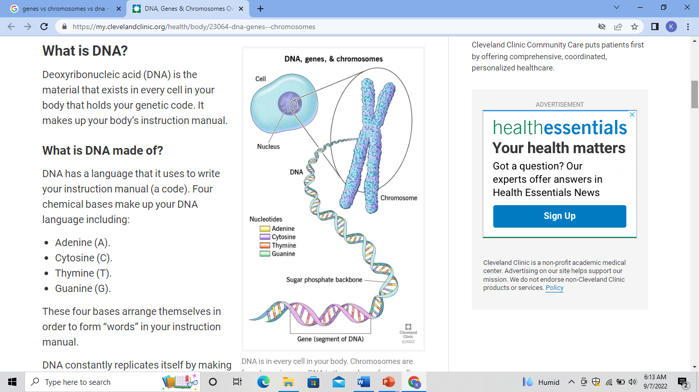
DNA
Genes
Chromosomes
Genome

Slide 3
Basic genetics
DNA is a double helix of special proteins called nucleotides in various combinations that carries the information or codes in a cell, usually in the nucleus.
A gene is a region of DNA that encodes a particular function.
A chromosome consists of a long strand of DNA containing many genes and can be viewed as a thread-like structure of nucleic acids and protein found in the nucleus of most living cells, carrying genetic information in the form of genes.
A single chromosome can have thousands of genes.
Human beings are thought to have about 35,000 genes in total.
These genes are then packaged into 23 chromosomes in 2 pairs to make a total of 46, one pair inherited from each parent.

Slide 4
Each human cell then carries all these genetic information packaged into these 23 pairs of chromosomes.
The “expression” of the various genes in the various chromosomes varies from cell to cell depending on the function of that cell.
The first 22 pairs of chromosomes are called autosomes or somatic chromosomes and regulate all the functions of the body.
The last pair(no. 23) are called sex chromosomes and determine the sex of the person.
Therefore an individual will inherit 1 pair of each of the 23 chromosomes from each parent.

Slide 5
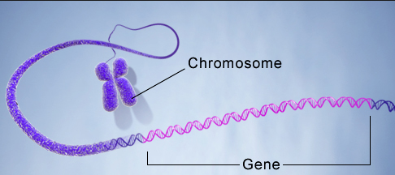
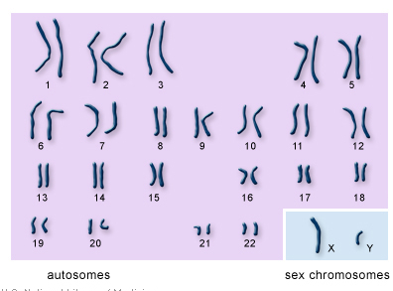
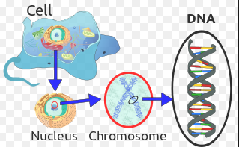

Slide 6
Chromosome 23 is designated X or Y.
XX denotes a female while XY denotes a male.
Having a pair of chromosomes is termed as diploid while having only 1 chromosome will be termed as haploid.
All cells(with 1 exception) contain diploid chromosomes i.e 23 pairs of chromosomes, a maternal pair and a paternal pair.
Moreover, all the chromosomes in each pair (except no.23) are similar in appearance and function.

Slide 7
The exception are the gametes(sex cells) which contain only a haploid number of chromosomes, i.e only 1 set.
Therefore the unique cells that are involved in conception, one from the father and one from the mother have 1 set each of 23 chromosomes and once united(fertilization) complete the pair to have 46 chromosomes once again.

Slide 8
Cell division
Ordinary cell division involves a process called mitosis where a cell divides into two giving rise to 2 “daughter” cells containing the same number of chromosomes as the “parent” cell i.e 46.
Before beginning mitosis, each cell replicates its DNA.
There are 4 phases:
Prophase
Metaphase
Anaphase
Telophase

Slide 9
Prophase
At the beginning of this phase the DNA will replicate and the chromosomes will be doubled.
The chromosomes will condense to form 2 distinct bands attached in the middle called chromatids with the area of attachment called a centromere.
Metaphase
The chromosomes assemble at the “equator” of the cell.
Anaphase
Each set of chromosomes from the duplicated DNA material will migrate to opposite poles of the cell.
Telophase
The cell will then divide into 2 enclosing each set of chromosomes.

Slide 10
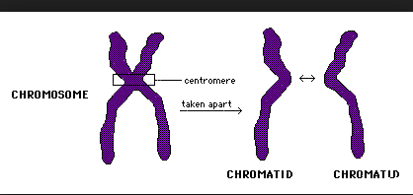
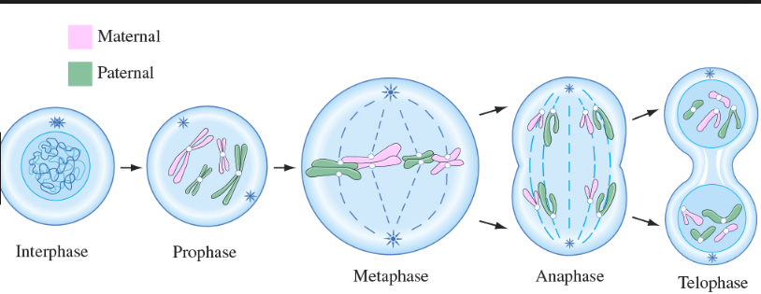

Slide 11
Gametes(sex cells) undergo meiosis where the number of chromosomes is halved such that each daughter cell ends up with half or haploid number of chromosomes.
Also it ends up with 4 daughter cells instead of 2 as with mitosis.
Meiosis is in 2 stages, Meiosis I and II.
Meiosis also has the stages similar to mitosis of prophase, metaphase, anaphase and telophase.
Meiosis I forms 2 daughter cells and these further divide in Meiosis II to 2 more each so that the end result is 4 daughter cells.

Slide 12
During Meiosis I, the chromatids exchange genetic material during a process called crossover which leads to genetic variability by “mixing up” genes from the maternal and paternal side thus by end of meiosis, the gametes contain a mixture of both paternal and maternal genes despite being haploid.

Slide 13
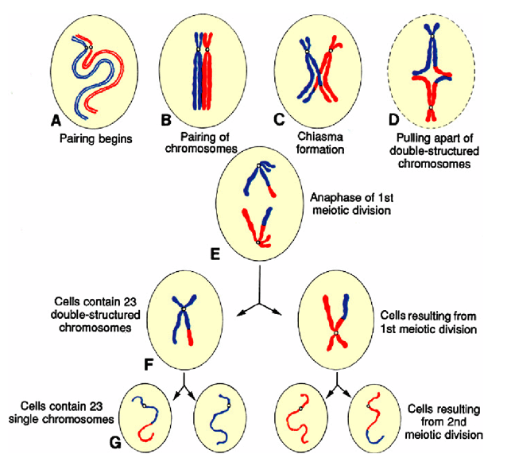

Slide 14
At the end of meiosis, there is production of spermatocyte in men and oocyte/egg in females.
Each of these gametes has haploid number of chromosomes and will require joining with another gamete during fertilization to go back to diploid status.
The oocyte will have chromosome 23 as X only, while the sperm will have the same chromosome 23 as either X or Y.
The primary oocyte gives rise to 4 “daughter cells” but only one of these is a viable gamete as the others degenerate into polar bodies.
The primary spermatocyte will also give rise to 4 “daughter cells” at the end of meiosis but unlike the oocyte, they will all be viable gametes.

Slide 15
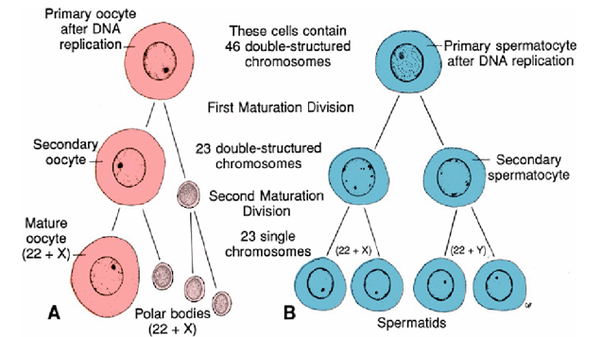

Slide 16
Oogenesis
The process by which a mature oocyte is formed.
It begins from primordial germ cells which differentiate into oogonia.
The oogonia further multiply from around the 3rd month in utero up to the 7th month by mitosis. They will increase in number up to about 7 million in the 5th month before reducing in number in a process of programmed cell death(apoptosis).
Some of these oogonia will enter into meiosis and stop their meiotic division at prophase of meiosis I at which point they will be called primary oocyte.
The process of programmed cell death will not only affect the oogonia but also some of the oocytes. All these happens in the developing ovary.

Slide 17
By the 7th month, the process of programmed cell death of these precursors of the ova will be almost complete taking with it most of the oogonia and a significant number of the primary oocytes.
The surviving primary oocytes will now enter prophase of meiosis I and will be surrounded by a layer of cells to form the primordial follicle.
The cells will remain arrested at prophase of meiosis I from this period near birth until puberty.
From the high point of about 7 million primordial ova at 5 months gestation, the female is born with about 600,000-800,000 primary oocytes all arrested at prophase of meiosis I.

Slide 18
From birth to puberty, some of these primary oocytes will die off to reduce this number to about 400,000.
Each month (from puberty) about 15-20 primordial follicles from an ovary will start to mature. However, of these, only one will reach full maturity. The rest will degenerate and die off.
The one to reach full maturity will be influenced by Luteinizing hormone and complete meiosis I giving rise to 2 daughter cells with diploid chromosomes. However only one of the cells will be well formed to form the secondary oocyte, with the other degenerating to form a polar body.
The well formed cell(secondary oocyte) then enters meiosis II but arrests at metaphase a few hours before ovulation.
The ovulated oocyte will now only finish meiosis II if it is fertilized, if not fertilized it will degenerate in 24 hours.
Only about 500 primary oocytes will be ovulated.

Slide 19
Spermatogenesis
Males are born with primordial germ cells that are yet to start any maturation.
Just before puberty the primordial germ cells become spermatogonia stem cells.
At puberty, the spermatogonia will at regular intervals begin the process of maturation into spermatozoa.
The spermatogonia stem cells will form type A spermatogonia which will divide by mitosis to form type B spermatogonia.
Type B spermatogonia will then divide into primary spermatocytes.
Primary spermatocytes will now begin meiosis I to form secondary spermatocytes.

Slide 20
Secondary spermatocytes will then enter meiosis II to form haploid spermatids.
The spermatids will then mature to form spermatozoa in a process called spermiogenesis.
Development of spermatogonia is influenced by luteinizing hormone which in turn causes production of testosterone.
The process of forming sperm from spermatogonia takes about 70 days.
300 million spermatozoa are produced daily.

Slide 21
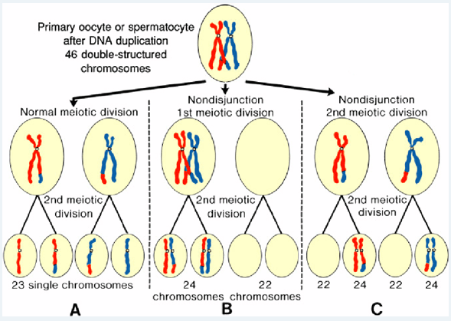
Abnormalities
Non-disjunction during meiosis leading to a daughter cell having less or more chromosomes than it should.

Slide 22
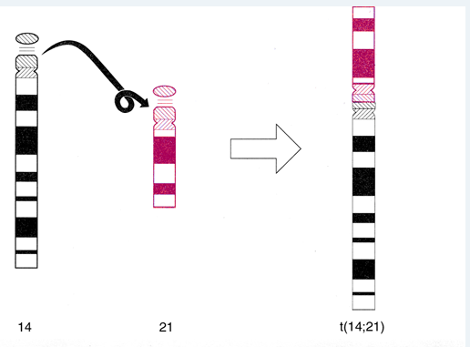
Translocation where a piece of chromatid from one chromosome might break off and be attached to another chromosome during meiosis such that the daughter cell has extra chromatid on one chromosome.

Slide 23
Non disjunction can also lead to an extra chromosome on no.21 especially during meiosis of oocyte formation. This extra chromosome is called trisomy and results in Down Syndrome characterized by facial anomalies, heart anomalies, susceptibility to certain cancers, early onset alzeihmer’s and varying degrees of mental retardation.

Slide 24
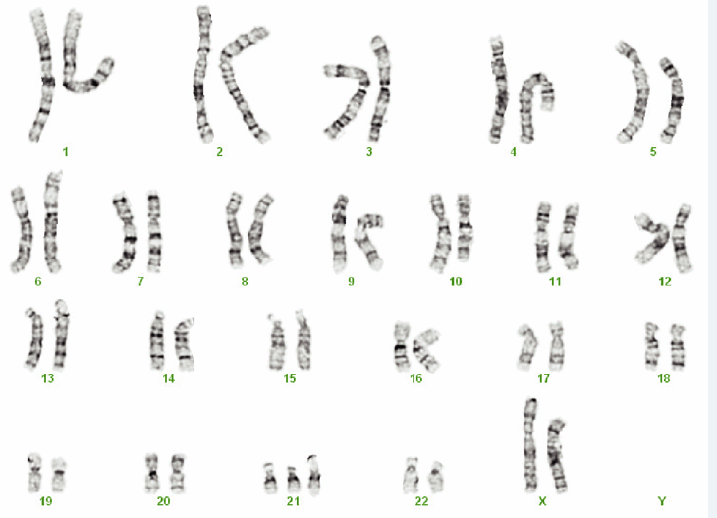

Slide 25
*47 XXY – Turner syndrome
*45X – Klinefelter’s syndrome

