Slide 1
DATA Management APEX Project A
By
Group 4
Jesus De La O
Christopher Komplin

Slide 2
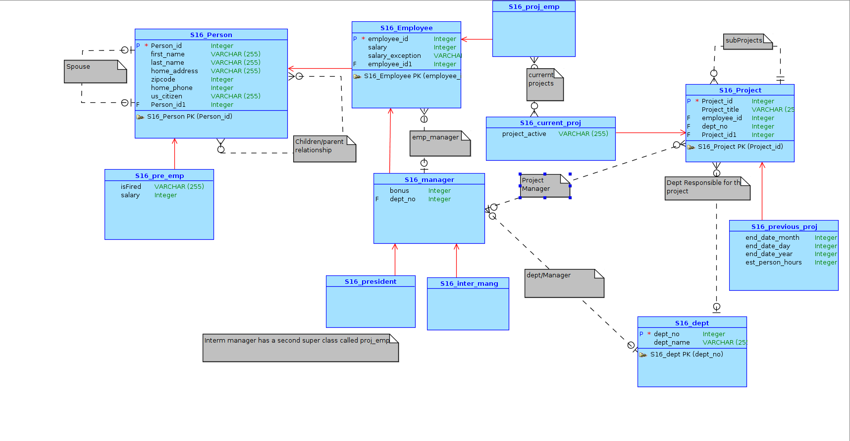
Conceptual Model

Slide 3
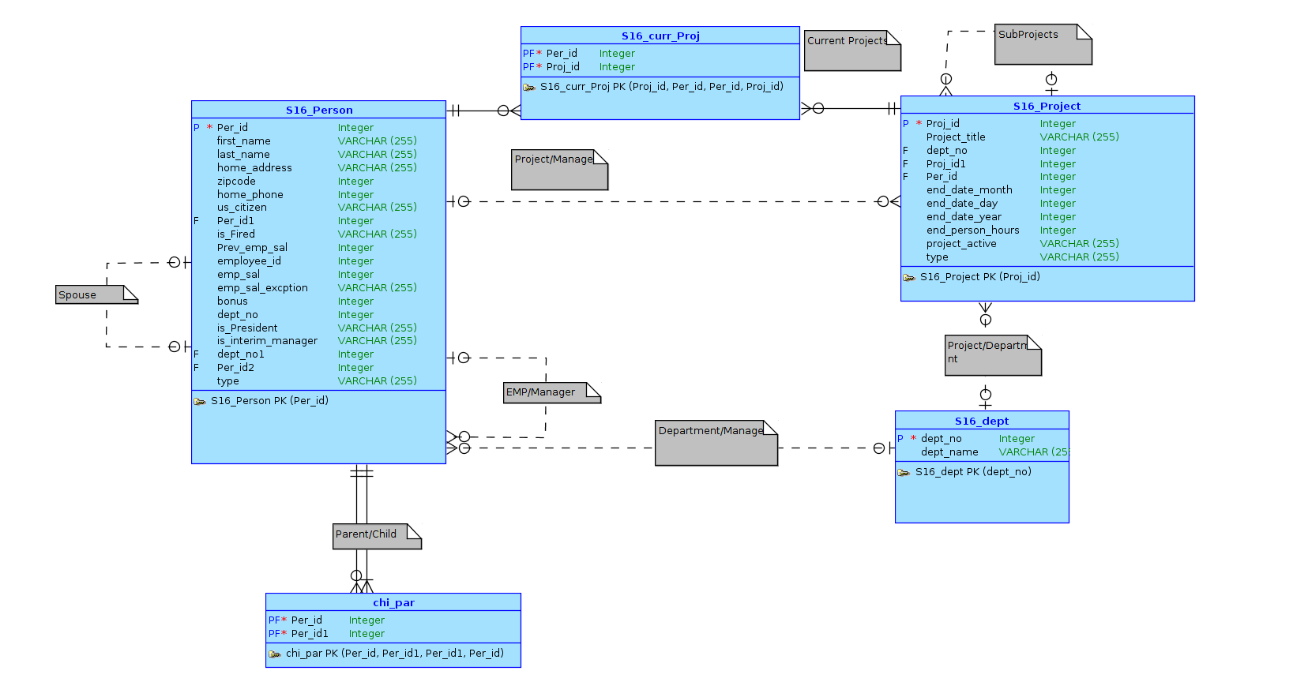
Logical Model

Slide 4
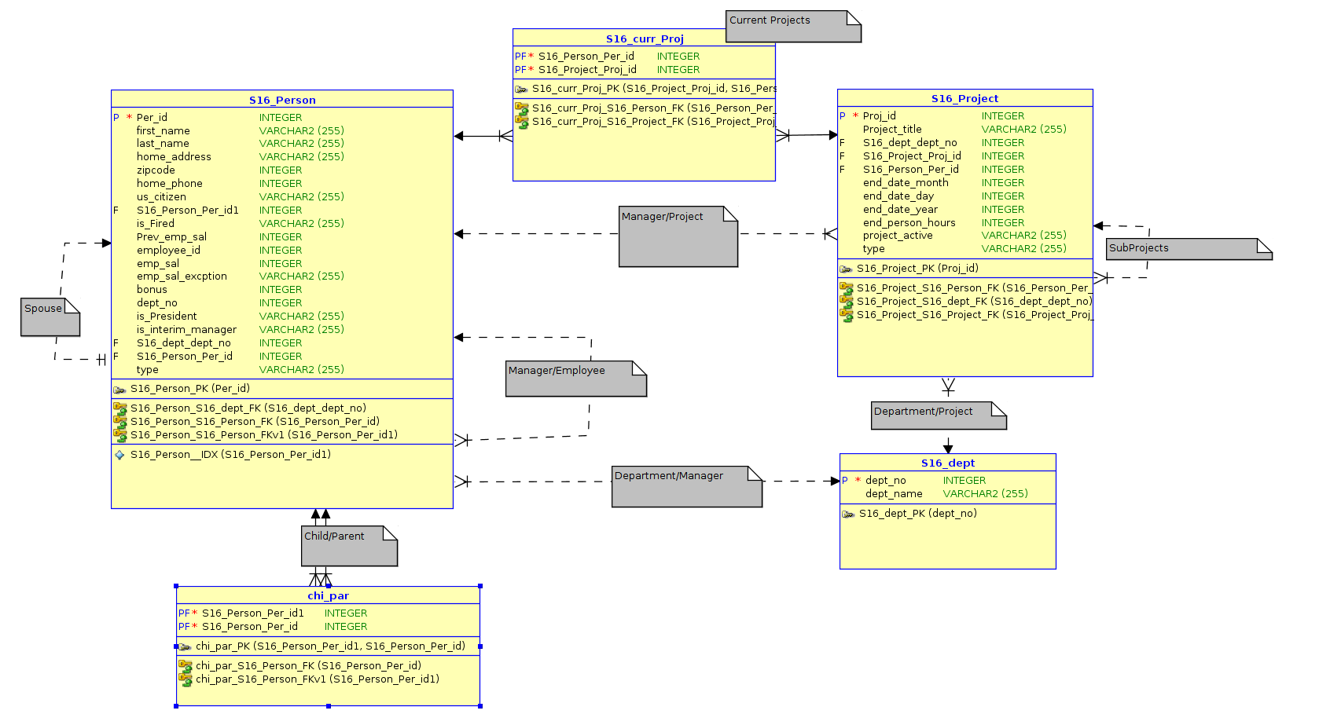
Relational Model

Slide 5
APEX Link
https://apex.oracle.com/pls/apex/f?p=43279:1:26583957999795:::::

Slide 6
Login Process

Slide 7
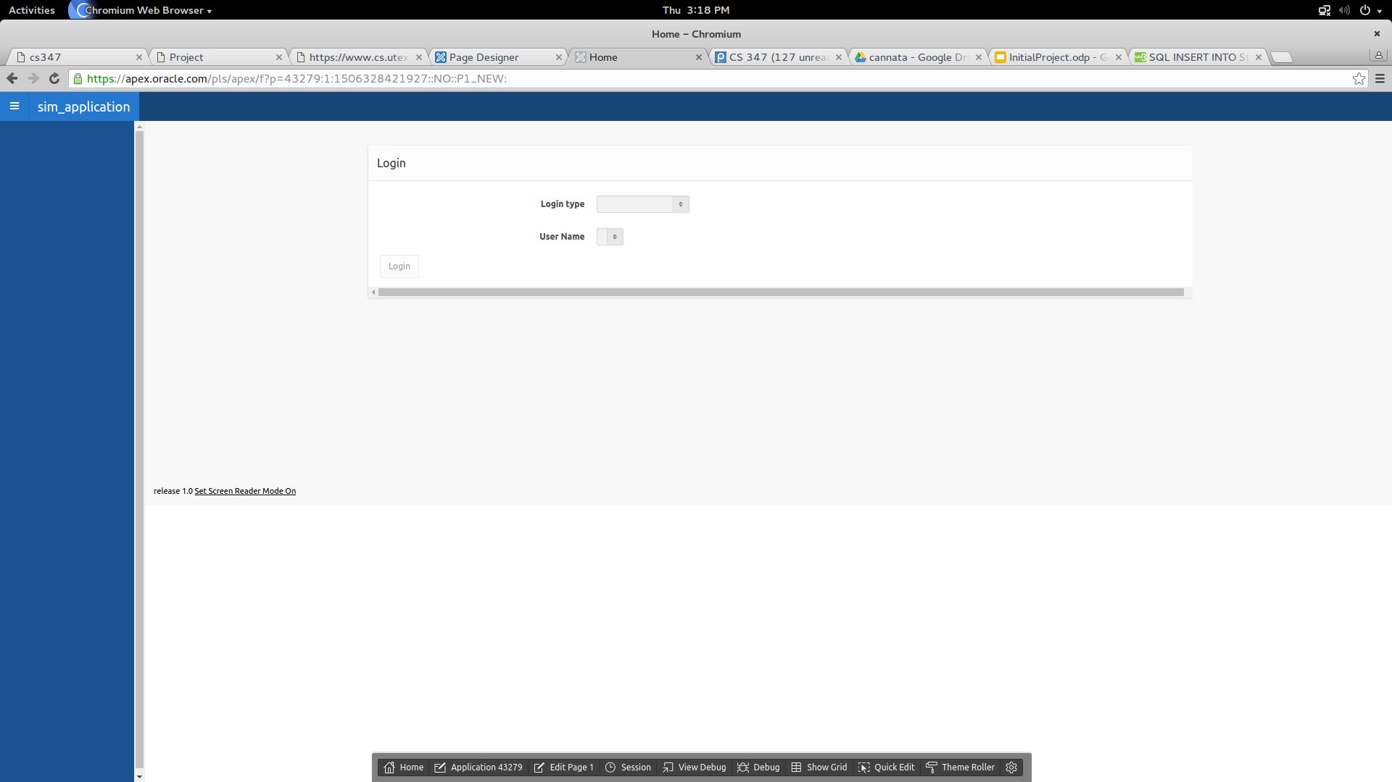
First Login Screen

Slide 8

Login type as manager

Slide 9
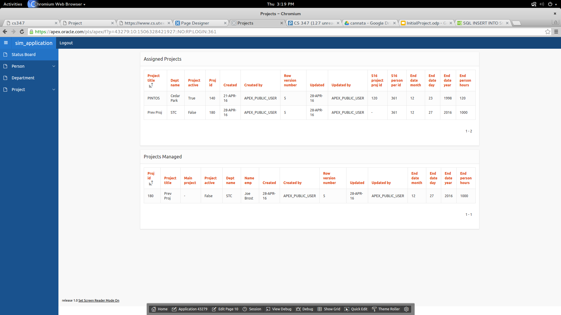
Page after you login for manager

Slide 10

Now when logged-in as Employee

Slide 11
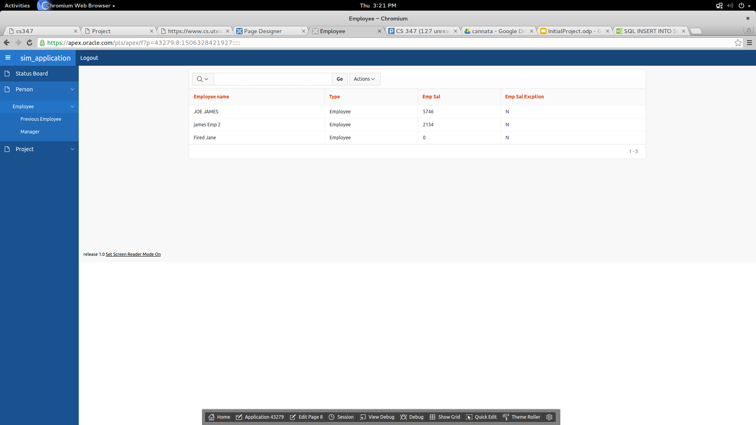
Don’t have edit or create button

Slide 12
Approval Process for Projects

Slide 13

Newly Created Projects

Slide 14
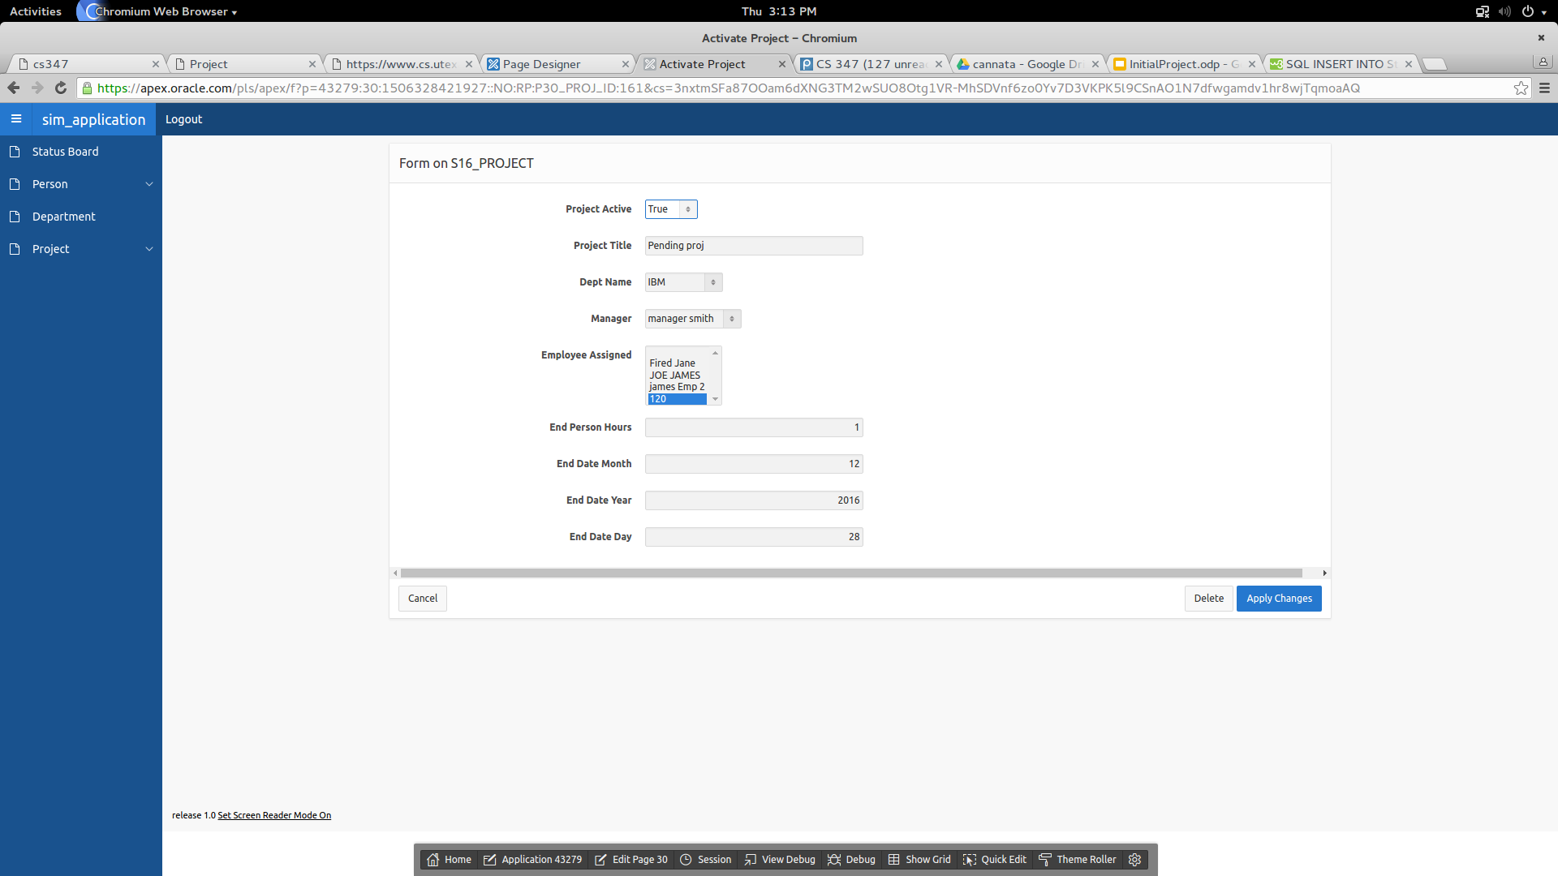
President Activating Project

Slide 15
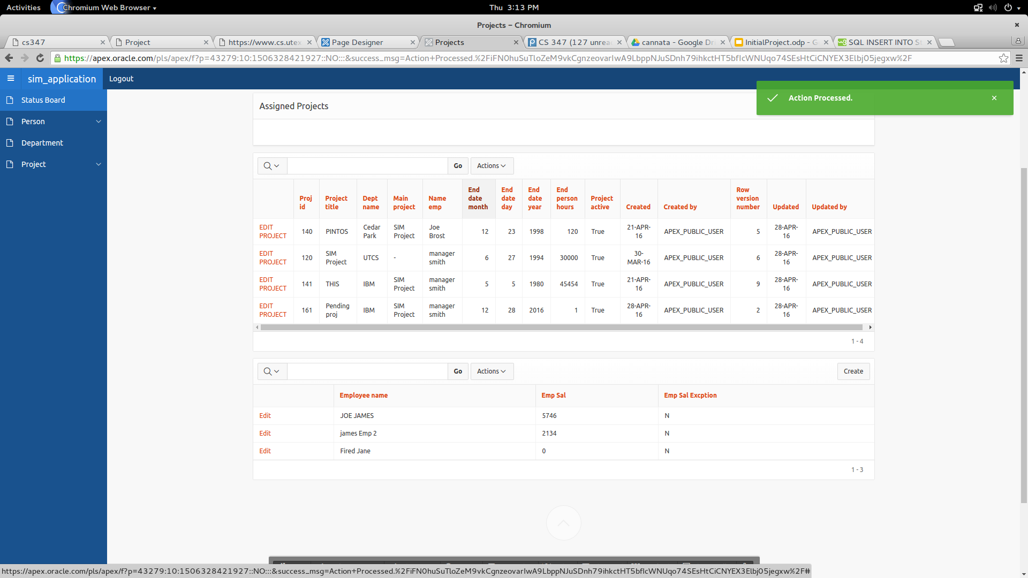
Now is an active project

Slide 16
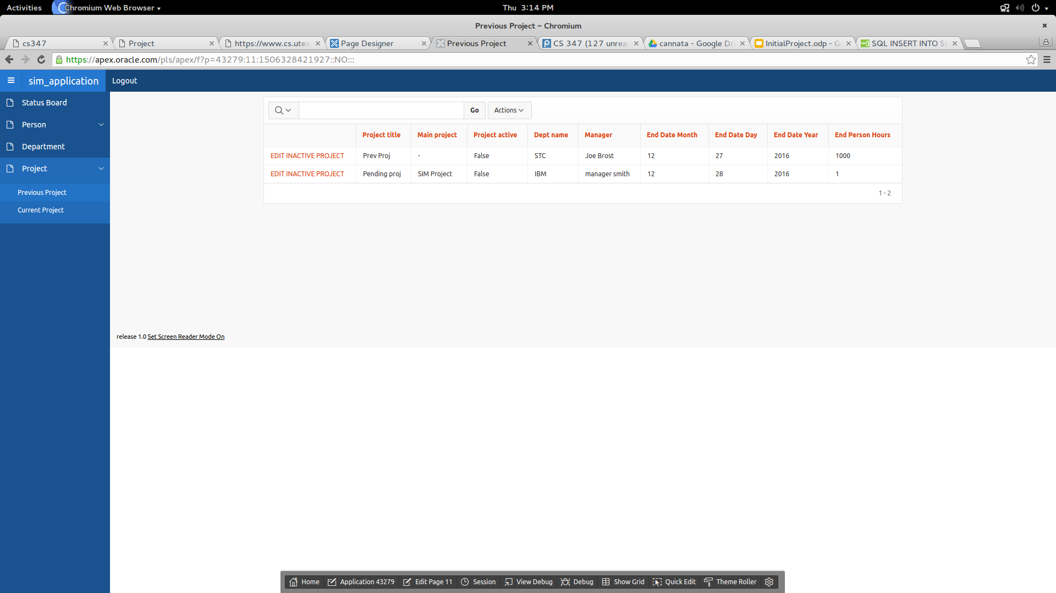
No longer active is prev proj

Slide 17
Part 2 SIM RestFUL API

Slide 18
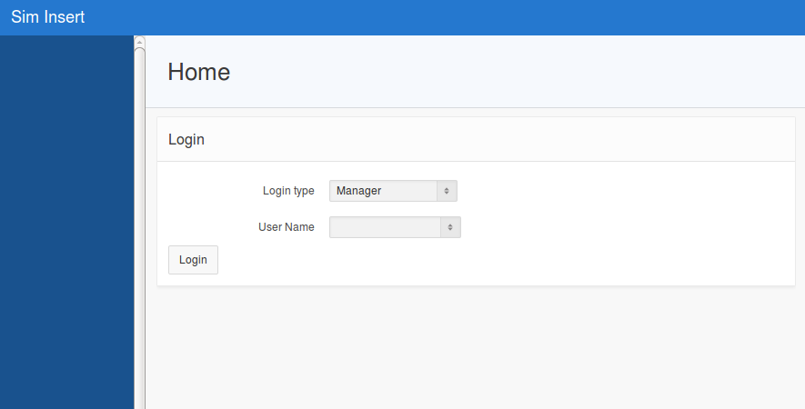

Slide 19
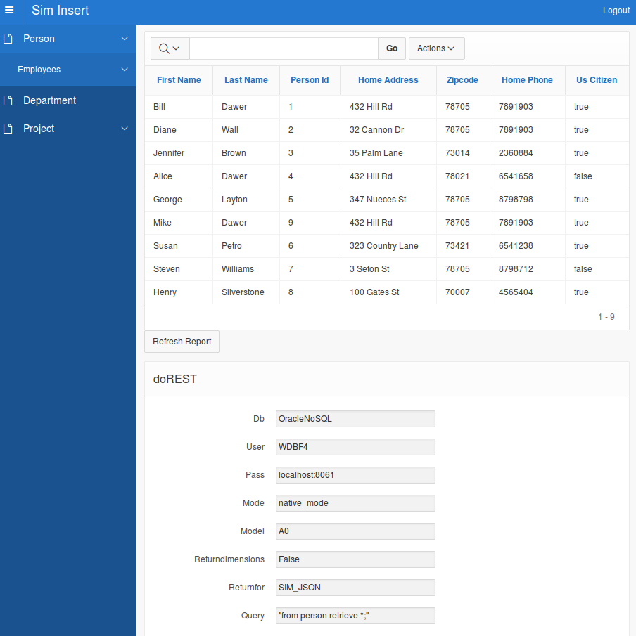

Slide 20
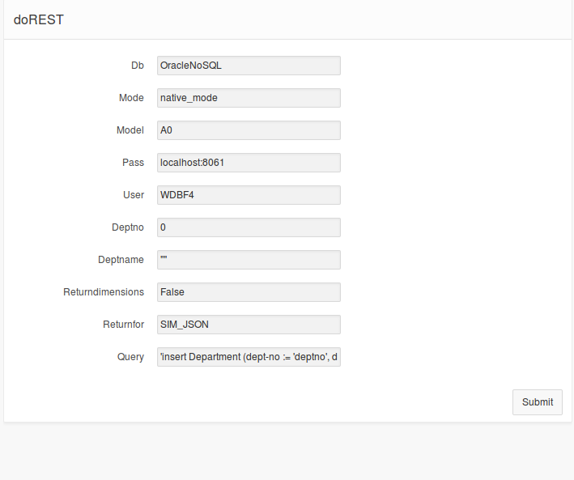
Creating department page
Restful call to SIM with insert into department table statement

Slide 21
Github Repo
https://github.com/delao27/FinalProjectREPO_GroupF4

