Slide 1

Artificial Neural Networks Part 1
ML Study Group
Session 2
December 2nd, 2015

Slide 2
Introduction
General method for learning real-valued, discrete-value and vector-valued functions from example
Backpropagation uses gradient-descent to adjust weights to best fit training data (input/output pairs)
Robust to noisy data
Successfully used in image recognition, speech recognition and robot control strategies.
LeCun 1989 (handwritten chars), Cottrell 1990 (face recognition)
In their simples form they are a network of thresholded linear units.

Slide 3
Appropriateness
Instances are many attribute/value pairs
Target fn is real-valued, discrete-value and vector-valued
Training data contains errors/noise
Training time is not an issue
Fast evaluation is important
Humans understanding of target fn is not important.

Slide 4
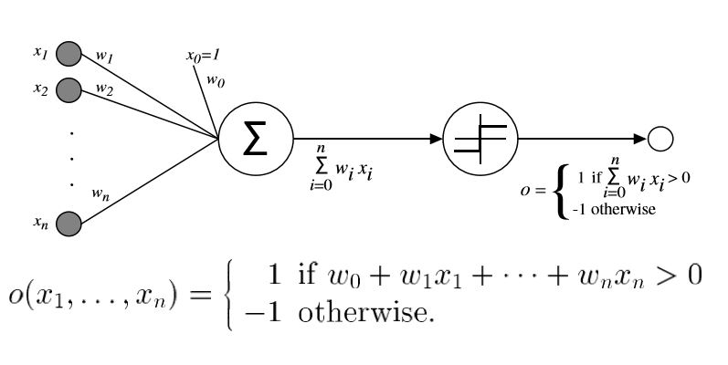
Linear units & Perceptrons
Linear Unit: A linear combination of weighted inputs (real-valued)
Perceptron: Thresholded Linear Unit (discrete-valued)

Slide 5
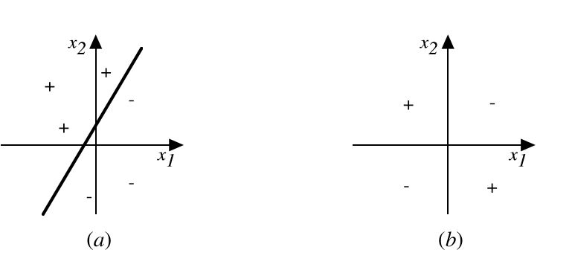
Representational Capacity & Linear Separabilty
A single Perceptron can represent all primitive Boolean functions: AND, OR, NAND and NOR which are all linear separable.
Every Boolean function can be represented by some network of perceptrons.
The XOR cannot be represented by a single perceptron because the decision surface is not linearly separable.

Slide 6
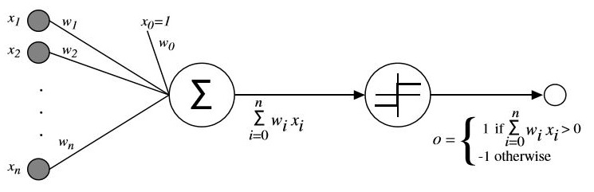
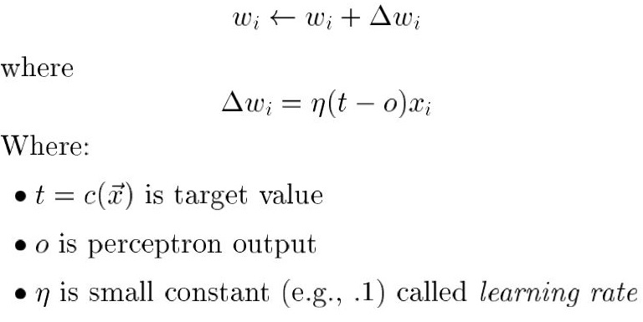
Perceptron Training Rule

Slide 7
Convergence
Perceptron Training Rule Convergence
Data linearly separable
Learning rate is small enough
Proved by Minsky & Pappert 1969
Delta Training Rule
Works with non-linearly separable data
Converges to a best-fit approximation
Can use gradient descent to search space of possible weights (hypotheses).

Slide 8
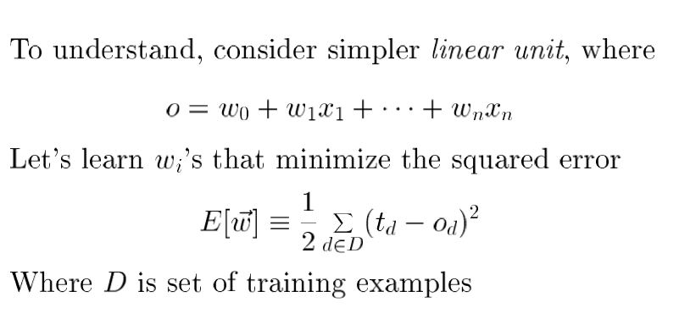
Intuition Behind Gradient Descent

Slide 9
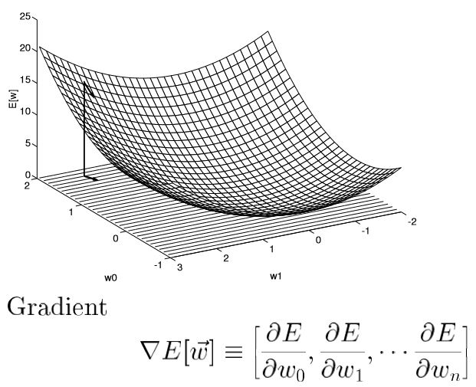
Error Surface

Slide 10
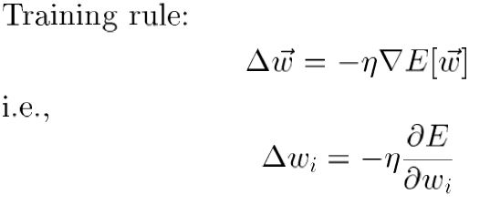
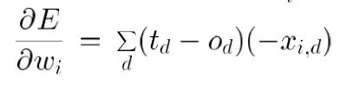
Delta Training Rule

Slide 11
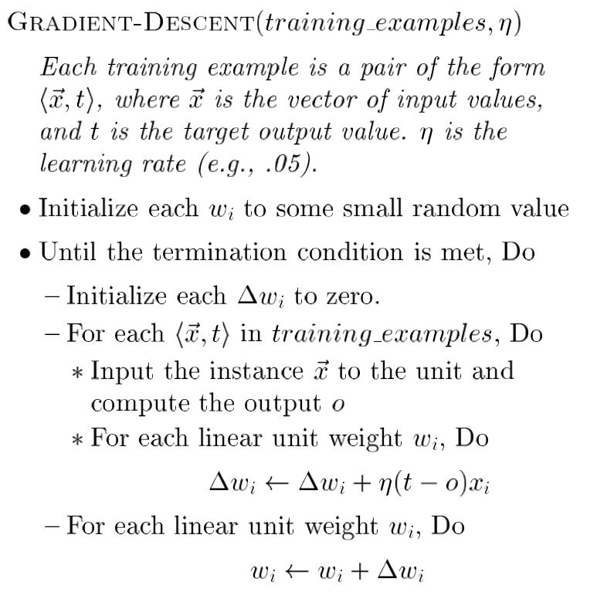
Gradient Descent

Slide 12
Gradient Descent
Gradient descent increments the weights after summing over all training examples
Incremental (aka Stochastic) gradient descent increments the weights for each training example.
Both approaches used in practice.
Stochastic version can avoid local minima.

Slide 13
Artificial Neural Networks
A network of sigmoid units.
Multiple Layers of units
Input units
Hidden units
Output Units.
Example ALVINN
960 Input Units
4 Hidden Units
30 Output Units

Slide 14
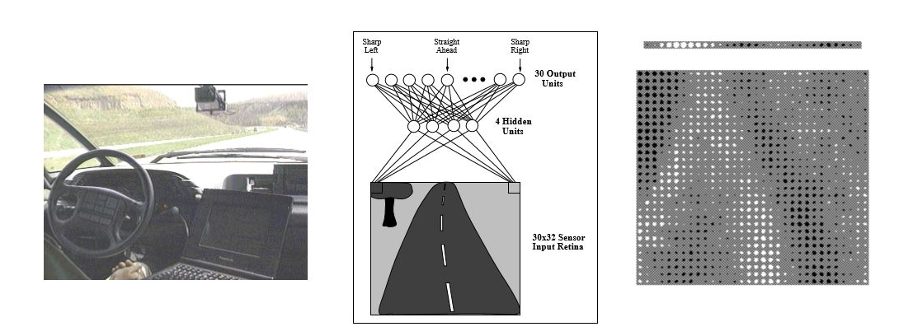
ALVINN
Drove Up 70 mph on California highway

Slide 15
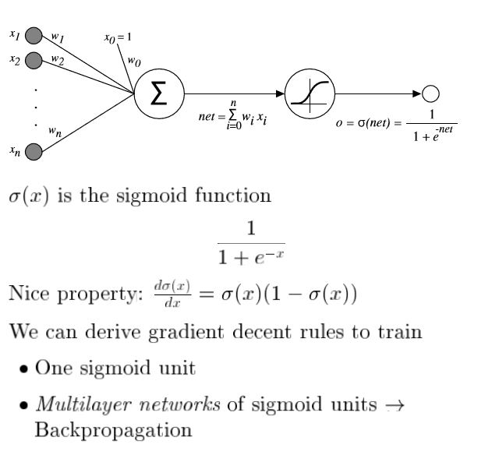
Sigmoid Units

Slide 16
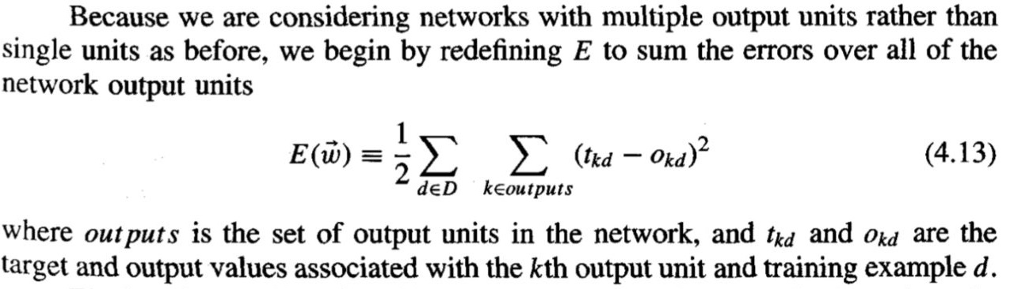
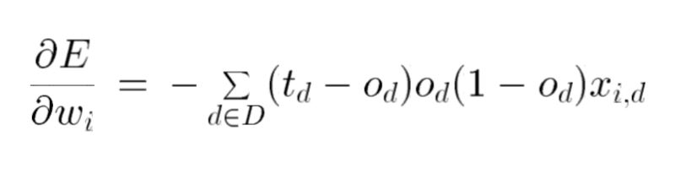
Error Gradient for Sigmoid Unit

Slide 17
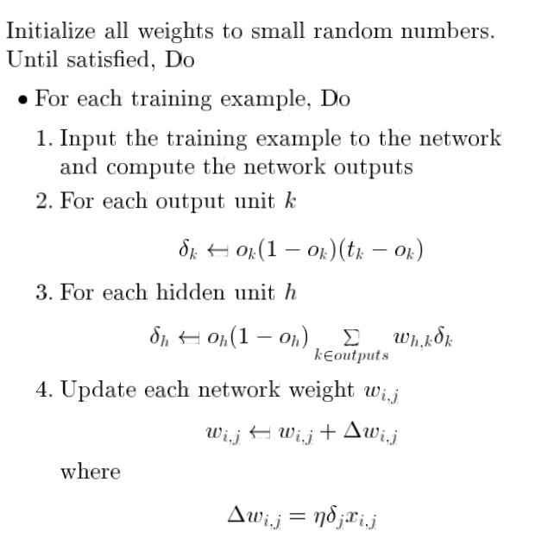
Backpropagation Algorithm

