Slide 1

Decision Tree Learning
ML Study Group
Session 1
November 18th, 2015

Slide 2
Decision Tree Learning
Quinlan, J. R., (1986). Induction of Decision Trees.
A tree can be "learned" by splitting the source set into subsets based on an attribute value test, then recursively repeated.
This process of top-down induction of decision trees (TDIDT) is an example of a greedy algorithm, and it is by far the most common strategy for learning decision trees from data.
Partitioning is based on Attribute Gain as measured by the Entropy of an attribute.

Slide 3

Entropy
Entropy measures homogeneity or impurity of a set of a set.
Concept from Information Theory that effectively represents the minimum number of bits of information needed to encode the classification of an arbitrary member of a set S.
We have a Set S of 14 examples, 9 positive and 5 negative
Entropy(S) = - (9/14) x log(9/14) – (5/14) x log(5/14) = 0.94

Slide 4
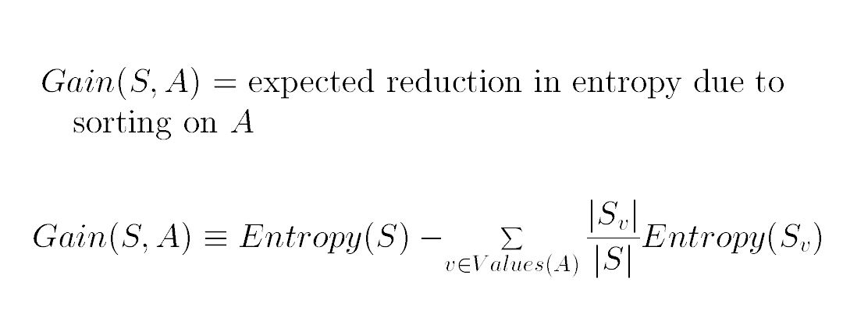
Attribute Gain
Attribute gain measures the reduction in Entropy that a particular attribute contributes to the set.
Attribute gain is used by the ID3 algorithm to select the next attribute to partition by at each node in the tree.

Slide 5
The ID3 Algorithm Summary (from Wikipedia)
Calculate the gain of every attribute using the training set
Split the set into subsets using the attribute for which gain is maximal
Make a decision tree node containing that attribute
Recur on subsets using remaining attributes.
C4.5 Algorithm (Quinlan, 1993) extends ID3
Handling both continuous and discrete attributes
Handling training data with missing attribute
Handling attributes with differing costs.
Pruning trees after creation - C4

Slide 6
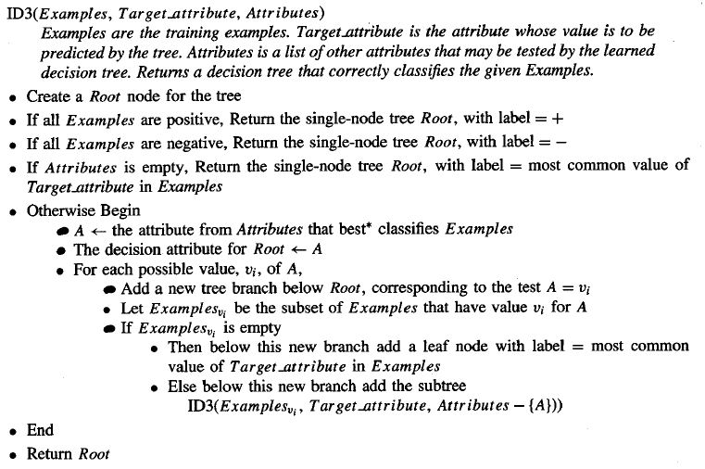
ID3 Algorithm

Slide 7
Play Tennis Training Data Tom Mitchell, Machine Learning, Chapter 3
Outlook | Temperature | Humidity | Wind | Play Tennis
Sunny | Hot | High | Weak | No
Sunny | Hot | High | Strong | No
Overcast | Hot | High | Weak | Yes
Rain | Mild | High | Weak | Yes
Rain | Cool | Normal | Weak | Yes
Rain | Cool | Normal | Strong | No
Overcast | Cool | Normal | Strong | Yes
Sunny | Mild | High | Weak | No
Sunny | Cool | Normal | Weak | Yes
Rain | Mild | Normal | Weak | Yes
Sunny | Mild | Normal | Strong | Yes
Overcast | Mild | High | Strong | Yes
Overcast | Hot | Normal | Weak | Yes
Rain | Mild | High | Strong | No

Slide 8
Play Tennis Example
ML(15): (defvar dt (id3 'play-tennis a e))
Attribute-gains ((OUTLOOK 0.24674982) (HUMIDITY 0.1518355)
(WIND 0.048126996) (TEMPERATURE 0.029222548))
Attribute: OUTLOOK = RAIN,
Attributes (WIND HUMIDITY TEMPERATURE)
Attribute-gains ((WIND 0.9709506) (HUMIDITY 0.01997304)
(TEMPERATURE 0.01997304))
Attribute: WIND = WEAK,
Attributes (HUMIDITY TEMPERATURE)
Attribute: WIND = STRONG,
Attributes (HUMIDITY TEMPERATURE)
Attribute: OUTLOOK = OVERCAST,
Attributes (WIND HUMIDITY TEMPERATURE)
Attribute: OUTLOOK = SUNNY,
Attributes (WIND HUMIDITY TEMPERATURE)
Attribute-gains ((HUMIDITY 0.9709506) (TEMPERATURE 0.5709506)
(WIND 0.01997304))
Attribute: HUMIDITY = HIGH,
Attributes (WIND TEMPERATURE)
Attribute: HUMIDITY = NORMAL,
Attributes (WIND TEMPERATURE)
DT
ML(16): (util::print-tree dt)
OUTLOOK
rain
WIND
weak
+
strong
-
overcast
+
sunny
HUMIDITY
high
-
normal
+

Slide 9
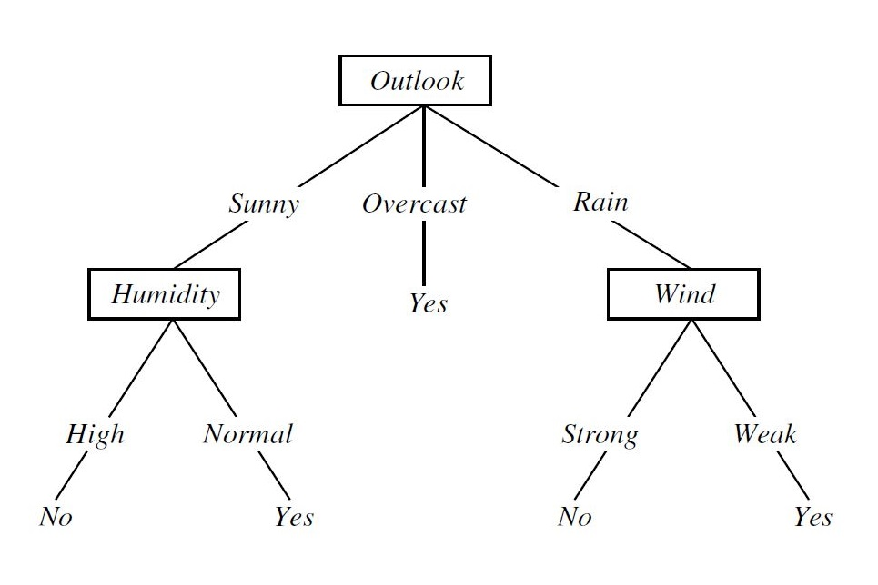
Play Tennis Decision Tree

Slide 10
Decision Trees as Prolog Programs
Take each positive branch of the decision tree and add it as Prolog rule (if-then rule) for the target attribute.
OUTLOOK
rain
WIND
weak
+
overcast
+
sunny
HUMIDITY
normal
+
⇒
play-tennis () :- outlook(rain), wind(weak)
play-tennis () :- outlook(overcast)
play-tennis () :- outlook(sunny), humidity(normal)

Slide 11
When to use Decision Trees
Instances are represented as attribute value pairs.
Target function has discrete output values
Disjunctive descriptions may be required
Training data may contain errors
Training data may contain missing attributes

Slide 12
Issues with Decision Trees
Depth of the Trees
Continuous Valued Attributes
Determine Threshold Values that maximize gain.
Attribute Selection Measure
Gain Ratio to penalize attributes like data which the information gain measure favors.
Missing Attribute Values
Assign them most common value for that attribute
Assign probabilities to values of the attribute.
Handling Overfitting
Stop growing tree early
Post pruning trees
Quinlan,C4.5, 1993 extends ID3 to handle all of the above.

Slide 13
Random Forests (Wikipedia)
Random forests is a notion of the general technique of random decision forests that are an ensemble learning method for classification, regression and other tasks.
They operate by constructing a multitude of decision trees at training time and outputting the class that is the mode of the classes (classification) or mean prediction (regression) of the individual trees.
Random decision forests correct for decision trees habit of overfitting to their training set

Slide 14
Sequential Covering Algorithms
Sequential-covering (target-attribute, attributes, examples, threshold)
learned-rules ← {}
rule ← learn-one-rule (target-attribute, attributes, examples)
while performance (rule, examples) > threshold
learned-rules ← learned-rules + rule
examples ← examples – (examples correctly classified by rule)
rule ← learn-one-rule (target-attribute, attributes, examples)
learned-rules <- sort learned-rules based on performance
return (learned rules)
Performance(h, target-attribute, examples)
entropy(subset of examples that match h wrt to target-attribute)

Slide 15
Learn-one-Rule¹
Learn-one-Rule (target-attribute, attributes, examples)
Initialize best-hypothesis to {} and candidate-hypotheses {best-hypothesis}
While candidate-hypotheses not empty
Generate next most specific candidate-hypotheses
all-constraints ← all constraints of the form (a = v) in examples
new-candidate-hypotheses ←
for each h in candidate-hypotheses and each c in all-constraints create a specialization of h by adding c to it
remove from new-candidate-hypotheses duplicates, inconsistent hypotheses and non-maximally specific
2. Update best-hypothesis
for all h in new-candidate-hypotheses
If performance (h, examples, target-attribute) > performance(best-hypothesis, examples, target-attribute)
then best-hypothesis ← h
Update candidate-hypotheses
set candidate-hypotheses best k hypotheses according performance metric.
Return a rule of the form “if <best-hypothesis> then <prediction>” where prediction is the most frequently occurring value for target attribute amongst covered examples.
¹Based on CN2 algorithm by Clark & Niblett (1989)

Slide 16
Learning Horn Clauses: FOIL
FOIL (target-predicate, predicates, examples)
pos ← those examples for target-predicate is true
neg ← those examples for target-predicate is true
learned-rules ← {}
while pos is not empty do
learn a new rule
new-rule ← rule that predicts target predicate with no preconditions.
new-rule-neg ← neg
while new-rule-neg do
add a new literal to specialize new rule
candidate-literals ← new literal candidates based on predicates
best-literal ← argmax (FOIL-Gain (literal, new-rule)) over candidate-literals
add best-literal to the preconditions of new-rule
new-rule-neg ← subset of new-rule-neg which satisfy new-rule preconditions.
learned-rules ← learned-rules + new-rule
pos ← pos – (members of pos covered by new-rule)
return learned-rules

Slide 17
FOIL Information Gain Criteria
Gain(R₀, R₁) := t * ( log₂(p₁/(p₁+n₁)) - log₂(p₀/(p₀+n₀)) )
R₀ denotes a rule before adding a new literal.
R₁ is an extesion of R₀.
p₀ denotes the number of positive examples, covered by R₀,
p₁ the number of positive examples covered by R₁.
n₀ and n₁ are the number of negative examples, covered by the according rule.
t is the number of positive examples, covered by both R₀ and R₁.
http://www-ai.cs.uni-dortmund.de/kdnet/auto?self=$81d91e8ddbd8094353

Slide 18
Decision Tree References
http://en.wikipedia.org/wiki/ID3_algorithm
http://en.wikipedia.org/wiki/C4.5_algorithm
http://www.cs.cmu.edu/afs/cs/project/theo-20/www/mlbook/ch3.pdf
http://www.cs.cmu.edu/afs/cs/project/theo-20/www/mlbook/ch10.pdf

