Slide 1
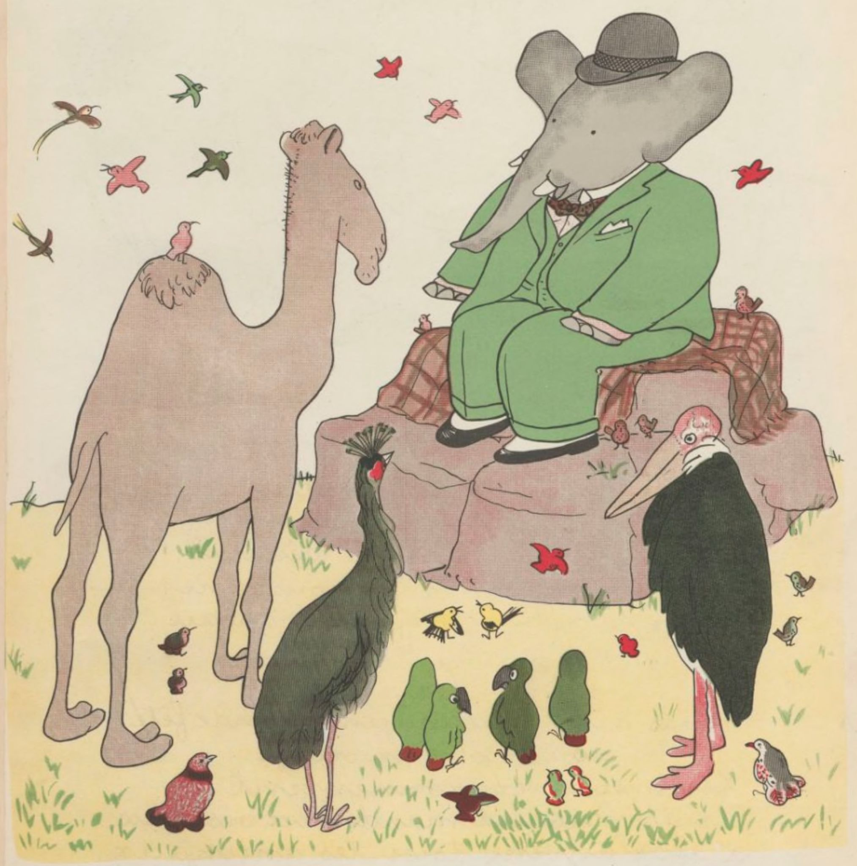
BABAR
Knowledge System
Raymond Pierre de Lacaze
rpl@lispnyc.org
Lisp NYC
Tuesday, April 13, 2021

Slide 2
Foreword
Babar is a research project in Artificial Intelligence. The Babar knowledge system is named in homage to John McCarthy who not only invented the LISP programming language but also coined the term “Artificial Intelligence” in 1958.
I had the honor and pleasure of knowing John personally when I worked at the Stanford Research Institute. We had lunch and dinner on several occasions and he was also a keynote speaker at both International Lisp Conferences that I organised and chaired in 2002 and 2003.
One of the last projects John worked on was the design of a programming language called Elephant 2000 which was based on speech acts I grew up up in a French culture in NYC and Babar the Elephant was a childhood character that I was particularly fond of.
Sadly, John McCarthy past away on October 24, 2011 which was the same year I started working on my knowledge extraction system.
I chose the name “Babar” as a way of honoring the memory of John McCarthy.

Slide 3
Babar Overview
A research project in Artificial Intelligence both neural and symbolic
Multi-language Implementation: CLOS, Python & Clojure
Lispbar: CLOS (Common Lisp Object System)
AI Planning M.S. Thesis (1993)
In-memory Hypergraph (2008)
English Language Parser (2012)
Unsupervised Learning (2014)
Pybar: Python 3.8
Web crawling & scraping
Database maintenance
Deep Learning
Clobar: Clojure
Web Development
Server side HTML
CSS & Javascript
Ultimately Clojurescript

Slide 4
Babar Server Architecture
Flask
(Python)
Pybar
Asynchronous
requests
Rest API
Nginx
Server
Babar
PostGres
Synchronous Queries
Requests
Clobar
Front End
Asynchronous Tasks
Ring
(Clojure)
Rest API
Asynchronous
requests
In-memory
Hypergraph
Lispbar
Clobar: Front End
Lispbar: Symbolic AI
Hunchentoot
(Common Lisp)
Pybar: Neural AI

Slide 5
Presentation Overview
Web Development
Clojure & Hiccup (Clobar)
Javascript Interface (Clobar)
Neural NLP
Word Embeddings (Pybar)
Neural Network Classifiers (Pybar)
Symbolic NLP
English Language Parser (Lipsbar)
Symbolic Machine Learning (Lispbar)
Knowledge Representation
Clausal Form Logic (Lispbar)
Semantic Nets (Lispbar) Unsupervised Learning (Lispbar)
Inductive Logic Programming (LispBar)
Applications
Browsing Wikipedia (Clobar)
Classifying Search Engine Results (Clobar)

Slide 6
A few Notes About Wikipedia...
The “De Facto” Online Source of Universal Knowledge
Fifth most visited website in the world (6.1 billion visitors per month)
Mostly objective and trustworthy knowledge
Implicit bias wrt to subject popularity
Used to train GTP-3 (largest NLP model to date)
Data vs. Knowledge
Knowledge as the structured organisation of data
Wikipedia content is for human consumption
Scraping Wikipedia content produces data
Wikipedia graph represents knowledge
Principle source of Babar’s Knowledge System
Wikipedia Topics: 5,155,052
Wikipedia Edges: 96,260,661

Slide 7
Wikipedia Graph Postgres Implementation
wiki_edges_0
Wikipedia Topics Table
reverse_wiki_edges_0
wiki_edges_1
reverse_wiki_edges_1
…….
…….
wiki_edges_9
Babar
Database
reverse_wiki_edges_9
wiki_edges_a
reverse_wiki_edges_a
wiki_edges_b
reverse_wiki_edges_b
…….
…….
wiki_edges_z
reverse_wiki_edges_z

Slide 8
CLOBAR: Graphical User Interface (GUI)
Current System
Implemented in Clojure
Generates server side html
Uses Ring as the web applications library
Uses Hiccup for HTML
Uses Compojure for routing
Uses futures for asynchronous requests
Uses CSS & Javascript
Currently not using Node, Angular or Ajax
Future System
Implemented in ClojureScript
Use Re-Frame & Reagent
MPSPA (multi-page single-page-application)

Slide 9
HTML Generation Example
(defn layout-page [title & content-section]
(html5 [:head [:meta {:content "text/html;charset=utf-8"}] [:title title] (include-css "css/grid.css") (include-css "css/clobar.css") (include-js "js/navbar.js")
[:header (babar-navbar-section)][:br]]
[:body {:style "background-color:lightblue"} (babar-logo-section) content-section]))

Slide 10
Interfacing Clojure & Javascript: Pie Charts
(defn select-pie-edges-data [rows] (let [erows (filter (fn [x](str/includes? (:name x) "Edges") rows) frows (filter (fn [x](> (:count x) 2000000)) erows) labels (map data-label frows) data (map :count frows) js-data (apply str (map (fn [x y](str x ":" y ",")) labels data))] (str "var data = {" js-data "};")))
(defn pie-chart-section [rows] (let [js-str (select-pie-edges-data rows)] [:div {:class "row-2"} [:h2 "Edge Tables Distribution (96,260,661)"] [:script {:type "text/javascript"} js-str] [:div {:id "my_dataviz"} [:script {:src "js/pie-chart.js"}]]))

Slide 11
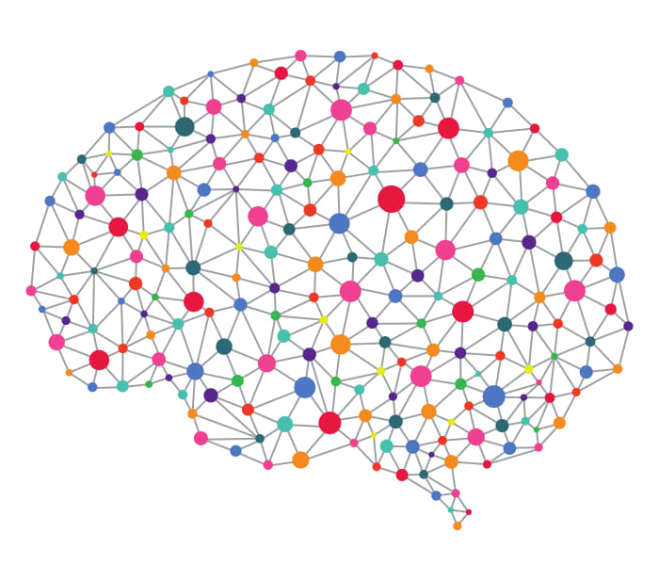
Topic Graphs
Wikipedia as Universal Knowledge
56 Million Wikipedia pages
Comparable to all the books in a library
Fifth most visited website in the world
Topic Graph
Depth three crawl of a Wikipedia topic
By definition a subgraph of Wikipedia
Quickly access relevant knowledge
More computationally plausible
Provide a contextual frame of reference
Interactively create topic graphs
Persisted in Postgres

Slide 12
PYBAR
Web crawling & Scraping
Word Embeddings
Automatically generated
Provided by Pybar API
Gensim: Google’s Word2Vec
Training Data
Automatically generated from Wikipedia
Based on prior human classification (i.e. knowledge)
Neural Net Classifiers
Automatically generated
Provided by Pybar API
Uses Keras and Tensorflow open source libraries
LSTM Based architecture
Future: BERT (Bidirectional Encoding Representation from Transformers)

Slide 13
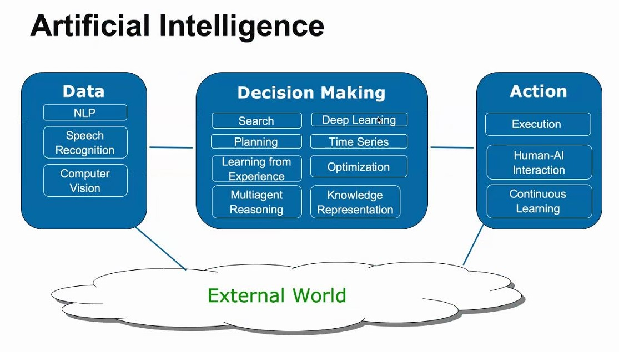
Take away: AI is much more extensive than just Deep Learning

Slide 14
Word Embeddings
Vectorization of words from a corpus
1-Hot Encoding
TF-IDF Encoding
Word2Vec Encoding (Google)
Glove (Stanford)
Spatially capture semantic similarity
Both distance and direction
Babar uses Gensim
Gensim is popular implementation of Word2Vec
Interactively create embeddings from Wikipedia
Typically first layer in an LSTM or Transformer based architecture

Slide 15
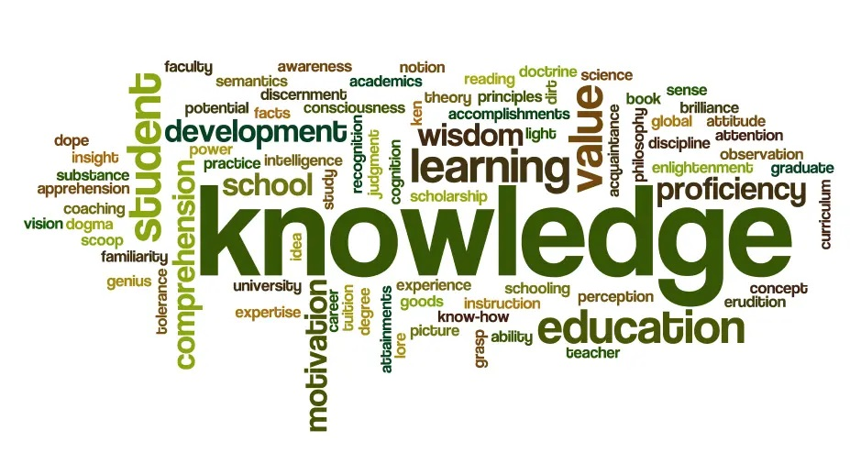
Word Embedding Demo

Slide 16
Create Word Embedding Example
Name: Art-Science Topics: ['art’, ‘science']
Processing create embedding request: Computing topic sentences…
Processing topic: Art
Related topics count: 5,910
Total Art related sentences: 378,290
Processing topic: Science
Related topics count: 5,782
Total Science related sentences: 310,797
Saving training data to: C:\babar\data\training\Art-Science-training-data.csv
Computing word embeddings..
Saving Gensim weights to: C:\babar\pybar\models\art_science_gensim_weights.npz
Saving Gensim vocabulary to: C:\babar\pybar\models\art_science_gensim_vocab.json Vocabulary Size: 68,221
Sending word embedding confirmation email to: delaray@hotmail.com
Finished processing request.

Slide 17
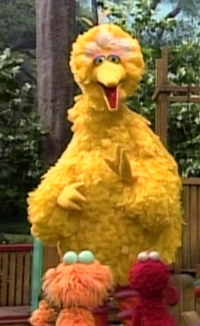
Example Word Comparisons`
Animals Word Embedding
Topics: Mammal, Reptile, Bird
Total sentences: 69,570
Vocabulary size: 17,438
Word 1 | Word 2 | Value
marsupial | placental | 93.36%
snake | lizard | 92.94%
zebra | lizard | 74.21%
lizards | nest | 58.91%
birds | nest | 76.51%
birds | bird | 69.39%

Slide 18
Artificial Neural Networks (ANN)
Tremendous amount of success
Alexnet CNN, Krizhevsky, Sutskever and Hinton(2012)
ImageNet Large Scale Visual Recognition Challenge (ILSVRC)
Object Identification & Facial Recognition
Language translation & generation
Deepmind's AlphaGo (beat Lee Sedol)
Deepmind's AlphaFold (3D models of proteins)
OpenAI’s GPT-3 (largest language model to date)
Many types of Neural Nets
Convolutional Neural Networks (CNN): Computer Vision
Recurrent Neural Networks (RNN): Natural Language
Generative Adversarial Networks (GAN): Computer Vision
Encoder/Decoder Networks (Transformers): NLP and Image processing
Goal of Babar
Leverage both Neural & Symbolic AI

Slide 19
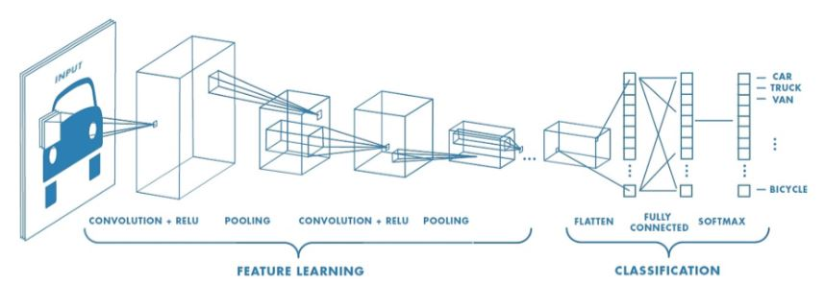
Feature Learning and Classification in Deep Learning
Take away: First learn high level features, then train a neural net using those features as input.

Slide 20
Babar Uses Long Short-Term Memory (LSTM)
Type of Recurrent Neural Network (RNN)
Based on gated neural nets
Trained used Backpropagation Algorithm
Solve vanishing and exploding gradient issue
Problem multi-layered networks
Well suited to handle sequences of inputs
Textual Language
Speech Processing
Becoming somewhat obsolete
Transformers (Attention mechanism)
BERT (Bidirectional Encoder Representation from Transformers)
GPT-3 (OpenAI): Largest language model to date.
175 billion machine learning parameters (variables)

Slide 21
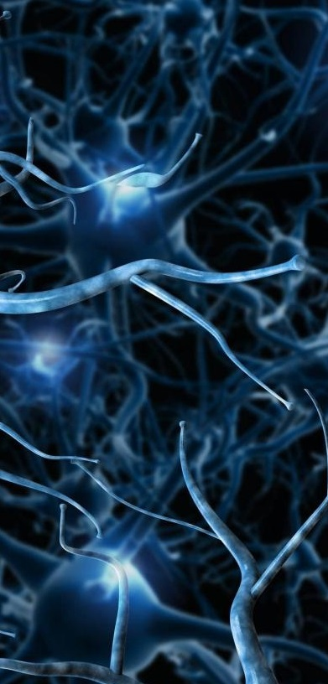
Babar LSTM Classifier Based Architecture
E
M
B
E
D
D
I
N
G
D
R
O
P
O
U
T
0.2
L
S
T
M
1
0
0
L
S
T
M
1
0
0
D
R
O
P
O
U
T
0.2
D
E
N
S
E
1
σ
Class
&
Confidence
Textual
Content

Slide 22

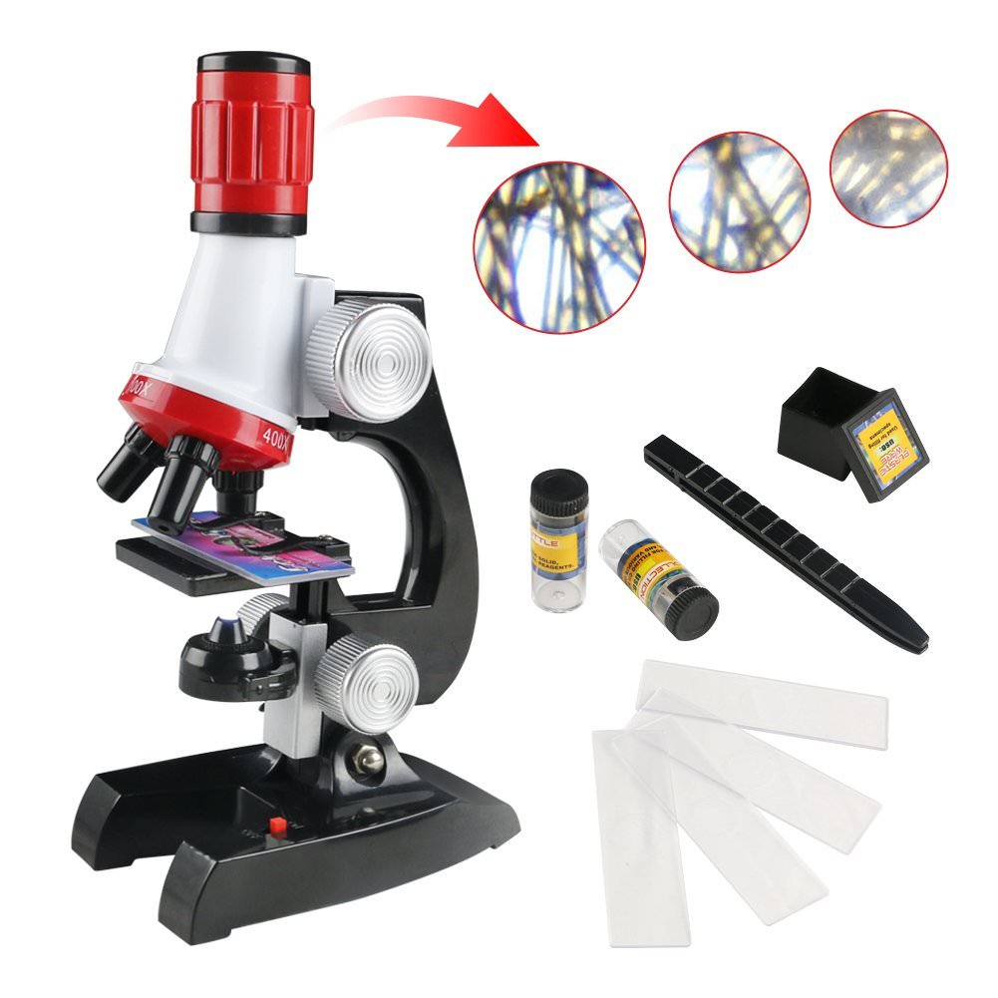
Art/Science Classifier Demo

Slide 23
Classifier Prediction Example: Art vs. Science
In [93]: classifier = cl.load_category_classifier("Art-Science")
In [94]: s1 = "John went to the Louvre museum for the Monet exhibit."
In [95]: pr.predict_category(classifier, s1)
Out[95]: ('Art', 0.99781513)
In [96]: s2 = "The technology in computers uses advanced circuits."
In [97]: pr.predict_category(classifier, s2)
Out[97]: ('Science', 0.7981771)

Slide 24
Prediction Ambiguity: Art vs. Science
In [21]: classifier = cl.load_category_classifier("Art-Science") In [22]: s = "Lucy went to the Zoo with her dad to see the elephants.”
In [23]: pr.predict_category(classifier, s)
Out[23]: (‘Art’, 0.58)
Importance of context
Maybe Lucy wanted to paint various exotic animals (Art)
Maybe Lucy wanted to work on her science project (Science)

Slide 25
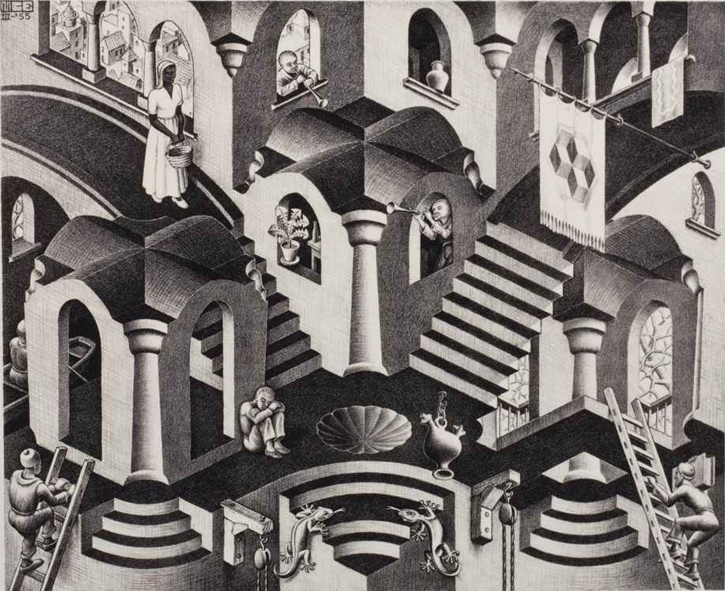
A Moment of Discontinuity
BRAINS
MINDS
Neurons
Thoughts
Python
LISP

Slide 26
LISPBAR (Symbolic AI)
Knowledge Representation
Clausal Form Logic
English Language Parser
Layered Design: Simple, Generic, Domain, English
Symbolic Machine Learning
Semantic Nets
In-memory hypergraph
Implemented Sparse matrices
Knowledge Base
Clustering
Unsupervised Learning
Inductive Logic Programming (ILP)
FOIL: Learning sets of Horn clauses

Slide 27
Knowledge Representation (KR)
Wikipedia is Knowledge for humans
Need for a language for representation
Mathematics is the language of Science
E.g. Ideal Gas Law: PV=nRT
Logics for Artificial Intelligence
Propositional Calculus (PC)
First Order Predicate Calculus (FOPC)
First order Logic
∃ x ∀ y | x+y=y (existence of a neutral element)
∀ x ∃ y | x+y=0 (existence of a inverse element)
Non-monotonic Reasoning
Modal Logics (Believes Jane (Stole John money))
Clausal Form Logic (CFL)
First Order Logics: (<predicate> <atomic-1> <atomic-2>...)
(mother Jane Peter)
(grandparent ?x ?y) ⇐ (parent ?x ?z)(parent ?z ?y)
Second Order Logics
(told Jeff Pierre (believes Zoe (ISA Arthur party-animal)))
HORN Clauses
Disjunction of conjuncts with at most one positive literal

Slide 28
Babar Knowledge Extraction (WIP)
Convert human knowledge to clausal form logic
A Horn clauses
A disjunction of literals with at most one positive literal (Alfred Horn, 1951)
A a literal is a predicate symbol applied to some terms. e.g. (isa cat mammal)
(a₁^a₂^...a_{n}) ⇒ b ⇔ ~(a₁^a₂^...a_{n}) ∨ b ⇔ (~a₁ ∨ ~a₂∨ … ∨ ~a_{n} ∨ b)
Parser Module
Scanner
Parser
Phraser
Knowledge Module
Frames (Marvin Minsky, 1974)
Horn Clauses

Slide 29
Knowledge Extraction in Babar
English Sentence
Augmented
English
GRAMMAR
English
LEXICON
SCANNER
POS Tokens
Grammar
Inferencing
Learning
Module
(Pattern Analysis)
English
GRAMMAR
PARSER
Patterns
Parse Tree
Parser Module
(Syntactic Analysis)
Phrases
PHRASER
FRAME Mapper
Frames
Knowledge Module
(Semantic Analysis)
Horn Clause
Generator
Horn Clauses

Slide 30
Knowledge Extraction Example
Text
"A cat has four legs"
PARSER
NAME "A cat has four legs"
VALUE: (#<PARSE-TREE: A cat has four legs>)
WORDS: (#<ARTICLE: a> #<NOUN: Cat> #<VERB: has>
#<NOUN: Four> #<NOUN: legs>)
Parse Tree
PHRASER
((#<PARSE-NODE: :NP> (#<ARTICLE: a> #<NOUN: Cat>))
(#<PARSE-NODE: :VP> (#<VERB: has>))
(#<PARSE-NODE: :NP> (#<NOUN: Four> #<NOUN: legs>)))
Phrases
CLAUSER
(KB::HASA #<NP: A cat> #<NP: four legs>)
Clauses

Slide 31
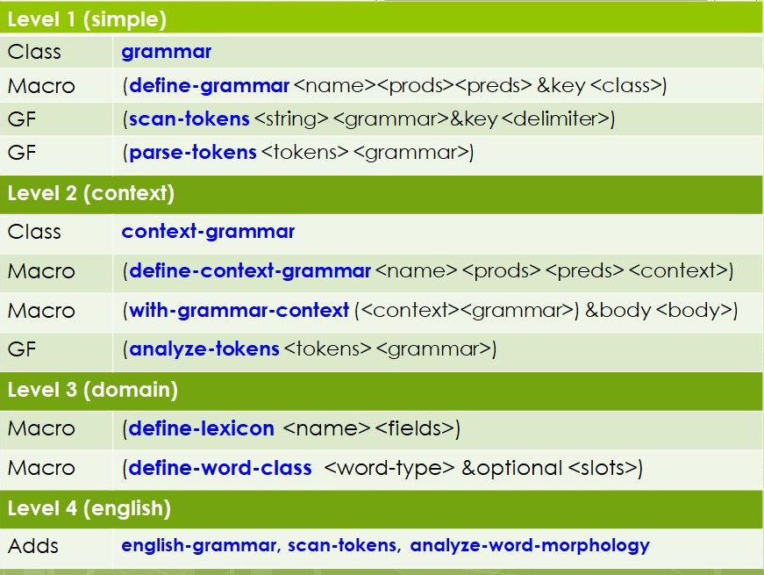
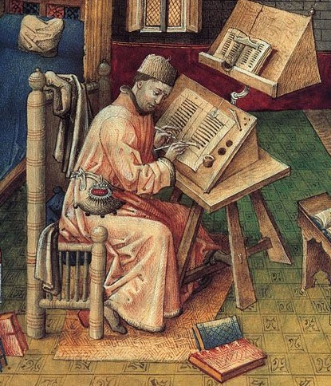
Parser Module Layers: Scanner, Analyzer & Parser

Slide 32
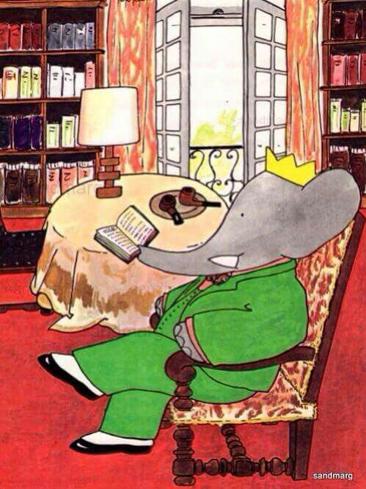
Lexicon: Books That Babar has Read (WIP)
Megan and the Princess of Death The Adventures of Goat, Dog and Cow Nancy Drew and the Hidden Staircase Agatha Christie: The Mysterious Affair at Styles Jules Verne: 20,000 Leagues Under the Sea Edgar Allan Poe: Tales of Mystery and Macabre Arthur Conan Doyle: Adventures of Sherlock Holmes Gabriel G.Marquez: One Hundred Years of Solitude Charles Dickens: Great Expectations Leo Tolstoy: War and Peace Charles Darwin: On the Origin of the Species The Dictionary of Biology Many, many, many Wikipedia pages
Take away: Vocabulary of 260,000+ words with parts of speech and definitions.

Slide 33
Scanner: Primitive Token Mixin Classes
Scanner methods are executed first and create primitive token classes
Analyzer methods analyze tokens and assign parts of speech
English Parser adds domain specific scanner & analyzer methods
E.g. Analyzer ⇒ Alpha-special “library.” ⇒ Split into “library” and “.”
Token Mixin Classes: Alphabetic Mixin, Numeric Mixin, Special Mixin
Alphabetic Class Numeric Class Special Class Alpha-Numeric Class Alpha-Special Class Numeric-Special Alpha-Numeric-Special
Primary methods (Domain specific knowledge) Before methods (Logging & printing patterns) After methods (Database persistence) Around methods (Domain specific knowledge)
Take away: Considerable domain knowledge application prior to parsing phase

Slide 34
Scanner & Analyzer: Merriam-Webster Parts of Speech
Merriam-Webster as a lexicon
Part of speech tagging
Penn Treebank Project: 36 POS tags & 12 Other tags
('3ps-present', 19), ('abbreviation', 114), ('adjective', 945), ('adjective combining form', 4), ('adjective suffix', 6), ('adverb', 216), ('auxiliary verb', 1), ('combining form', 21), ('conjunction', 9), ('idiom', 2), ('imperative', 1), ('imperative verb', 1),
(interjection', 18), ('intransitive verb', 41), ('noun', 1738), ('noun combining form', 1), ('noun phrase', 3), (noun suffix', 5), ('past-participle', 69), ('past-tense', 69), ('person', 14), ('place', 10), ('plural', 72), ('plural noun', 6), ('prefix', 14),
('preposition', 39), ('present-participle', 71), ('pronoun', 13), ('pronoun, plural in construction', 2), ('pronoun, construction', 1), ('proper-noun', 41), ('suffix', 1), ('symbol', 17), ('trademark', 3), ('transitive verb', 129), ('verb', 1489), ('verb suffix', 1)]

Slide 35
DEFINE-ENGLISH-WORD-CLASS
(defmacro DEFINE-ENGLISH-WORD-CLASS (word-class word-type &optional slots) (let* ((predicate-name (intern (string-upcase (concatenate 'string (symbol-name word-class) "-P")) :parser))) `(progn (defclass ,word-class (ENGLISH-WORD) (,@slots)) (defmethod INITIALIZE-INSTANCE :after ((word ,word-class &rest args))) (setf (english-word-type word) ,word-type))
(defmethod PRINT-OBJECT ((obj ,word-class) stream) (cond (*print-readably* (call-next-method)) (t (format stream "#<~a: ~a>" (english-word-type obj) (util::object-name obj)))))
(defmethod ,predicate-name ((word DOMAIN-WORD)(context T)) (typep word ',word-class))
Take away: Homogeneity. Defined new behavior without overwriting methods or any breaking changes.

Slide 36
English Language Parser (Weak AI)
Classical Recursive Descent Parser
Top-down parsing approach
Non-determinism is handled by backtracking
Three ways of handling non-determinism in Computer Science
Backtracking, Parallelism & Probability Theory
Could optimize using Earley algorithm (CNF)
Novel Aspect: Parser Never Fails
Always returns a forest of parse trees
Creates unparse trees for sequences of unparsed tokens
Novel Aspect: Adaptive Parser (machine learning)
Logs parser forest patterns
Learns new grammar productions (rules)
Terrifies functional programming folks
Model-based vs. Model-free AI
Normally this qualifies as a model-based reductionist approach
Peter Norvig: “ABC as Easy as 123”, shift in Natural Language Processing paradigm.
Unparse trees & the adaptive aspect allow for emergence (model-free)

Slide 37
English Parser: Recursive Descent Parser
Classical Parsing Technology (Martin & Jurafski)
A context-free grammar describes an AND-OR Tree
Nested disjunctions of conjunctions
Non-determinism is handled with backtracking (O(2^{n}))
Can be optimized with Earley Algorithm (O(n³))
Babar returns the first successful parse tree.
Easily extended to return all parse trees.
Parser can be viewed as a predicate function
Compilation Error:
Expecting semicolon but found the string “Arthur”
Babar: Purpose is knowledge extraction
Babar: Returns a forest of parse trees
Eg. “A cat and a dog” ⇒ (noun-phrase unparse-tree noun-phrase)

Slide 38
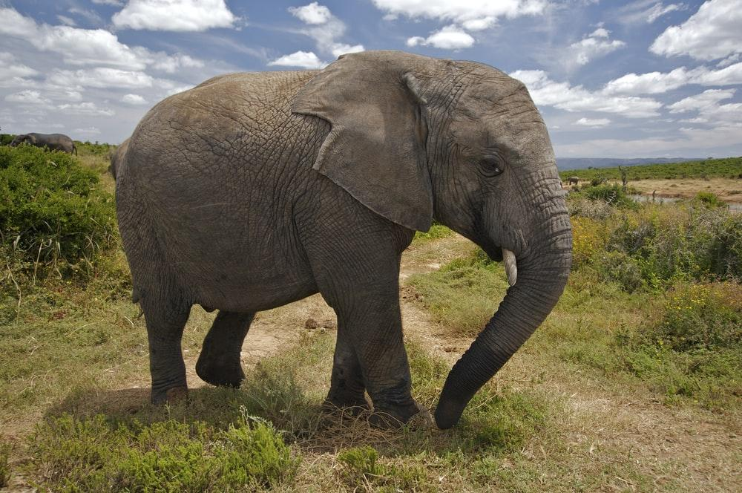

Babar Parser Demo

Slide 39
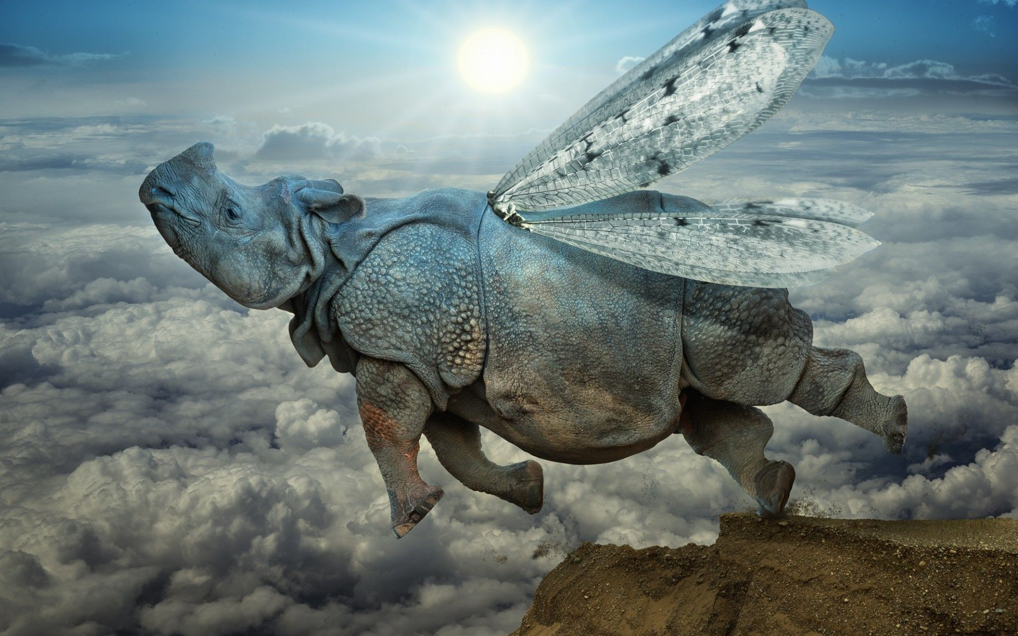
Knowledge Sideline : Consistency of Human Knowledge
Question: Can birds fly?
Answer: Yes
Question: Are penguins birds?
Answer: Yes
Question: Can penguins fly?
Answer: No
Take away: Always question the rationality of Homo Sapiens.

Slide 40
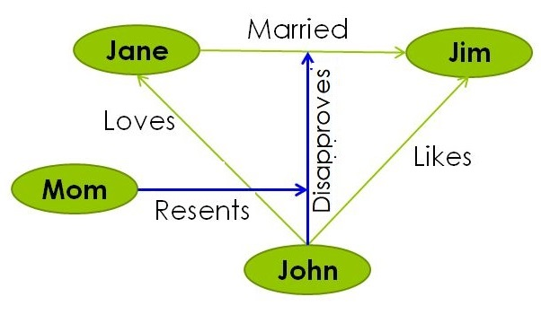
Knowledge Representation & Reasoning (WIP)
Clauses in a Semantic network
In-Memory Hypergraph
Mary, Jane, John & Mom
Persisted in PostGres
Generalization (FOIL)
Cats, dogs, rabbits have four legs
Cats, dogs, rabbits are mammals
⇒ All mammals have four legs
Inferencing (syllogisms)
All animals have four legs
Arthur is a party animal
⇒ Arthur has four legs

Slide 41
Knowledge Extraction Examples (WIP)
(HASA "Female African Elephants" "large tusks")
(ISA "Elephants" "large land mammals")
(ISA "Elephants" "herbivores")
(HASA "African Elephants" “three nails")
(HASA "Indian Elephants" "four nails")
Examples of Clausal Form Logic (CFL)
Well suited for a Graph Database (i.e. triples)
Still handling False-Positives and Nonsense
Form of KR that is very different from ANN

Slide 42
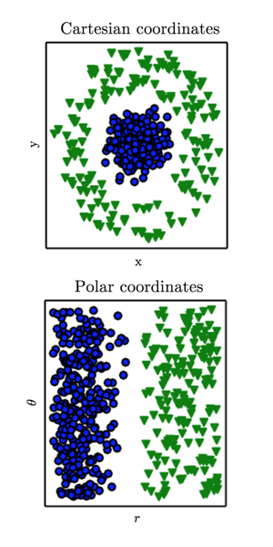
Clustering as Model-free Knowledge Representation
Unsupervised Learning (mostly model-free)
Typically applied to unlabeled data
A form of categorization and generalisation
Many Different Clustering Algorithms
K-Means (spheroids)
Hierarchical Agglomerative Clustering (Dendrogram)
Big Data Clustering
Distributed algorithms (Spark ML)
Representative elements (e.g. CURE)
Fails to semantically label the clusters
Labels are an important: of semantic generalization
Provide conciseness if not preciseness, e.g. birds can fly.
Babar Uses SR-Clustering

Slide 43
SR Clustering
Simple-Ray Clustering
Proprietary Algorithm
Sort of like a flattened version of hierarchical agglomerative clustering
Basic Algorithm
For each data point, place it in the correct cluster and you’re done.
Provably correct by definition
If it doesn’t belong to any cluster, create a new cluster with that single data point
Cluster Membership Predicate
Within a proximity threshold of every data point in that cluster.
Proximity Metric
The Jaccard Index
Norm of the intersection divided by the norm of the union
I.e. Percentage overlap of two sets
Babar uses the outbound links of each Wikipedia topic being compared

Slide 44
Clustering Metric: Jaccard Index (WIP)
Compute the Jaccard Index of pairs of topics using the related topics of each topic as the sets to be compared.
 | African | Asian | Indian | Babar | Horton | War
African | 100.00 | 38.46 | 21.05 | 4.35 | 6.82 | 7.94
Asian | 38.46 | 100.00 | 37.74 | 4.00 | 6.25 | 20.00
Indian | 21.05 | 37.74 | 100.00 | 6.90 | 7.14 | 24.39
Babar | 4.35 | 4.00 | 6.90 | 100.00 | 28.57 | 7.14
Horton | 6.82 | 6.25 | 7.14 | 28.57 | 100.00 | 7.41
War | 7.94 | 20.00 | 24.39 | 7.14 | 7.41 | 100.00
NB: An optimal proximity threshold can be determined automatically by maximizing the threshold such that there is no overlap between the individual clusters.

Slide 45
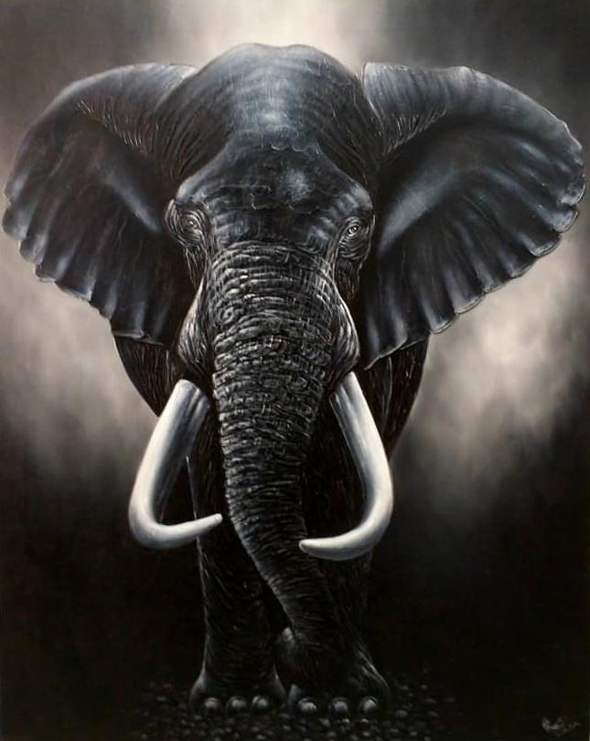
Example Clustering Results for Subtopics of Elephant
Take away: Strictly based on Graph connectivity. Exemplifies the importance of relations.
Cluster 1
Asian_elephant(49) African_elephant(60)
Cluster 2
Babar_the_Elephant(7) Horton_the_Elephant(5) Elmer_the_Patchwork_Elephant(4)
Cluster 3
Asian_elephant(49)
Indian_Elephant(18) Sri_Lankan_elephant(12) Sumatran_Elephant(11) Borneo_pygmy_elephant(3)
Cluster 4
War_elephant(22) Spotting_the_elephant (7)
Shooting_the_elephant (15)
Execution_by_elephant(5)
Cluster 5
Year_of_the_Elephant(8)
Cluster 6
Dwarf_elephant(24)
Cluster 7
White_elephant(10)

Slide 46
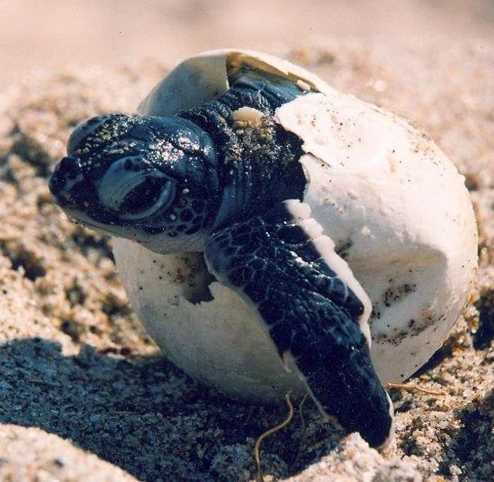
Human Knowledge Acquisition Process
Can be a two decade long process !!!
Kindergarten – Post Doctoral work
Reptiles are born as mini adults
Grade school topics as default knowledge categories.
Science, History, Literature, Art, etc…
Goal: Assign categories to subtopic clusters
Create topic graphs for each knowledge category
Use Jaccard Index to identify the category
Automatically generate semantic cluster labels
E.g. Babar = Literature_Elephant
E.g. Asian Elephant = Science_Elephant

Slide 47
(((( :SCIENCE 0.47666672) (:HISTORY 0.44666672))
(#<Concept(49): Asian_elephant> #<Concept(60): African_elephant>))
((( :SCIENCE 0.39) (:GEOGRAPHY 0.37800002))
(#<Concept(3): Borneo_pygmy_elephant> #<Concept(49): Asian_elephant>
#<Concept(18): Indian_Elephant> #<Concept(12): Sri_Lankan_elephant>
#<Concept(11): Sumatran_Elephant>))
((( :ART 0.33333334) (:GEOGRAPHY 0.30666667))
(#<Concept(7): Babar_the_Elephant> #<Concept(5): Horton_the_Elephant>
#<Concept(4): Elmer_the_Patchwork_Elephant>))
((( :HISTORY 0.6) (:GEOGRAPHY 0.46)
(#<Concept(8): Year_of_the_Elephant>))
((( :GEOGRAPHY 0.72333336) ( :HISTORY 0.43666664))
(#<Concept (7) Spotting_the_elephant> #<Concept (15) Shooting_the_elephant>
#<Concept(5): Execution_by_elephant> #<Concept(22): War_elephant>
#<Concept(4): Crushing_by_elephant>))

Slide 48
Examples of Clustering topics not containing “elephant”
Take away: Model-Free Emergence of concepts knowledge from relations
(( #<Concept(60): African elephant>
#<Concept(49): Asian_elephant>)
(#<Concept(10): Elephant intelligence>
#<Concept(103): Animal cognition>
#<Concept(4): Elephant tusk>
#<Concept(102): Proboscidea>
#<Concept(876): Mammal>)
(#<Concept22): War_elephant>
#<Concept(41): Spotting_the_elephant>
#<Concept(13): Shooting_the_elephant>
#<Concept(37): Execution_by_elephant>
#<Concept(55): Ivory>)
(#<Concept(24): Dwarf elephant>
#<Concept(66): Mammoth>
#<Concept(25): Mastodon>
#<Concept(62): Afrotheria>
#<Concept(86): Gestation>
#<Concept(8): Gomphotherium>
#<Concept(27): Tooth>
#<Concept(8): Tooth_development>))
(#<Concept(7): Babar_the_Elephant>
#<Concept(5): Horton_the_Elephant>
#<Concept(4): Elmer_the_Patchwork_Elephant>
#<Concept(6): List_of_fictional_elephants>)

Slide 49
Afterthoughts on Clustering Results & KR in General
In 2012: There were 36 subtopics of Elephant on Wikipedia
In 2021: There 105 subtopics of of Elephant on Wikipedia
Indiscriminately selecting neighbor-based metrics
Need a natural way of filtering relenat topics
Weighted approach
Strongly Related Topics
Triangles in the Graph
Addressing Wikipedia Popularity Bias
External references
Other sources in general
Factor in content based Deep Learning paradigms (Word Embeddings)
Most importantly: Need to maintain a model-free approach
Basically anything that enables natural emergence and evolution
E.g. In 2012 there was no Covid-19 Wikipedia page of FB group.

Slide 50
Inductive Logic Programming (WIP)
Yet another form of symbolic machine learning
Learning sets of Horn clauses
“Learning Logical Definitions From Relations” (Quinlan, 1990)
FOIL Algorithm (FOIL-Gain)
Supports learning recursive rules
E.g. Learning “Ancestor” relation
Learning Prolog programs
Relationship with Decision Tree Learning (Information Gain)
ILP in Babar (WIP)
Symbolic Generalization: E.g. (hasa mammals four-legs)
Concept identification: E.g. Prehistoric animals
Concept emergence: E.g. Fictional elephants
Concept creation (Imagination)
Hotel Elephant: An elephant that hangs out at hotel bars drinking Piña Coladas with Arthur
Elephant Hotel: A type of hotel that accommodates such elephants and party animals

Slide 51
The FOIL Algorithm (Inductive Logic Programming)
FOIL (target-predicate, predicates, examples) pos = those examples for which target-predicate is true neg = those examples for which target-predicate is false learned-rules {} while pos is not empty do learn a new rule new-rule = rule that predicts target predicate with no preconditions. new-rule-neg = neg while new-rule-neg do add a new literal to specialize new rule candidate-literals = new literal candidates based on predicates best-literal = argmax (FOIL-Gain (literal, new-rule)) over candidate-literals add best-literal to the preconditions of new-rule new-rule-neg = subset of new-rule-neg which satisfy new-rule preconditions. learned-rules = learned-rules + new-rule pos = pos – (members of pos covered by new-rule) return learned-rules

Slide 52
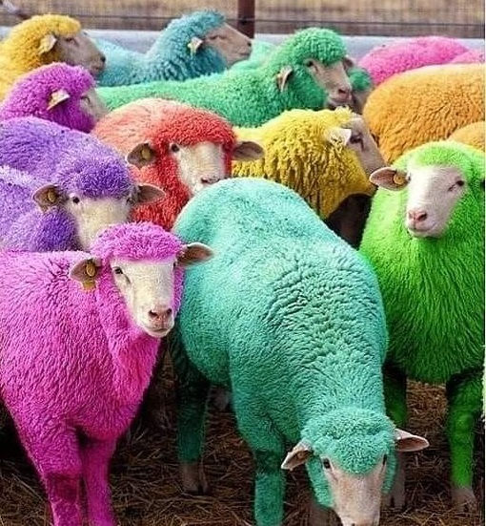
Classification & Clustering Remarks
A function of the Classes and/or the Data
Classes are subject to data coverage limitations
E.g. Black sheep vs. white sheep
Classes are subject to subjectivity
E.g. It’s a bird. Is it a plane. No, it’s Batman.
Classes not always mutually exclusive
E.g. Arthur: Party animal, Land mammal, Bar(n) animal
Seriously: Taxonomies are subject to their usage
E.g. Classifying web sites and web pages
Meta Knowledge & Context
Why are we asking the question?
What knowledge does it provide?
Is the question reasonable or useful?

Slide 53
Combining Supervised and Unsupervised Learning
Semi-supervised Learning
Small set of labeled data
Large set of unlabeled data
Train a classifier on the labeled data
Use classifier to label the unlabeled data
Example: Identifying people on Wikipedia
Start with a database of about 30,000 scraped famous people
Generate labeled data for the corresponding Wikipedia pages
Sample Wikipedia in order to generate examples of non-people
Train a person page classifier on the labeled data
Use the classifier to predict and label unlabeled pages
Finally, train a classifier on the larger set of labeled data
Application: Identifying people or news articles about people (NER)

Slide 54
Neuro-Symbolic Computing
Integrates in a principled way neural network-based learning with symbolic knowledge representation and logical reasoning

Slide 55
Possible Real World Applications of Babar (WIP)
Clustering Search Engine Results
Model-based Approach
Pre-select categories of interest
Train a classifier on those categories
Predict category of each Google Search result
Group results by pre-defined category
Model-free Approach
Analyze Google Search results and vocabulary
Allow categories to naturally emerge
Group results according to those categories
Research Engine
Browsing the Web more effectively
Researching topics in general
Hours vs. Milliseconds
Content Generation
Topic Summaries
Advertisement content

Slide 56
Scalability Issues (WIP)
Handling 56 million wikipedia topics
How does Wikipedia do do it?
Handling billions of edges
How social media platforms do it?
Handling millions of users
Standard practices?
Partitioned Tables vs. Multiple Tables
Are other options?
Distributed Databases
CAP Theorem
Graph Databases
Neo4j
AllegroGraph
Datomic

Slide 57
References
Books
Artificial Intelligence: A Modern Approach, 4th Ed., Russell and Norvig, 2019
Speech and Language Processing, 3rd Ed., Jurafsky, and Martin, 2020
Dive into Deep Learning, Zhang, Lipton, Li, and Smola, 2021
Deep Learning, Goodfellow, Bengio and Courville, 2016
Mining of Massive Datasets, Leskovec, Rajaraman and Ullman, 2010
Pattern Recognition and Machine Learning, Christopher Bishop, 2006
Machine Learning, Tom Mitchell, 1997
Papers
Attention is All You Need, Vaswanie, Shazeer, Parmar, Uszkoreit, Dec. 2017
Neurosymbolic AI: The 3rd Wave, Artur d’Avila Garcez and Luís C. Lamb, Dec. 2020
Learning Logical Definitions from Relations, J.R. Quinlan, 1990
Elephant 2000: A Programming Language Based on Speech Acts, John McCarthy, 2000
A Framework for Representing Knowledge, Marvin Minsky, 1974

Slide 58


Slide 59
Appendix A: BERT (NLP State of the Art)

Slide 60
Appendix B: Programmer Ethics in CLOS
Primary methods do a call-next-method
Ensures complete inheritance
Ensures complete behavior
Around methods conditionally do a call-next-method
Heavy handed by definition
Typically do a call-next-method
Allow deviation in method dispatching (before part)
Allow customization of returned value (after part)
Before and After methods are used for side effects
Logging information
Persisting data in a database

Slide 61
Appendix C: Programmer Responsibility in CLOS
Do not change existing functionality (no breaking changes)
Inheriting partial attributes is a bad idea
Inheriting partial behavior is a bad idea
Create new classes to extend existing functionality
Guitarist inherits from Person, adds tour dates and a mailing list
Create new classes to add functionality
Department of Airborne Vehicles
Add methods on on existing classes to augment functionality
Teleportation ID & associated methods

Slide 62
Appendix D: Business Issues
Legal Concerns
Copyright violations: Wikipedia & Merriam-Webster
Extracting content in general
Cost Issues
Cloud computing is expensive
Ideally one server per customer
Security Issues
Proprietary customer data
Login Info
Payment Info

