Slide 1
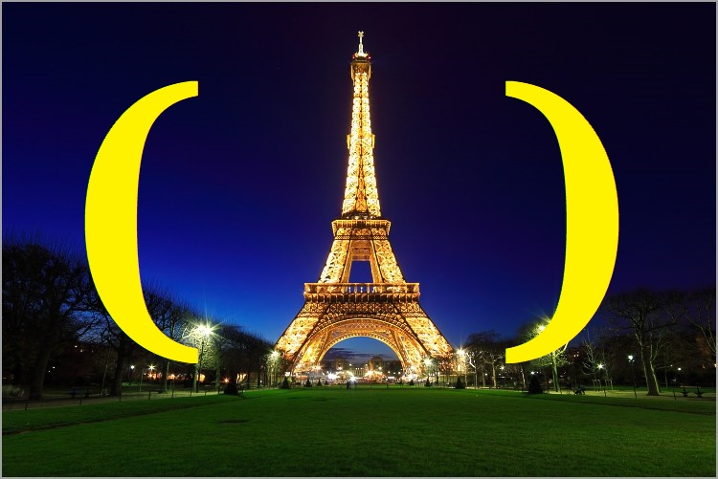
BABAR
Knowledge Browser

Slide 2
Foreword
The Babar knowledge system is named in homage to John McCarthy who not only invented the LISP programming language but also coined the term “Artificial Intelligence” in 1958.
I had the honor and pleasure of knowing John personally when I worked at SRI. We had lunch and dinner on numerous occasions and he was also a keynote speaker at both International Lisp Conferences that I organised and chaired in 2002 and 2003.
One of the last projects John worked on was the design of a programming language called Elephant 2000 which was based on speech acts I grew up up in a French culture in NYC and Babar the Elephant was a childhood character that I was particularly fond of.
Sadly, John McCarthy past away on October 24, 2011 which was the same year I started working on my knowledge extraction system.
I chose the name “Babar” as a way of honoring the memory of John McCarthy.

Slide 3
Presentation Overview
Introduction
System Architecture: Clobar, Pybar & Lispbar
Natural Language Processing:
Word Embeddings (Pybar)
Category Classifiers (Pybar)
Recursive Descent Parsing (Lipsbar)
Symbolic Machine Learning (Lispbar)
Clustering (Lispbar)
Knowledge Extraction
Clausal Form Logic (Lispbar)
Hypergraphs & Semantic Nets (Lispbar)
Inductive Logic Programming (LispBar)
Applications
Browsing Wikipedia (Clobar)
Classifying Google Search Results (Clobar)
Babar as a Research Engine (Clobar)
Conclusion

Slide 4
Wikipedia
The “De Facto” Online Source of Universal Knowledge
Fifth most visited website in the world (6.1 billion visitors per month)
Mostly trustworthy objective knowledge
Implicit subject popularity bias
Used by GTP-3 (Largest NLP model with 175 billion parameters)
Data vs. Knowledge
Knowledge as the structured organisation of data
Wikipedia content is for human consumption
Scraping Wikipedia content produces data
Wikipedia graph on the other hand is knowledge
Wikipedia is the foundation of Babar’s Knowledge System

Slide 5
Babar: Birds-eye View
Multi-language Implementation
CLOS (Common Lisp Object System)
Lisp
M.S. Thesis (1993)
In-memory Hypergraphs (2008)
English Language Parser (2012)
Python
Web crawling & scraping
Deep Learning: Keras and Tensorflow
Clojure
Lisp
Javascript
CSS
HTML
Ultimately Clojurescript

Slide 6
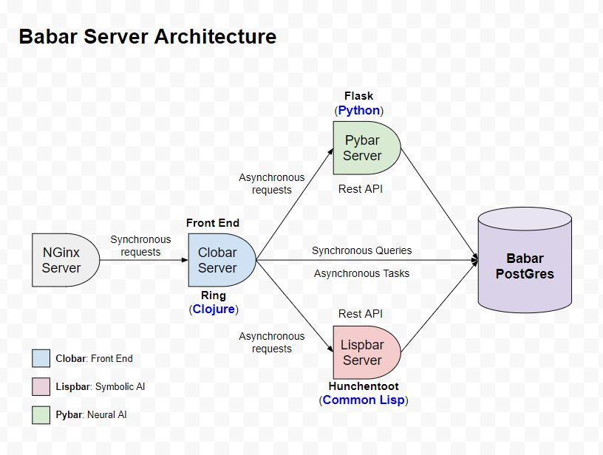

Slide 7
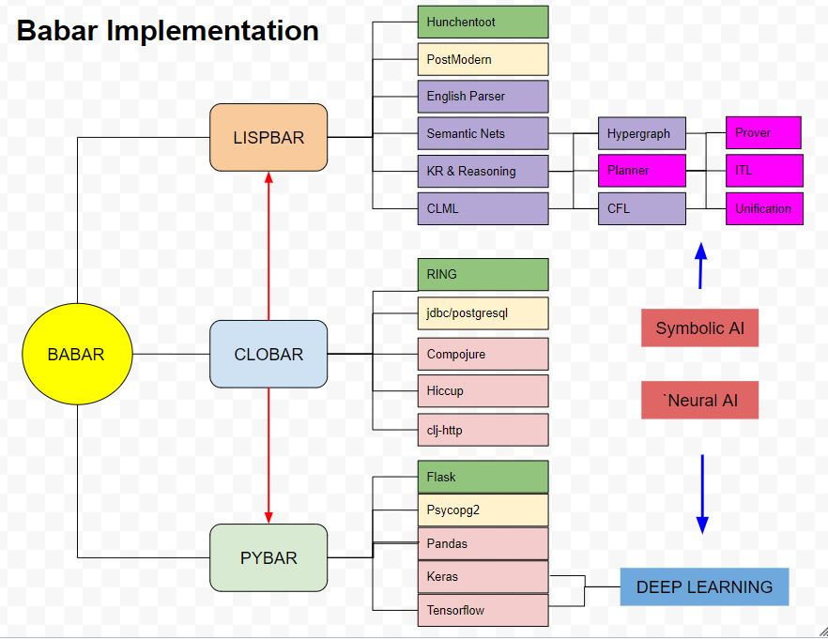

Slide 8
CLOBAR (Web Server)
Current System
Implemented in Clojure
Generates server side html
Uses Hiccup for HTML, CSS & Javascript
Uses Compojure for routing
Uses futures for asynchronous requests
Currently not using Node, Angular or Ajax
Future System
Implemented in ClojureScript
Use Re-Frame & React
MPSPA (multi-page single-page-application)

Slide 9
HTML Generation Example
(defn layout-css [title & content-section]
(html5 [:head [:meta {:content "text/html;charset=utf-8"}] [:title title] (include-css "css/grid.css") (include-css "css/clobar.css") (include-js "js/navbar.js")
[:header (babar-navbar-section)][:br]]
[:body {:style "background-color:lightblue"} [:br] (babar-logo-section) [:div content-section]]))

Slide 10
PYBAR (Neural AI)
Word Embeddings
Provided by Pybar API
Google’s Word2Vec
Gensim Library
Neural Net Classifiers
Provided by Pybar API
LSTM Based architecture
Currently use Keras and Tensorflow
Future: BERT (Bidirectional Encoding Representation from Transformers)
Training Data
Automatically generated
Babar exploits Supervised Learning (e.g. quote topics)
MOstly Based on prior human classification (i.e. knowledge)

Slide 11
Neural AI
Based on Artificial Neural Networks (ANNs)
Tremendous amount of success
Object Identification & Facial Recognition
Language translation & Generation
Deepmind's AlphaGo & AlphaFold
Many types of Neural Nets
Convolutional Neural Networks (CNN): Computer Vision
Recurrent Neural Networks (RNN): Natural Language
Generative Adversarial Networks (GAN): Computer Vision
Encoder/Decoder Networks (Transformers): NLP and Image processing
Goal of Babar
Leverage both Neural & Symbolic AI

Slide 12
Word Embeddings
Vectorization of words from a corpus
1-Hot Encoding
TF-IDF Encoding
Word2Vec Encoding (Google)
Glove (Stanford)
Spatially capture semantic similarity
Both distance and direction
Babar uses Gensim
Gensim is Popular implementation of Word2Vec
Interactively create embeddings from Wikipedia
Typically first layer in an LSTM or Transformer based architecture

Slide 13
Babar Create Word Embedding Example
Name: Animals Topics: ['mammal', 'reptiles', 'bird']
Processing create embedding request: Computing topic sentences…
Processing topic: mammal Neighbor count: 74 Total mammal related sentences: 4705
Processing topic: reptiles Neighbor count: 99 Total reptiles related sentences: 3348
Processing topic: bird Neighbor count: 1237 Total bird related sentences: 61517
Saving training data to: C:\babar\data\training\Animals-training-data.csv
Computing word embeddings..
Saving Gensim weights to: C:\babar\pybar\models\animals_gensim_weights.npz
Saving Gensim vocabulary to: C:\babar\pybar\models\animals_gensim_vocab.json Vocabulary Size: 17438
Sending word embedding confirmation email to: delaray@hotmail.com
Finished processing request.

Slide 14
Long Short-Term Memory (LSTM)
Type of Recurrent Neural Network (RNN)
Based on gated neural nets
Solve vanishing and exploding gradient issue
Problem multi-layered networks
Well suited to handle sequences of inputs
Textual Language
Speech Processing
Becoming somewhat obsolete
Transformers (Attention mechanism)
BERT (Bidirectional Encoder Representation from Transformers)
GPT-3 (OpenAI): Largest language model to date.
175 billion machine learning parameters (variables)

Slide 15
Babar LSTM Classifier Based Architecture
E
M
B
E
D
D
I
N
G
D
R
O
P
O
U
T
0.2
L
S
T
M
1
0
0
L
S
T
M
1
0
0
D
R
O
P
O
U
T
0.2
D
E
N
S
E
1
σ
Class
&
Confidence
Textual
Content

Slide 16
Classifier Prediction Example: Art vs. Science
In [93]: classifier = cl.load_category_classifier("Art-Science")
In [94]: s1 = "John went to the Louvre museum for the Monet exhibit."
In [95]: pr.predict_category(classifier, s1)
Out[95]: ('Art', 0.99781513)
In [96]: s2 = "The technology in computers uses advanced circuits."
In [97]: pr.predict_category(classifier, s2)
Out[97]: ('Science', 0.7981771)

Slide 17
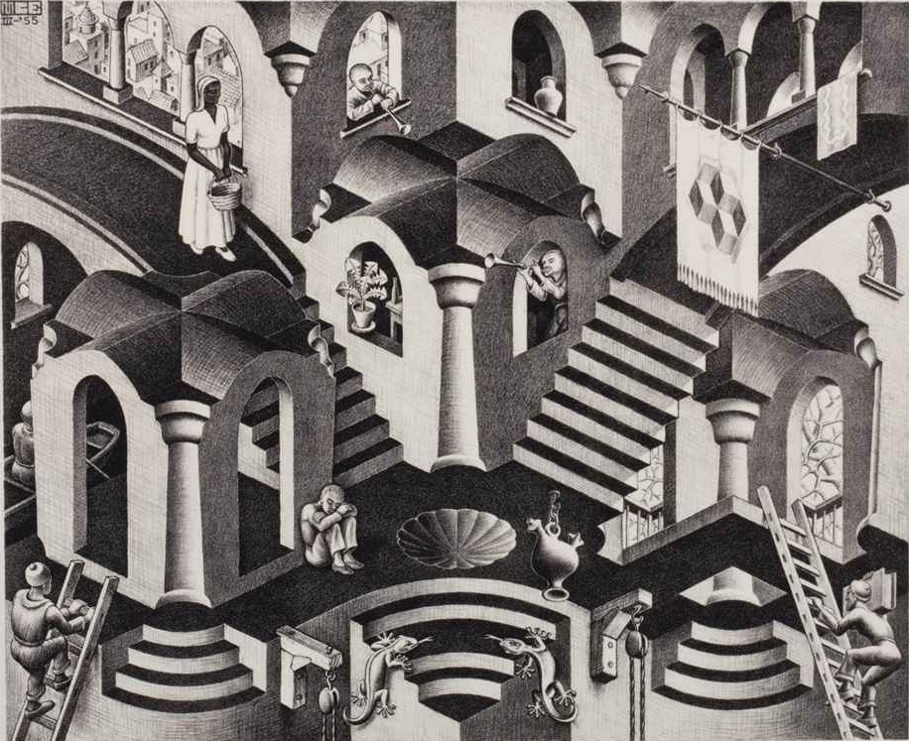
Moment of Discontinuity
BRAIN
MIND
Neurons
Thoughts
Python
LISP

Slide 18
LISPBAR (Symbolic AI)
Knowledge Representation
Clausal Form Logic
Backward Chaining Reasoning
Interval Temporal Logic (ITL)
English Language Parser
Layered Design: Simple, Generic, Domain, English
Symbolic Machine Learning
Hypergraph
Semantic Nets
In-memory hypergraph
Sparse matrices
Knowledge Base
Inductive Logic Programming (ILP)
FOIL: Learning sets of Horn clauses

Slide 19
Knowledge Representation (KR)
Wikipedia is Knowledge for humans
Need for a language for representation
Mathematics is the language of Science
Logics for Artificial Intelligence
Propositional Calculus (PC)
First Order Predicate Calculus (FOPC)
First order Logic
∃ x ∀ y | x+y=x (existence of a neutral element)
∀ x ∃ y | x+y=0 (existence of a inverse element)
Non-monotonic Reasoning
Modal Logics (Believes Jane (Stole John money))
Clausal Form Logic (CFL)
First Order Logics: (<predicate> <literal-1> <literal-2>...)
(mother Jane Peter)
(grandparent ?x ?y) ⇐ (parent ?x ?z)(parent ?z ?y)
Second Order Logics
(told John Liz (believes Mary (ISA Peter Jerk)))
HORN Clauses
Disjunction of c

Slide 20
Babar Knowledge Extraction (WIP)
Convert human knowledge to clausal form logic
Incorporate clauses in a semantic net (hypergraph)
Apply generalization principles
Cats, dogs, rabbits have four legs
Cats, dogs, rabbits are animals
⇒ Animals have four legs
Apply inferencing principles (syllogisms)
All animals have four legs
Arthur Smyles is a party animal
⇒ Arthur has four legs

Slide 21
Knowledge Extraction
English Sentence
Augmented
English
GRAMMAR
English
LEXICON
SCANNER
POS Tokens
English
GRAMMAR
Patterns
Grammar
Inferencing
PARSER
Learning
Module
(Pattern Analysis)
Parse Tree
Parser Module
(Syntactic Analysis)
Phrases
PHRASER
FRAME Mapper
Frames
Knowledge Module
(Semantic Analysis)
Horn Clause
Generator
Horn Clauses

Slide 22
Knowledge Extraction Example
Text
"A cat has four legs"
PARSER
NAME "A cat has four legs"
VALUE: (#<PARSE-TREE: A cat has four legs>)
WORDS: (#<ARTICLE: a> #<NOUN: Cat> #<VERB: has>
#<NOUN: Four> #<NOUN: legs>)
Parse Tree
PHRASER
((#<PARSE-NODE: :NP> (#<ARTICLE: a> #<NOUN: Cat>))
(#<PARSE-NODE: :VP> (#<VERB: has>))
(#<PARSE-NODE: :NP> (#<NOUN: Four> #<NOUN: legs>)))
Phrases
CLAUSER
(KB::HASA #<NP: A cat> #<NP: four legs>)
Clauses

Slide 23
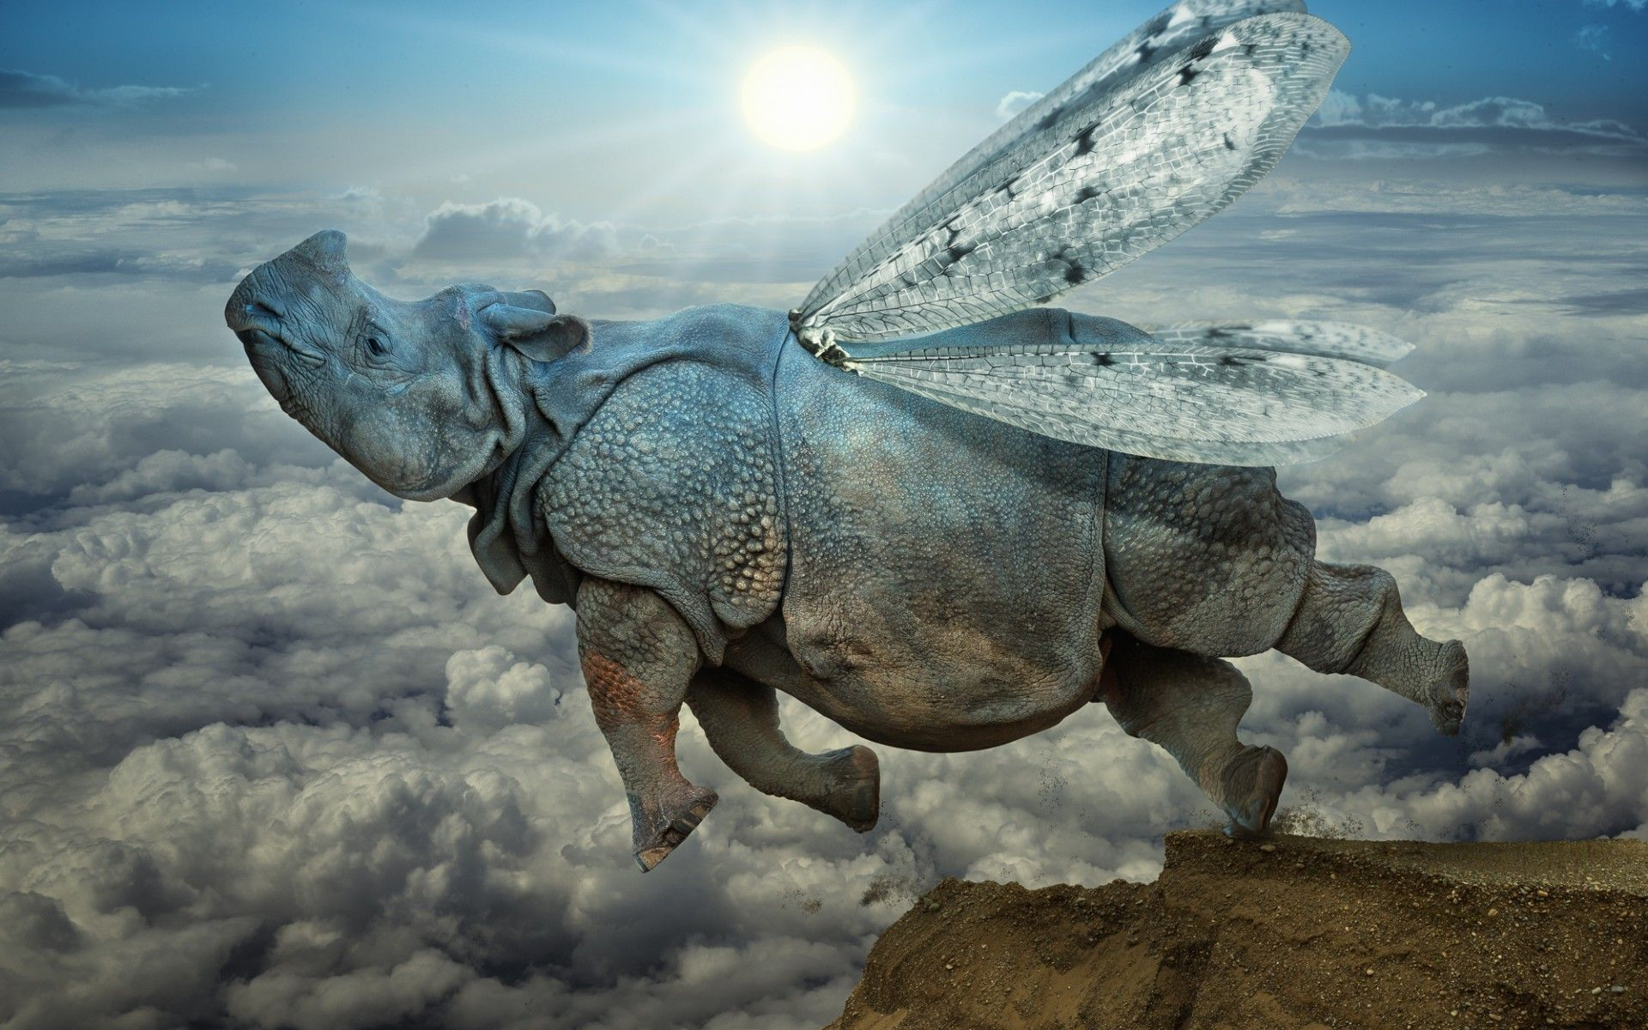
Sideline: Inaccuracy of Human Knowledge
Question: Can birds fly?
Answer: Yes
Question: Are penguins birds?
Answer: Yes
Question: Can penguins fly?
Answer: No

Slide 24
English Language Parser
Classical Recursive Descent Parser
Top-down parsing approach
Could optimize using Earley algorithm
Merriam-Webster as a lexicon
Part of speech tagging
Non-determinism is handled by backtracking
Three ways of handling non-determinism in Computer Science
Backtracking, Parallelism & Probability Theory
Novel Aspect: Parser Never Fails
Always returns a forest of parse trees
Creates unparse trees for sequences on unparsed tokens
Adaptive Parser (machine learning)
Logs parser forest patterns
Learns new grammar productions (rules)
Model-based vs. Model-free AI
Normally this qualifies as a model-based reductionist approach
Unparse trees & the adaptive aspect allow for emerge (model-free)

Slide 25
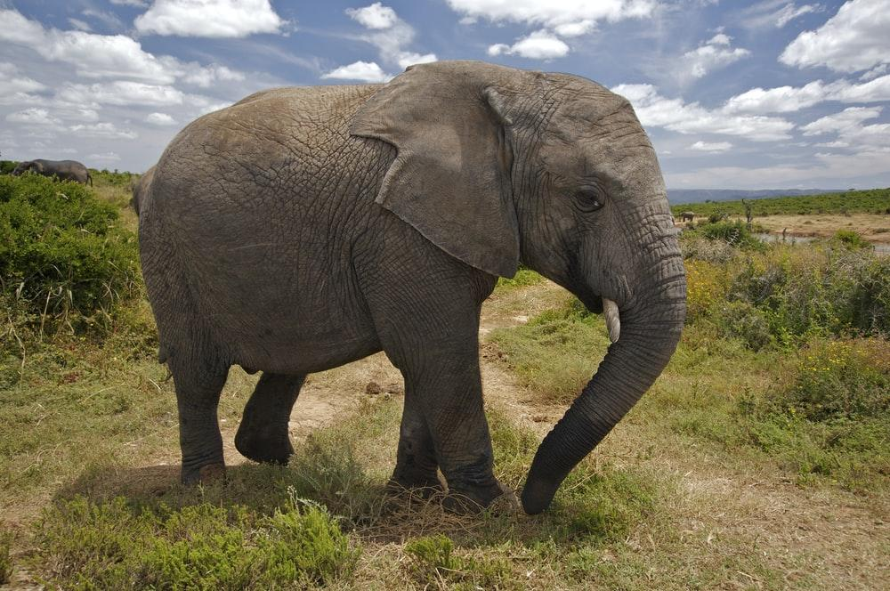

Babar Parser Demo

Slide 26
Clustering
A form Unsupervised Learning
Mostly Model-Free (this is a good thing)
Many Different Clustering Algorithms
K-Means (spheroids)
Hierarchical Agglomerative Clustering (Dendrogram)
Big Data Clustering
Representative element
E.g. CURE
Fail to label the clusters
Labels are important
Babar Uses SR-Clustering

Slide 27
SR Clustering
Simple-Ray Clustering
Proprietary Algorithm
Sort of like non-hierarchical agglomerative clustering
Basic Algorithm
For each data point, place it in the correct cluster
Provably correct by definition
If it doesn’t belong to any cluster, create a new cluster with that single data point
Cluster Membership
Defined as being within a proximity threshold of every data point in that cluster.
Proximity Metric
The Jaccard Index
Norm of the intersection divided by the norm of the union
I.e. Percentage overlap of two sets
Babar uses the outbound links of each Wikipedia topic being compared

Slide 28
Clustering Metrics: Jaccard Index
Compute the Jaccard Index of pairs of topics using the related topics of each topic as the sets to be compared.
 | African | Asian | Indian | Babar | Horton | War
African | 100.00 | 38.46 | 21.05 | 4.35 | 6.82 | 7.94
Asian | 38.46 | 100.00 | 37.74 | 4.00 | 6.25 | 20.00
Indian | 21.05 | 37.74 | 100.00 | 6.90 | 7.14 | 24.39
Babar | 4.35 | 4.00 | 6.90 | 100.00 | 28.57 | 7.14
Horton | 6.82 | 6.25 | 7.14 | 28.57 | 100.00 | 7.41
War | 7.94 | 20.00 | 24.39 | 7.14 | 7.41 | 100.00
NB: The proximity threshold can be determined automatically by maximizing the threshold such that there is no overlap between the individual clusters.

Slide 29
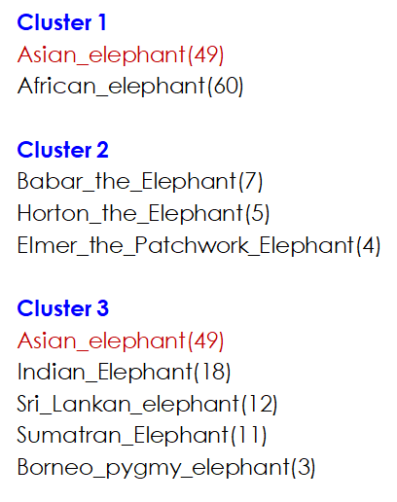
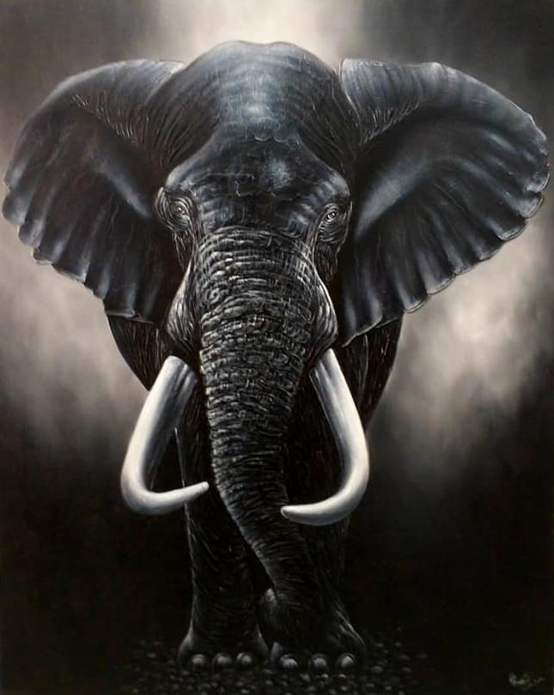
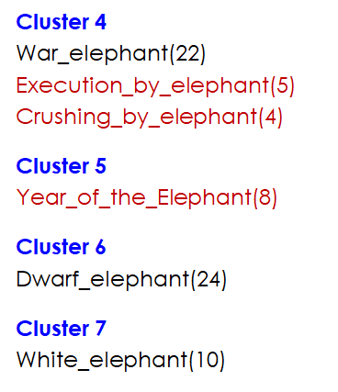
Example Clustering Results for topics containing “elephant”

Slide 30
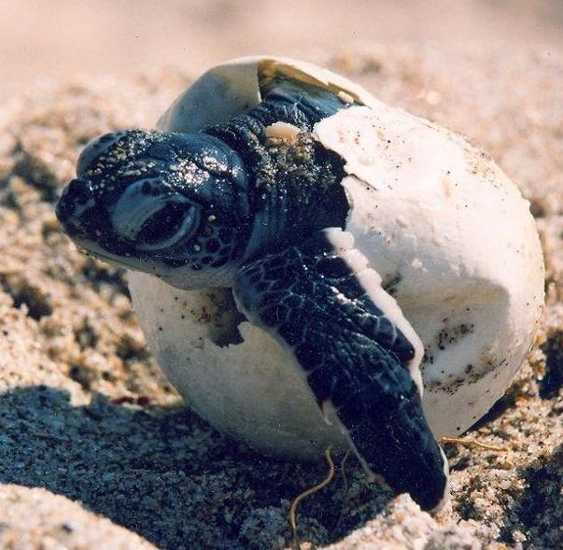
Human Knowledge Acquisition Process
Can be a two decade long process !!!
Kindergarten – Post Doctoral work
Babar: Grade school as knowledge categories.
Science, History, Literature, Art, etc…
Goal: Assign categories to subtopic clusters
Use Jaccard Index to identify the category
Auto-create subtopic category names
E.g. Babar = Literature_Elephant
E.g. Asian Elephant = Science_Elephant

Slide 31
(((( :SCIENCE 0.47666672) (:HISTORY 0.44666672))
(#<Concept(49): Asian_elephant> #<Concept(60): African_elephant>))
((( :SCIENCE 0.39) (:GEOGRAPHY 0.37800002))
(#<Concept(3): Borneo_pygmy_elephant> #<Concept(49): Asian_elephant>
#<Concept(18): Indian_Elephant> #<Concept(12): Sri_Lankan_elephant>
#<Concept(11): Sumatran_Elephant>))
((( :ART 0.33333334) (:GEOGRAPHY 0.30666667))
(#<Concept(7): Babar_the_Elephant> #<Concept(5): Horton_the_Elephant>
#<Concept(4): Elmer_the_Patchwork_Elephant>))
((( :HISTORY 0.6) (:GEOGRAPHY 0.46)
(#<Concept(8): Year_of_the_Elephant>))
((( :GEOGRAPHY 0.72333336) ( :HISTORY 0.43666664))
(#<Concept(5): Execution_by_elephant> #<Concept(22): War_elephant>
#<Concept(4): Crushing_by_elephant>))

Slide 32
Example Clustering for topics not containing “elephant”
(( #<Concept(60): African elephant>
#<Concept(49): Asian_elephant>)
(#<Concept(10): Elephant intelligence>
#<Concept(103): Animal cognition>
#<Concept(4): Elephant tusk>
#<Concept(15): African>
#<Concept(102): Proboscidea>
#<Concept(96): Mammalia>
#<Concept(876): Mammal>>)
((#<Concept22): War_elephant>
#<Concept(5): Execution_by_elephant>
#<Concept(4): Crushing_by_elephant>)
(#<Concept(55): Ivory>
#<Concept(77): Kenya>))
((#<Concept(24): Dwarf elephant>)
(#<Concept(66): Mammoth>
#<Concept(25): Mastodon>
#<Concept(275): Genus>
#<Concept(62): Afrotheria>
#<Concept(86): Gestation>
#<Concept(749): Eutheria>
#<Concept(8): Gomphotherium>
#<Concept(27): Tooth>
#<Concept(8): Tooth_development>))
((#<Concept(7): Babar_the_Elephant>
#<Concept(5): Horton_the_Elephant>
#<Concept(4): Elmer_the_Patchwork_Elephant>
#<Concept(6): List_of_fictional_elephants>
#<Concept(5): List_of_elephants_in_mythology_and_religion>)

Slide 33
Neural AI vs Symbolic AI Classification
Fundamentally encounter similar biases and issues
Classification is a function of the chosen classes
For example a gray image fed into Black or White classifier
Google image classification: An Afro-American vs. a Gorilla
Classes in real life are rarely exclusive
E.g. Rainbows?: Black or White? 🌈
Coverage issues:
E.g. Is it a bird? Is it a plane? No, it’s Batman.
Is a Trip to the Zoo: Art or Science?
Mary likes zoology and asks her father to take her to the Zoo (Science)
John likes drawing animals and asks his mother to take him to the Zoo (Art)
Meta Knowledge (Purpose and Intent)
Why do we need to know whether it is Blacl or White?
What knowledge does it provide?
How important is it?
Is it reasonable to ask the question?
Meta reasoning and introspection

Slide 34
Topic Graphs
Wikipedia as Universal Knowledge
56 Million Wikipedia pages
Comparable to all the books in a library
200GB Zipped (tar)
Topic Graph
Motivation: Access relevant knowledge
Depth three crawl of a Wikipedia topic
By definition a subgraph of Wikipedia
More computationally plausible
Provide a contextual frame of reference
Babar users can create topic graphs
Represent one way of creating labeled data

Slide 35
Clustering Google Search Results

Slide 36
Scalability Issues
Handling 56 million wikipedia topics
How does Wikipedia do it?
Handling billions of edges
How does FB do it?
How does Twitter do it
How does LinkedIn do it?
Handling millions of users
Standard practices?
Cost: Human & Machine?
Partitioned Tables vs. Multiple Tables
What are other options?
Distributed Databases
CAP Theorem
Graph Databases
Neo4j
AllegroGraph
Datomic

Slide 37
Business Issues
Legal Concerns
Copyright violations: Wikipedia & Merriam-Webster
Extracting content in general
Cost Issues
Cloud computing is expensive
Ideally one server per customer
Security Issues
Proprietary customer data
Login Info
Payment Info

Slide 38
References

Slide 39
Appendices
Programmer Ethics
Programmer Responsibility

Slide 40
Programmer Ethics in CLOS
Primary methods do a call-next-method
Ensures complete inheritance
Ensures complete behavior
Around methods conditionally do a call-next-method
Heavy handed by definition
Typically do a call-next-method
Allow deviation in method dispatching (before part)
Allow customization of returned value (after part)
Before and After methods are used for side effects
Logging information
Persisting data in a database
Communication with the user

Slide 41
Programmer Responsibility in CLOS
Do not change existing functionality (no breaking changes)
Inheriting partial attributes is a bad idea
Inheriting partial behavior is a bad idea
Create new classes to extend existing functionality
Guitarist inherits from Person, adds tour dates and a mailing list
Create new classes to add functionality
Department of Airborne Vehicles
Add methods on on existing classes to augment functionality
Teleportation ID & associated methods

