Slide 1
Model Prediction Interpretation with Shapley Additive Explanations ODSC East – May, 2019
Applied Statistics Seminar
Andrew Dodge
Shusaku Asai
10/17/2019
Notes:
Shu 1-6

Slide 2
Agenda
Introduction / Motivation
Shapley Values
Strengths of SHAP
Feature Importance in xgboost
Python example – King County housing
R example – Control Tower

Slide 3
Introduction
Modern machine learning methods often achieve highest prediction accuracy at the cost of low interpretability.
Methods such as LIME and DeepLIFT are known to provide explanations for complex models.
SHAP offers a novel, unified framework to understand why a model makes a certain prediction and its feature importance.

Slide 4
Properties of Strong Feature Importance Measures
So, what makes a good feature attribution method?
Consistency – Feature attribution remains consistent with changes in the model.
If a model is changed such that it relies more on a feature, its importance should not decrease.
Accuracy – The sum of all feature importances should sum to the overall importance of the model.
Allows for comparison of variable importances relative to each other.

Slide 5
Shapley Values & Game Theory
Given a coalitional game of multiple players, shapley values estimate the fairest way to distribute payoff based on each player’s marginal contribution.
What does this have to do with Machine Learning?
The same principle can be applied to estimate the marginal contributions of each feature/variable to model predictions.

Slide 6
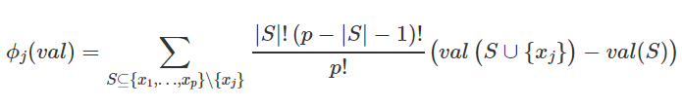

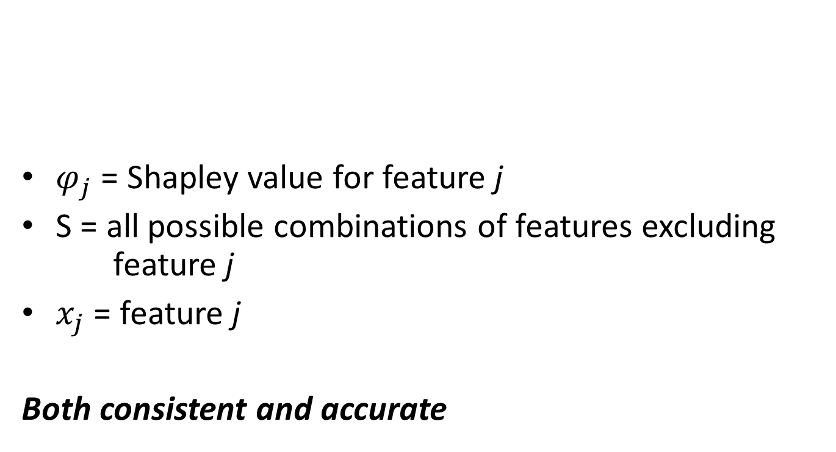
Shapley Value Equation
$φ_{j}$ = Shapley value for feature j
S = all possible combinations of features excluding feature j
$x_{j}$ = feature j
Both consistent and accurate

Slide 7
Shapley Values Explained
Castle building – 3 contributors
Each work in order
What is each person's contribution?
What is each person’s value to the team?
Can be dependent on the order
Average of the marginal contributions across all permutations

Slide 8
Shapley Values and SHAP
Shapley values become computationally expensive as your dataset grows.
SHAP provide estimates of shapley values, allowing for quick computation in practice.
This is achieved by leveraging the hierarchy of tree based models.

Slide 9
SHapley Additive exPlanations
For a single prediction, SHAP provides each model feature an importance value
SHAP strengths:
Measure global importance, uniquely
Measure local importance
Can be used on any tree based model

Slide 10
Gradient Boosting Machine
Tree based ML algorithm, where an ensemble of trees/regression models are fit successively.
‘xgboost’ is a popular GBM tool that can be loaded into R (famous for winning ML competitions)
‘xgb.importance’ provides multiple measures of feature importance, but are difficult to interpret.

Slide 11
Python Example - Background
King County (WA) housing prices
Homes sold between May 2014 – May 2015
21,613 observations by 21 columns
“price” as outcome
Variables such as “bedrooms”, “bathrooms”, “waterfront”, “yr_built”, “sqft_living”.
Split data 80 – 20
Built model with RandomForestRegressor in python

Slide 12

Python Example - Background
King County, WA
Includes the Seattle area, east to the Cascades

Slide 13
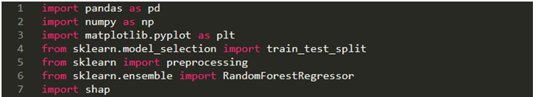
Setup Code

Slide 14
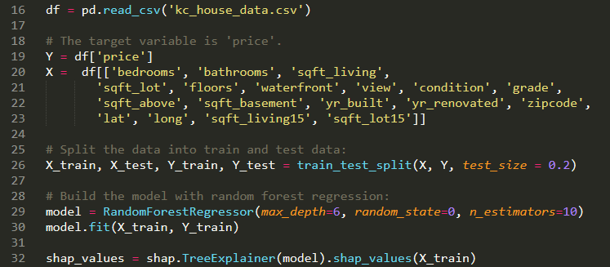
Setup Code

Slide 15
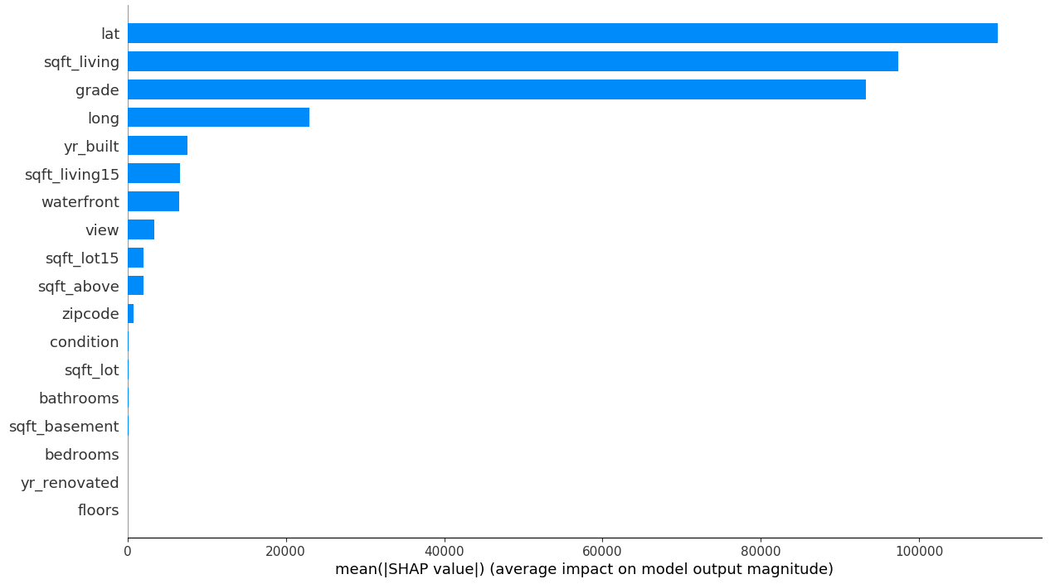
SHAP Summary Plot
Global variable importance

Slide 16
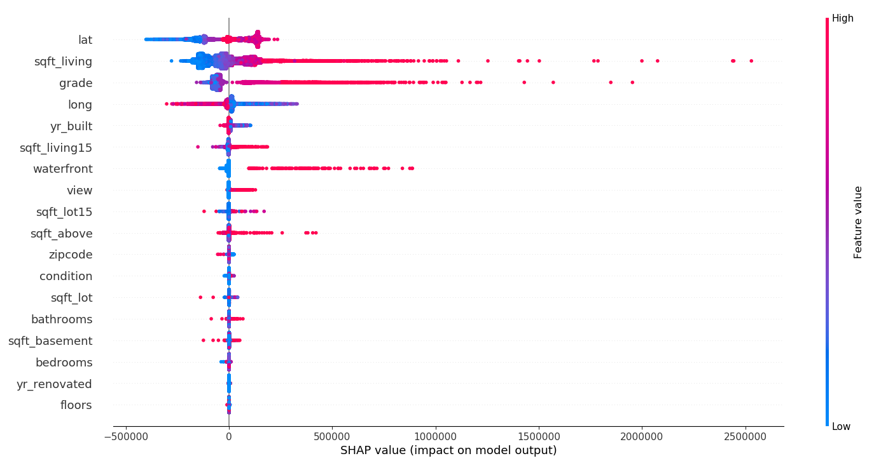
SHAP Summary Plot
Displays feature importance, impact, original value, correlation
Notes:
Each dot is an individual observation
Feature imp = ordered with most important at the top
Impact = horizontal shows if the effect is associated with a lower or higher predicted value
Original val = color shows if variable is high (red) or low) for that observation
Correlation = sqft_living has a high positive correlation with price

Slide 17
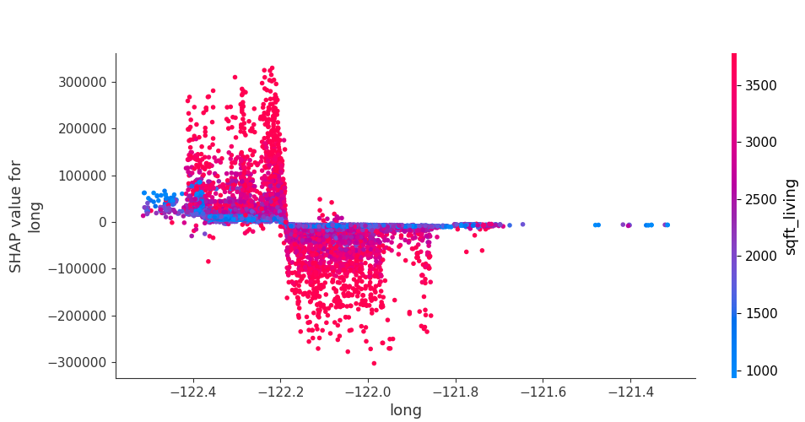
Partial Dependence Plot
Relationship between ‘price’ and ‘long’, as well as the variable it interacts most with
Notes:
Shows the marginal effect one or two features have on the predicted outcome
Shows if relationship is linear, monotonic, or more complex

Slide 18
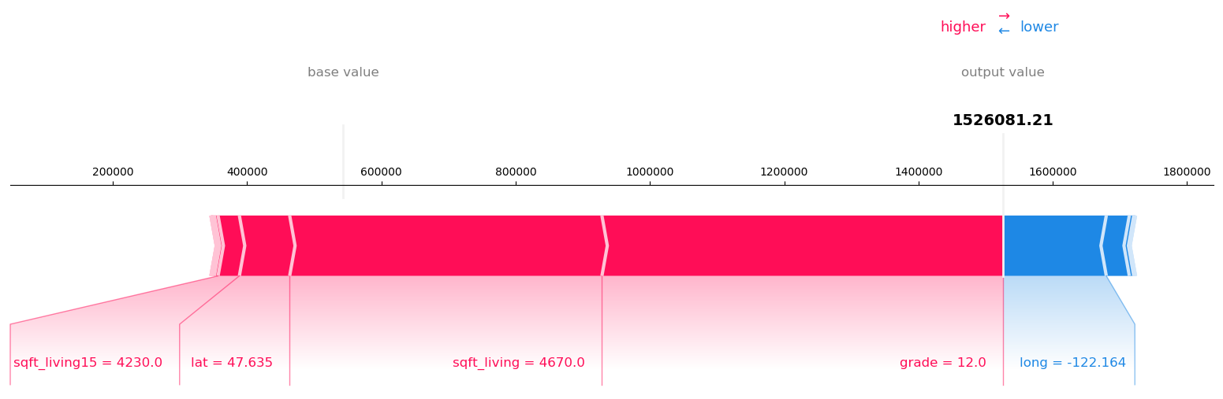
Prediction Plot
Local interpretability
Output value, base value, top predictor impact
Actual value = $1,578,000
Notes:
Output value = prediction ($1.53mil)
Base value = “value that would be predicted if we did not know any features” – mean prediction
Red/blue = show if they pushed the prediction higher or lower
Average actual price of test = $529,242
Average predicted price = $531,789

Slide 19
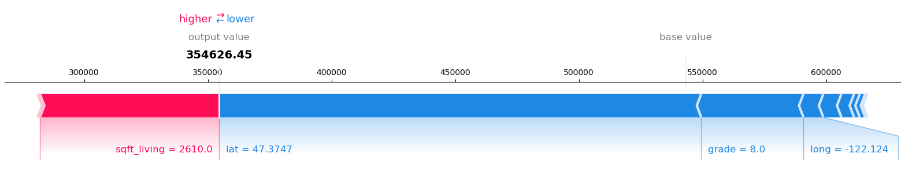
Prediction Plot
Local interpretability
Actual value = $345,000

Slide 20
Example in R - Control Tower
Outcome: Palliative Care Consultation
~150 variables
Demographics, Prior History (inpatient visit history, prior palliative care consultations), existing conditions (~70 HCC categories), laboratory values, nursing unit location
~705,000 rows
~70,000 encounters
~2,400 PC consults (outcome = “pc”)

Slide 21
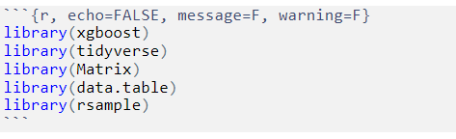
Set up
This example uses R 3.6.1

Slide 22
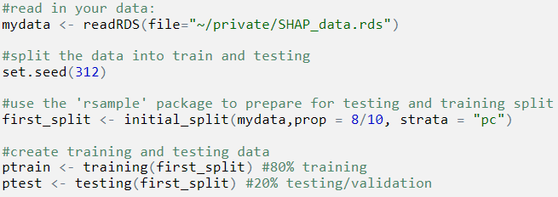
Data Split: Testing and Training

Slide 23
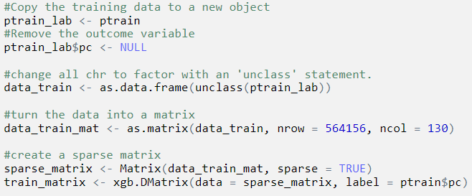
Create a Sparse Matrix

Slide 24

Modeling the Data

Slide 25
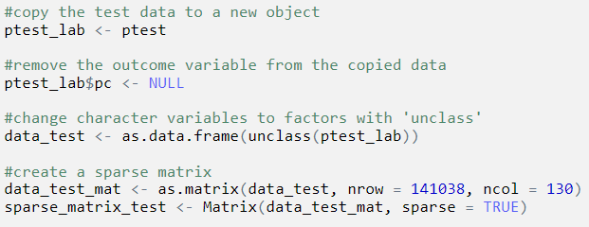
Test Set: Sparse Matrix

Slide 26
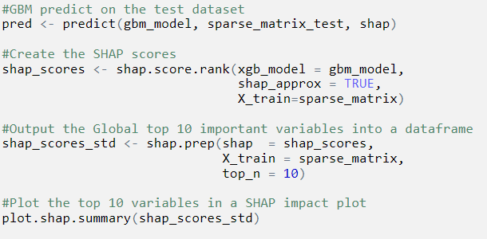
Generate SHAP Scores

Slide 27
References
http://papers.nips.cc/paper/7062-a-unified-approach-to-interpreting-model-predictions.pdf
https://towardsdatascience.com/interpretable-machine-learning-with-xgboost-9ec80d148d27
https://blog.datascienceheroes.com/how-to-interpret-shap-values-in-r/

