Slide 1

We the People
Team 13: Koonj, Jacob, sam, natalia, ayo

Slide 2
What is the issue?
Legislature = Intimidating Process.
A lot of legislature fails.
Individuals are experiencing injustices at a faster rate than ever before.

Slide 3
Relevance
99.5% of perpetrators will walk.
55% of bills died in House committee alone.

Slide 4


Mission Statement
To educate and empower the average individual to make a legislative change in their community.

Slide 5
Inspirations
Duolingo
Video Games
Notes:
With my educational background, I’ve always been curious to learn. In my personal experience of learning a Language, I was inspired and motivated to reach my goal through apps, like Duolingo, which gamified the learning experience. In our web app, We the People, we wanted to make contributions to Rise by keeping people motivated by completing levels towards achieving their goals.

Slide 6


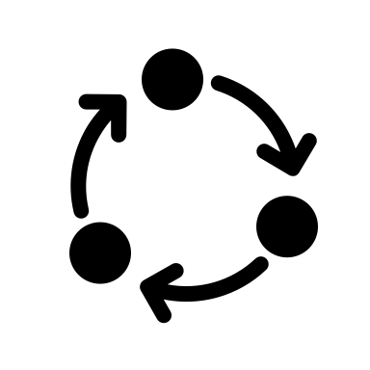
What is our solution?
A comprehensive web application that details the process for changing a law in any U.S. state.
Allows users to create an account.
Application tracks each user’s completion as they move through the road map.
Provides prizes at different checkpoints to users who complete levels.
Allows users to input individual findings for each applicable level to help support an ‘open-source’ ideology.
Individual findings are sent to Rise for vetting before shared on the application.
Provides an interactive roadmap.
Highlights where one is in the process and where they need to go.
Describes a holistic view of the process.
Allows users to directly see how their research fits in with Rise’s vision.
Notes:
In our web app, we created an interactive roadmap that details the process for changing laws in the United States.

Slide 7



Technologies
Mock UI Fabrication Tool
Figma
Web Framework
React
Foundational Programming Language
JavaScript

Slide 8
Challenges Faced
Novelty to React framework
Time crunch < 18 hrs
Ideating a concrete, feasible solution
Constructing database to store user information
Embedding with Typeform

Slide 9
Current and Future Directives
What is provided at this moment?
Full user interface with working logical movements.
Future Development?
Backend to track user accounts.
Administrative portal to validate user information.
Connect users with similar goals.

Slide 10
Demo!

Slide 11
Questions?

