Slide 1
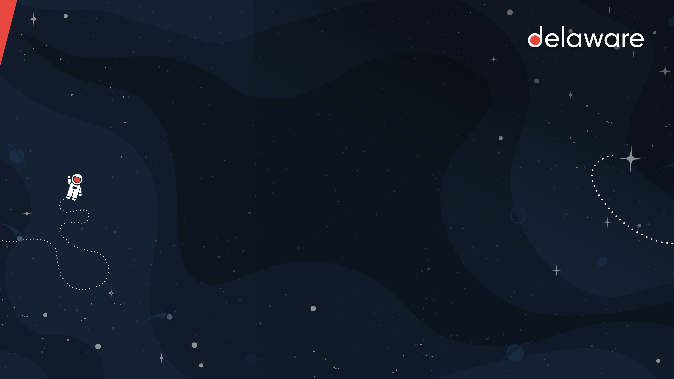
Azure Durable Functions

Slide 2
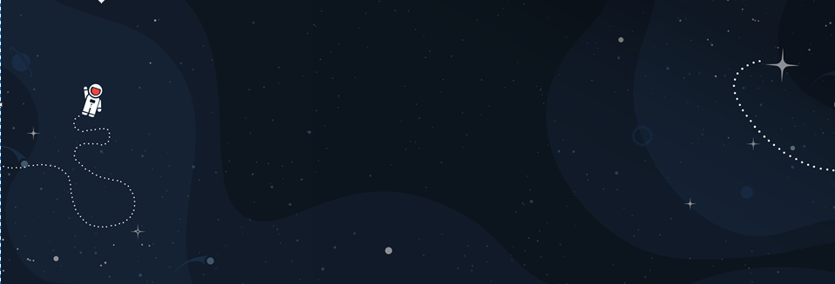
Azure Functions
Serverless

Slide 3
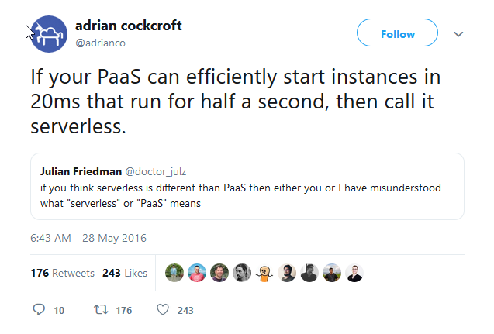

Slide 4
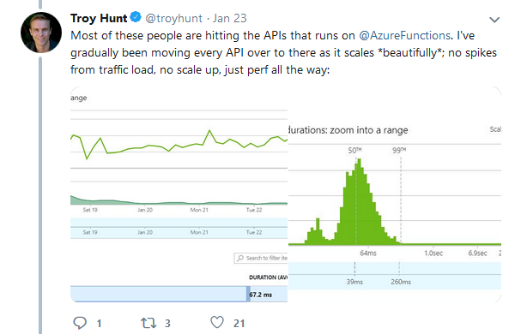
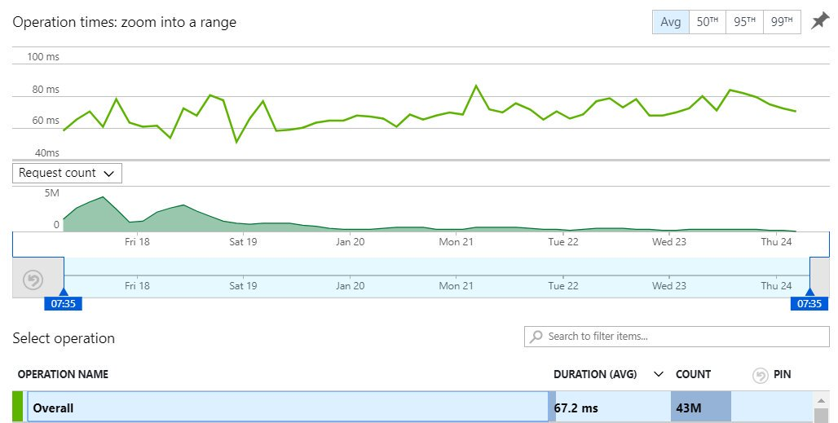

Slide 5
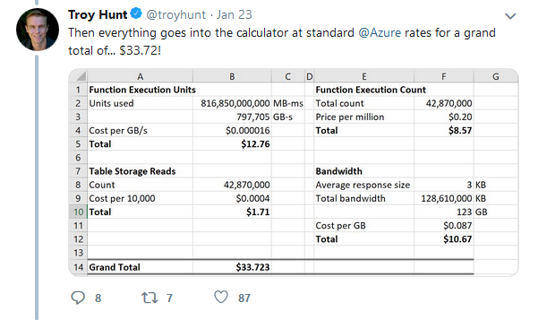
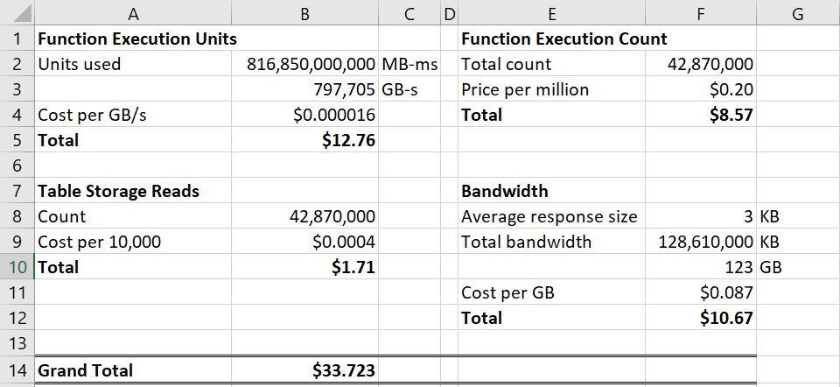

Slide 6
Azure Functions
Basic Functions

Slide 7









Events
Code
Outputs
React to timers, HTTP, or events from your favorite Azure services, with more on the way
Author functions in C#, F#, Node.JS, Java, and more
Send results to an ever-growing collection of services

Slide 8
Triggers
and
Bindings
Type | Trigger | Input | Output
Blob storage | ✔ | ✔ | ✔
Cosmos DB | ✔ | ✔ | ✔
Event Grid | ✔
Event Hubs | ✔ |  | ✔
HTTP & webhooks | ✔ |  | ✔
IoT Hub | ✔ |  | ✔
Excel tables |  | ✔ | ✔
OneDrive files |  | ✔ | ✔
Outlook email |  |  | ✔
Microsoft Graph | ✔ | ✔ | ✔
Auth tokens |  | ✔
Mobile Apps |  | ✔ | ✔
Notification Hubs |  |  | ✔
Queue storage | ✔ |  | ✔
SendGrid |  |  | ✔
Service Bus | ✔ |  | ✔
SignalR |  | ✔ | ✔
Table storage |  | ✔ | ✔
Timer | ✔
Twilio |  |  | ✔

Slide 9
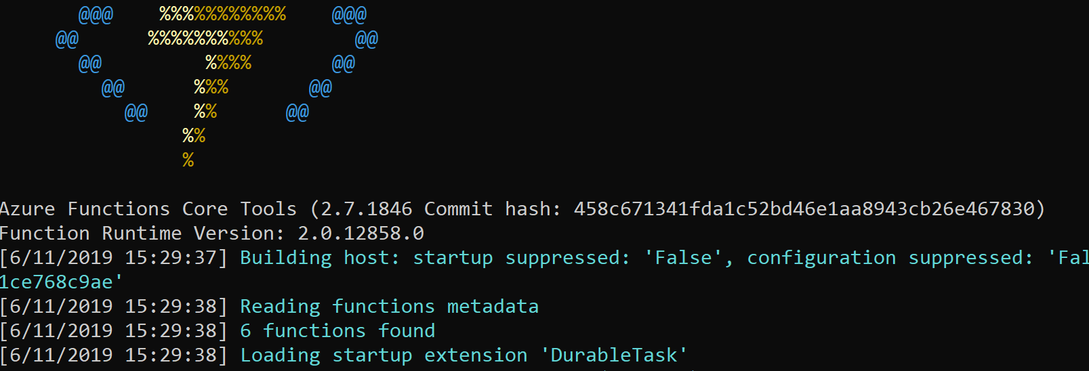
Demo
Basic Function
Notes:
HTTP Trigger

Slide 10
Demo:
HTTP Trigger

Slide 11
Azure Functions
Durable Functions

Slide 12


Slide 14
Functions
Durable Functions
Single Action
Multiple Activities
Fast!
Long Running
Stateless
Stateful

Slide 15
Trigger
Orchestration
Activity
History

Slide 16
Demo
Durable Function

Slide 17
Demo:
Basic Flow
Fan In / Fan Out

Slide 18
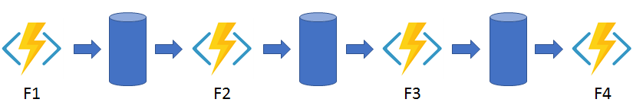
Application Pattern: Function Chaining

Slide 19
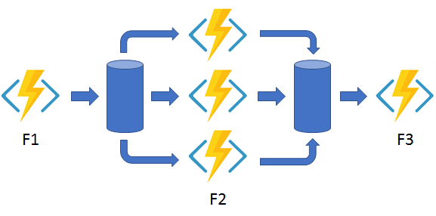
Application Pattern: Fan out / Fan in

Slide 20
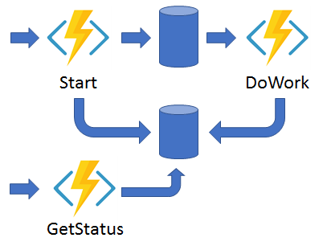
Application Pattern: Async HTTP API’s

Slide 21
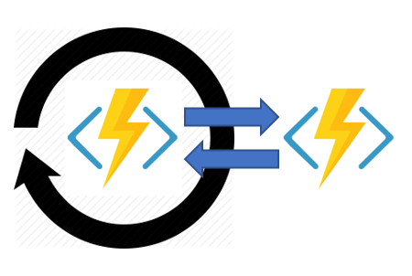
Application Pattern: Monitoring

Slide 22
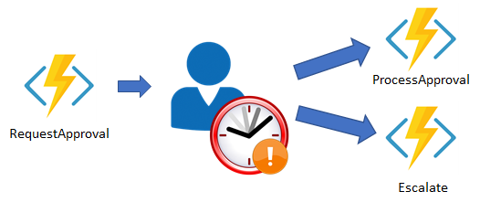
Application Pattern: Human Interaction

Slide 23
Demo
Durable Function
Notes:
Show flowchart in next slide

Slide 24
Start
Status
Available
Unavailable
Timer
Available Event
Unavailable Event
Orchestration
Availability
ScoreBoard Activity
Notes:
Blue = Http Triggers
Red = Orchestrations
Yellow = Events
Green = Activity

Slide 25
Demo:
Flows
Fan out / Fan in
Status
External Event
Highlights
Re-execution of orchestration

Slide 26
Azure Functions
Durable Entities

Slide 27
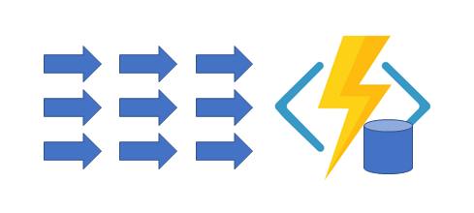
Application Pattern: Durable Entities

Slide 28
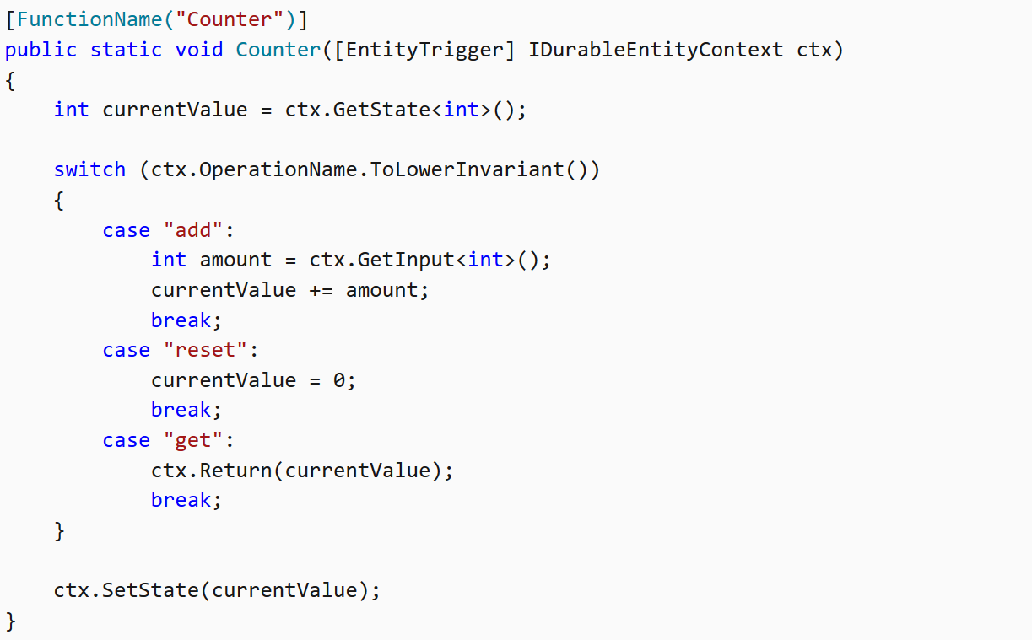
Durable Entities: Function Approach

Slide 29
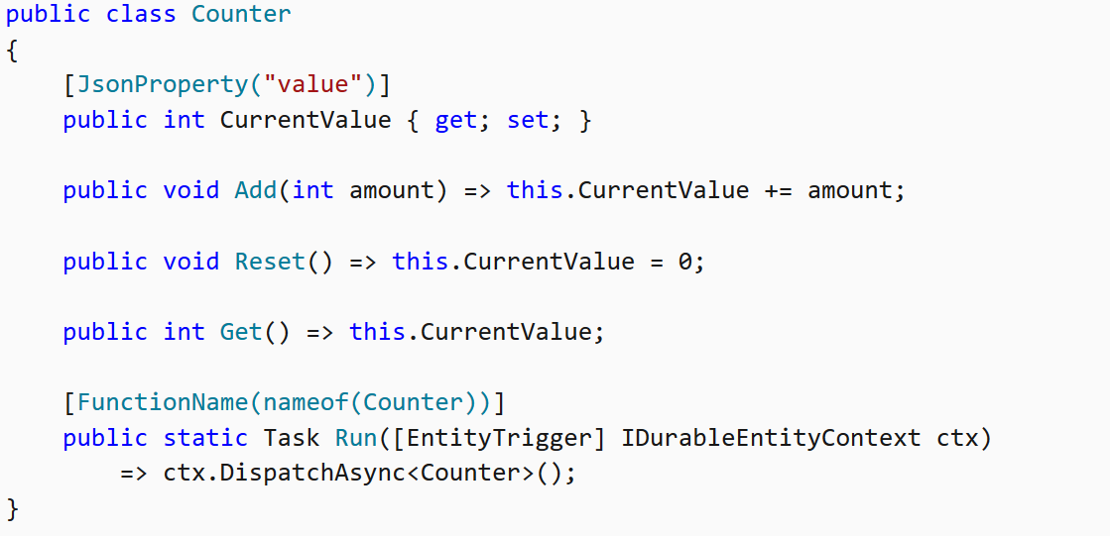
Durable Entities: Class Approach

Slide 30
Demo
Durable Entities

Slide 31
Start
Status
Yea
Nay
Voter Entity
Orchestration
Voting Open Activity
Voting Entity
Vote Accepted Event

Slide 32
Demo:
Flows
Fan out / Fan in
Status
External Event
Highlights
Re-execution of orchestration

Slide 33
Azure Functions
Summary

Slide 34
Remarks
Deterministic
Long Running?
Activity: long running compute
Orchestration: waiting on activities or events
Do not create infinite loops!
Minimize State

Slide 35
Remarks
Versioning
State
Orchestration Flow
Performance
Azure Storage limits apply

Slide 36
Thanks You!

