Slide 1
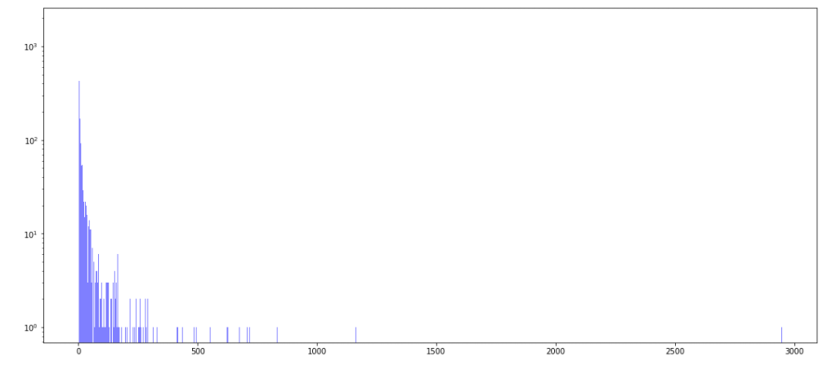
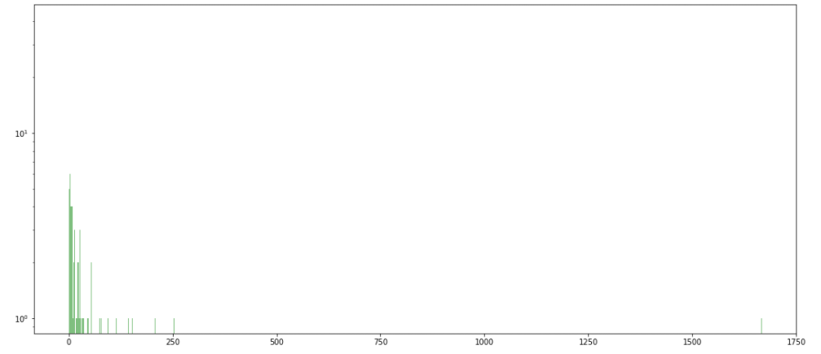
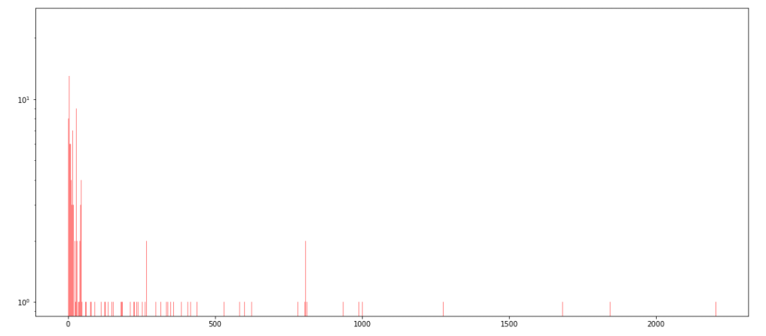
Non-friend interactions
Overall, there are a lot of pairs that interact but aren’t reported friendships with each other.
Most of these pairs have less than 125 interactions.
Histograms of pairs per amount of times in contact
X-axis: the number interactions
Y-axis: frequency, the number of pairs that interacted that much
One-friend interactions
This group has the fewest amount of pairs.
Most of these pairs have less than 60 interactions.
Mutual-friend interactions
The data is tightly clustered between 1 and 40 interactions.

Slide 2
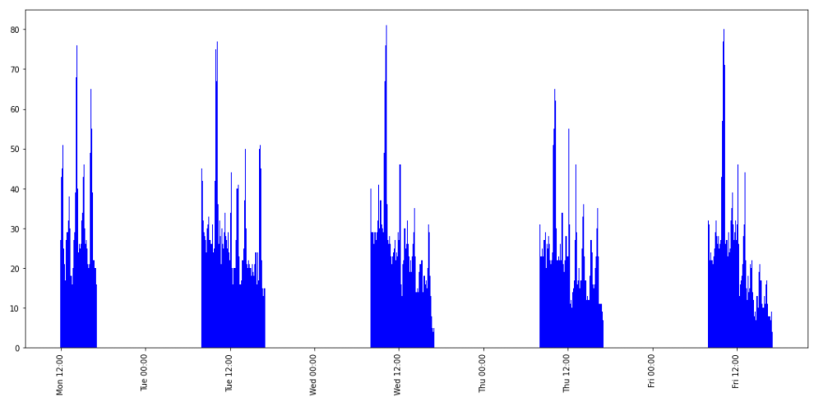
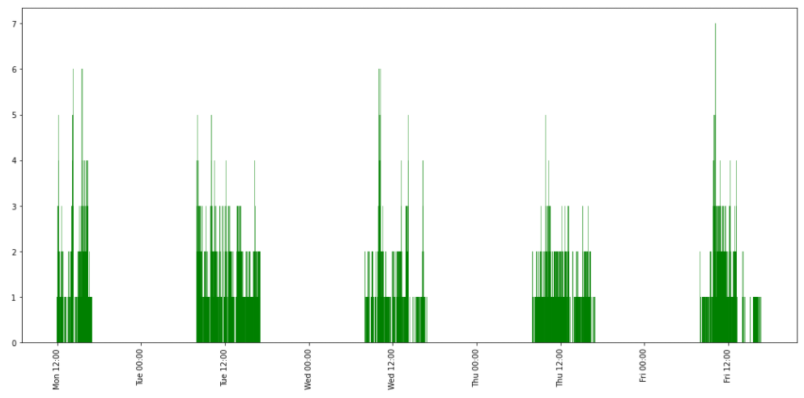
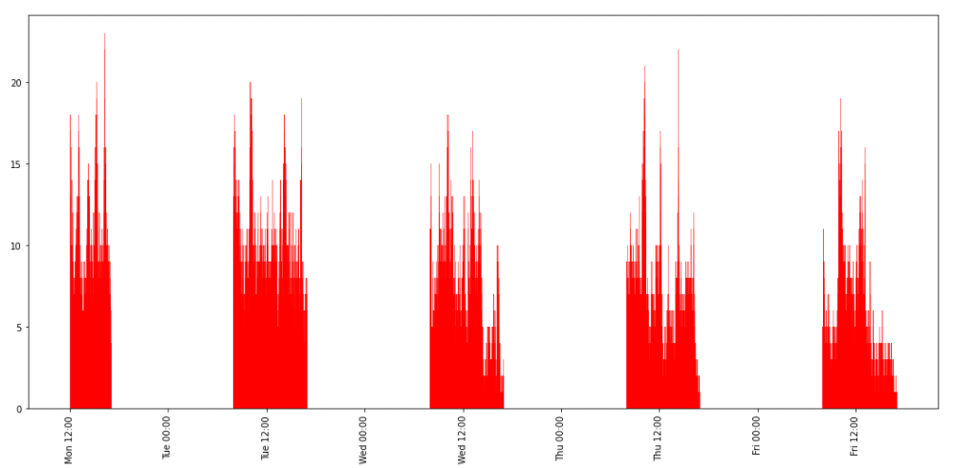
Non-friend interactions
Like the histogram, pairs that aren’t friends still interact the most.
This graph is the one that most closely follows the total interaction vs time graph.
Graphs of interactions over time
X-axis: timestamp
Y-axis: the number of pairs that interacted for that timestamp
One-friend interactions
The spike at break time can be seen in most of the days.
Overall, there isn’t much data to go off of.
Mutual-friend interactions
The spike during break time isn’t as noticeable as on the non-friend graph.

Slide 3
Are there some pairs listed as friendships but do not ever interact?

