Slide 1
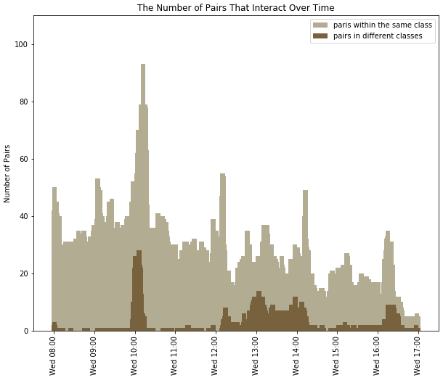
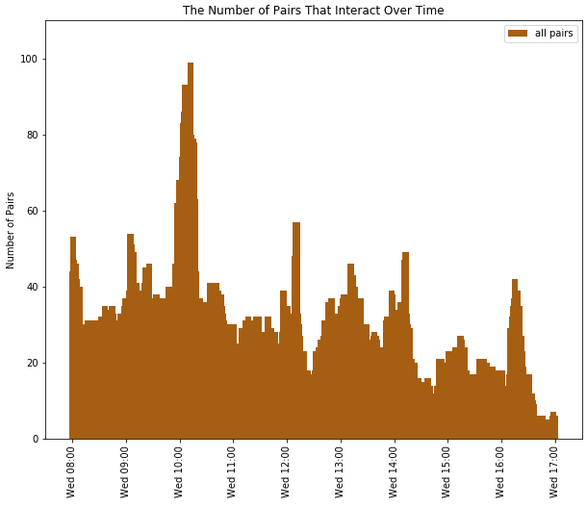
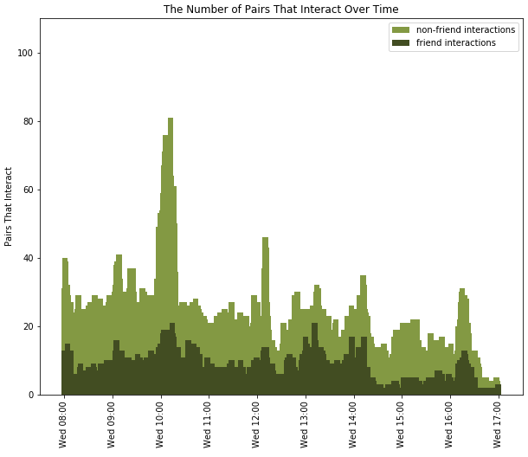
Deducing School Schedules based on Daily Contact Frequency
Conclusion
Based on results from this investigation, it is evident that the schedules of students are closely correlated to with whom and when they interact. Some possible areas of study for future investigations include factoring in the gender of the students and their known Facebook friendship statuses.
By Delaynie McMillan
Decline in interactions at the end of the day
Introduction
The goal of this investigation was to examine frequency of interaction between students, and how it is affected by friendships and classes.
30-minute long break time at 10AM
Most of the people that students interact with are not listed as friends
Method
This data was collected in 2013 using sensors in badges that the students wore throughout the day.
Mapped interaction frequency throughout the day
Filtered data through other statistics:
Friendship status
Class
Class time in the morning, few outside-class interactions
Sources: SocioPatterns high school and contact friendship networks and Contact Patterns in a High School: A Comparison between Data Collected Using Wearable Sensors, Contact Diaries and Friendship Surveys

