Slide 1
Applied Data Science_Capstone: Battle of Neighborhoods
Applied Data Science Capstone Project
January 18, 2020

Slide 2
Goal of Study
The goal of this study is to help a group of investors (Food 4 Soul Investors Club) who are looking to open a restaurant in Toronto to use income and population data about each neighborhood to inform their decision. This is a data-driven decision by a group of business speculators will help them identify the best location for the restaurant.

Slide 3
DatA
Sources Employed:
Toronto’s 2016 Census Data (i.e., population, average income per neighborhood)
Toronto’s Open Data Catalogue (neighborhood profiles, 2016, csv file)
City Government Shapefile for Toronto Neighborhoods
Foursquare (to identify potential restaurant locations and restaurants in region)
ArcGis.com Toronto Population Density Map

Slide 4
Exploratory Data analysis (Methodology)
Used Lat./Long. Information to generate maps (Toronto, locations, etc.) to help identify points of interest, key sites
Foursquare data was used to show restaurants in the area and Toronto's 2016 Census data was employed to identify neighborhoods with differential incomes.
Examined postal Toronto’s postal codes by neighborhood

Slide 5
Methodology
Generated a Folium map of Toronto to produce a visual of potential restaurant locations
Used Toronto's Population Density Choropleth map to compare neighborhoods
Foursquare data was used to show restaurants in the area
Employed Toronto's 2016 Census data to identify neighborhoods with differential incomes
Examined postal codes by neighborhood

Slide 6
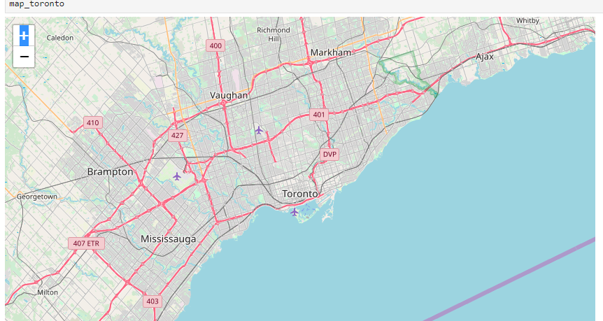
Map of Toronto

Slide 7
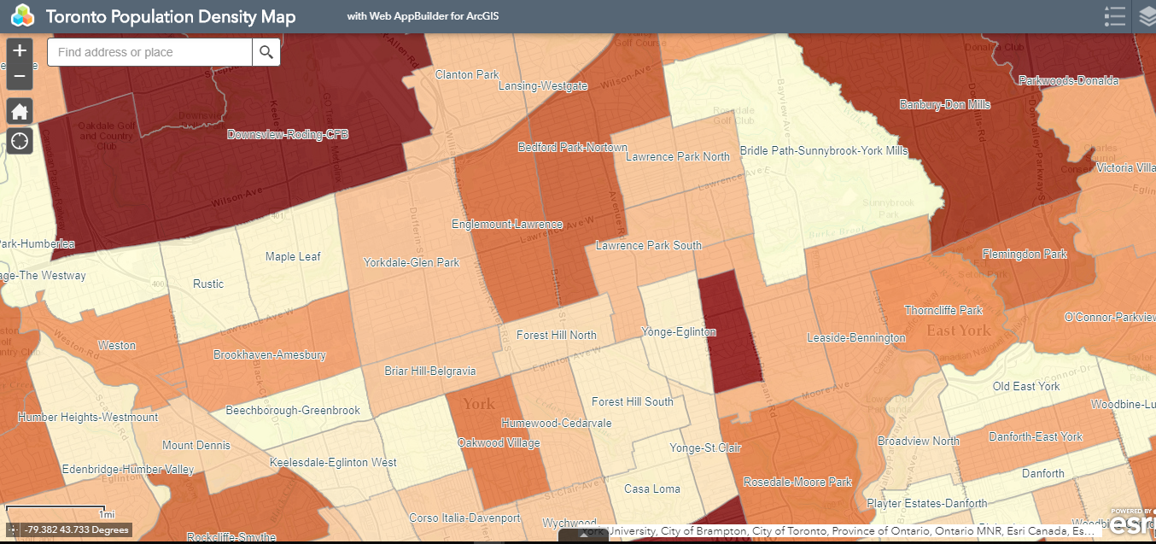
ARCGIS.com Toronto Population Density Map (Choropleth map)

Slide 8
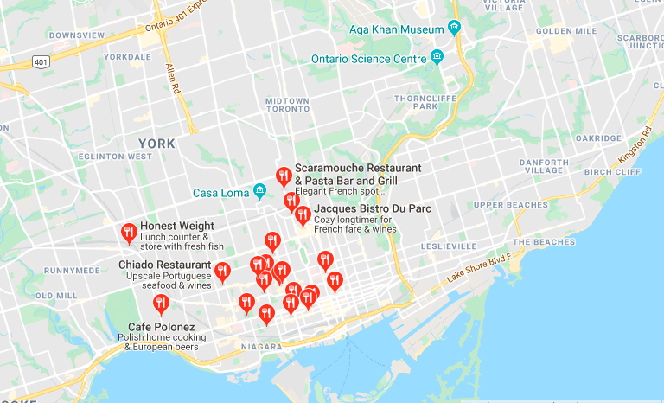
Toronto Restaurant Competitors

Slide 9
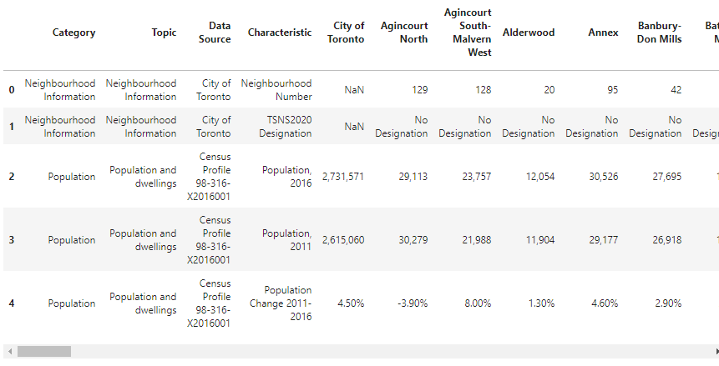
2016 Census Data

Slide 10
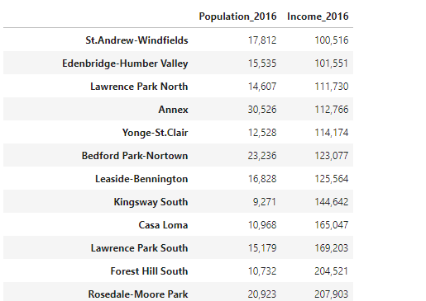
Population vs. Income

Slide 11
Results
The most densely populated areas did not prove to be a reliable source for speculation for a restaurant for the Food 4 Soul Investors Club. As expected, most of the competitor restaurants were concentrated in the downtown area of Toronto in streets frequently accessed by city dwellers (e.g., main and central streets). The more high-income neighborhoods had more competitor restaurants than the more densely populated areas.
Places of interest for the Food 4 Soul Investors Club to consider to share customers for the restaurant included lodging / hotels, banks, coffee shops, shopping centers, landmarks such as museums, government buildings, etc.

Slide 12
Discussion
This report proved to be helpful for the Food 4 Soul Investors Club as they speculated on potential areas in Toronto for opening up a restaurant. The club was provided with differential data about neighborhood income, population comparisons by neighborhood, restaurant competitor data, and postal code by neighborhood. We cannot conclude that all factors are considered n this report for making an investment decision, yet it is a start for the Food 4 Soul Investors Club.

Slide 13
conclusion
In this capstone project, I learned that data analysis can be detailed, exhaustive, and on-going for the investigator. It is important to maintain fluid and open communication with the group who seeks the data to make a key business decision (i.e., Food 4 Soul Investors Club). Sometime, there can be assumptions that are confirmed or disprove. For instance, I expected to find more densely populated areas with better restaurant competitors, but this was not the case in my analyis.
I also learned more about how to generate maps using different sources (python, arcgis.com, Foursquare). There is so much more for me to learn!

