Slide 1
What Causes Student Stress?
Tyler deLellis & Ruiming Zeng
Data Science • 12/3/25

Slide 2
Background on Student Stress
- Student stress affects academic performance and well-being
- High stress levels are linked to anxiety, burnout, and poor grades
-60 percent of students report being stressed everyday
-1 in 5 college students are stressed all or most of the time
- Identifying major stressors helps improve support systems
- Goal: Determine which factors contribute most to student stress

Slide 3
Dataset Overview
Dataset: Student Stress Monitoring Dataset (Kaggle)
- 20+ stress-related features
-843 college students filled out the survey
Categories:
• Psychological (anxiety, depression, self esteem)
• Physiological (headaches, blood pressure, sleep quality)
• Environmental (living conditions, safety, basic needs)
• Academic (study load, academic performance, career concerns)
• Social (peer pressure, social support, extracurricular activities)

Slide 4
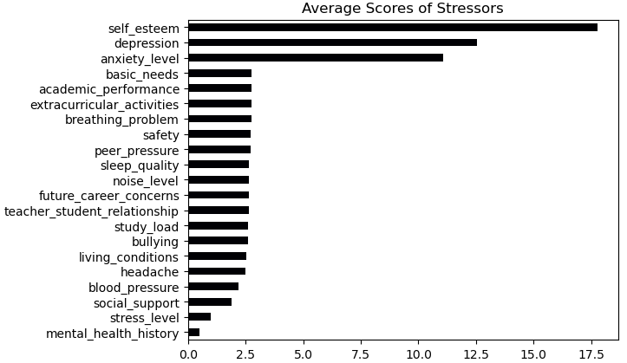
Results – Average Stress Scores
Key Insights:
- Self-esteem shows highest average stress
- Depression and anxiety follow closely

Slide 5
Top Stressors in Each Category
Psychological:
Self-esteem had the highest stress score overall, making it the strongest psychological stressor.
Physiological:
Breathing problems were the most significant physical stress factor.
Environmental:
Basic needs (food security, housing, safety) ranked as the top environmental stressor.
Academic:
Academic performance was the highest academic stressor, showing strong pressure related to grades.
Social:
Extracurricular activities produced the highest stress score in the social category.

Slide 6
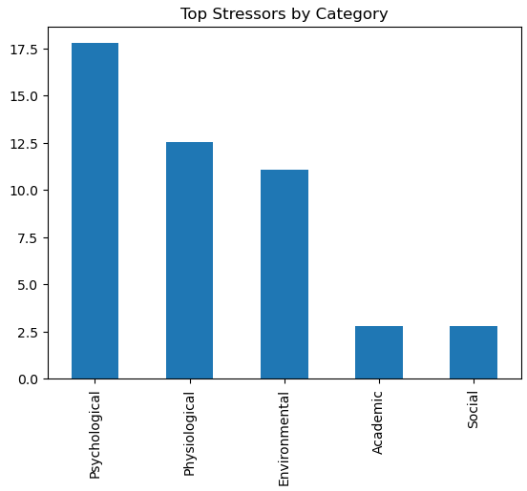

Slide 7
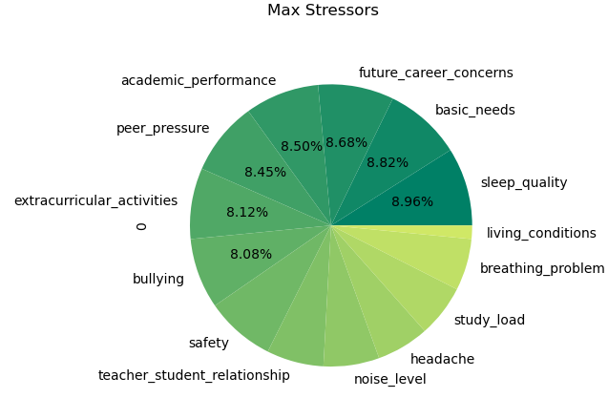
Results – Max Stress Level (5)
- Sleep quality has the most maximum-stress votes
- Basic needs and career concerns also rate high

Slide 8
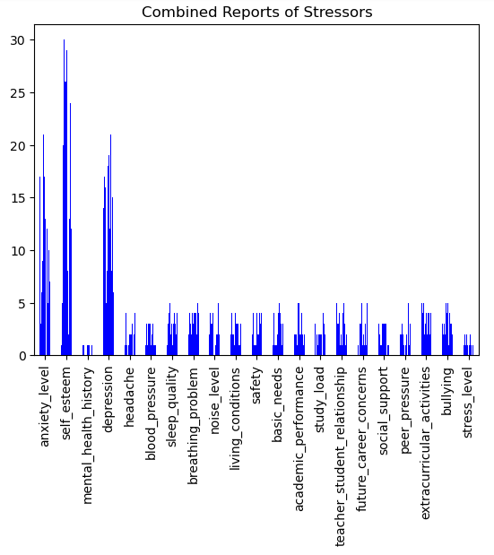
Combined Top Stressors
Overall Top Stressors:
1. Self-esteem
2. Depression
3. Anxiety level
4. Sleep quality
5. Future career concerns

Slide 9
Conclusion
- Psychological and academic stressors are the strongest overall
- Sleep quality and basic needs significantly affect severe stress
- Findings highlight a need for better mental health and academic support
- Future work: demographic analysis or predictive modeling

