Slide 1

People Analytics Project
Training Budget
Effectiveness Analysis
Tracing $1.68M of training spend and testing whether the 80% effectiveness target is reachable
Bellwood Networks, Inc. | Deleonard Simanjorang | 2026
Notes:
Bellwood Networks spent $1.68M on training last year. Only half of it produced a completed course. This deck traces where the money went and tests whether management's 80% target can actually be reached.

Slide 2
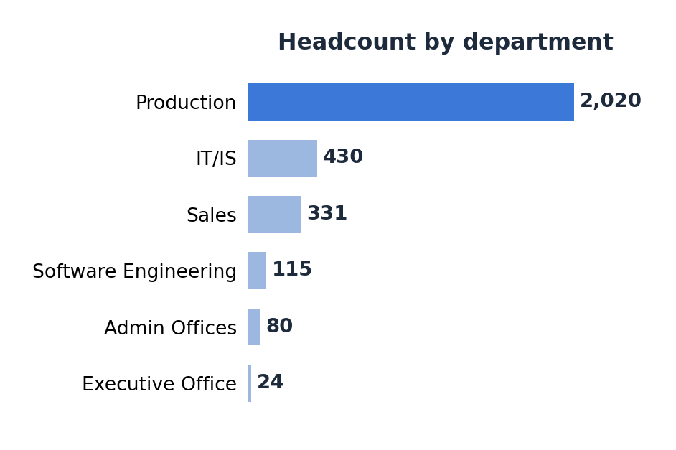
Our Company !
Who Are We?
Bellwood Networks is a telecommunications infrastructure contractor headquartered in Massachusetts, building and maintaining fiber, cable and wireless networks — aerial and underground construction, splicing, CATV and wireless site work — for carrier and municipal clients.
Why Training Matters Here
3,000 employees, two-thirds of them in field production roles.
Crews work on live utility infrastructure, so certification currency decides whether a crew can legally be dispatched. An incomplete course is not a missed development opportunity — it is a crew member who cannot be deployed.
Source: employee master, 3,000 records

Slide 3
Executive Summary
The problem
What we found first
Bellwood spent $1,675,886 on 3,000 training sessions in FY22–23. Only 50.6% produced a completed course. Management targets 80% within 6 months.
43.9% of all training records ($735,145) carry dates that are impossible against the employee's own employment period.
The real number
What does not explain it
Only $492,343 — 29.4% of the budget — is fully defensible: plausibly recorded and completed.
Five of six tested drivers show no effect. Cost, duration, tenure, department and delivery type are all unrelated to completion.
The target is unreachable
What we recommend
Every available lever combined moves effectiveness from 50.6% to 53.4% — closing 3 of the 29.4 points required.
Six actions addressing $768,304 (45.8%) of the budget, a replacement KPI set, and a staged target to replace the 80% figure.

Slide 4
We cannot account for $735,145
Why training budget governance is a financial priority
Of the $1,675,886 spent on training last year, 43.9% sits on records whose dates cannot be true — sessions booked for employees who had already left, or who had not yet been hired.
$1.68M
50.6%
$735,145
29.4%
Total training budget
FY Aug 2022 – Aug 2023
Budget effectiveness
$847,484 completed
On impossible records
1,317 of 3,000 sessions
Fully defensible spend
only $492,343
Budget segment | Amount | Share
Plausibly recorded and completed | $492,343 | 29.4%
Plausibly recorded, not completed | $448,398 | 26.8%
Impossible date, recorded as completed | $355,140 | 21.2%
Impossible date, not completed | $380,004 | 22.7%
Two explanations, both serious
If the money genuinely left the company, this is real leakage. If it is a recording error, then the $1.68M reported to the board is wrong and every L&D report must be restated.
All figures derived from 3,000 training records joined to the employee master. See Appendix B for source queries.

Slide 5
People Analytics Project
Analysis
Objectives
Bellwood Networks, Inc. | Deleonard Simanjorang | 2026

Slide 6
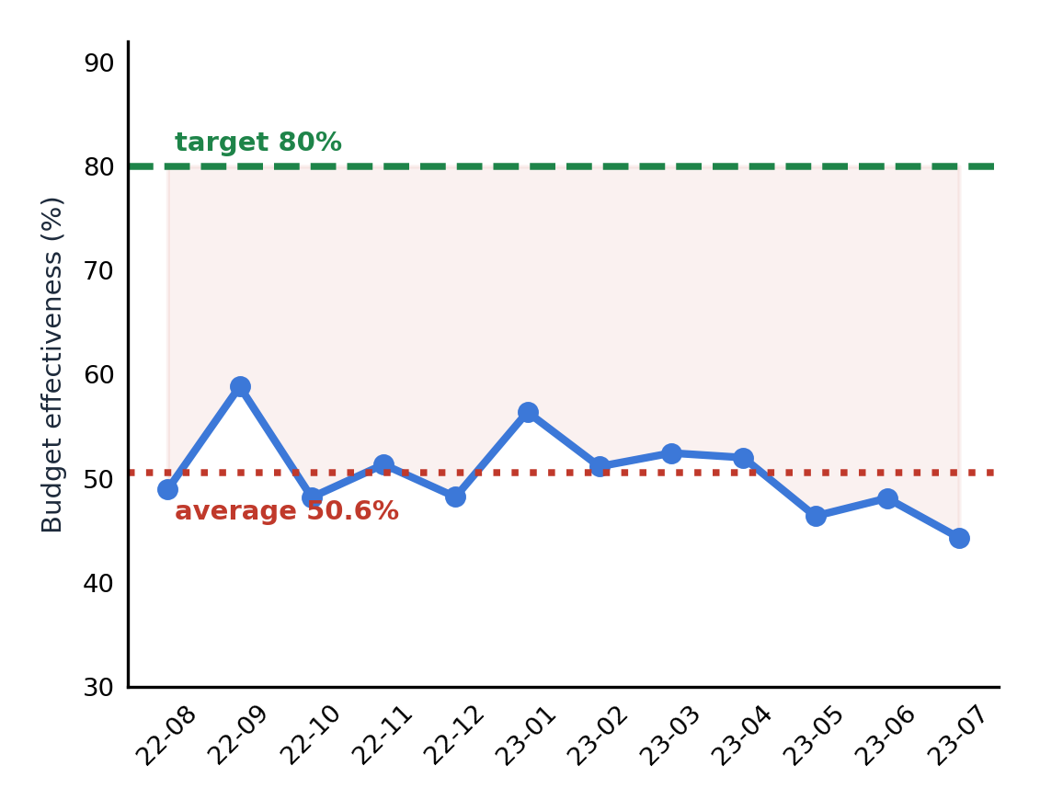
What's driving this? — Project Background
The situation
Budget effectiveness has sat between 44.3% and 58.9% for twelve straight months. The downward drift is not statistically significant (p = 0.087) — this is a stable state, not a decline.
Why that matters
There is no incident, vendor change or quarter to point at. A problem that has been steady for a year cannot be fixed by a one-off remediation — it points to a missing control.
Monthly budget effectiveness, Aug 2022 – Jul 2023

Slide 7
Project Goals
Problem Statement
SMART Objective
Bellwood spent $1,675,886 on training with only 50.6% effectiveness. No one can explain where the money goes or which levers would move the number, and next year's budget is due for approval.
Identify where the training budget is lost and determine which levers can raise effectiveness from 50.6% toward the 80% target within 6 months, measured through a Power BI monitoring dashboard.
In Scope
Out of Scope
3,000 training records (Aug 2022 – Aug 2023) joined to the employee master for status and date validation.
Drivers tested: programme, delivery type, tenure, duration, cost, department.
Training ROI against job performance — the system records cost and completion only, with no before/after measurement.
Tools used: PostgreSQL (extraction), Python (preparation, statistical testing), Power BI (monitoring).

Slide 8
Methodology
Data analytics project lifecycle — from business problem to business impact
01
Define
02
Data Discovery
03
Data Preparation
Business problem, SMART objective, stakeholders
Identify datasets, map sources, validate reliability
Extract, clean, standardise, engineer features
Tools: —
Tools: Python
Tools: SQL · Python
04
Analysis
05
Communication
06
Action
EDA, anomaly detection, hypothesis testing
Visualisation, storytelling, dashboard
Recommendations, KPI tracking, business impact
Tools: Python · SQL
Tools: Power BI
Tools: —

Slide 9
People Analytics Project
Deep Dive
Analysis
Bellwood Networks, Inc. | Deleonard Simanjorang | 2026

Slide 10
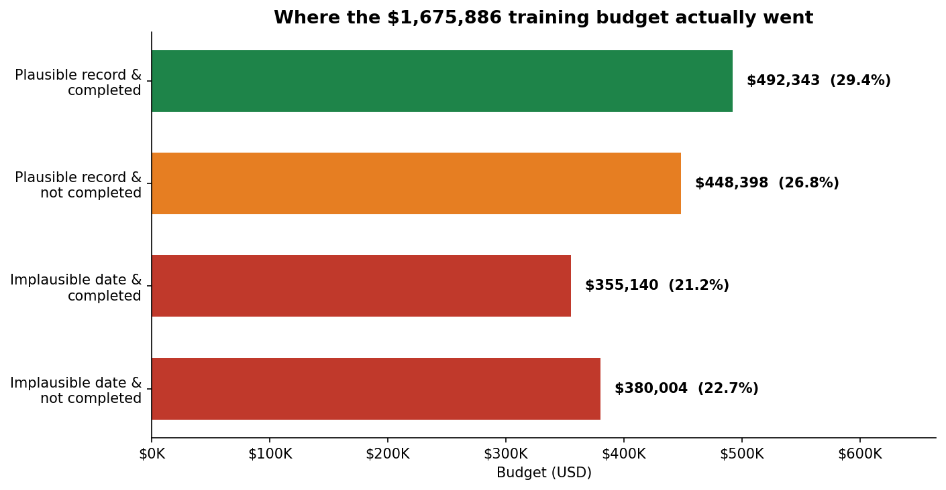
What does data tell us? — Where the budget went
Key Finding
Only $492,343 (29.4%) of the $1.68M budget is fully defensible — plausibly recorded and completed. The remaining 70.6% fails at least one of the two tests.
Insight
The headline effectiveness rate of 50.6% overstates what can actually be justified, because it only tests completion. Cross-tabulating completion against record integrity halves the defensible figure.

Slide 11
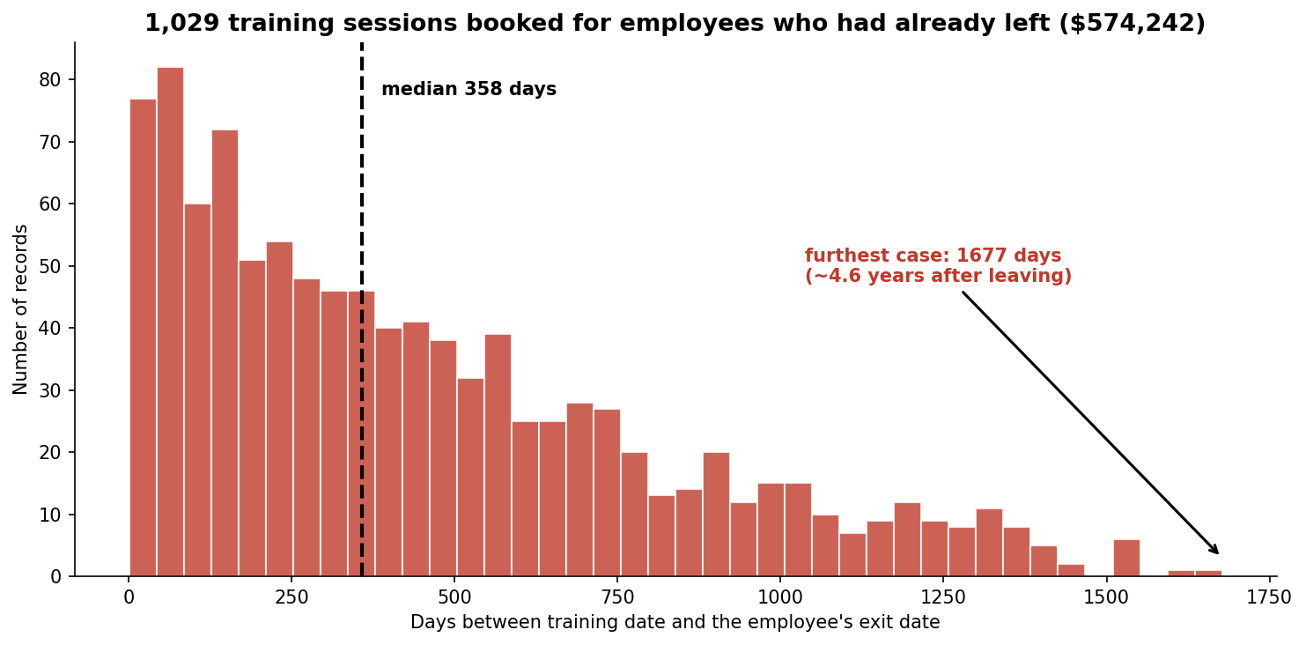
What does data tell us? — Record integrity
Key Finding
1,029 sessions ($574,242) are dated after the employee's exit — a median of 358 days after, with the furthest case 1,677 days (4.6 years). A further 288 sessions predate the employee's hire date.
Insight
The enrolment system never checks employment status. One employee who left in November 2018 is recorded as attending a course in July 2023 and passing it.

Slide 12
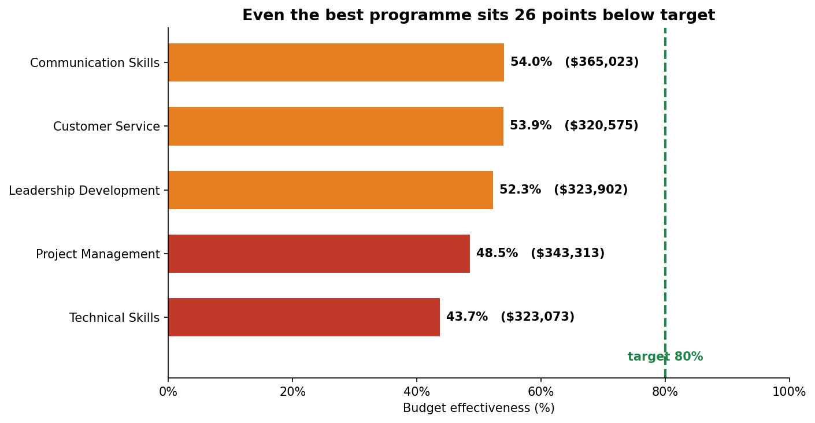
What does data tell us? — Programme performance
Key Finding
Technical Skills is the weakest programme at 43.7% while absorbing $323,073. The best performer, Communication Skills, reaches only 54.0%. The whole portfolio spans just 10 points.
Insight
Programme choice is statistically significant (p = 0.002) but the effect is weak (Cramér's V = 0.075). Even the best programme sits 26 points below target — no reshuffle of the portfolio reaches 80%.

Slide 13
What does data tell us? — Drivers tested
Five of six candidate drivers show no relationship with completion
Hypothesis | p-value | Effect size | Verdict
Programme drives completion | 0.002 | V = 0.075 | Supported
Budget leaks to departing employees | 0.008 | $857,430 | Supported
External training is less effective | 0.101 | V = 0.030 | Rejected
Shorter tenure lowers completion | 0.123 | r = −0.027 | Rejected
Longer courses are less completed | 0.445 | r = 0.014 | Rejected
Costlier training is more completed | 0.480 | r = 0.011 | Rejected
What this rules out
Expensive training is not completed more often than cheap training. Five-day courses fare no worse than one-day courses. New hires complete at the same rate as veterans.
What it means
Every intuitive explanation was tested and failed. The failure is systemic, not confined to any programme, vendor or employee group.
Chi-square for categorical drivers, Mann-Whitney U for numeric. Full census, n = 3,000.

Slide 14
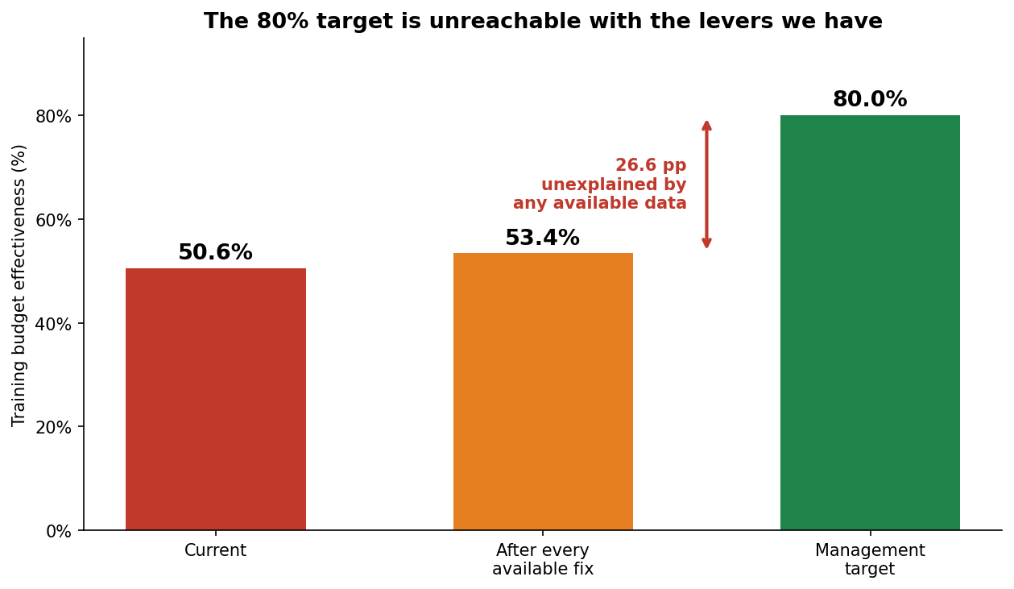
Can we actually reach 80%?
Sizing every available lever against the 29.4-point gap
Lever | Reaches | Gap closed
Baseline today | 50.6% | —
Shift all sessions to best programme | 54.0% | +3.5 pp
Stop all 1,317 invalid-date sessions | 52.3% | +1.8 pp
Both levers combined | 53.4% | +2.8 pp
Remaining gap to 80% | — | 26.6 pp
The honest conclusion
26.6 of the 29.4 points cannot be explained by any variable the L&D system captures. The residual lies in factors never recorded: instructor quality, course relevance, and participant workload.

Slide 15
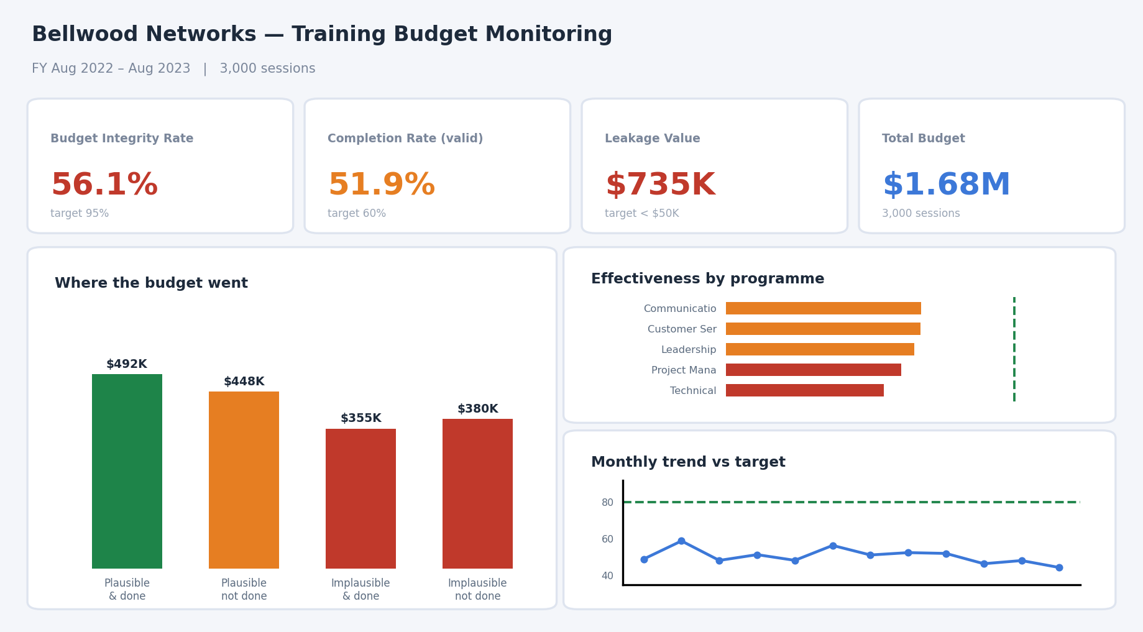
How do we track progress?
Training budget monitoring dashboard — Power BI
KPI Cards
Budget Integrity Rate, Completion Rate and Leakage Value, each against its 6-month target
Budget Flow
Four-way split by record integrity and completion, surfacing the $492,343 defensible core
Programme View
Effectiveness and spend per programme against the 80% reference line
Trend Line
Monthly effectiveness with target and average reference lines
Dashboard goal: make the leakage visible instead of letting a single effectiveness percentage conceal it. | Design mockup — Power BI build in progress.

Slide 16
People Analytics Project
Insight &
Recommendations
Bellwood Networks, Inc. | Deleonard Simanjorang | 2026

Slide 17
Recommendation 1 — Enrolment Control
Key Finding
1,029 sessions ($574,242) recorded for employees who had already left, and 288 sessions ($160,903) for employees not yet hired. The enrolment system never checks employment status.
Why This Happens
Recommendation
• No validation rule linking training date to the employment period
• Enrolment and HRIS run as separate systems with no status handshake
• Completion can be recorded by a third party without the employee
1. Hard validation rule
Reject any enrolment where the training date falls outside hire-to-exit.
Tool: system-level constraint in the L&D platform
2. Nightly status sync
HRIS pushes active-employee status daily, so exits propagate within 24 hours.
Owner: Head of L&D + HRIS Deadline: 30 days
Value secured: $735,145 per year (43.9% of budget)
Risk if Unaddressed
The company keeps paying for training on behalf of people who left years ago, and every budget figure reported to the board stays unverifiable.

Slide 18
Recommendation 2 — Replace the KPI
Key Finding
Stopping all $735,145 of invalid spend raises measured effectiveness by only 1.8 percentage points. The single largest available saving barely registers on the metric management is targeting.
The Measurement Trap
Three replacement metrics that cannot mask one another
Bellwood could hit a good-looking effectiveness number while the leakage continues undetected. The KPI actively conceals the problem it was meant to surface.
Budget Integrity Rate
now 56.1% → target 95% owner: HRIS
Completion Rate (valid records)
now 51.9% → target 60% owner: Head of L&D
The Fix
Retire the single effectiveness percentage as a target. Keep it on the report for historical comparison, but stop setting targets against it.
Owner: CFO + Head of L&D Deadline: 30 days
Leakage Value
now $735,145 → target < $50,000 owner: CFO

Slide 19
Recommendations 3 & 4 — Clean the Baseline, Fix the Weakest Programme
3 · Audit the 1,317 Historical Records
4 · Redesign or Retire Technical Skills
The current baseline is calculated from data where 43.9% of records are internally inconsistent. Any target set on top of this rests on a false foundation.
Trace all flagged records against invoices and attendance registers, classify each as recording error or genuine payment, then restate the fiscal-year baseline.
Technical Skills absorbs $323,073 at 43.7% effectiveness — the lowest of five programmes and 10 points below the best performer.
Review the course design and delivery format. If it fails to reach the portfolio average across two cycles, reallocate the budget.
Impact
Stated Honestly
Produces a defensible baseline the board can be shown.
Effect size is weak (V = 0.075). Optimising the whole portfolio adds roughly 3 points. Worth doing — but not the main lever.
Owner: HRIS + Finance Deadline: 60 days
Owner: Head of L&D · 90 days · $33,159/year

Slide 20
Recommendations 5 & 6 — Collect What's Missing, Reset the Target
5 · Record the Three Missing Factors
6 · Renegotiate the 80% Target
After testing every captured variable, 26.6 of the 29.4-point gap remains unexplained. Add three mandatory fields:
1. Standardised instructor ID — currently 2,942 unique trainer names across 3,000 sessions
2. Course relevance rating from the participant at completion
3. Manager approval and participant workload flag
Running every available lever reaches 53.4%. The 80% target has no evidenced path. An unreachable target cascaded to L&D invites metric manipulation rather than improvement.
Horizon | Staged target | Lever
6 months | Budget Integrity 56.1% → 95% | R1, R3
6 months | Completion (valid) 51.9% → 60% | R4
12 months | Reset effectiveness target on new data | R5
Risk if Unaddressed
Next year's analysis reaches the same dead end, after another $1.6M is spent.
Owner: Head of L&D Deadline: 90 days
Owner: CFO Deadline: 14 days

Slide 21
People Analytics Project
Conclusion &
Next Steps
Bellwood Networks, Inc. | Deleonard Simanjorang | 2026

Slide 22
Conclusion & Next Steps
Bellwood cannot account for 43.9% of its training budget. Six actions address $768,304 — 45.8% of annual spend — but the 80% target itself needs restating.
01
02
03
04
Fix the control
Fix the metric
Fix the target
Fix the data
One validation rule stops $735,145 of unaccountable spend. Largest number, lowest difficulty.
Three KPIs replace one. The current metric hides the biggest problem.
53.4% is the evidenced ceiling. Stage the target against real levers.
26.6 points stay dark until instructor, relevance and workload are recorded.
30 days
30 days
14 days
90 days
What's the ROI?
$768,304 addressed (45.8% of budget) | Budget Integrity 56.1% → 95% | Leakage $735,145 → under $50,000 | Monitored via Power BI

Slide 23




THANK YOU
Training Budget Effectiveness Analysis · Bellwood Networks, Inc.
WhatsApp & Phone
LinkedIn
Email
+62 812 4154 4992
Deleonard Simanjorang
deleonard20@gmail.com

Slide 24
People Analytics Project
Appendix
Bellwood Networks, Inc. | Deleonard Simanjorang | 2026

Slide 25
Appendix A — References & Data Source
Dataset
Methods Applied
HR Analytics dataset (public, Kaggle)
Files: 4 CSV — employee master, training & development, engagement survey, recruitment
Records: 3,000 per file, employee ID range 1001–4000
Fiscal window: 5 Aug 2022 – 5 Aug 2023 (365 days)
Coverage: full census, one training record per employee
Chi-square test of independence with Cramér's V (categorical drivers)
Mann-Whitney U and point-biserial correlation (numeric drivers)
Linear regression on the monthly series (trend significance)
Temporal logic validation against employment period
Scenario modelling for lever sizing
Excluded Fields and Why
Trainer (2,942 unique values across 3,000 rows) and Location (2,738) are near-unique per row and form no analysable groups.
Supervisor (2,952 unique across 3,000 employees) yields no usable hierarchy. LocationCode (2,821) behaves as a random identifier.
recruitment_data.csv shares the same ID range but 0 of 3,000 names and 0 of 636 job titles match — a separate population, never joined.
Disclaimer: Bellwood Networks, Inc. is a fictional company created for this portfolio project. All figures are derived from the public dataset and do not represent a real business.

Slide 26
Appendix B — Key SQL Queries
PostgreSQL queries used for extraction and analysis
-- Temporal logic violations
-- Budget effectiveness by programme
SELECT CASE
WHEN e.exit_date IS NOT NULL
AND t.training_date > e.exit_date THEN 'after_exit'
WHEN t.training_date < e.start_date THEN 'before_hire'
ELSE 'valid' END AS date_validity,
COUNT(*), ROUND(SUM(t.training_cost),2)
FROM hr.training_records t
JOIN hr.employees e ON e.emp_id = t.employee_id
GROUP BY 1;
SELECT t.training_program_name,
COUNT(*) AS sessions,
ROUND(SUM(t.training_cost),2) AS spend,
ROUND(100.0 * SUM(t.training_cost)
FILTER (WHERE t.training_outcome
IN ('Completed','Passed'))
/ SUM(t.training_cost),1) AS effectiveness
FROM hr.training_records t
GROUP BY 1 ORDER BY effectiveness;
Full query set
Extraction, data-quality checks, budget breakdowns and KPI baselines: 04_analysis/sql/training_spend_analysis.sql · Statistical testing: 04_analysis/statistical_analysis/training_effectiveness_analysis.py

Slide 27

Appendix C — About the Analyst
Deleonard Simanjorang
Data Analyst | People & HR Analytics
Background in HR and business operations, working in data analytics with a focus on workforce analytics, people analytics and operational efficiency.
Technical Skills
SQL (PostgreSQL, MySQL, BigQuery) · Python · Power BI · Tableau · Excel
Certifications
Business Intelligence Analyst — Digital Skola (2026)
Full Stack Data Analytics — RevoU (2025)
Microsoft Excel Mastery — Digital Skola (2026)
Links
LinkedIn: Deleonard Simanjorang · GitHub: github.com/deleonard20
Email: deleonard20@gmail.com

