Slide 1
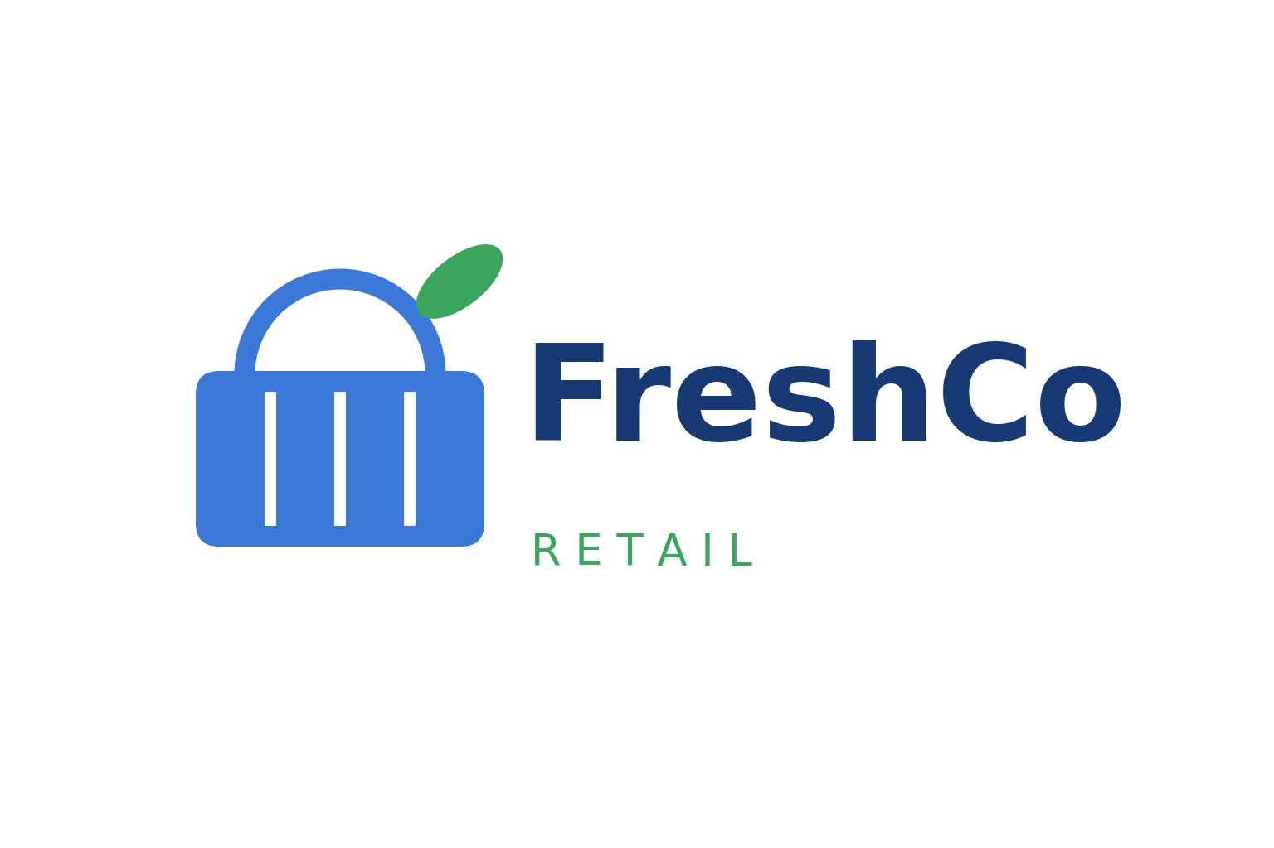
Sales Analytics Project
Grocery Sales Performance Analysis
Identifying Category Revenue Drivers & Recommendations to Unlock $74.5M Annual Growth
FreshCo Retail | Deleonard Simanjorang | 2026

Slide 2
Our Company !
Who Are We?
FreshCo Retail is a fictional multi-store grocery retail chain offering 11 product categories, from fresh produce and dairy to confections and beverages, serving nearly 99,000 active customers.
Our Mission
Make everyday groceries fresh, affordable, and within everyone’s reach.
Grow sustainably by turning transaction data into smarter category, pricing, and loyalty decisions.

Slide 3
Executive Summary
FreshCo generates $4.28B in annual revenue across 11 product categories. A 5% lift in the top-3 categories would add $74.5M in revenue every year.
This analysis leverages Google BigQuery and Power BI to analyze transaction-level sales records, pinpointing how volume, customer reach, and pricing drive revenue.
Confections is the #1 category with $556.9M revenue (13% of total) and the highest repeat purchase rate at 99.85%, making it FreshCo’s loyalty powerhouse.
Revenue is volume and reach driven: categories that sell more units and reach more unique customers consistently outperform. The top 5 categories contribute 53% of revenue.
Premium pricing limits reach: Grain carries the highest average price at $59.6 but the lowest customer reach, revealing price sensitivity, accessibility gaps, and untapped mass-market potential.
Three data-driven recommendations are proposed to unlock $74.5M annual growth within 6 months, with progress monitored via a real-time Power BI dashboard.

Slide 4
Where is our next $74.5M ?
Why category strategy is a financial priority
FreshCo’s growth is concentrated: the top 5 of 11 categories generate 53% of revenue, while premium categories reach 1,400 fewer customers — a clear signal of untapped growth levers.
$4.28 B Total annual revenue (after discount, across 11 categories) | 53 % Revenue from top 5 categories, led by Confections ($556.9M | 13%) | +$74.5 M Projected annual upside from a 5% revenue lift in top-3 (Confections, Meat, Poultry)
Projected Annual Upside: +$74.5 M by lifting top-3 category revenue 5% within 6 months
Revenue measured after discount. Projection assumes a 5% revenue lift on the top-3 categories ($1.49B base) through reach, pricing, and loyalty initiatives.

Slide 5
Sales Analytics Project
Analysis
Objectives
FreshCo Retail | Deleonard Simanjorang | 2026

Slide 6
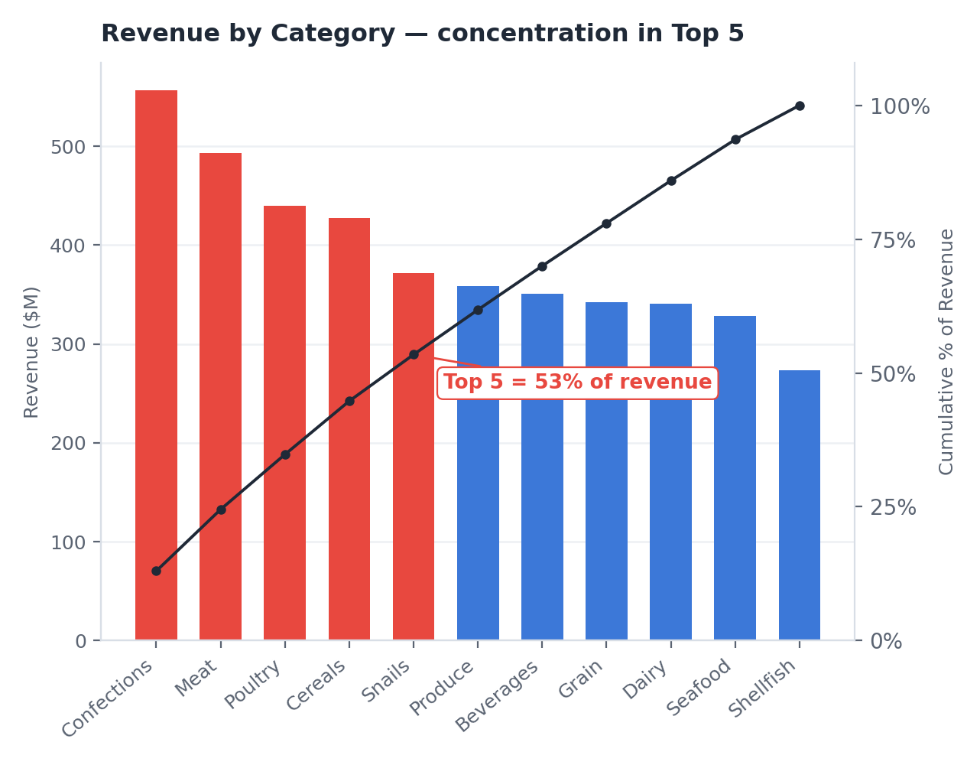
What's driving this? - Project Background
Revenue Share by Category
13% Top Category (Confections) | 53% Top 5 Categories | 47% Remaining 6 Categories
Dataset: Kaggle Grocery Sales
FreshCo generates $4.28B in annual revenue, but leadership lacks visibility into which levers — volume, reach, or price — actually drive category performance.
The 5% revenue lift on the top-3 categories is a realistic 6-month target. Achieving it would add $74.5M in annual revenue, without opening a single new store.
Revenue is highly concentrated: the top 5 of 11 categories contribute 53% of total revenue, led by Confections at 13%.

Slide 7
Project Goals
Problem Statement
Objective
FreshCo’s $4.28B revenue is concentrated in a handful of categories, with 53%, coming from the top 5 of 11 categories — and no clear playbook for what drives category growth.
To identify the key drivers of category revenue and provide data-driven recommendations to grow top-3 category revenue by 5% (+$74.5M) within 6 months, measured through a real-time monitoring dashboard.
In Scope
Out Scope
This analysis utilized the Grocery Sales dataset from Kaggle, comprising millions of transaction records across 11 product categories.
Revenue was analyzed across all categories, with key variables including Quantity, Price & Discount, Unique Customers, and Repeat Purchases (Loyalty).
Several variables were excluded from this analysis, including store/location detail, seasonality & time trends, and profit margin (no cost data) to keep focus on category-level revenue drivers.
Tools Used:
Google BigQuery (exploration & analysis), Power BI (monitoring dashboard)

Slide 8
Methodology
1
2
3
Business Problem
Definition
Data Preparation & Cleaning
Data Analysis
Define business problem & SMART objective
Tools : BigQuery
Check missing values, duplicates & inconsistent values
Tools : Python
Identify revenue patterns & key drivers
Tools : BigQuery
5
4
Insight & Recommendation
Dashboard Development
Translate findings into actionable recommendations
Output : Business Insights
Build KPI Monitoring dashboard in Power BI
Tools : Power BI

Slide 9
Sales Analytics Project
Deep Dive Analysis
FreshCo Retail | Deleonard Simanjorang | 2026

Slide 10
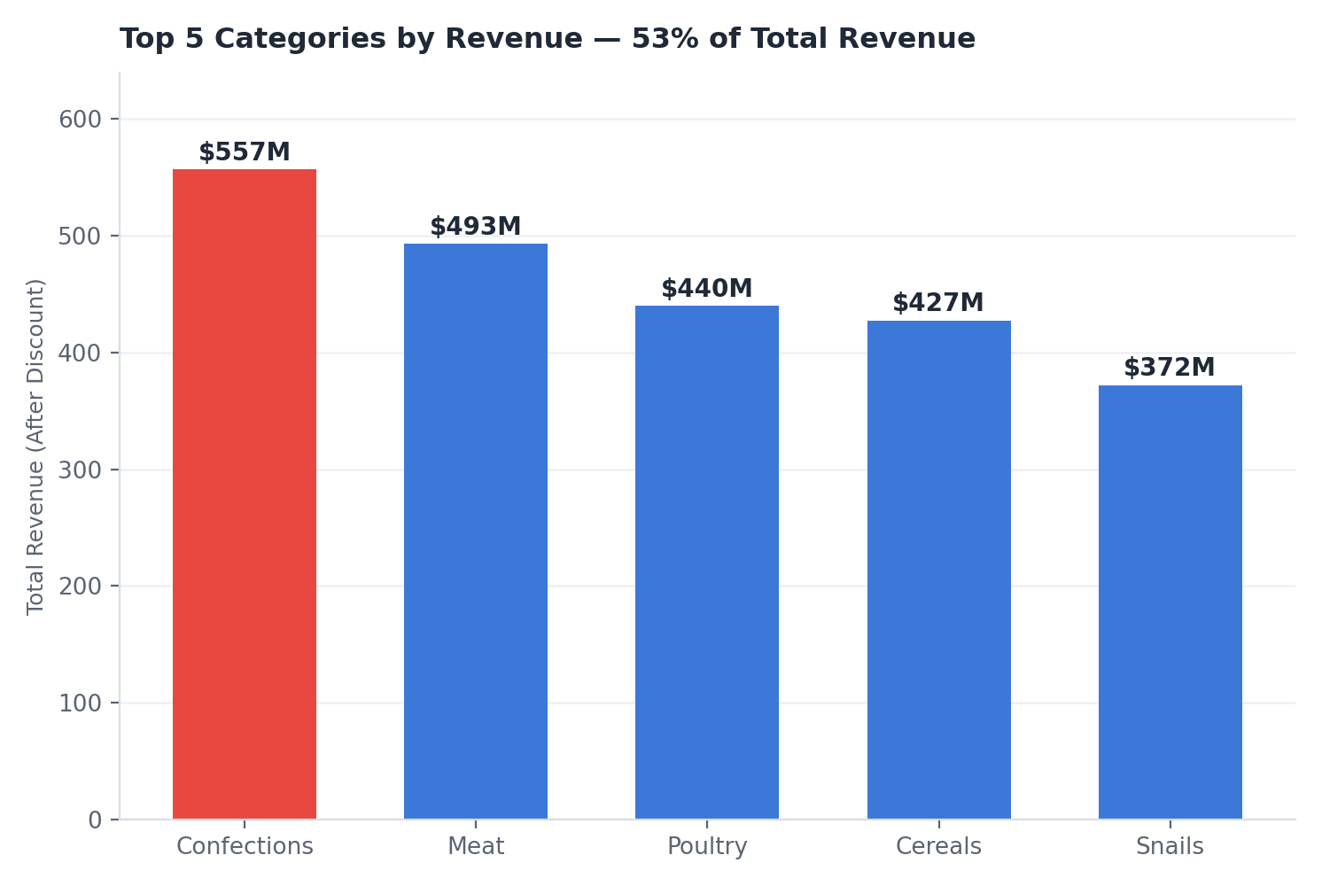
What does data tell us? — Category Revenue
Key Finding :
Confections is the highest-revenue category at $556.9M (13% of total), and the top 5 categories contribute 53%.
Insight :
Revenue is concentrated in a few winning categories. Protecting and growing these winners is the fastest path to overall growth.

Slide 11
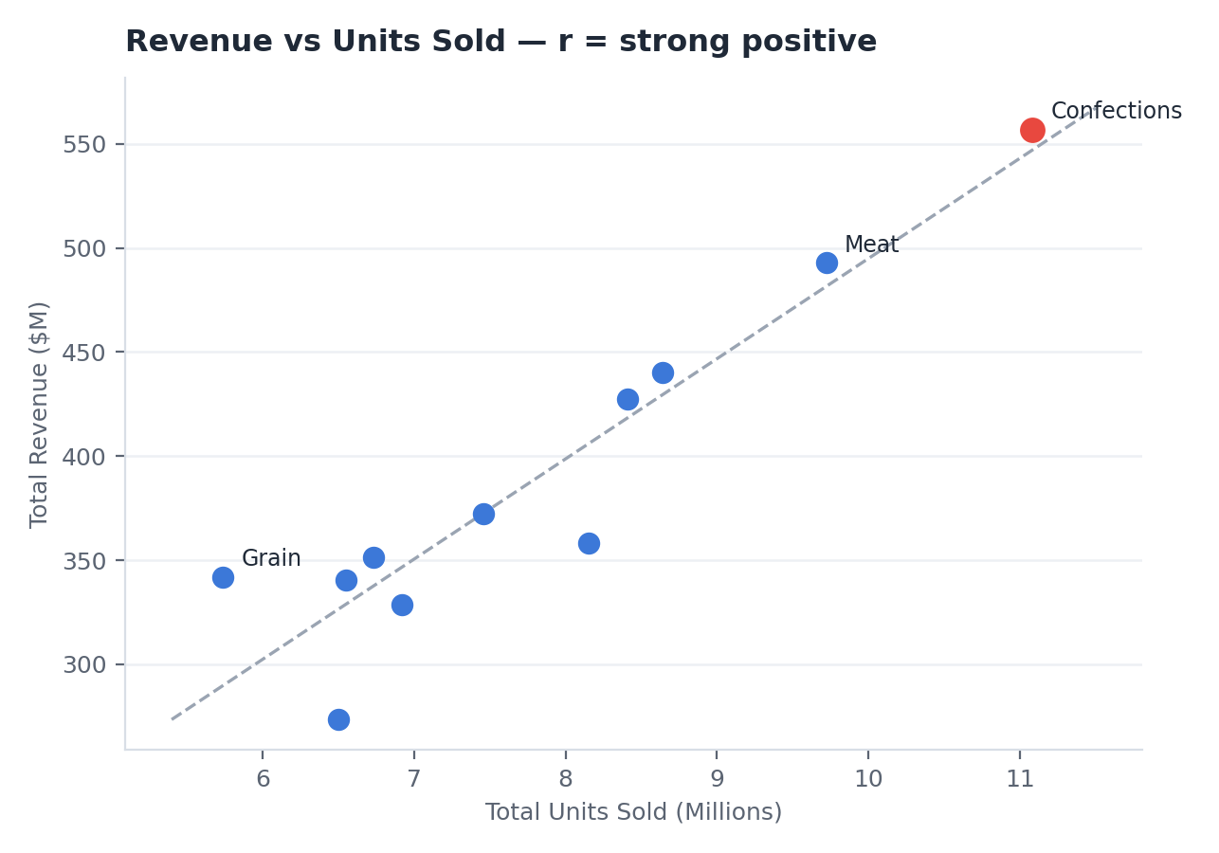
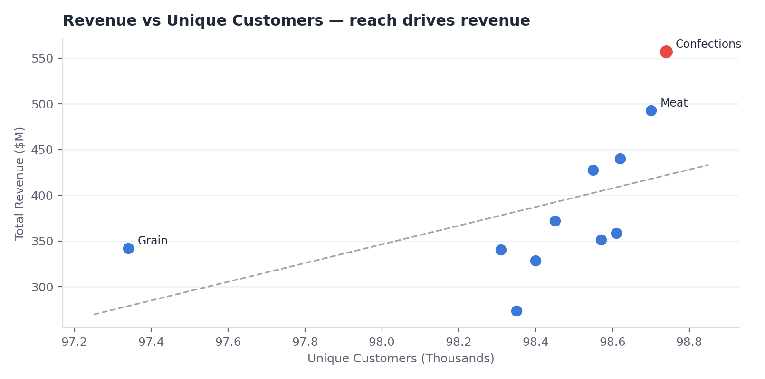
What does data tell us? — Volume & Customer Reach
Key Finding :
Categories selling more units and reaching more customers earn more: Confections leads with 11.08M units sold and 98,743 unique customers, the highest reach in the dataset
Insight :
Both correlations are strongly positive: volume and reach are the two primary levers for category revenue growth.

Slide 12
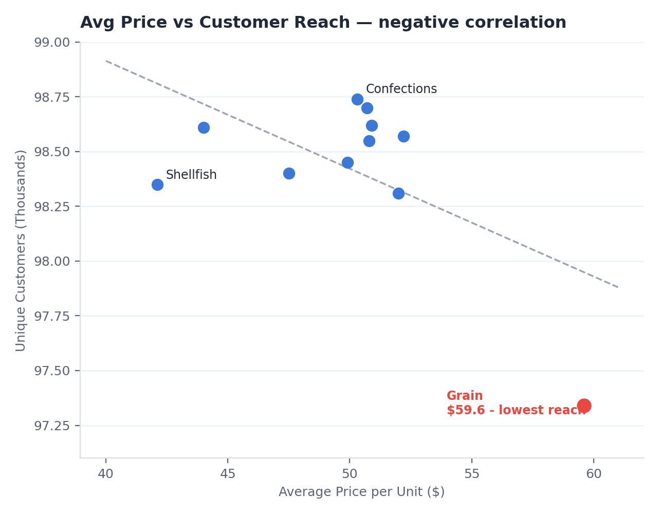
What does data tell us? — Pricing & Reach
Key Finding :
Grain carries the highest average unit price at $59.6, yet the lowest reach at 97,335 customers, roughly 1,400 fewer than top categories.
Insight :
Higher prices correlate with lower customer reach. Premium categories are leaving mass-market demand untapped.

Slide 13
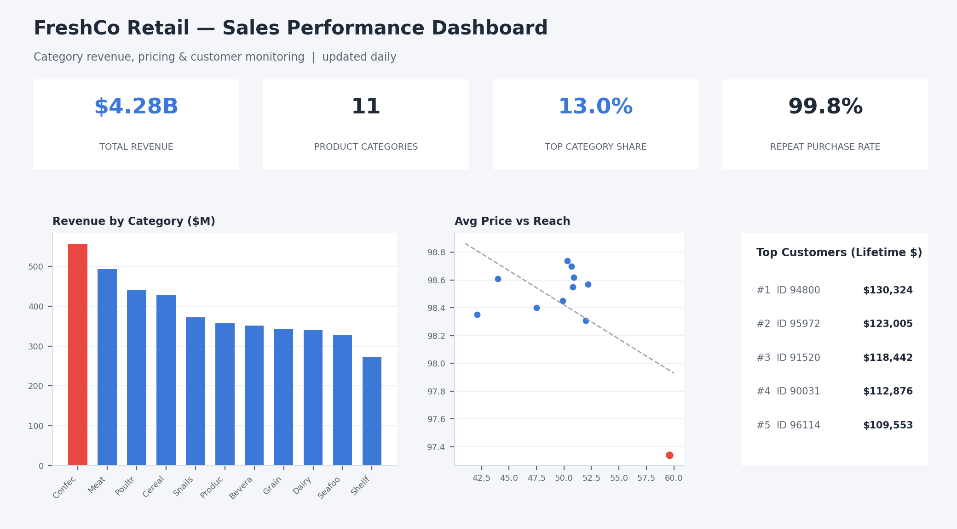
How do we track progress?
Real-time Sales Performance Dashboard
KPI Cards
Key metrics: Total Revenue, Top Category Share & Repeat Purchase Rate at a glance
Bar Charts
Revenue breakdown by category, identifying winners and underperformers instantly
Scatter & Table
Price-vs-reach analysis and top customer tracking for pricing and loyalty actions
Dashboard Goal :
Monitor progress toward the +$74.5M target across all key growth levers

Slide 14
Sales Analytics Project
Insight &
Recommendations
FreshCo Retail | Deleonard Simanjorang | 2026

Slide 15
Reach & Volume
Key Finding :
Volume and reach are the strongest revenue drivers: top categories sell 11M+ units to nearly 99K customers. A 5% lift on the top-3 categories = +$74.5M/year.
Why This Happens :
Reach gaps are often a symptom of:
- Promotions not reaching new shoppers
- Weak cross-category exposure,
shoppers stick to habitual aisles
- Underused bundling between high-
loyalty and low-reach categories
- Promo budget spread evenly instead
of focusing on winnable categories
Risk if Unaddressed :
Growth stalls at $4.28B while competitors capture mass-market demand. Every quarter of inaction defers ~$18.6M of the projected annual upside.
Recommendation
Targeted Promotions Focus promo & sampling budget on top categories (Confections, Meat, Poultry) to convert their high reach into higher purchase frequency.
Tool: Category promo calendar + A/B testing
Cross-selling & Bundling Bundle high-loyalty Confections with lower-reach categories to lift units per basket and expose shoppers to new aisles.
Tool: Market-basket analysis in BigQuery

Slide 16
Premium Pricing
Finding :
Grain is priced at $59.6 per unit, about 18% above the portfolio average, but reaches 1,400 fewer customers than mass categories.
Risk if Unaddressed :
Keeping premium categories inaccessible will cap their growth at the smallest customer base and leave mass-market demand open for competitors.
Recommendation
Tiered Pricing Introduce entry-size packs and mid-tier SKUs in Grain and Dairy to widen reach without eroding the premium positioning of existing products.
Tool: Price ladder & pack architecture review
Price Sensitivity Testing Pilot targeted discounts in selected stores and measure reach elasticity before rolling out changes portfolio-wide.
Tool: Controlled pricing experiments (test vs control)
Expected Impact :
Lift Grain customer reach from 97.3K → 98.3K+ within 6 months

Slide 17
Loyalty & Top Customers
Key Finding :
Confections holds the highest repeat purchase rate at 99.85%, and the #1 customer (ID 94800) has contributed $130,324 in lifetime revenue.
Opportunity Hypothesis :
Repeat rates are uniformly high, so loyalty itself is not the problem — the untapped value lies in monetizing it :
Hypothesis 1
Loyal shoppers buy frequently but from a narrow range of aisles; personalized cross-category offers could expand baskets.
Hypothesis 2
Top customers (up to $130K lifetime value) receive the same generic treatment as everyone else, leaving high-value retention to chance.
Risk if Unaddressed :
High-value customers remain unrecognized and vulnerable to competitor offers. Losing a single top-10 customer erases six figures of reliable annual revenue.
Recommendation
Loyalty Program Launch a points program anchored on Confections (99.85% repeat rate) to reward frequency and incentivize cross-category redemption.
Tool: RFM segmentation in BigQuery
VIP Top-Customer Program Identify the top 1% of customers by lifetime value and serve them tailored offers, early access, and dedicated service.
Tool: Customer lifetime value ranking + personalized campaigns

Slide 18
Sales Analytics Project
Conclusion &
Next Steps
FreshCo Retail | Deleonard Simanjorang | 2026

Slide 19
Conclusion & Next Steps
FreshCo’s $4.28B revenue is concentrated in 5 winning categories. Three targeted interventions are projected to add $74.5M annually within 6 months.
Month 1 & 2
Implement
Launch promo calendar & bundling pilots
Design tiered pricing pilot
Build loyalty & VIP program
Month 3 & 4
Monitor
Track revenue lift via dashboard
Measure reach
& basket size
Validate hypothesis
Month 5 & 6
Evaluate
Measure revenue lift vs +5% target
Adjust strategies if needed
Report ROI to stakeholder
What's the ROI? :
Lift top-3 revenue by 5% | Add $74.5 M / year | Monitored via Dashboard

Slide 20



THANK YOU
LinkedIn
Deleonard Simanjorang
Email
deleonard20@gmail.com
WhatsApp & Phone
+62 812 4154 4992

Slide 21
Sales Analytics Project
Appendix
FreshCo Retail | Deleonard Simanjorang | 2026

Slide 22
Appendix A — References & Data Source
Notes & References
1. FreshCo Retail is a fictional company created for analytical and portfolio purposes.
2. Revenue calculated after discount: quantity × price × (1 − discount).
3. Analysis performed in Google BigQuery; monetary values follow the dataset’s original units.
Dataset
Grocery Sales Dataset (public)
Source : Kaggle
Link : kaggle.com/datasets/andrexibiza/ grocery-sales-dataset
Tables : sales, products, categories, customers
Scope : 11 product categories

Slide 23
Appendix B — Key SQL Queries
BigQuery queries used for analysis
-- Revenue by Category (After Discount)
SELECT c.categoryname,
ROUND(SUM(s.quantity * p.price
* (1 - s.discount)), 0) AS total_revenue
FROM freshco_ds.sales s
JOIN freshco_ds.products p USING(productid)
JOIN freshco_ds.categories c USING(categoryid)
GROUP BY 1
ORDER BY 2 DESC;
-- Customer Reach & Avg Price per Category
SELECT c.categoryname,
COUNT(DISTINCT s.customerid) AS unique_customers,
ROUND(AVG(p.price * (1 - s.discount)), 2)
AS avg_price_per_unit
FROM freshco_ds.sales s
JOIN freshco_ds.products p USING(productid)
JOIN freshco_ds.categories c USING(categoryid)
GROUP BY 1;
-- Repeat Purchase Rate per Category
WITH cust AS (
SELECT c.categoryname, s.customerid,
COUNT(*) AS purchases
FROM freshco_ds.sales s
JOIN freshco_ds.products p USING(productid)
JOIN freshco_ds.categories c USING(categoryid)
GROUP BY 1, 2 )
SELECT categoryname,
ROUND(COUNTIF(purchases > 1) / COUNT(*), 4)
AS repeat_purchase_rate
FROM cust GROUP BY 1;

Slide 24

Appendix C — About the Analyst
Deleonard Simanjorang
Data Analyst | Business & People Analytics
Background in HR & Business Operations,
transitioning into data analytics with focus
on business analytics, people analytics,
and operational efficiency.
Technical Skills SQL (MySQL, BigQuery) · Python · Power BI Tableau · Excel · Data Visualization
Certifications
· Business Intelligence Analyst — Digital Skola (2026)
· Full Stack Data Analytics — RevoU (2025)
· Microsoft Excel Mastery — Digital Skola (2026)
Links
LinkedIn : Deleonard Simanjorang
Portfolio : [Link]
Email : deleonard20@gmail.com

