Slide 1
Diagnosing
from Medical
Transcriptions
Delaram Fartoot
610399153
Math Laboratory
Dr. Jamshidi

Slide 2
What are we going to see?
What is the purpose?
What are medical transcriptions? How are we going to predict from them?
How to predict?
How do we predict something by code?
Preprocessing our text.
We can’t use sentences like that!
Feature extracting and modeling
It’s time to predict.

Slide 3
Medical Transcriptions
Transcription means to listen to a recorded voice and to write down what it is saying.
Medical transcription means to do this for a hospital, doctor's office or other medical place. when doctors and nurses help someone in the hospital, they do not have time to write down what they saw or heard. So later they record what they saw and heard, so someone else can write it down. The notes are then added to the hospital’s
history.

Slide 4
“This 5-year-old male presents to Children's Hospital Emergency Department by the mother with "have asthma." Mother states he has been wheezing and coughing. They saw their primary medical doctor. He was evaluated at the clinic, given the breathing treatment and discharged home, was not having asthma, prescribed prednisone and an antibiotic. They told to go to the ER if he got worse. He has had some vomiting and some abdominal pain. His peak flows on the morning are normal at 150, but in the morning, they were down to 100 and subsequently decreased to 75 over the course of the day.”

Slide 5
Our data set
transcriptions
Medical
specialty
X
Y
+
Allergy / Immunology

Slide 6
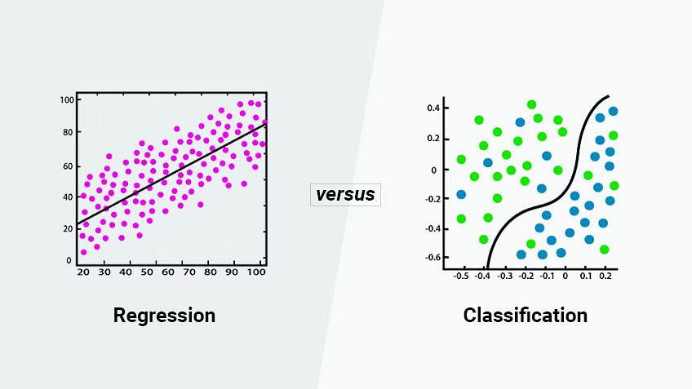
How can we predict?
Our case
Regression and classification

Slide 7
But what should we do with text?

Slide 8
We work with words!
Tokenizing
[“Never give up”]
[”Never”,“give”,“up”]
The first step is always
Preprocessing!
Some words don’t add anything
Stop words
[‘between’, ‘yourself’, ‘but’, ‘again’, ‘there’]
!
Don’t forget to lowercase the
words
We need the roots
Stemming
Creating
Creative
Creates
Created
create

Slide 9
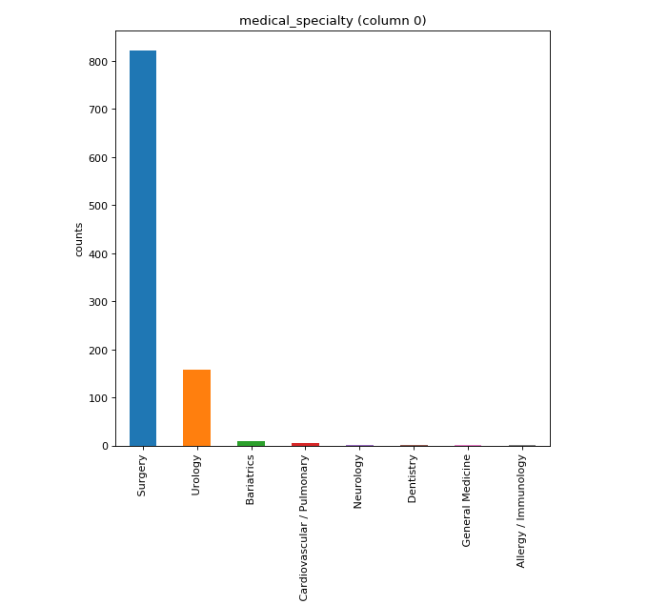
Imbalanced data
An issue which can occur more often than you think
We chose:
Obstetrics / Gynecology
ENT – Otolaryngology
Urology

Slide 10
How can we change text to numbers?

Slide 11
N-gram and Countvectorizer
 | Word1 (hello) | Word2 (give) | Word3 (health) | Word4 (secure) | Word5 (round) | …
Doc1 | 0 | 2 | 0 | 1 | 4
Doc2 | 5 | 0 | 0 | 0 | 7
Doc3 | 1 | 0 | 7 | 5 | 4
…
In our case each document is one of our transcriptions.
So each of transcriptions becomes a vector with dimension of the vocabulary.

Slide 12
Some important points
For using less memory and for higher computational speed it’s better not to use all the vocabulary.
To do so we can:
Sort our matrix so we can use the most frequent words
Use PCA

Slide 13
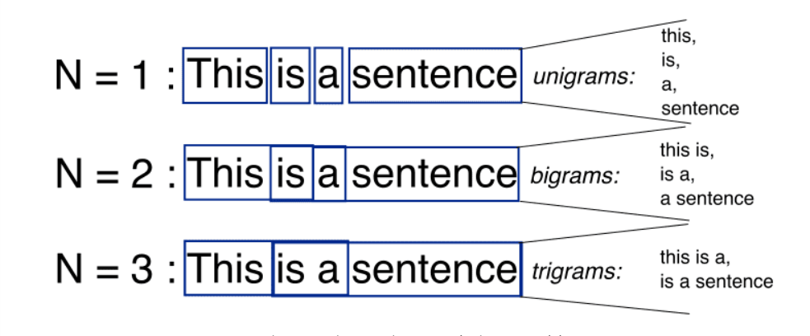
N-grams
We are not forced to always use single words for our Countvectorization.
We can use 2 words, up to 2 words , three words and …
Has its own advantages and disadvantages.

Slide 14
Now, that we’ve got our numbers
it’s time to predict

Slide 15
First we should divide our data
into train sample and
test sample.
We use our trainings to predict about the test sample.
KNN
“Birds of a feather flock
together.”
Logistic
regression
Change regression problem to a classification one
As we said we are dealing with a classification.
So we try some of the most famous models on our data.
Random forest
Average of many decision trees

Slide 16
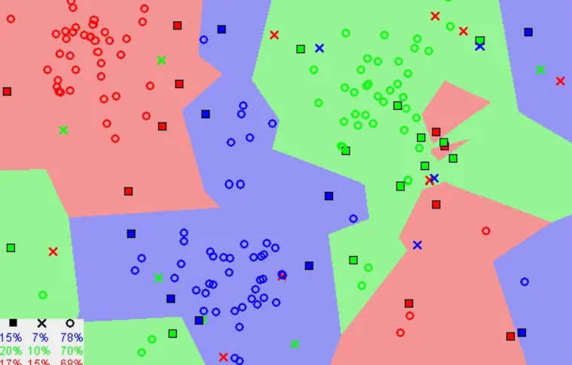
K nearest neighbor
We are like our neighbors!

Slide 17
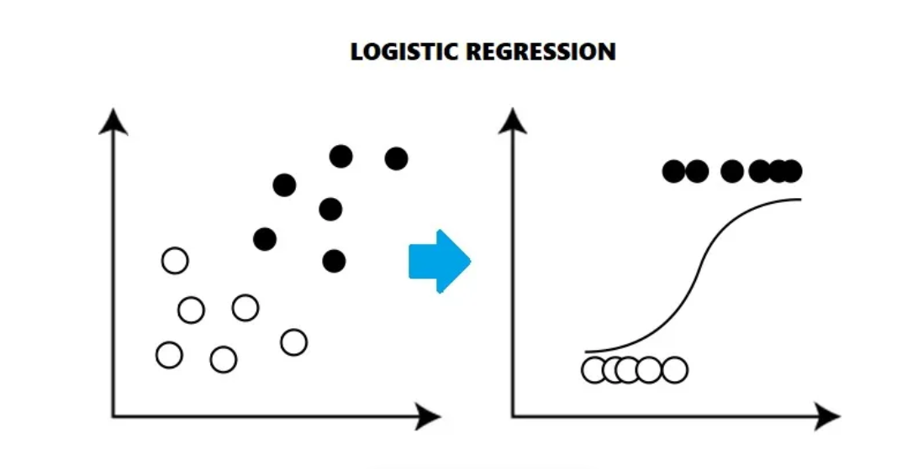
Logistic regression
It’s a simple version(2d)

Slide 18
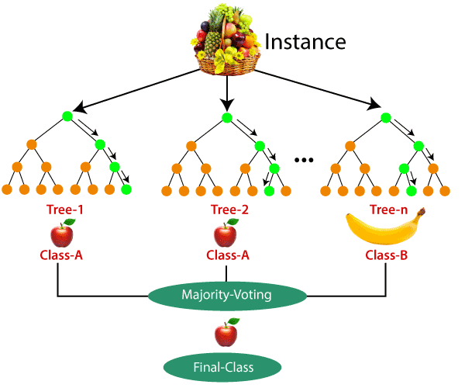
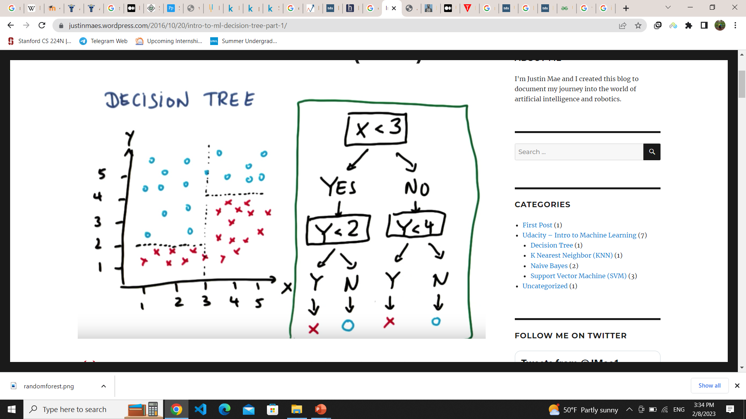
Random Forest

Slide 19
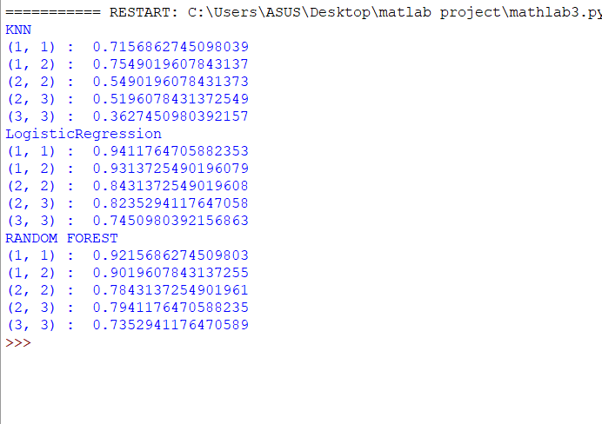
Results
Knn wasn’t a very good model.
Logistic regression was time consuming and the most accurate one.
Random forest was much faster than logistic regression but a little bit less accurate

Slide 20
References
https://mtsamples.com/
https://towardsdatascience.com/understanding-word-n-grams-and-n-gram-probability-in-natural-language-processing-9d9eef0fa058
https://towardsdatascience.com/machine-learning-basics-with-the-k-nearest-neighbors-algorithm-6a6e71d01761
https://www.geeksforgeeks.org/using-countvectorizer-to-extracting-features-from-text/
https://medium.com/analytics-vidhya/understanding-logistic-regression-b3c672deac04
https://machinelearningmastery.com/logistic-regression-for-machine-learning
https://www.analyticsvidhya.com/blog/2021/06/understanding-random-forest/
https://www.simplilearn.com/regression-vs-classification-in-machine-learning-article

Slide 21
Thank you

