Slide 1

Simulated Origins of Social Traits
with Coevolving Automata as digital organisms
Spring 2023
Weigang Qiu @ Hunter College
Book: Ex Machina (2022) by John H. Miller, Santa Fe Institute
Github: https://github.com/SantaFeInstitute/ExMachina

Slide 2




Introduction & Motivation
Origins of collaborative social behavior characterize major evolutionary transitions: quorum sensing, biofilm, eukaryotes, multicellularity, sexual reproduction, eusociality, language, religion, and culture (no neuron or brain needed)
Could it be used to model antagonistic co-evolution such as selfish genetic elements, Red Queen run-away evolution, and pathogen-host antigen/immunity co-diversification?

Slide 3
Games Theory
Payoff Matrix (fitness) for Prisoner’s Dilemma
Cooperation
Coordination
Public Goods
Signaling
Red Queen?
Chickens
Prisoner’s Dilemma
Battle of the Sexes
Stag Hunt
Ultimatum
Centipede
Hawk Dove
Matching Pennies
Blotto
Rock, Paper, Scissors
Keynesian Beauty Contest
 |  | Column Player
 |  | 0 (cooperate) | 1 (defect)
Row Player | 0 (cooperate) | 3, 3 | 0, 5
 | 1 (defect) | 5, 0 | 1, 1
Reward: R = 3
Punishment: P = 1
Sucker : S = 0
Temptation: T = 5
Conditions for cooperation:
T > R > P > S
R > (T + S)/2 (rewards need be substantial; temptation & sucker not too great)

Slide 4
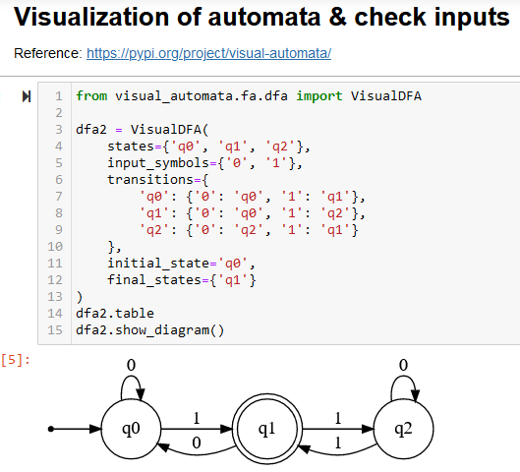
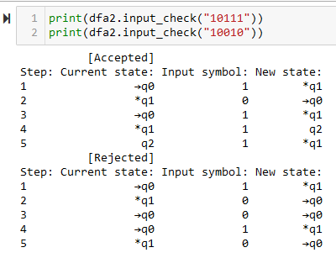
Finite Automata
Input & output symbols: 0 or 1
States: q0, q1, q2 (outputs either 0 or 1)
Transitions: input/output rules for each state
Input stream: e.g., “10111”
Output stream: q0 → q1→ q0 → q1 → q2 → q1
An automata: an individual displaying a social behavior or a game strategy
A mutation alters either an output or a transition

Slide 5
Genetic Algorithm
Constant population size
Mutation
Selection (based on a fitness function)
Repeat
Ely, Koh, Ho, Hassan, Pham & Qiu (2023). “Novelty Search Promotes Antigenic Diversity in Microbial Pathogens.” Pathogens 12:388.

Slide 6



Proof-of-Concept Tests
Test 1. Adaptation to a target environment
Evolve machines that emit a desired binary string, given a fixed input
Test 2. Sensory detection
Evolve machines that identify strings with exactly 3 one’s
Training set: n = 240 random strings, prefixed
Test set: n = 1000 random strings
Test 3. Add coevolution
Training data set: coevolves, with a problem is preferred if fail by automata
More robust machines evolved: avoid overfitting (to the fixed or randomized problem set)
Reference: Ex Machina, Appendix F (“Testing Evolving Automata”)

Slide 7

Test 1. Adaptation
Evolving automata outputting a target (randomly generated) binary string, from an input (also randomly generated) binary string

Slide 8
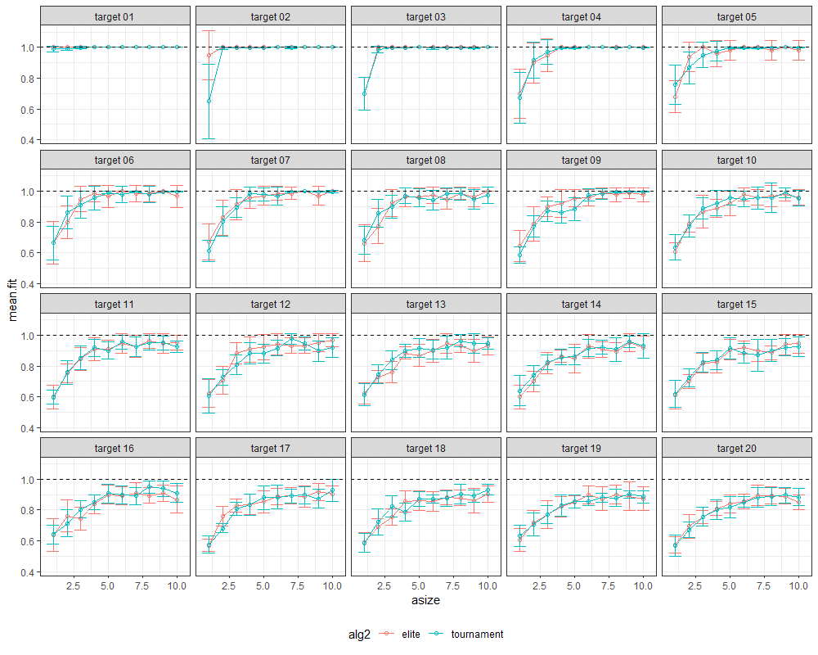
Test 1. Adaptation
Target string: L = 1 to 20 long binary strings (panels)
Input stream: an L – 1 long random binary string
Automata size: 1 to 10 states (x-axis)
Pop size: N = 40 automata
Generations: g = 100
Mutation: m = 1/3 per automata per generation
Fitness: % matched digits to the target string (y-axis)
Selection: Elite or Tournament

Slide 9
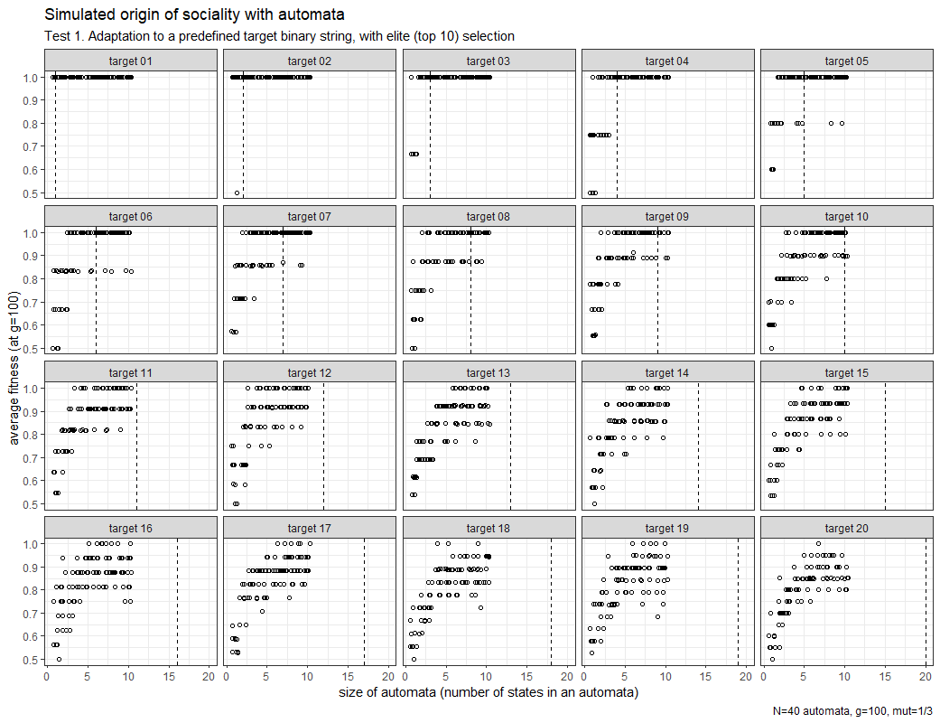
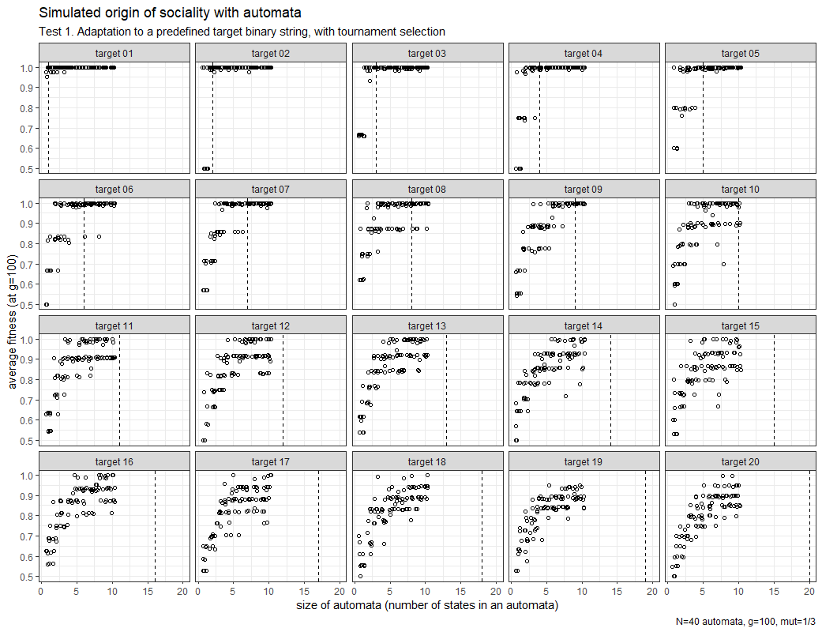
Test 1. Automata adapted to a target output
Elite selection
Tournament selection

Slide 10
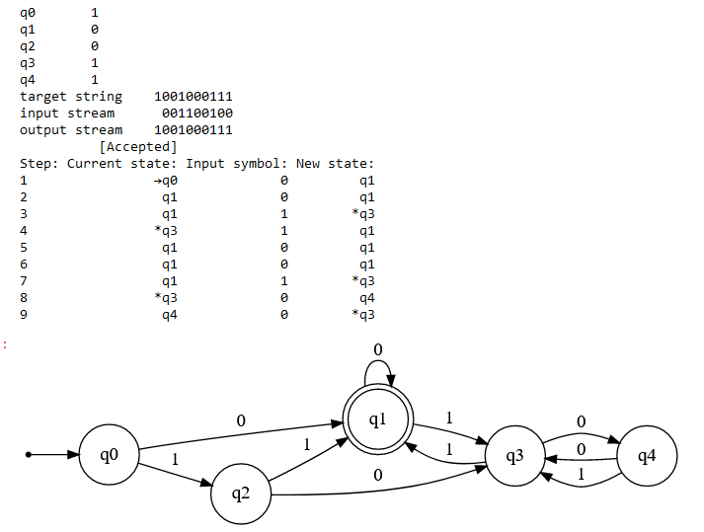
Test 1. An adapted automata

Slide 11
Test 2. Pattern recognition
Evolving automata able to identify strings with exactly 3 ones
Trained with a fixed set of 240 random strings

Slide 12
Test 3. Coevolution
Evolving automata able to identify strings with exactly 3 ones
Trained with randomized but fixed strings
Trained with coevolving strings

Slide 13
Emergence of Cooperation
Chap 6. Conflict Resolution
Chap 7 Coordination
Chap 8. Coordination
Chap 9. Cooperation
Chap 10. Commerce
Chap 11 Communication

Slide 14
Models of Red Queen Evolution
Level 1. Immune escape
Evolve machines that emits a complementary string
Level 2. Immune escape with coevolving host
Add co-evolving hosts
Add threshold
Add cross-reactivity
Hypotheses:
Selective sweeps (influenza)
Balanced polymorphism (Lyme Borreliella)
Strain theory
Vaccine design & effect prediction

Slide 15




Team
Name
Name
Name
Name
Title
Title
Title
Title

Slide 16
Timeline & Roadmap
Title
To start a presentation, go to the Slide Show tab, and select From Beginning.
Title
To display Presenter view, in Slide Show view, on the control bar at the bottom left select the three dots, and then Show Presenter View.
Title
During your presentation, the speaker notes are visible on your monitor, but aren't visible to the audience.
Title
Title
If you don’t see the Notes pane or it is completely minimized, click Notes on the task bar across the bottom of the PowerPoint window.
The Notes pane is a box that appears below each slide. Tap it to add notes.

Slide 17


Thank You
Presenter name
Email address
Website address

