Slide 1

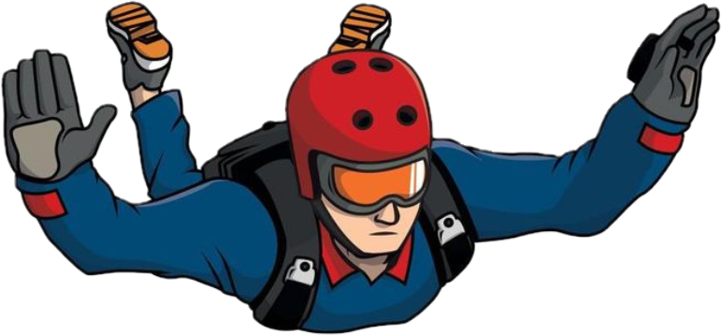

HACKATHON 2026 · BROWSER GAME
PLAN-JAMP
A split-screen skydiving duel you play with your bare hands.
Webcam hand-tracking control no controller, no keyboard
Phaser 4 · MediaPipe · Vite
Notes:
Open big: this is a skydiving race you control with your bare hand via the webcam. Hook them on the no-controller angle before explaining rules.

Slide 2
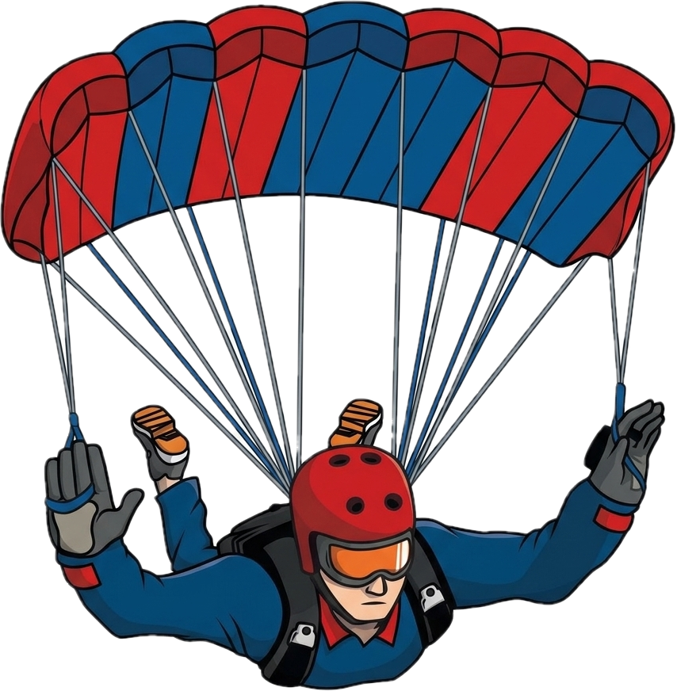



THE CONCEPT
A game of nerve, not buttons
Two skydivers leap from a plane and race to the ground. The catch: the ground is the enemy. Fall fast to land first — but open your parachute one beat too late and you splatter.
Risk = reward
Greed kills
Latest safe wins
Keep your chute closed and you fall fastest. Greed wins the race.
Deploy below the safe line and the canopy can’t save you. Splat.
Optimal play: pop the chute at the last possible safe altitude.

Slide 3
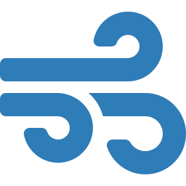

HOW IT PLAYS
One round, three phases
Played simultaneously on a split screen. The instant either player fails a phase, the round ends and the other player wins.
01
02
03
JUMP
→
FREEFALL
→
LANDING
REACTION
CONTROL
NERVE
A 3-second window. Hit ACTION to leap. Hesitate and your seat explodes.
Steer left / right to dodge planes, birds and debris screaming past.
Altitude ticks down. Deploy the chute as late as you dare — and survive.
Win = first player to touch down safely.

Slide 4


THE CORE TENSION
The ground is the enemy
Falling fast wins the race — but the canopy needs altitude to inflate. The whole game lives in the gap between “late” and “too late.”
Descent speed vs. altitude
Open too early Safe, but you drift — and lose the race.
Open latest-safe Maximum speed, you land first. Win.
Open too late Canopy can’t catch you. Crash.
Notes:
The whole game is the gap between "late" and "too late". The red freefall line is fast; the green canopy line is slow. You want to switch as low as possible without crashing.

Slide 5

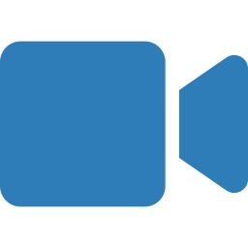

THE HACKATHON TWIST
You are the controller
Solo mode reads your hand straight from the webcam. No hardware, no install — point and pinch in the air to fly.
HAND DETECTED
Move your fingertip
Your index fingertip steers the diver across the sky in real time.
Pinch to act
Webcam feed + landmark overlay
Thumb + index pinch jumps from the plane and pops the parachute.
Mirrored & smoothed
Selfie-mirrored, lightly filtered — responsive but never jittery.
Notes:
This is the hackathon centerpiece. Index fingertip = steering, pinch = action. Demo live if the camera cooperates.

Slide 6


TWO WAYS TO PLAY
Solo vs. Versus
SOLO
2 PLAYERS
Hand-tracked time trial
Local split-screen duel
Fly with your webcam hand
Beat your fastest safe landing
Top-5 local leaderboard (localStorage)
Keyboard fallback if no camera
Two divers, one keyboard
P1: W / A / D · P2: ↑ / ← / →
Independent camera per half-screen
First to fail hands the win away

Slide 7



UNDER THE HOOD
Built in the browser, zero backend
Phaser 4
MediaPipe HandLandmarker
Game loop, physics, sprites & scene state machine for the three phases.
21-point hand model on the webcam, fingertip + pinch detection.
Dual-camera split screen
Vite
Two viewports, each ignoring the other player’s objects + a HUD camera on top.
Instant dev server and a static build — runs fully client-side.
No servers · no networking · loads as a single static page.

Slide 8
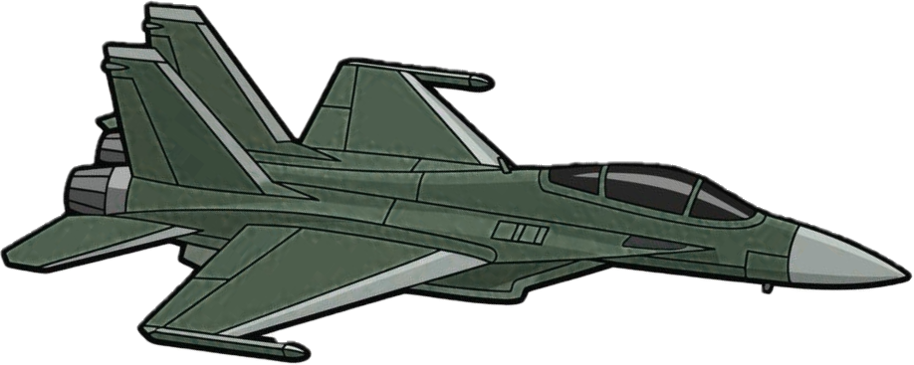
SEE IT IN ACTION
Live gameplay
Solo / hand cam
Gameplay screenshot — drop image here
Split-screen versus

Slide 9

WHERE IT GOES NEXT
Roadmap
Best-of-N & scoreboard
Tuck & spread
Wind & power-ups
Multi-round matches with a running tally between players.
Squeeze or flare your body to actively control fall speed mid-drop.
Gusts that shove you sideways; pickups that shake up the race.
AI opponent
Two-hand versus
Juice & audio
A solo-friendly rival so you always have someone to beat.
Both players hand-tracked at once on one camera.
Chute-pop, ground impact, ambient wind, screen shake.

Slide 10
Open late. Win big.
Plan-Jamp — a skydiving game of nerve, played with nothing but your hand and a webcam.
npm run dev
Thanks — questions?

