Slide 1



It Is Like Finding a Polar Bear in the Savannah! Concept-level AI Explanations with Analogical Inference from Commonsense Knowledge
Gaole He, Agathe Balayn,
Stefan Buijsman, Jie Yang,
Ujwal Gadiraju
Notes:
Hello everyone, my name is Gaole He.
In this work, we go one step further on concept-level explanations with analogy and commonsense knowledge to help laypeople understand AI advice

Slide 2
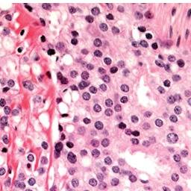


Background & Research Gap
XAI
Experts
Non-experts
Concept-level explanations: With cribriform and fused glands in needle core biopsy from prostate, this is diagnosed as adenocarcinoma of the prostate.
Research Gap
Laypeople lack the technical expertise and domain knowledge to interpret AI systems
Concept-level explanations impose a high cognitive load on laypeople
Notes:
In this paper, we mainly focus on concept-level explanations.
With recent studies of explainable AI, post-hoc explanations like heatmap can be provided as explanations for AI advice.
However, on challenging tasks like medical image analysis, such explanations can only work for experts.
A wide community of non-experts can hardly understand such explanations and get benefits from them.
Thus, we identified two research gaps in existing work:
First,
Second

Slide 3

What can we do for non-experts who need intelligible explanations?
Blackbox ML Models
XAI
(concept-level)
Experts
(e.g., doctors)
Notes:
So we can’t help asking, what can we do for non-experts to help them understand AI advice?

Slide 4

Analogical Inference – The Magic Sauce!
Blackbox ML Models
XAI
(concept-level)
Analogical
Inference
Non-expert Stakeholders
Motivation
Laypeople have sophisticated mental models and commonsense knowledge
Analogical Inference with commonsense knowledge can address aforementioned research gaps
Notes:
In this work, we propose to add analogical inference as extra layer to improve user understanding
The benefits of such an extra layer are two-fold:
First
Second

Slide 5





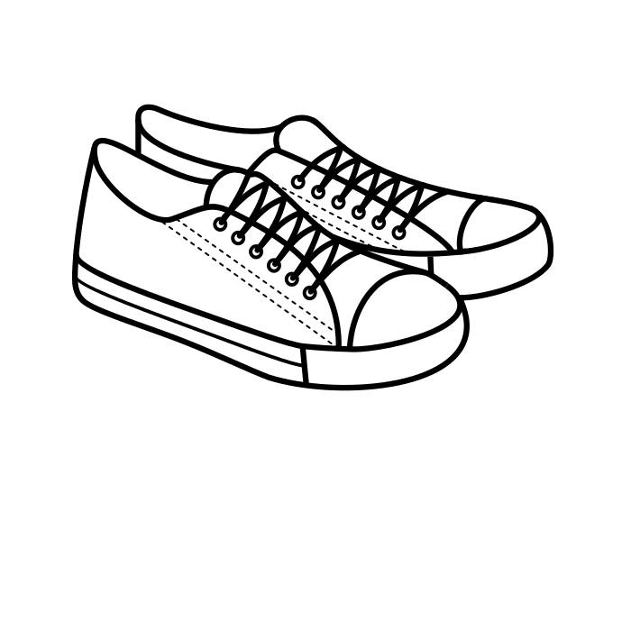
Our Idea ➔ Commonsense Knowledge + Analogical Inference
Experts
Expert
Knowledge
Concept-level
Explanation
Appropriate trust and reliance
Analogical Inference
Commonsense
Knowledge
Appropriate trust and reliance
Laypeople
Concept-level
Explanation
Notes:
Let’s use an analogy to explain our idea.
Considering the understanding concept-level explanations as crossing a river. Experts can drive boats to reach the goal.
While laypeople do not have such experience to drive the boat, they have shoes and know about how to walk.
To cross the river, they need a bridge to walk on. That bridge here, is just the analogical inference, which can be walked on with their shoes.

Slide 6
Example: Concept-level Explanation
Notes:
A more specific example in prostate cancer prediction may help us understand the analogy-based explanations.
In this example, complex terminology cribriform and fused glands in needle core biopsy is quite challenging to understand.

Slide 7
Example: Analogy-based Explanation
Target Domain
Source Domain
Notes:
The function of analogical inference is to explain sth you do not understand (target domain) with the ones you are familiar with (source domain).
To clarify what original explanation means, we use commonsense explanation “It’s like recognizing a unicorn due to the horn on its head”.
Users can get the point, such concepts are observed in this image, which is highly indicative of the prostate cancer.

Slide 8
Research Questions
RQ1: How can we systematically assess the quality of analogy-based explanations?
RQ2: How can we generate high-quality analogy-based explanations using non-experts?
Notes:
In this work, we mainly focus on two research questions.
First,
Second

Slide 9
Research Questions
RQ1: How can we systematically assess the quality of analogy-based explanations?
RQ2: How can we generate high-quality analogy-based explanations using non-experts?
Synthesize a Structured Set of Dimensions
Crowdsourcing
Notes:
To answer the first research question, we synthesized a Structured Set of Dimensions based on existing literature of analogy.
To answer the second one, we designed a novel crowd-based analogy generation method.

Slide 10
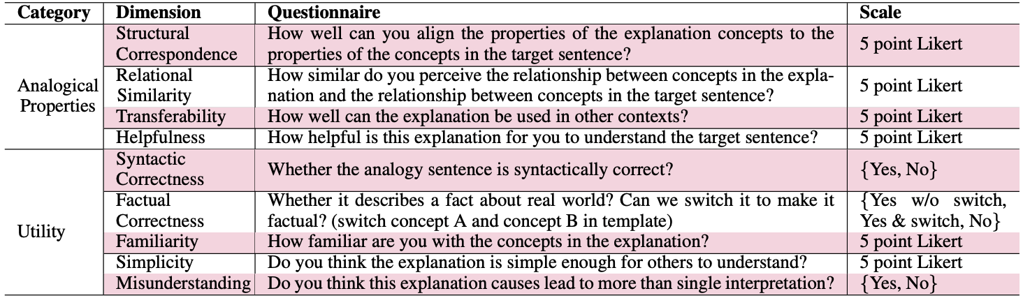
Analogy Evaluation
Table. Structured dimensions used in qualitative assessment of analogy-based explanations
Notes:
With a literature review about existing work with analogy-based explanations, we summarized a structured set of dimensions for qualitative evaluation.
For the analogical properties, most of these dimensions are defined by comparison of the source domain and target domain.
For the utility, the dimensions more focused on the generated commonsense explanations, which are independent of target sentence.

Slide 11
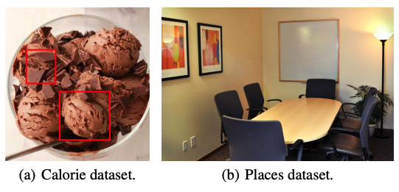
Crowdsourced Analogy Generation
Analogy generation tasks
Calorie dataset (two labels)
Places dataset (six labels)
User Task: Describe the relevance of observed concept(s) to the given label
Notes:
Based on the definition of analogical inference, we designed crowd-based methods to generate commonsense explanations which takes the target sentence as input.
Two image classification datasets are used in our study, namely calorie dataset and places dataset.
In each task users will describe the relevance of observed concepts to the given label
Calorie dataset of two labels: (1) high calorie level, fat more than 30%, (2) low calorie level, otherwise
Places dataset with six place labels: living room, bathroom, hospital room, conference room, bedroom, dining room

Slide 12
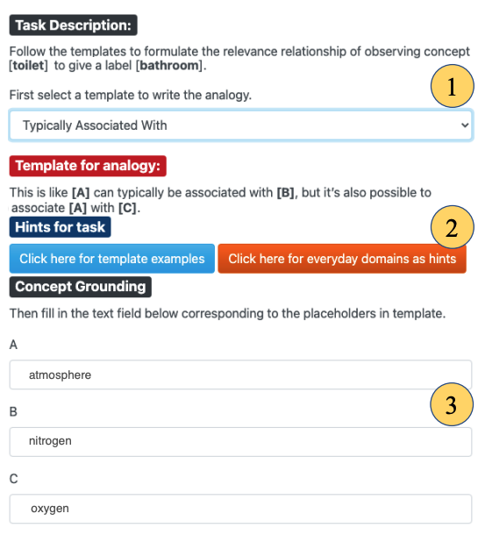
Analogy Generation Procedure
Procedure
Participants select a template to describe the relevance level
Refer to examples and everyday domains as hints
Fill in concepts in placeholders to generate analogy
Fig . Analogy generation Interface
Notes:
In the analogy generation tasks, crowd workers follow three steps to generate the analogy-based explanations
First, they describe the relevance level with templates
Secondly, they refer to examples and everyday domains as hints
And finally, they fill in concepts in placeholders to generate analogy

Slide 13
Experimental Setup
1. Analogy Generation
100 crowd workers, 50 for calorie dataset, 50 for place dataset
Each participant worked on 6 tasks
2. Analogy Evaluation
Annotation rubrics for dimensions
Five experts, each worked on 82 analogy-based explanations
10% overlap (29 samples) for agreement evaluation
Notes:
Then, we move forward to the experiment part.
For the analogy generation, we hired 100 participants from prolific. And evenly split them into the two tasks.
For the evaluation, we invited five PhD students in our lab as experts. We trained them with annotation manual, which contains the rules for evaluation.

Slide 14
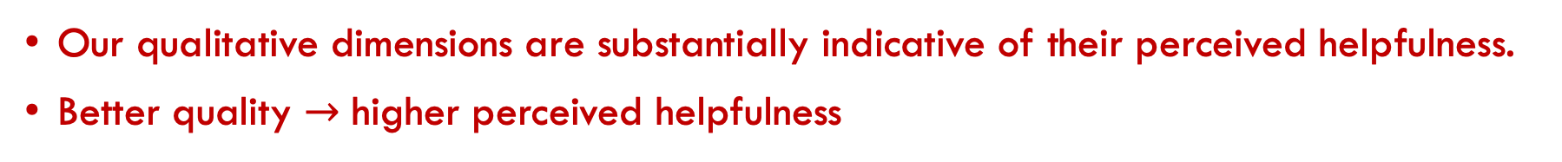
How Qualitative Dimensions Affect The Perceived Helpfulness
Spearman rank-order correlation coefficients between Helpfulness and the other Likert-based dimensions
Dimensions | r | p
Structural Correspondence | 0.191 | 0.003
Relational Similarity | 0.374 | 0.000
Familiarity | 0.312 | 0.000
Transferability | 0.445 | 0.000
Simplicity | 0.467 | 0.000
Our qualitative dimensions are substantially indicative of their perceived helpfulness.
Better quality $→$ higher perceived helpfulness
Notes:
To investigate how qualitative dimensions affect the perceived helpfulness of analogy-based explanations, we calculated Spearman rank-order correlation coefficients between the Helpfulness and other Likert-based dimensions.
The results show that our qualitative dimensions are substantially indicative of their perceived helpfulness.
Our findings suggest that if we ensure the generated explanations are of high quality across these dimensions, they have a higher chance to be helpful in understanding the target sentence.

Slide 15
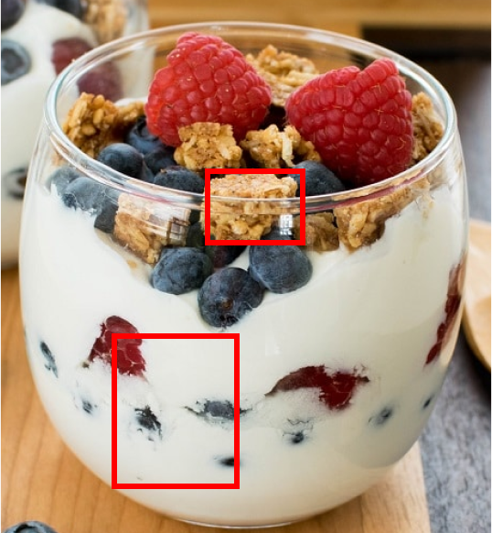
Context Matters
The explanations generated with places dataset show much higher Relational Similarity than the ones generated from calorie dataset (with significance)
Potential Cause
The relationship between “concept” and “label” in the place dataset is more explicit than in the calorie dataset.
Example from Calorie dataset: Nuts are seldom found in high calorie food. This is similar to how one cannot find fire hydrants in boats.
Notes:
In the comparison between the quality of analogy-based explanations from the two dataset, we found that the ones generated from places dataset show significantly higher relational similarity.
One potential cause is that the relationship between “concept” and “label” in the place dataset is more explicit than that in the calorie dataset

Slide 16
Key Takeaways
We provide a structured set of dimensions, which can be used to evaluate the quality of analogies. These dimensions were found to positively correlate with perceived helpfulness of analogy-based explanations
Promising future directions:
Novel human computation workflows for analogy generation
Generating high-quality analogy candidates with machine learning methods
Obtain useful commonsense knowledge to power personalized analogies
Data and code ➔ https://github.com/delftcrowd/HCOMP2022_ARCHIE
Notes:
In summary, according to existing literature, we proposed a structured set of dimensions to assess the quality of analogy-based explanations.
And found that these dimensions are positively correlated with perceived helpfulness of analogy-based explanations.
Based on our findings, we point out several promising future directions, like improving the analogy generation with machine learning methods in the loop.
Our data and code is now public on github.

Slide 17


Thanks!
Reach out to us if you want to collaborate.
Scan QR code for more HCOMP’22 work from our lab.
Notes:
Thanks for your listening! For more HCOMP work from our lab, you can scan the QR code

Slide 18
Key Findings and Implications
Subjectivity of Analogies
Disagreement is signal for improvement instead of noise.
User factors (e.g., experience, belief) matters, and further study qualitative dimensions on helpfulness is required
Commonsense explanations are not one-size-fits-all solution for laypeople. Need for personalization
Notes:
Taking disagreement from multiple explainees as a signal to further improve analogy-based explanations
We observe that high relational similarity does not necessarily translate into high perceived helpfulness. While analogy-based explanations with low relational similarity are always perceived less helpful.

Slide 19
Key Findings and Implications
Subjectivity of Analogies
Analogy Generation
The task is quite challenging for human, machine augmentation may be of good potential
For higher factual correctness, structural correspondence and relational similarity.
Notes:
In our study, we observed that around one third of generated analogies are not factually correct,
and that it can be difficult for workers to generate analogies that demonstrate a high Structural Correspondence and Relational Similarity.
Thus, we consider machine learning based methods combined with commonsense knowledge base can generate high quality candidates to augment humans in this task.

Slide 20
Summary
Our Contribution:
A novel analogy-based explanation generation method with non-expert crowds and a dataset of analogies generated using this method
An elaborate set of qualitative dimensions to assess the quality of analogy-based explanations
An extensive evaluation of the quality of the analogy-based explanations collected from two distinct AI tasks
Our findings reveal significant positive correlations between the qualitative dimensions of analogies and the perceived helpfulness of analogy-based explanations.

