Slide 1
Projet Drone Alten
Design et simulation d’un drone pour la mapping de site industriel.
Valentin Druart
Florent Dransart
Adrien Delhaye

Slide 2

Objectif
Réaliser un drone télécommandé pour le mapping de site industriel.
Déterminer les différents éléments nécessaire à la création d’un drone.
Simuler les différentes signaux et comportement des éléments du drone.
Effectuer le dimensionnement d’un prototype (virtuel).

Slide 3
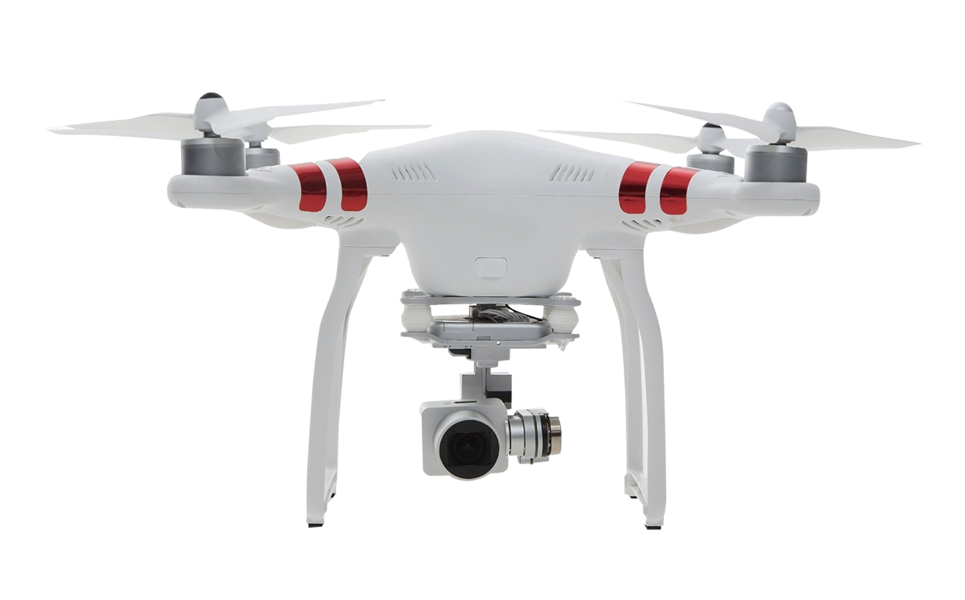
Cahier des Charges
Motors and Electronic Speed Controller
Battery Pack
Payload : camera
Sensor systems
And
communication
Flight Control system
Structure

Slide 4
Motors and Motors control
The Electronic Speed Controler (ESC) :
Motor-control topology (type of motor) : brushless motor?
ESC efficiency vs flight time vs cost
Battery voltage of the drone
Maximum speed of the ESC (in RPM)
PID control system : how to choose te parameters ?

Slide 5
Battery Pack
Choice of the battery :
Voltage of the battery
Capacity of the battery
Weight of the battery

Slide 6
Payload of the drone
Camera :
Which resolution ?
Which weight ?
Control of the camera (additional telecommunication for rotation,…)
Other Payload :
Light ?
Additional sensors ?
…

Slide 7
Sensors System and communication
Which sensors :
Acceleremoters : tilting of the drone and displacement
Gyroscope : Rotation speed and angle
Altimeter : get the actual altitude of the drone (calibration?)
Telecommunication:
Wireless communication with the drone system.
Bluetooth ? Wi-Fi ? …

Slide 8
Flight Controller
Embedded board :
An HDMI Input for the camera
A wide DC Voltage range to fit with the battery power (see battery).
The connection for the sensor and sensor themself (GPIO, UART,Accelerometer, Magnetometer,…)
Have a low power consumption (see battery)
A Wireless Communication support with hight-power-long-range (Mini-PCIe?)
Compatible port with the ESC.
Idea : Ventana GW5510 Rugged & Industrial Single Board Computer
https://www.gateworks.com/products/industrial-single-board-computers/imx6-single-board-computer-gateworks-ventana-family/gw5510-single-board-computer/

