Slide 1

Building and Growing with the Community
Delhi School of AI

Slide 2

Activities and Events
Hack-a-thons & Make-a-thons
Mentorships
Jam Sessions (Online + Offline)
Research Clubs
Delegating at Symposiums
Open Source Projects + Teams

Slide 3

Roles and Responsibilities
GitHub Repository Maintainers
Web Developers
Community Outreach Fellows
Event Management
Event Content Creators
Technical Writers
Social Media Experts
Co-Deans

Slide 4
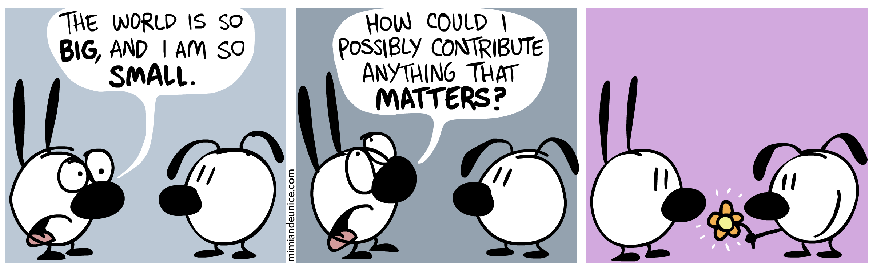
Community Expectations
Asking Questions
Participating Actively
Contributing Constructively
Encouraging Inclusivity
Sharing of Knowledge
Code of Conduct
https://github.com/delhischoolofai/delhischoolofai/blob/master/CODE_OF_CONDUCT.md

Slide 5












Slide 6




Website’s tech stack...

Slide 7

Resources and Materials
Study Material github.com/delhischoolofai/resources
Website github.com/delhischoolofai/delhischoolofai.github.io
Meetup Content github.com/delhischoolofai/delhischoolofai

Slide 8
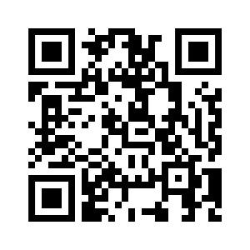
Getting to Know the community better.
Please fill out the form...

Slide 9
Thank you

