Slide 1
Analyses of Data on Non-Communicable Disease Mortality
Kyra Zhu and Delia Carlino

Slide 2
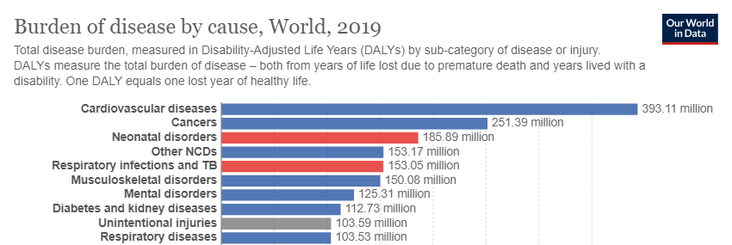
Non-Communicable Diseases (NCD) are the disease category with the highest burden of disease and highest rates of mortality
Notes:
41 million people die each year - equivalent to 74% of all global deaths

Slide 3
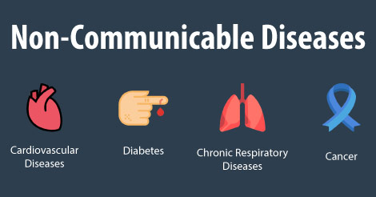
Four groups of diseases account for more than 15 million premature (between the ages of 30 and 69) and over 30 million total deaths per year
17.9 million
1.5 million
4.1 million
9.3 million
Notes:
Total annual deaths - not just premature deaths

Slide 4

NCD mortality can be investigated for patterns that can be used for a more focused response to health discrepancies and trends

Slide 5
Objectives
Examine WHO NCD mortality database for:
Sexual dimorphic trends
Region specific trends
Trends over time
Analysis of correlation with potential risk factors

Slide 6
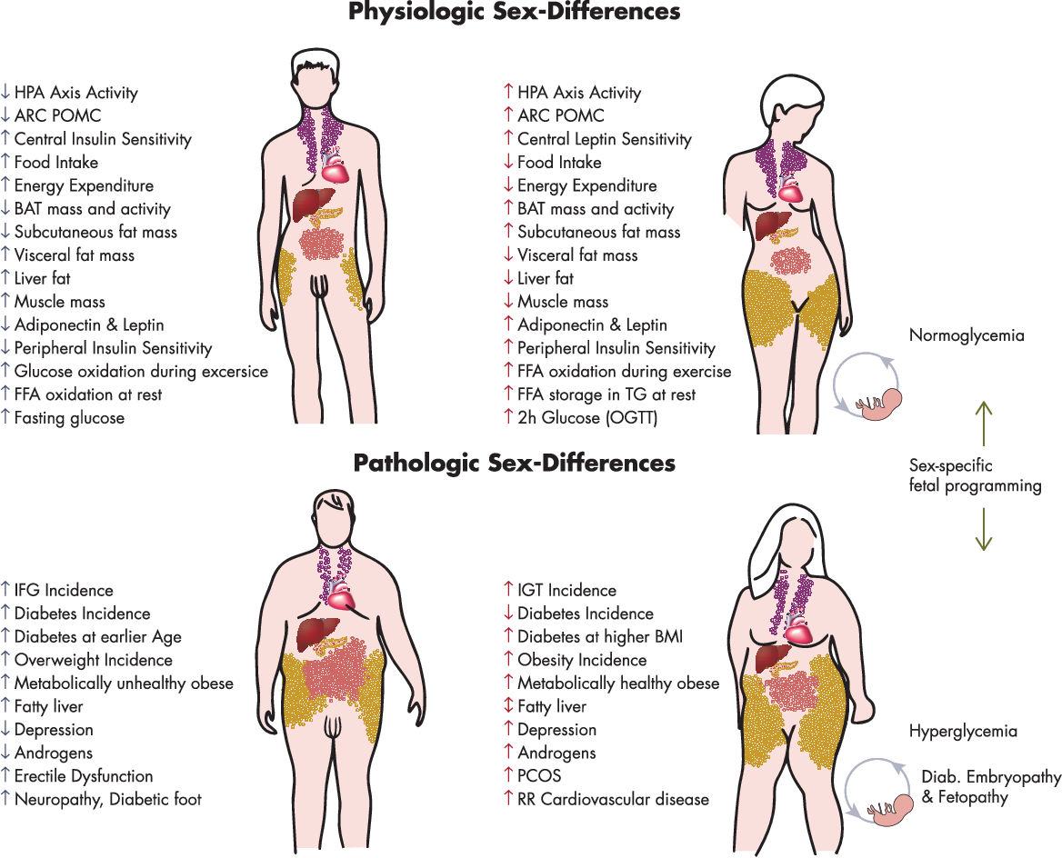
Sex is being recognized as a biological variable with influences on physiology and pathophysiology
Notes:
For the time being many analyses, including our consider sex as a binary in which hormonal, chromosomal, gonadal factors align. In many of these studies, including ours, gender is not considered as a seperate variable although studies have shown that the experience of gender does have physiological effects

Slide 7
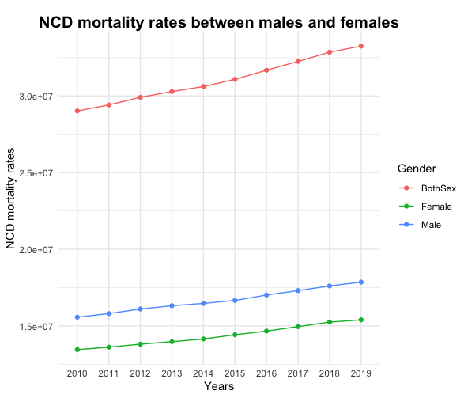
Males experience higher rates of NCD mortality

Slide 8
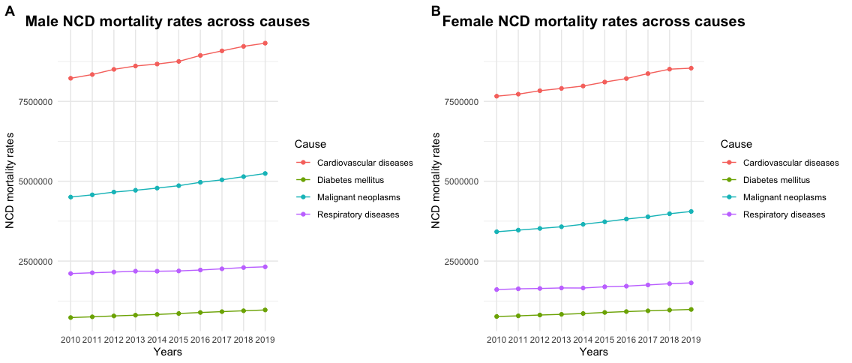
Both males and females experience significantly higher rates of cardiovascular disease mortality as opposed to other NCDs

Slide 9
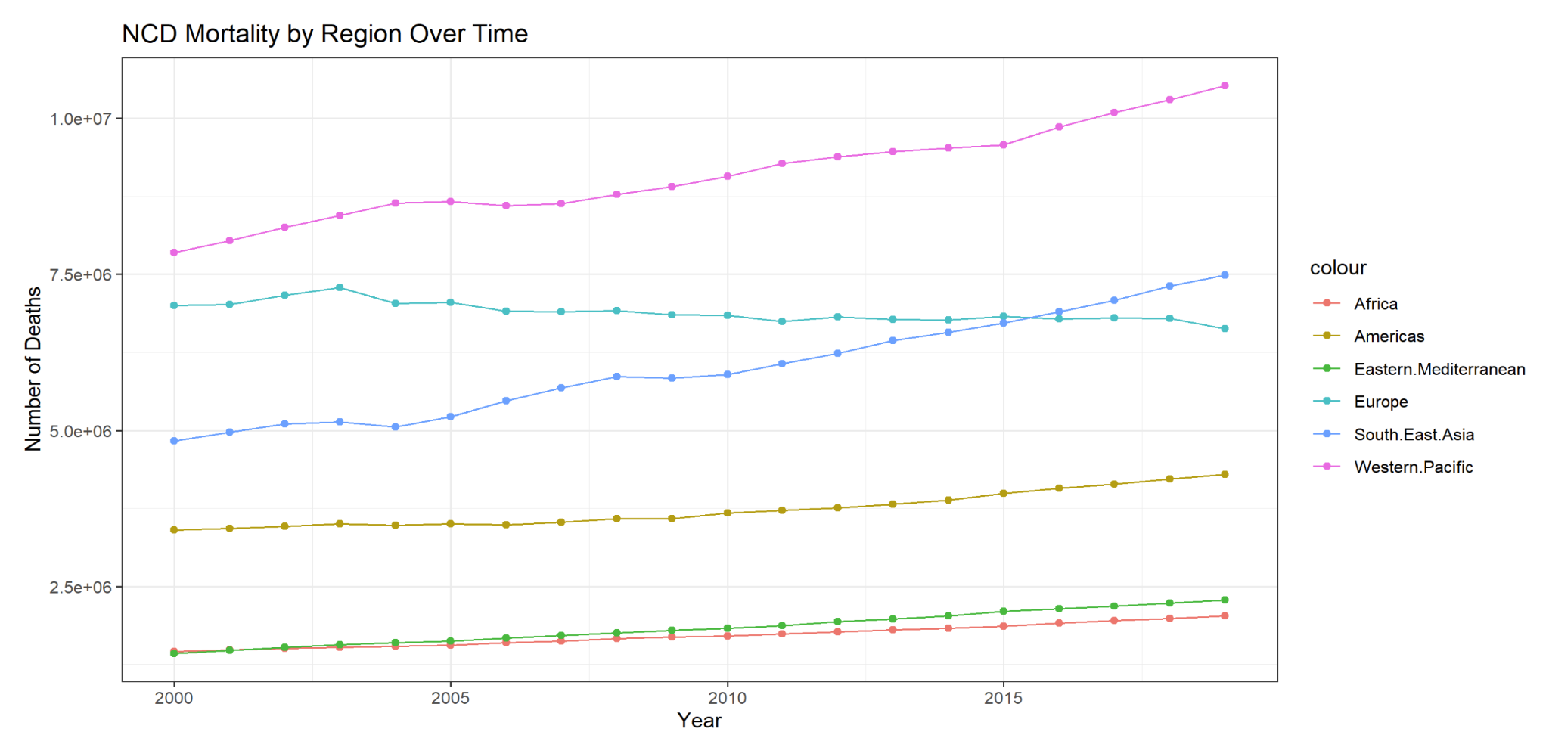
NCD Mortality has increased in the past 20 years

Slide 10
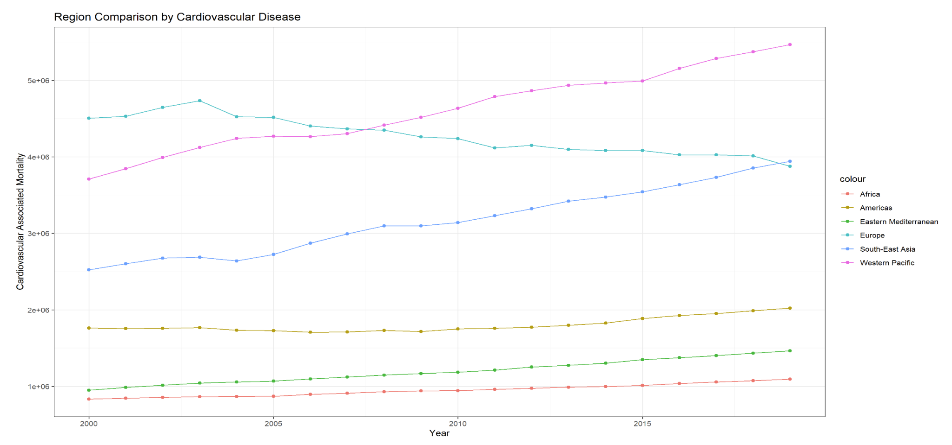
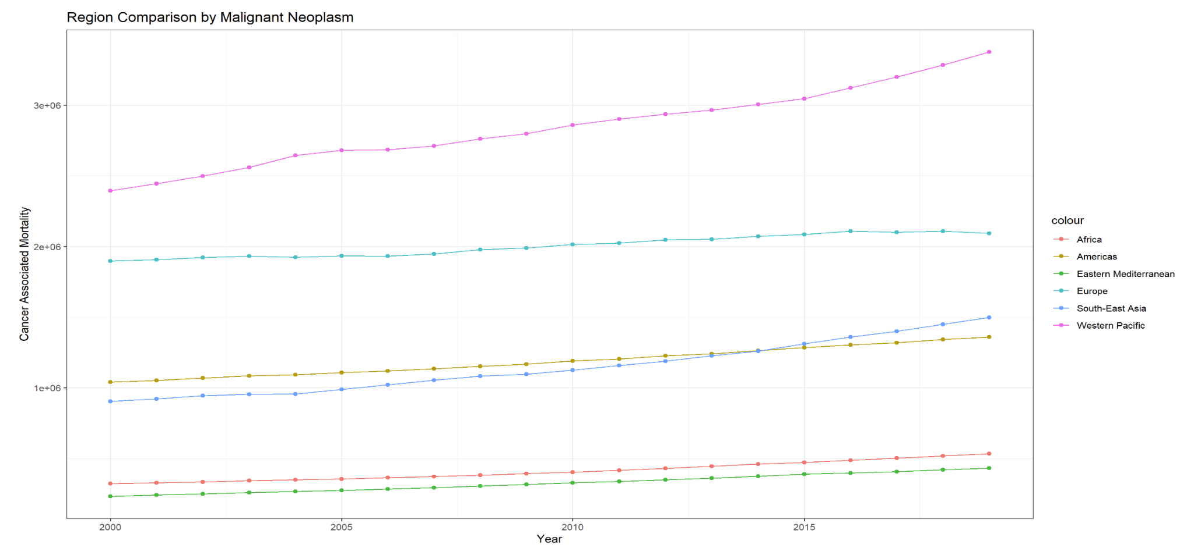
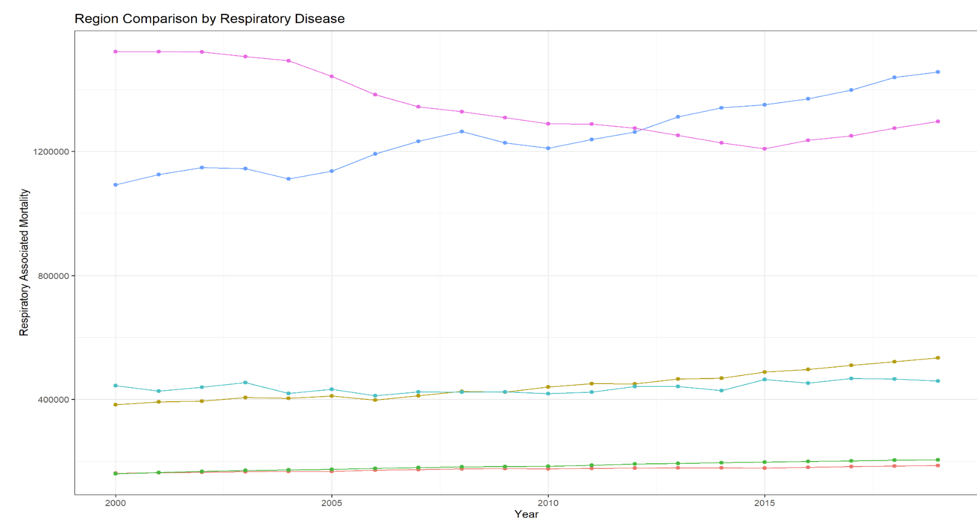

Slide 11
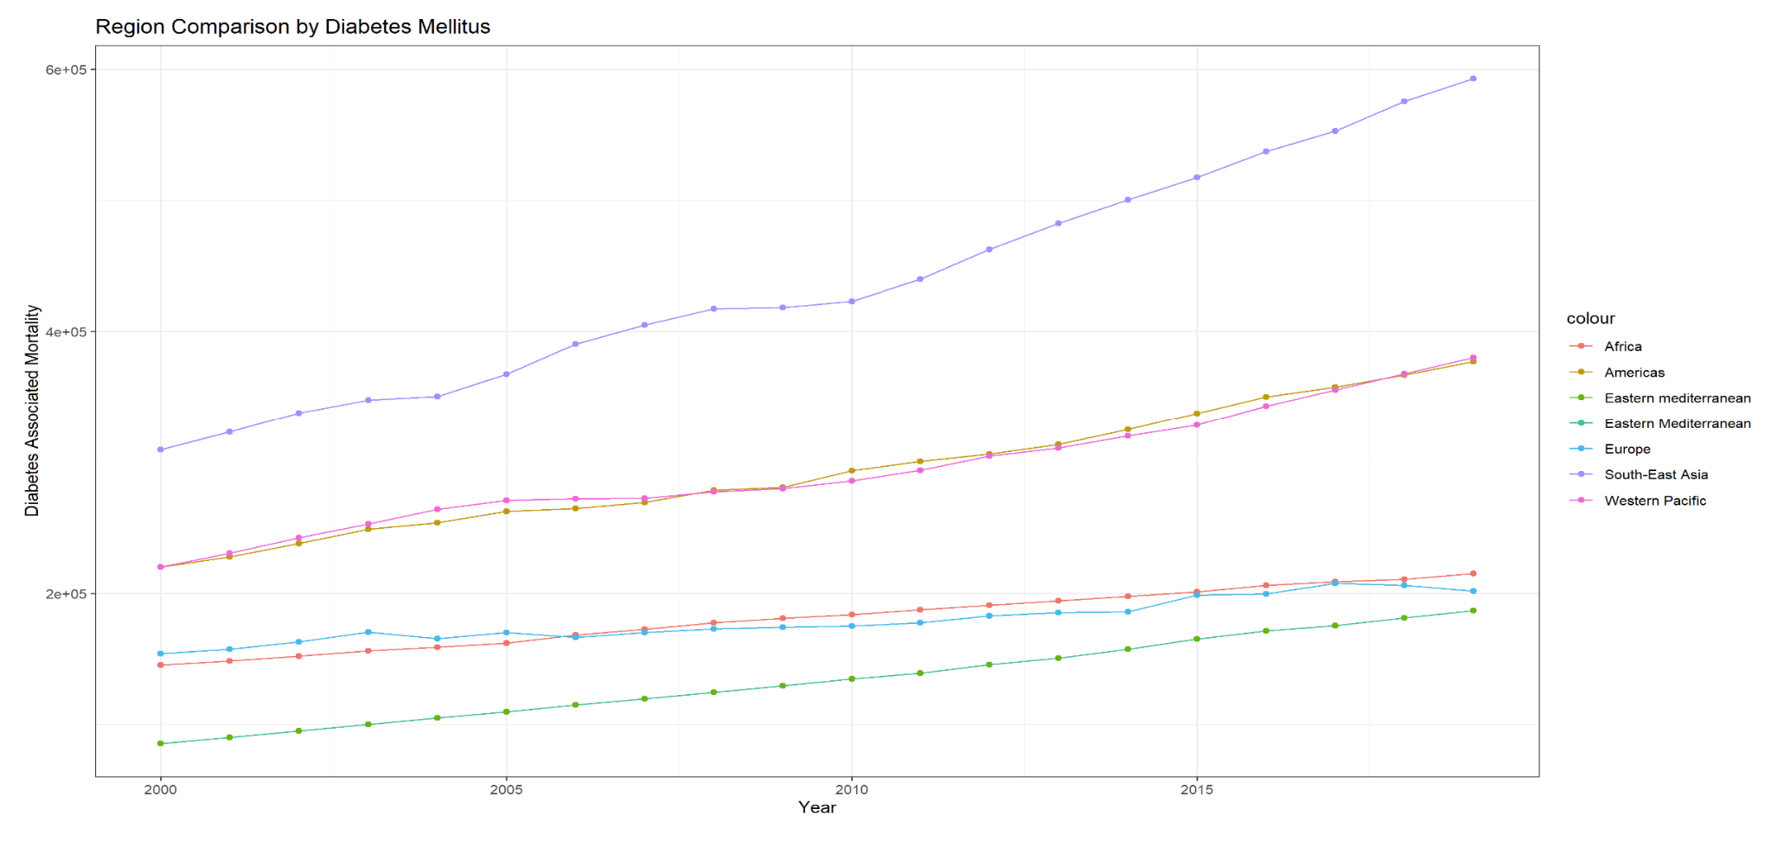
Diabetes associated mortality has increased in the past 20 years

Slide 12
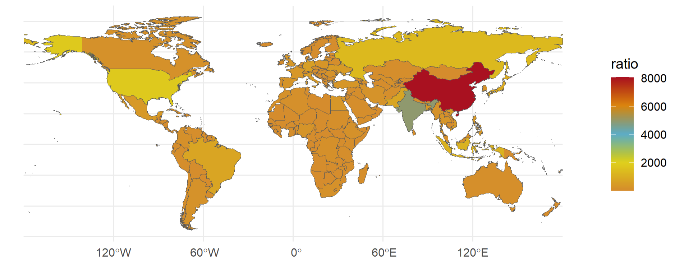
NCD Mortality has a higher incidence in countries with higher populations, even when measured as a ratio of deaths/population

Slide 13
Risk factors
Rates of adult obesity
Percentage of adults with BMI greater than or equal to 30
Rates of alcohol consumption
Percentage of alcohol consumers in the past 12 months
Blood pressure
Age standardized estimate of mean systolic blood pressure
Cholesterol
Crude estimate of mean total cholesterol
Human Development Index
Developed by the United Nations Development Programme
Life expectancy at birth
Mean years of schooling/expected years of schooling
Gross national income per capita

Slide 14

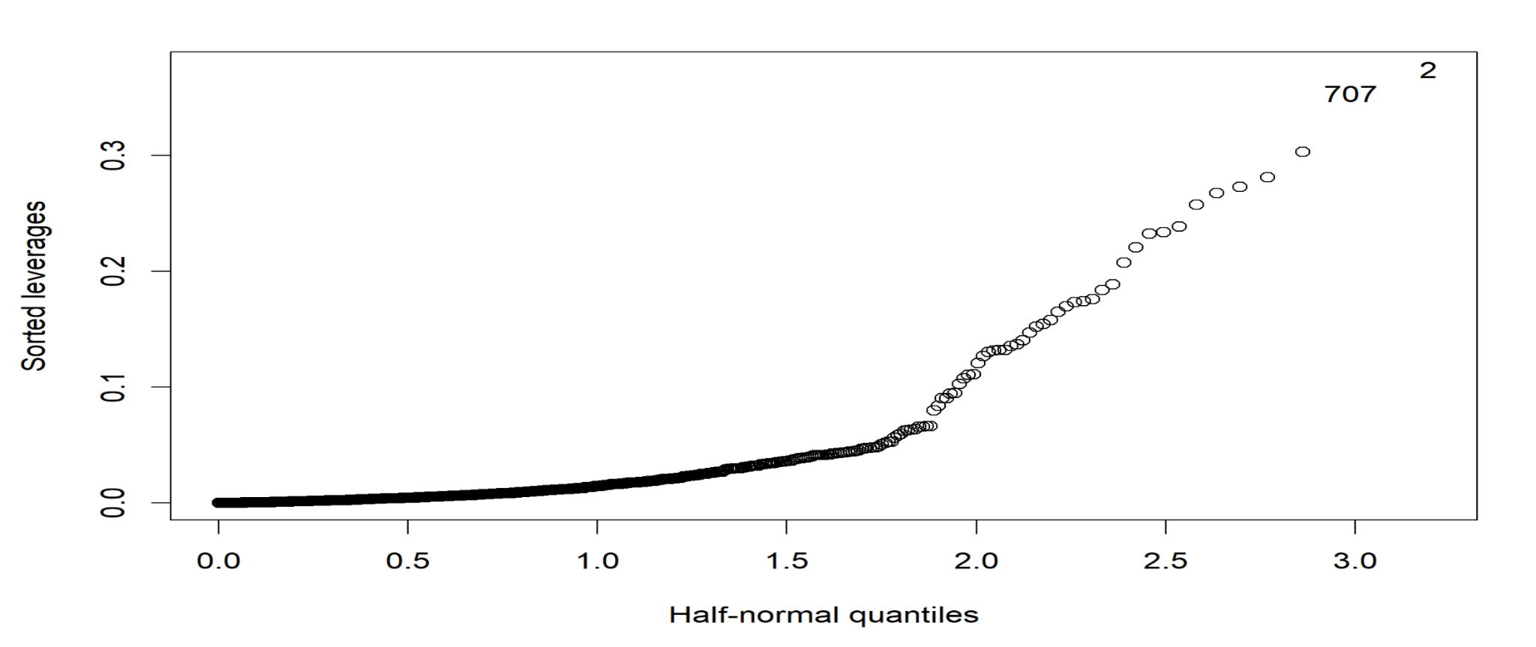
Regression Model: = 0: HDI rank and Cholesterol are most significant predictors

Slide 15
Conclusions
NCD Mortality trends are steadily increasing
Men have higher rates of NCD mortality for all four major disease groups
Certain regions are experiencing higher rates of mortality
Rates are increasing
Potential for powerful public health interventions
Cardiovascular disease rates are increasing
Potential for powerful public health interventions

