Slide 1

JAVA EE 7
The Java Platform, Enterprise Edition (Java EE), provides a standards-based platform for developing web and enterprise applications.
These applications are typically designed as multitier applications with:
  a frontend tier consisting of a web framework
  a middle tier providing security and transactions
  a backend tier providing connectivity to a database or a legacy system
These applications should be responsive and capable of scaling to accommodate the growth in user demand.

Slide 2
JAVA EE 7
JAVA EE specifications:
Web technologies
JSR 45: Debugging Support for Other Languages 1.0
JSR 52: Standard Tag Library for JavaServer Pages (JSTL) 1.2
JSR 245: JavaServer Pages (JSP) 2.3
JSR 340: Servlet 3.1
JSR 341: Expression Language 3.0
JSR 344: JavaServer Faces (JSF) 2.2
JSR 353: Java API for JSON Processing (JSON-P) 1.0
JSR 356: Java API for WebSocket 1.0

Slide 3
JAVA EE 7
Enterprise technologies
• JSR 236: Concurrency Utilities for Java EE 1.0
• JSR 250: Common Annotations for the Java Platform 1.2
• JSR 316: Managed Beans 1.0
• JSR 318: Interceptors 1.2
• JSR 322: Java EE Connector Architecture (JCA) 1.7
• JSR 330: Dependency Injection for Java 1.0
• JSR 338: Java Persistence API (JPA) 2.1
• JSR 343: Java Message Service (JMS) 2.0
• JSR 345: Enterprise JavaBeans (EJB) 3.2
• JSR 346: Contexts and Dependency Injection (CDI) for the Java EE
Platform 1.1
• JSR 349: Bean Validation 1.1
JSR 352: Batch Applications for Java Platform 1.0
• JSR 907: Java Transaction API (JTA) 1.2
• JSR 919: JavaMail 1.5

Slide 4
JAVA EE 7
Web service technologies
JSR 93: Java API for XML Registries (JAXR) 1.0 (optional for Java EE 7)
• JSR 101: Java API for XML-based RPC (JAX-RPC) 1.1 (optional for Java EE 7)
• JSR 109: Implementing Enterprise Web Services 1.4
• JSR 181: Web Services Metadata for the Java Platform 2.1
• JSR 222: Java Architecture for XML Binding (JAXB) 2.2
• JSR 224: Java API for XML Web Services (JAX-WS) 2.2
• JSR 339: Java API for RESTful Web Services (JAX-RS) 2.0

Slide 5
JAVA EE 7
Management and security technologies
JSR 77: J2EE Management API 1.1
JSR 88: Java Platform EE Application Deployment API 1.2 (optional for Java EE 7)
JSR 115: Java Authorization Contract and Containers (JACC) 1.5
JSR 196: Java Authentication Service Provider Inteface for Containers
(JASPIC) 1.1

Slide 6
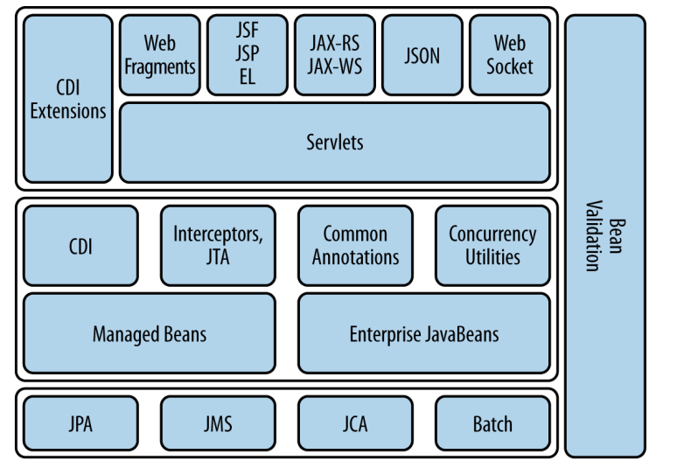
Architecture
JAVA EE 7

Slide 8




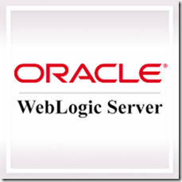
Application servers

Slide 9
Servlets
Servlet 3.1 – JSR 340
https://jcp.org/aboutJava/communityprocess/final/jsr340/index.html

Slide 10
Servlets
A servlet is a web component hosted in a servlet container and generates dynamic content
The web clients interact with a servlet using a request/response pattern
The servlet container is responsible for the life cycle of the servlet, receives requests and sends responses, and performs any other encoding/decoding required as part of that

Slide 11
Servlets
A servlet is defined using the @WebServlet annotation on a POJO, and must extend the javax.servlet.http.HttpServlet class
@WebServlet("/account")
public class AccountServlet extends javax.servlet.http.HttpServlet {
  //. . .
}
@WebServlet(urlPatterns={"/account", "/accountServlet"})
public class AccountServlet extends javax.servlet.http.HttpServlet {
//. . .
}

Slide 12
Servlets
The HttpServlet interface has one doXXX method to handle each of HTTP GET , POST , PUT , DELETE , HEAD , OPTIONS , and TRACE requests.
Typically the developer is concerned with overriding the doGet and doPost methods.
Handling the GET request:
@WebServlet("/account")
public class AccountServlet extends javax.servlet.http.HttpServlet {
@Override
protected void doGet(HttpServletRequest request,
HttpServletResponse response) {
  //. . .
}

Slide 13
Servlets
protected void doGet(HttpServletRequest request,
HttpServletResponse response) {
  try (PrintWriter out = response.getWriter()) {
    out.println("<html><head>");
    out.println("<title>MyServlet</title>");
    out.println("</head><body>");
    out.println("<h1>My First Servlet</h1>");
    //. . .
    out.println("</body></html>");
  } finally {
    //. . .
  }
}

Slide 14
Servlets
Acccesing request parameters:
protected void doGet(HttpServletRequest request,
HttpServletResponse response) {
  String txValue = request.getParameter("tx");
//. . .
}
Initialization parameters, also known as init params, may be defined on a servlet to store startup and configuration information
@Override
public void init(ServletConfig config) throws ServletException {
  type = config.getInitParameter("type");
  //. . .
}

Slide 15
Servlets
Servlet’s lifecycle methods (inherited from javax.servlet.Servlet interface)
  init
  service
  destroy

Slide 16
Servlets
web.xml
<?xml version="1.0" encoding="UTF-8"?>
<web-app version="3.1"
xmlns="http://xmlns.jcp.org/xml/ns/javaee"
xmlns:xsi="http://www.w3.org/2001/XMLSchema-instance"
xsi:schemaLocation="http://xmlns.jcp.org/xml/ns/javaee
http://xmlns.jcp.org/xml/ns/javaee/web-app_3_1.xsd">
<servlet>
<servlet-name>AccountServlet</servlet-name>
<servlet-class>org.sample.AccountServlet</servlet-class>
</servlet>
<servlet-mapping>
<servlet-name>AccountServlet</servlet-name>
<url-pattern>/account</url-pattern>
</servlet-mapping>
</web-app>

Slide 17
Servlets
Accesing HTTP session
protected void doGet(HttpServletRequest request,
HttpServletResponse response) {
HttpSession session = request.getSession(true);
  //. . .
}
Forwarding request
protected void doGet(HttpServletRequest request,
HttpServletResponse response) {
  request.getRequestDispatcher("bank").forward(request, response);
  //. . .
}
Redirecting request
protected void doGet(HttpServletRequest request,
HttpServletResponse response) {
  //. . .
  response.sendRedirect("http://example.com/SomeOtherServlet");
}

Slide 18
JAX-RS 2.0(Java API for RESTful Webservices) - JSR 339
https://jcp.org/aboutJava/communityprocess/final/jsr339/index.html

Slide 19
JAX-RS
REST is an architectural style of services that utilizes web standards.
Everything can be identified as a resource, and each resource can be uniquely identified by a URI
A resource can be represented in multiple formats, defined by a media type. Standard methods are defined for the client and server to negotiate on the content type of the resource
Use standard HTTP methods to interact with the resource:
    GET to retrieve a resource
    POST to create a resource
    PUT to update a resource
    DELETE to remove a resource
Communication between the client and the endpoint is stateless.

Slide 20
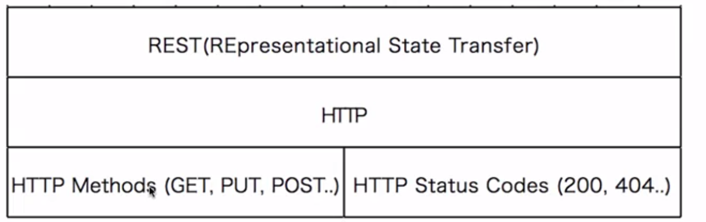
JAX-RS
Make best use of HTTP

Slide 21
JAX-RS
Key abstraction - Resource
Resource – identified by an URI (Uniform Resource Identifier)
  /courses
  /courses/1
  /students
  /students/1
  /students/1/courses
  /students/1/courses/1
A resource can have different respresentations:
  XML
  JSON
  HTML

Slide 22
JAX-RS
Create a student : POST /students
Delete a student : DELETE /students/1
Get all students : GET /students
Get one student : GET /students/1
Get all courses for a student : GET /students/1/courses
Add a course to a student : POST /student/1/courses

Slide 23
JAX-RS
Mapping a JAX-RS resource
@Path("orders")
public class OrderResource {
@GET
public List<Order> getAll() {
//. . .
}
@GET
@Path("{oid}")
public Order getOrder(@PathParam("oid")int id) {
//. . .
}
}
@XmlRootElement
public class Order {
int id;
//. . .
}
GET http://localhost:8080/store/webresources/orders
GET http://localhost:8080/store/webresources/orders/1

Slide 24
JAX-RS
@QueryParam binds a value of a query param:
public List<Order> getAll(@QueryParam("start")int from,
@QueryParam("page")int page) {
//. . .
}
GET http://localhost:8080/store/webresources/orders?start=10&page=20
@CookieParam binds the value of a cookie:
public Order getOrder(
@CookieParam("JSESSIONID")String sessionid) {
//. . .
}
@HeaderParam binds the value of an HTTP header:
public Order getOrder(
@HeaderParam("Accept")String accept) {
//. . .
}

Slide 25
JAX-RS
@FormParam binds the value of a form parameter contained within a request entity body
@MatrixParam binds the name/value parameters in the URI path:
public List<Order> getAll(@MatrixParam("start")int from,
@MatrixParam("page")int page) {
//. . .
}
GET http://localhost:8080/store/webresources/orders;start=10;page=20

Slide 26
JAX-RS
You can obtain more details about the application deployment context and the context of individual requests using the @Context annotation.
@Path("orders")
public class OrderResource {
@Context Application app;
@Context UriInfo uri;
@Context HttpHeaders headers;
@Context Request request;
@Context SecurityContext security;
@GET
@Produces("application/xml")
public List<Order> getAll(@QueryParam("start")int from,
@QueryParam("end")int to) {
//. . .(app.getClasses());
//. . .(uri.getPath());
//. . .(headers.getRequestHeader(HttpHeaders.ACCEPT));
//. . .(headers.getCookies());
//. . .(request.getMethod());
//. . .(security.isSecure());
//. .
}
}

Slide 27
JAX-RS
Typically, a RESTful resource is bundled in a .war file along with other classes and resources.
The Application class and @ApplicationPath annotation are used to specifythe base path for all the RESTful resources in the packaged archive
The Application class also provides additional metadata about the application
@ApplicationPath("webresources")
public class ApplicationConfig extends Application {
}

Slide 28
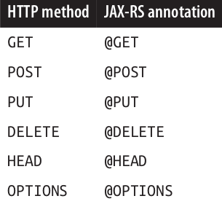
JAX-RS
HTTP methods supported by JAX-RS

Slide 29
JAX-RS
@POST example
<form method="post" action="webresources/orders/create">
  Order Number: <input type="text" name="id"/><br/>
  Customer Name: <input type="text" name="name"/><br/>
  <input type="submit" value="Create Order"/>
</form>
@POST
@Path("create")
@Consumes("application/x-www-form-urlencoded")
public Order createOrder(@FormParam("id")int id,
@FormParam("name") String name) {
  Order order = new Order();
  order.setId(id);
  order.setName(name);
  return order;
}

Slide 30
JAX-RS
@PUT example
@PUT
@Path("{id}")
@Consumes("*/xml")
public Order putXml(@PathParam("id")int id, String content) {
  Order order = findOrder(id);
  // update order from "content"
  . . .
  return order;
}

Slide 31
JAX-RS
@DELETE example
@DELETE
@Path("{id}")
public void deleteOrder(@PathParam("id")int id) {
  Order order = findOrder(id);
  // delete order
}

Slide 32
JAX-RS
@HEAD example
@HEAD
@Path("{id}")
public void headOrder(@PathParam("id")int id) {
System.out.println("HEAD");
}

Slide 33
JAX-RS
@OPTIONS example
@OPTIONS
@Path("{id}")
public Response options() {
// create a custom Response and return
}

Slide 34
JAX-RS
Multiple Resource Representations
  By default, a RESTful resource is published or consumed with the */* MIME type
  A RESTful resource can restrict the media types supported by request and response using the @Consumes and @Produces annotations
  These annotations may be specified on the resource class or a resource method.
  @GET
  @Path("{oid}")
  @Produces({"application/xml", "application/json"})
  public Order getOrder(@PathParam("oid")int id) { . . . }
  The exact return type of the response is determined by the HTTP Accept header in the request
  Wilcard are supported
  @GET
  @Path("{oid}")
  @Produces("application/*")
  public Order getOrder(@PathParam("oid")int id) { . . . }

Slide 35
JAX-RS
Multiple Resource Representations
  @POST
  @Path("{oid}")
  @Consumes({"application/xml", "application/json"})
  public Order getOrder(@PathParam("oid")int id) { . . . }
  The resource method invoked is determined by the HTTP Content-Type header of the request.

Slide 36
JAX-RS
Multiple Resource Representations
  JAX-RS 2.0 allows you to indicate a media preference on the server side using the qs(short for “quality on server”) parameter
  @POST
  @Path("{oid}")
  @Consumes({"application/xml; qs=0.75", "application/json; qs=1"})
  public Order getOrder(@PathParam("oid")int id) { . . . }
  If a client issues a request with no preference for a particular representation or with an Accept header of application/*; , then the server will select a representation with a higher qs value— application/json in this case.

Slide 37
JAX-RS
Mapping Exceptions
  An application-specific exception may be thrown from within the resource method and propagated to the client. The application can supply checked or exception mapping to an instance of the Response class.
  public class OrderNotFoundException extends RuntimeException {
  public OrderNotFoundException(int id) {
  super(id + " order not found");
  }
  }
  @Path("{id}")
  public Order getOrder(@PathParam("id")int id) {
  Order order = null;
  if (order == null) {
    throw new OrderNotFoundException(id);
  }
  //. . .
  return order;
  }

Slide 38
JAX-RS
The exception mapper will look like:
@Provider
public class OrderNotFoundExceptionMapper
implements ExceptionMapper<OrderNotFoundException> {
@Override
public Response toResponse(OrderNotFoundException exception) {
  return Response
    .status(Response.Status.PRECONDITION_FAILED)
    .entity("Order not found")
    .build();
}
}

Slide 39
JAX-RS
Client API
JAX-RS 2 adds a new Client API that can be used to access web resources
and provides integration with JAX-RS providers
Client client = ClientBuilder.newClient();
Order order = client
  .target("http://localhost:8080/store/webresources/orders")
  .path("{oid}")
  .resolveTemplate("oid", 1)
  .get(Order.class)
Order order = client
  .target(...)
  .request()
  .post(Entity.entity(new Order(1), "application/json"),
    Order.class);
client.target("...")
.target("{oid}")
.resolveTemplate("oid", 1)
.request()
.delete();

Slide 40
JAX-WS (Java API for XML-Based Web Services) - JSR 224
https://jcp.org/aboutJava/communityprocess/mrel/jsr224/index4.html

Slide 41
JAX-WS
SOAP is an XML-based messaging protocol used as a data format for exchanging information over web services
The SOAP specification defines an envelope that represents the contents of a SOAP message and encoding rules for data types
The SOAP protocol provides a way to communicate among applications running on different operating systems, with different technologies, and different programming languages
Java API for XML-Based Web Services (JAX-WS) hides the complexity of the SOAP protocol and provides a simple API for development and deployment of web service endpoints and clients

Slide 42
JAX-WS
The JAX-WS specification defines mapping from WSDL 1.1 to Java. This mapping defines how different WSDL constructs such as wsdl:service , wsdl:portType , and wsdl:operation are mapped to Java
Java to WSDL 1.1 mapping is also defined by this specification. This mapping defines how Java packages, classes, interfaces, methods, parameters, and other parts of a web service endpoint are mapped to WSDL 1.1 constructs.

Slide 43
JAX-WS
You can convert a POJO to a SOAP-based web service endpoint by adding the @WebService annotation:
@WebService
public class SimpleWebService {
  public String sayHello(String name) {
    return "Hello " + name;
  }
}
All public methods of the class are exposed as web service operations.

Slide 44
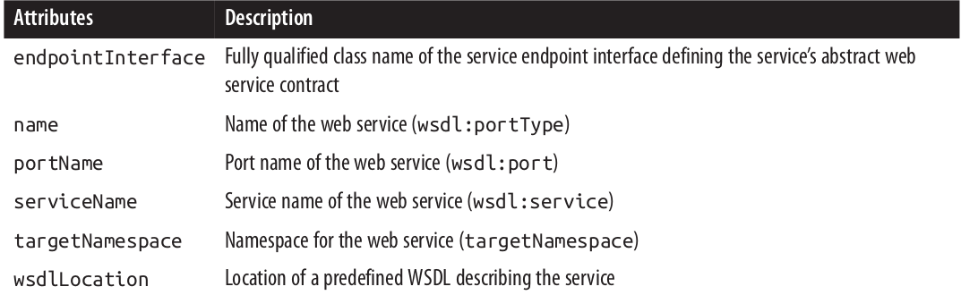
JAX-WS
@WebService attributes

Slide 45
JAX-WS
Web service client
  Use wsconsume to generate client artifacts
  @WebServiceRef(wsdlLocation ="http://localhost:8080/training_javaee7Web/Hello?WSDL")
  private HelloService service;
  service.getHelloPort().sayHello("Gigi")

Slide 46
Enterprise Java Beans
EJB 3.2(Enterprise java beans) – JSR 345
https://jcp.org/aboutJava/communityprocess/final/jsr345/index.html

Slide 47
Enterprise Java Beans
What is it an Enterprise Java Bean?
a server-side component that encapsulates the business logic of an application
the business logic is the code that fulfills the purpose of the application

Slide 48
Enterprise Java Beans
Benefits of EJB?
Simplify the development of large, distributed applications
EJB container provides system-level services to
enterprise beans like security, transactions, concurrency etc.
Clients are thinner because the business is already contained in the business layer
EJBs can be reused

Slide 49
Enterprise Java Beans
Types of Enterprise Beans
Session : Performs a task for a client; optionally, may implement a web service
Message-driven : Acts as a listener for a particular messaging type, such as the Java Message Service API

Slide 50
Enterprise Java Beans
What is a Session Bean?
encapsulates business logic that can be invoked programmatically by a client over local, remote, or web service client views
to access an application that is deployed on the server, the client invokes the session bean's methods.

Slide 51
Enterprise Java Beans
Types of Session beans
Stateful Session Beans
Stateless Session Beans
Singleton Session Beans

Slide 52
Enterprise Java Beans
Stateful Session Bean
A stateful session bean contains conversational state for a specific client.
The state is stored in the session bean instance’s field values.
A stateful session bean is not shared; it can have only one client
The state is retained for the duration of the client/bean session. If the client removes the bean, the session ends and the state disappears.

Slide 53
Enterprise Java Beans
Stateful Session Bean with no-interface view
@Stateful
public class CartBean {
List<String> items;
public CartBean() {
items = new ArrayList<>();
}
public void addItem(String item) {
items.add(item);
}
public void removeItem(String item) {
items.remove(item);
}
public void purchase() {
//. . .
}
public List<String> getItems() {
return items;
}
@Remove
public void remove() {
items = null;
}
}

Slide 54
Enterprise Java Beans
Stateful Session Bean with remote view
@Remote
public interface Cart {
public void addItem(String item);
public void removeItem(String item);
public void purchase();
}
@Stateful
public class CartBean implements Cart {
public float addItem(String item) {
//. . .
}
public void removeItem(String item) {
//. . .
}
}

Slide 55
Enterprise Java Beans
Stateless Session Bean
A stateless session bean does not contain any conversational state for a specific client.
All instances of a stateless bean are equivalent, so the container can choose to delegate a client-invoked method to any available instance.
Because they can support multiple clients, stateless session beans can offer better scalability for applications that require large numbers of clients.
A stateless session bean can implement a web service, but a stateful session bean cannot.

Slide 56
Enterprise Java Beans
Stateless session bean with no-interface view
@Stateless
public class AccountSessionBean {
private float amount = 0;
public String withdraw(float amount) {
this.amount -= amount;
return "Withdrawn: " + amount;
}
public String deposit(float amount) {
this.amount += amount;
return "Deposited: " + amount;
}
public float getAmount() {
return this.amount;
}
}

Slide 57
Enterprise Java Beans
Stateless session bean with remote view
@Remote
public interface Account {
public String withdraw(float amount);
public String deposit(float amount);
public float getAmount();
}
@Stateless
public class AccountSessionBean {
private float amount = 0;
public String withdraw(float amount) {
this.amount -= amount;
return "Withdrawn: " + amount;
}
public String deposit(float amount) {
this.amount += amount;
return "Deposited: " + amount;
}
public float getAmount() {
return this.amount;
}
}

Slide 58
Enterprise Java Beans
Singleton session bean
A singleton session beanis instantiated once per application and exists for the lifecycle of the application.
Singleton session beans are designed for circumstances in which a single enterprise bean instance is shared across and concurrently accessed by clients.
Like stateless session beans, singleton session beans can implement web service endpoints.
Applications that use a singleton session bean may specify that the singleton should be instantiated upon application startup, which allows the singleton to perform initialization tasks for the application.

Slide 59
Enterprise Java Beans
Singleton session bean
A singleton session beanis instantiated once per application and exists for the lifecycle of the application.
Singleton session beans are designed for circumstances in which a single enterprise bean instance is shared across and concurrently accessed by clients.
Like stateless session beans, singleton session beans can implement web service endpoints.
Applications that use a singleton session bean may specify that the singleton should be instantiated upon application startup, which allows the singleton to perform initialization tasks for the application.

Slide 60
Enterprise Java Beans
Singleton session bean with bean managed concurrency
@Startup
@Singleton
@ConcurrencyManagement(ConcurrencyManagementType.BEAN)
public class MySingletonBeanManagedConcurrency{
volatile StringBuilder builder;
@PostConstruct
private void postConstruct() {
builder = new StringBuilder();
System.out.println("postConstruct");
}
public String readSomething() {
return "current timestamp: " + LocalDateTime.now();
}
public String writeSomething(String something) {
synchronized (builder) {
builder.append(something);
}
return builder.toString() + " : " + LocalDateTime.now();
}
}

Slide 61
Enterprise Java Beans
Singleton session bean with bean managed concurrency
@Startup
@Singleton
@ConcurrencyManagement(ConcurrencyManagementType.BEAN)
public class MySingletonBeanManagedConcurrency{
volatile StringBuilder builder;
@PostConstruct
private void postConstruct() {
builder = new StringBuilder();
System.out.println("postConstruct");
}
public String readSomething() {
return "current timestamp: " + LocalDateTime.now();
}
public String writeSomething(String something) {
synchronized (builder) {
builder.append(something);
}
return builder.toString() + " : " + LocalDateTime.now();
}
}

Slide 62
Enterprise Java Beans
Message driven bean
A message-driven bean (MDB) is a container-managed bean that is used to process
messages asynchronously.
An MDB can implement any messaging type, but is most
commonly used to process Java Message Service (JMS) messages.
These beans are state‐less and are invoked by the container when a JMS message arrives at the destination.
A session bean can receive a JMS message synchronously, but a message-driven bean can receive a message asynchronously.

Slide 63
Enterprise Java Beans
JMS (Java Message Service)
Allows sending and receiving messages between distributed systems
provides a way for Java programs to create, send, receive, and read an enterprise messaging system’s messages.
JMS defines the following concepts:
JMS provider - An implementation of the JMS interfaces, included in a Java EE implementation.
JMS client - A Java program that produces and/or receives messages. Any Java EE applicationcomponent can act as a JMS client.
JMS message - An object that contains the data transferred between JMS clients.
A JMS producer/publisher creates and sends messages.
A JMS consumer/subscriber receives and consumes messages.
Administered objects - Objects created and preconfigured by an administrator. They typically refer to ConnectionFactory and Destination, and are identified by a JNDI name.
ConnectionFactory is used to create a connection with the provider.
The Destination is the object used by the client to specify the destination of messages it is sending and the source of messages it is receiving.
JMS supports two messaging models: Point-to-Point and Publish-Subscribe.

Slide 64
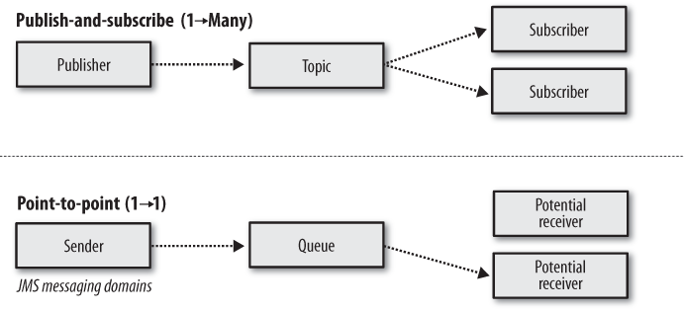
Enterprise Java Beans
JMS messaging models

Slide 65
Enterprise Java Beans
Message Driven Bean which receives messages from a JMS queue
@MessageDriven(activationConfig = {
@ActivationConfigProperty(propertyName = "destinationLookup",
propertyValue = "java:jboss/exported/jms/queue/test"),
@ActivationConfigProperty(propertyName = "destinationType",
propertyValue = "javax.jms.Queue")
})
public class QueueMessageDrivenBean implements MessageListener {
@Resource
private MessageDrivenContext mdc;
public void onMessage(Message inMessage){
try {
if (inMessage instanceof TextMessage) {
System.out.println("Queue received message: " + inMessage.getBody(String.class));
} else {
System.out.println("Message is in the wrong format");
}
}catch (JMSException e){
mdc.setRollbackOnly();
}
}
}

Slide 66
Enterprise Java Beans
Message Driven Bean which receives messages from a JMS topic
@MessageDriven(activationConfig =
{@ActivationConfigProperty(propertyName = "destinationLookup", propertyValue = "java:jboss/exported/jms/topic/test"),
@ActivationConfigProperty(propertyName = "destinationType", propertyValue = "javax.jms.Topic")})
public class TopicMessageDrivenBean implements MessageListener {
@Resource
MessageDrivenContext mdc;
@Override
public void onMessage(Message message) {
if (message instanceof TextMessage) {
TextMessage textMessage = (TextMessage) message;
try {
System.out.println("Topic received message: " + textMessage.getText());
} catch (JMSException e) {
mdc.setRollbackOnly();
}
} else {
System.out.println("Message has bad format");
}
}
}

Slide 67
Enterprise Java Beans
Accesing enterprise beans
Clients access enterprise beans either through a no-interface view or through a business interface
A no-interface view of an enterprise bean exposes the public methods of the enterprise bean implementation class to client
A business interface is a standard Java programming language interface that contains the business methods of the enterprise bean
@Local
@Remote
Session beans can have more than one business interface

Slide 68
Enterprise Java Beans
Using Enterprise Beans in Clients
dependency injection (if client runs in same JAVA EE app)
@EJB
JNDI lookup (if client is not necesarilly in the same JAVA EE app)
java:global[/application name]/module name/enterprise bean name[/interface name]
java:module/enterprise bean name/[interface name]
java:app[/module name]/enterprise bean name[/interface name]

Slide 69
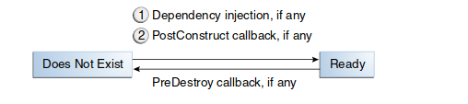
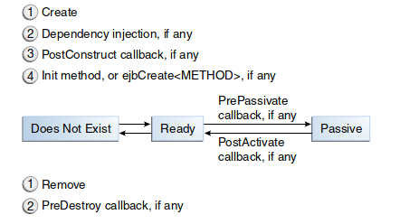
Enterprise Java Beans
Lifecycle for Enterprise Java Beans
For Stateless & Singleton Session bean
For Stateful Session bean

Slide 70
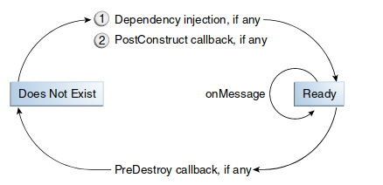
Enterprise Java Beans
Lifecycle for Enterprise Java Beans
For Message Driven Bean

Slide 71
CDI 1.1 (Contexts and dependency injection)
https://jcp.org/aboutJava/communityprocess/final/jsr346/index.html

Slide 72
CDI
Contexts and Dependency injection
CDI defines a type-safe dependency injection mechanism in the Java EE platform
A bean specifies only the type and semantics of other beans it depends upon allowing compile time validation
Strong typing, loose coupling between the client and the bean
Almost any POJO can be injected as a CDI bean including EJBs, JNDI resources, entity classes, and persistence units and context

Slide 73
CDI
Discovery of beans
beans.xml should be present in WEB-INF directory for web applications or in META-INF directory in case of an ejb module or jar file
<beans
xmlns="http://xmlns.jcp.org/xml/ns/javaee"
xmlns:xsi="http://www.w3.org/2001/XMLSchema-instance"
xsi:schemaLocation="http://xmlns.jcp.org/xml/ns/javaee
http://xmlns.jcp.org/xml/ns/javaee/beans_1_1.xsd
bean-discovery-mode="all">
</beans>
Bean discovery modes
all – All types in the archive are considered for injection
annotated - Only types with bean-defining annotations will be considered for injection
none – Disable CDI

Slide 74
CDI
Injection Points
Field
@Stateless
public class GreetingService {
@Inject
Greeting greeting;
public String greet(String name) {
return greeting.greet(name);
}
}
Method
Greeting greeting;
@Inject
public setGreeting(Greeting greeting) {
this.greeting = greeting;
}
Constructor
Greeting greeting;
@Inject
public SimpleGreeting(Greeting greeting) {
this.greeting = greeting;
}

Slide 75
CDI
Qualifiers
Qualifier allows you to uniquely specify a bean to be injected among its multiple implementations
Defining new qualifier
@Qualifier
@Retention(RUNTIME)
@Target({METHOD, FIELD, PARAMETER, TYPE})
public @interface Fancy {
}
@Fancy
public class FancyGreeting implements Greeting {
public String greet(String name) {
return "Nice to meet you, hello" + name;
}
}
Using predefined @Named qualifier
@Named("simple")
public class SimpleGreeting implements Greeting {…}
@Inject
public void setGreeting(@Named("simple") Greeting greeting){
this.greeting = greeting;
}

Slide 76
CDI
Produces and Disposes
@Inject and @Qualifier provide static injection of a bean (i.e., the concrete type of the bean to be injected is known)
The producer methods provide runtime polymorphism where the concrete type of the bean to be injected may vary at runtime, the injected object may not even be a bean, and objects may require custom initialization
@Produces
List<String> greetings(){
List<String> greetings = new ArrayList<String>();
greetings.add("Hey!");
greetings.add("Howdy!");
return greetings;
}
@Inject
List<String> greetings;
void clean(@Disposes List<String> greetings) {
//some cleanup operations
}

Slide 77
Interceptors
Interceptors are used to implement cross-cutting concerns, such as logging, auditing,
and security, from the business logic
An interceptor is a class whose methods are invoked when business
methods on a target class are invoked, life-cycle events such as methods that create/destroy the bean occur, or an EJB timeout method occurs.
We need to define an interceptor binding type in order to intercept a business method.
@InterceptorBinding
@Retention(RUNTIME)
@Target({METHOD,TYPE})
public @interface Logging {
}
@Interceptor
@Logging
public class LoggingInterceptor {
@AroundInvoke
public Object log(InvocationContext context) throws Exception {
  String name = context.getMethod().getName();
  String params = context.getParameters().toString();
  //. . .
  return context.proceed();
}
}
CDI

Slide 78
CDI
Interceptors
By default, all interceptors are disabled. They need to be explicitly enabled and orderedvia the @Priority annotation, along with a priority value on the interceptor class:
@Priority(Interceptor.Priority.APPLICATION+10)
@Interceptor
@Logging
public class LoggingInterceptor {….}
Interceptor priority values:
Interceptor.Priority.PLATFORM_BEFORE 0
Interceptor.Priority.LIBRARY_BEFORE 1000
Interceptor.Priority.APPLICATION 2000
Interceptor.Priority.LIBRARY_AFTER 3000
Interceptor.Priority.PLATFORM_AFTER 4000
Interceptors with the smaller priority values are called first. If more than one interceptor has the same priority, the relative order of these interceptor is undefined.

Slide 79
CDI
Bean scopes:
@RequestScoped
@SessionScoped
@ApplicationScoped
@ConversationScoped
@Dependent

Slide 80
CDI
Built-in Beans:
A Java EE or embeddable EJB container must provide the following built-in beans, all
of which have the qualifer @Default :
  A bean with bean type javax.transaction.UserTransaction , allowing injection
of a reference to the JTA UserTransaction :
@Stateless
@TransactionManagement(TransactionManagementType.BEAN)
public class SimpleGreeting {
@Inject UserTransaction ut;
//. . .
public String greet(String name) {
ut.start();
//. . .
ut.commit();
}
}

Slide 81
CDI
Built-in Beans:
A bean with bean type javax.security.Principal , allowing injection of a Principal representing the current caller identity:
@Stateless
public class SimpleGreeting {
  @Inject Principal principal;
  public String greet(String name) {
    if (principal.getName().equals("manager")) {
    //...
    }else{
    //….
    }

Slide 82
CDI
Built-in Beans:
A servlet container must provide the following built-in beans, all of which have the
qualifer @Default :
A bean with bean type javax.servlet.http.HttpServletRequest , allowing injection of a reference to the HttpServletRequest :
  @Inject HttpServletRequest request;
A bean with bean type javax.servlet.http.HttpSession , allowing injection of a reference to the HttpSession :
  @Inject HttpSession session;
A bean with bean type javax.servlet.ServletContext , allowing injection of a reference to the ServletContext :
  @Inject ServletContext context;

Slide 83
JPA 2.1 (Java persistence API) – JSR 338
https://jcp.org/aboutJava/communityprocess/final/jsr338/index.html

Slide 84
JPA
JPA defines an API for the management of persistence and object/relational mapping using a Java domain model
A database table, typically with multiple columns, stores the persistent state of a business entity
JPA defines a standard mapping between a database table and a POJO
A single column or combination of columns may define the uniqueness of each row using primary key constraint
Typically, an application accesses and stores data to multiple tables. These tables generally have relationships defined among them using foreign key
constraint.

Slide 85
JPA entity
lightweight persistence domain object.
typically represents a table in a relational database
annotated with javax.persistence.Entity annotation

Slide 86
JPA
Entities : mappings between classes and tables via annotations or xml configuration
JPQL – Java Pesistence Query Language
Criteria API

Slide 87
Persistent fields and properties
Types of persistent fields:
java.lang.String
Wrappers of Java primitive types
java.math.BigInteger
java.math.BigDecimal
java.util.Date
java.util.Calendar
java.sql.Date
java.sql.Time
java.sql.TimeStamp
User-defined serializable types
byte[]
Byte[]
char[]
Character[]
Enumerated types
Other entities and/or collections of entities
Embeddable classes

Slide 88
Persistent fields and properties
@Column (name="newColumnName")
@Id
@GeneratedValue - Together with an ID this annotation defines that this value is generated automatically or according to the strategy attributes:
    TABLE
    SEQUENCE
    IDENTITY
    AUTO
@Transient - Field will not be saved in database

Slide 89
Clic
Persistent fields and properties
@Embeddable
@Embeddable
public class ZipCode {
String zip;
String plusFour;
...
}

Slide 90
Persistent fields and properties
@Embedded
@Entity
public class Address {
@Id
protected long id
String street1;
String street2;
String city;
String province;
@Embedded
ZipCode zipCode;
String country;
...
}

Slide 91
JPA relationships
  Relatioships between entities:
    one to one - @OneToOne
    one to many - @OneToMany
    many to one - @ManyToOne
    many to many - @ManyToMany
  Relationships can be :
    bidirectional
    unidirectional

Slide 92
EntityManager
javax.persistence.EntityManager
  persist
  remove
  update
  query operations
Java EE : the EntityManager is managed by the container
Java SE : the EntityManager is managed by the developer
Other operations:
  merge()
  flush()
  close()

Slide 93
Persistence context
What is the persistence context?
What it's the lifecycle of a persistence context?
  There are 2 scopes of persistence context, depending on how entity manager is created:
    Entity manager scoped if entity manager is created via EntityManagerFactory
    Transaction scoped if entity manager is injected (managed by a container)

Slide 94
Persistence context
What is the persistence context?
What it's the lifecycle of a persistence context?

Slide 95
Persistence context
A container-managed entity manager is obtained by the application directly through dependency injection:
@PersistenceContext
EntityManager em;
The entity manager can also be obtained via JNDI
@PersistenceContext(name="persistence/myJNDI")
By default, a container-managed persistence context is scoped to a single transaction, and entities are detached at the end of a transaction.
For stateful session beans, the persistence context may be marked to span multiple transactions and is called an extended persistence context. The entities stay managed across multiple transactions in this case:
@PersistenceContext(type=PersistenceContextType.EXTENDED)
EntityManager em;

Slide 96
Persistence context
An application-managed entity manager is obtained by the application from an entity manager factory:
@PersistenceUnit
EntityManagerFactory emf;
//. . .
EntityManager em = emf.createEntityManager();
A new isolated persistence context is created when a new entity manager is requested, and the application is responsible for managing the life cycle of the entity manager.

Slide 97
Entity states
  New
  Managed
  Detached
  Removed

Slide 98
Persistence unit
persistence.xml resides in META-INF or WEB-INF directory of the application. It configures:
  the database connection data:
    database url
    database driver
    user and password
  set of entities logically grouped

Slide 99
Persistence unit
<?xml version="1.0" encoding="UTF-8"?>
<persistence version="2.1"
xmlns="http://xmlns.jcp.org/xml/ns/persistence"
xmlns:xsi="http://www.w3.org/2001/XMLSchema-instance"
xsi:schemaLocation=
"http://xmlns.jcp.org/xml/ns/persistence
http://xmlns.jcp.org/xml/ns/persistence/persistence_2_1.xsd">
<persistence-unit name="MyPU" transaction-type="JTA">
<jta-data-source>jdbc/sample</jta-data-source>
<exclude-unlisted-classes>false</exclude-unlisted-classes>
<properties/>
</persistence-unit>
</persistence>

Slide 100
JPQL
Java Persistence Query Language
Simple, string-based language similar to SQL, used to query entities and their relationships.
Not typesafe and require a cast when retrieving the query result from the entity manager
List<Project> projects = (List<Project>) em.createQuery("select p from Project p").getResultList();

Slide 101
Language Criteria API
    It's a Java API, so you don't need to learn another language
    The queries are typesafe, but more verbose than JPQL queries
    Dynamic queries are parsed only once
    CriteriaBuilder cb = em.getCriteriaBuilder();
    CriteriaQuery<Project> cq = cb.createQuery(Project.class);
    Root<Project> project = cq.from(Project.class);
    cq.select(project);
    sTypedQuery<Project> q = em.createQuery(cq);
    List<Project> projects = q.getResultList();s

Slide 102
JPQL
Dynamic query
public List findWithName(String name) {
return em.createQuery(
"SELECT c FROM Customer c WHERE c.name LIKE :custName")
.setParameter("custName", name)
.setMaxResults(10)
.getResultList();
}
Static query (named query)
@NamedQuery(
name="findAllCustomersWithName",
query="SELECT c FROM Customer c WHERE c.name LIKE :custName"
)
customers = em.createNamedQuery("findAllCustomersWithName")
.setParameter("custName", "Smith")
.getResultList();

Slide 103
JPQL
Named Parameters in Queries
public List findWithName(String name) {
return em.createQuery(
"SELECT c FROM Customer c WHERE c.name LIKE :custName")
.setParameter("custName", name)
.getResultList();
}
Positional Parameters in Queries
public List findWithName(String name) {
return em.createQuery(
“SELECT c FROM Customer c WHERE c.name LIKE ?1”)
.setParameter(1, name)
.getResultList();
}

Slide 104
JPQL
Navigate to related relationships
SELECT DISTINCT p FROM Player p JOIN p.teams t
The LIKE Expression
SELECT p FROM Player p WHERE p.name LIKE ’Mich%’
IS NULL Expression
SELECT t FROM Team t WHERE t.league IS NULL
IS EMPTY Expression
SELECT p FROM Player p WHERE p.teams IS EMPTY
BETWEEN Expression
SELECT DISTINCT p FROM Player p
WHERE p.salary BETWEEN :lowerSalary AND :higherSalary
Comparison Operators
SELECT DISTINCT p1 FROM Player p1, Player p2 WHERE p1.salary > p2.salary AND p2.name = :name

Slide 105
JPQL
Bulk Updates and Deletes
UPDATE Player p SET p.status = 'inactive' WHERE p.lastPlayed < :inactiveThresholdDate
Delete Queries
DELETE FROM Player p WHERE p.status = 'inactive' AND p.teams IS EMPTY
EXISTS expressions
SELECT DISTINCT emp FROM Employee emp WHERE EXISTS (
SELECT spouseEmp FROM Employee spouseEmp WHERE spouseEmp = emp.spouse)
ALL and ANY expressions
SELECT emp FROM Employee emp WHERE emp.salary > ALL ( SELECT m.salary FROM Manager m WHERE m.department = emp.department)
Aggregate Functions in Select Statements
SELECT COUNT(o) FROM Order o
GROUP BY and HAVING Clauses
SELECT c.country, COUNT(c) FROM Customer c GROUP BY c.country

Slide 106
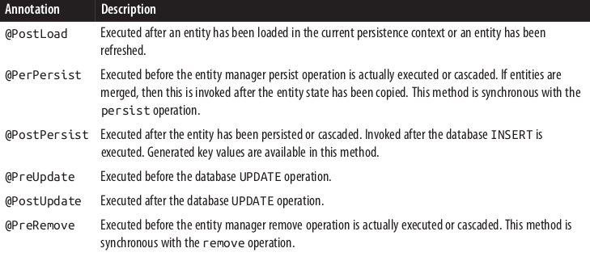
Entity Listeners

Slide 107
Entity Listeners
public class StudentListener
@PostLoad
public void studentLoaded(Student student) {
//. . .
}
@PostPersist
public void newStudentAlert(Student student) {
//. . .
}
@PostUpdate
public void studentUpdateAlert(Student student) {
//. . .
}
}
@PreRemove
public void studentDeleteAlert(Student student) {
//. . .
}

