Slide 1

“The secret of getting ahead is getting started.” -Mark Twain

Slide 2

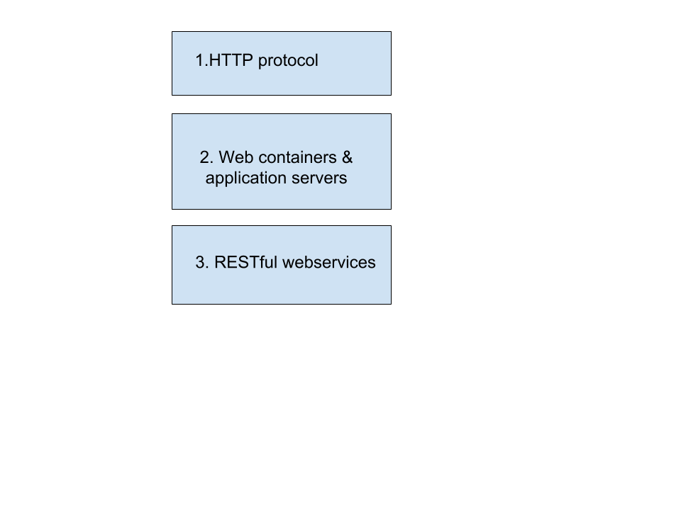
Summary

Slide 3
HTTP(HyperText Transfer
Protocol)
HTTP is the foundation of data communication for the World Wide Web.
The HTTP is the Web’s application-layer protocol for transferring various forms of data between server and client like plaintext, hypertext, image, videos and sounds.
HTTP is implemented in two programs: a client program and a server program, executing on different end systems, talk to each other by exchanging HTTP messages.

Slide 4
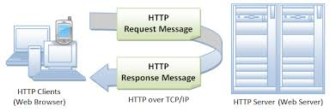
HTTP(HyperText Transfer
Protocol)

Slide 5
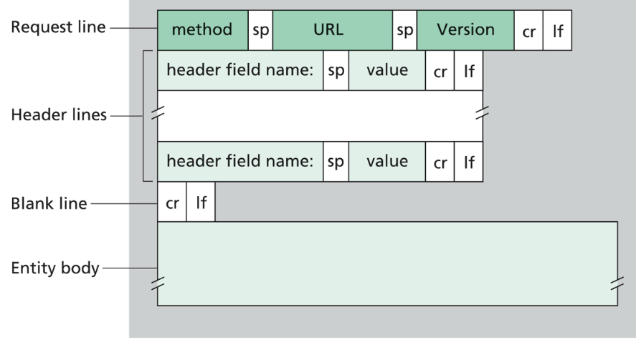
HTTP request message
The first line of an HTTP request message is
called the request line; the subsequent lines are
called the header lines.
The request line hast hree fields: the method field, the URL field, and the HTTP version field.
The method field can take on several different values, including GET, POST, HEAD, PUT, and DELETE etc.

Slide 6
HTTP REQUEST METHODS
• GET: Retrieve Document identified in URL
• HEAD: Retrieve meta information about document identified in URL
• DELETE: Delete document at specified URL
• OPTIONS: Request information about available options
• PUT: Store document under specified URL
• POST: Send information to server
• TRACE: Loopback request message
• CONNECT: For use by Proxies

Slide 7
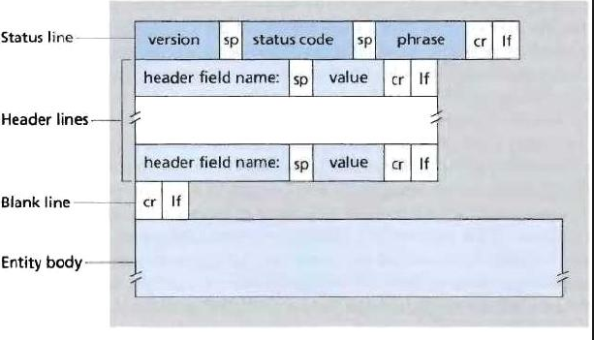
HTTP response message
It has three sections: an initial status line,
header lines, and then the entity body.
The entity body contains the requested object
itself.
The status line has three fields: the
protocol version field, a status code, and a
corresponding status message.

Slide 8
Common HTTP status codes
Some common status codes and associated phrases include:
• 200 OK: Request succeeded and the information is
returned in the response.
• 301 Moved Permanently: Requested object has been
permanently moved; the new URL is specified in Location:
header of the response message. The client software will
automatically retrieve the new URL.
• 400 Bad Request: This is a generic error code indicating
that the request could not be understood by the server.
• 404 Not Found: The requested document does not exist
on this server.
• 505 HTTP Version Not Supported: The requested HTTP
protocol version is not supported by the server.

Slide 9
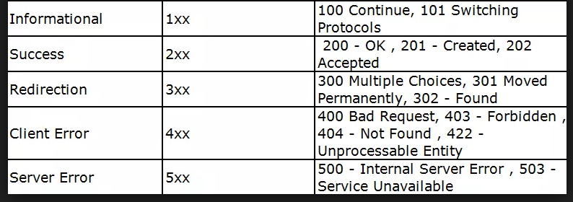
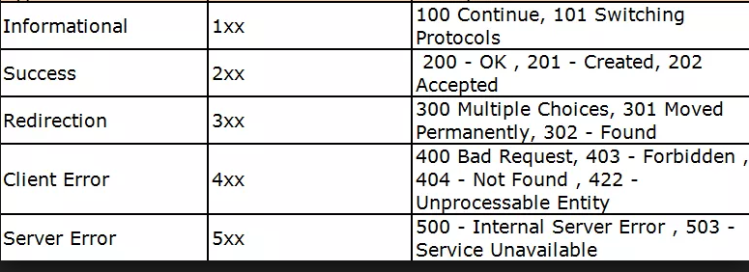
Common HTTP status codes

Slide 10
HTTP: A STATELESS PROTOCOL
HTTP is a stateless protocol, because an HTTP server maintains no information about the clients.
If a particular client asks for the same object twice in a period of a few seconds, the server resends the object, as it has completely forgotten what it did earlier.

Slide 11
USER-SERVER INTERACTIONS: COOKIES
It is often desirable for a Web site to identify users, either because the server wishes to restrict user access or because it wants to serve conten tas a function of the user identity. For these purposes, HTTP uses cookies. Cookies allow sites to keep track of users.

Slide 12
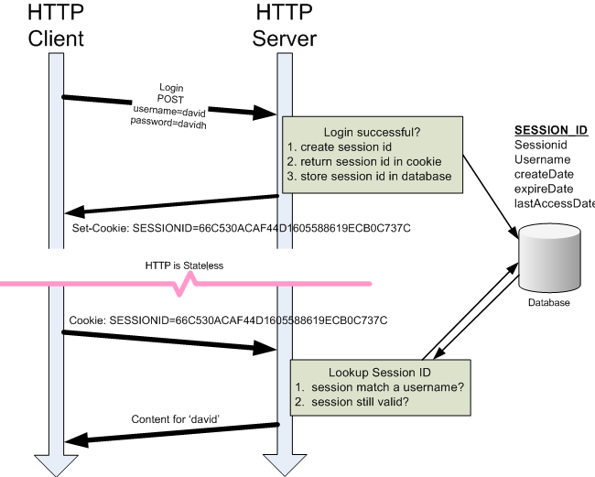
USER-SERVER INTERACTIONS: COOKIES

Slide 13

“Tell me and I forget, teach me and I may remember, involve me and I learn.”
– Benjamin Franklin

Slide 14



Web containers

Slide 15
Web containers
Apache Tomcat
Free and open source project from Apache
Java HTTP(Web) server
Supports:
  Java Servlet
  JavaServer Pages(JSP)
  Java EL
  WebSocket
Embeddable

Slide 16
Web containers
Eclipse Jetty:
  Free and open source project, as part of the Eclipse Foundation
  Java HTTP(Web) server
  Supports:
    Java Servlet API
    JSP
    HTTP/2
    WebSocket
  Persistent Connection: By default, Undertow includes HTTP persistent connections by adding keep-alive response header
  Embeddable

Slide 17
Web containers
Undertow (from Jboss)
  Java HTTP(Web) server providing both blocking and non-blocking API's based on NIO
  Is default web server in the Wildfly Application Server
  Supports:
    Java Servlet API
    JSP
    HTTP/2
    WebSocket
  Persistent Connection: By default, Undertow includes HTTP persistent connections by adding keep-alive response header
  Embeddable (can be embedded in an application or run stanadalone)

Slide 18
Application servers
Extend web containers capabilities
Implements Java EE standards
The Java EE infrastructure is partitioned into logical containers:
  EJB container: EJB—a modular server, mainly business component providing many features, including declarative transaction management, and improving application scalability.
  Web container: The Web modules include servlets and JavaServer Pages (JSP).
  JCA container (Java EE Connector Architecture)
  JMS provider (Java Message Service)

Slide 19



Application servers

Slide 20

“The way to get started is to quit talking and begin doing.”– Walt Disney

Slide 21
Web Services key terminology
Request/Response
Message exchange format
XML/JSON
Service provider
Service consumer
Service definition
Transport : HTTP vs. MQ

Slide 22
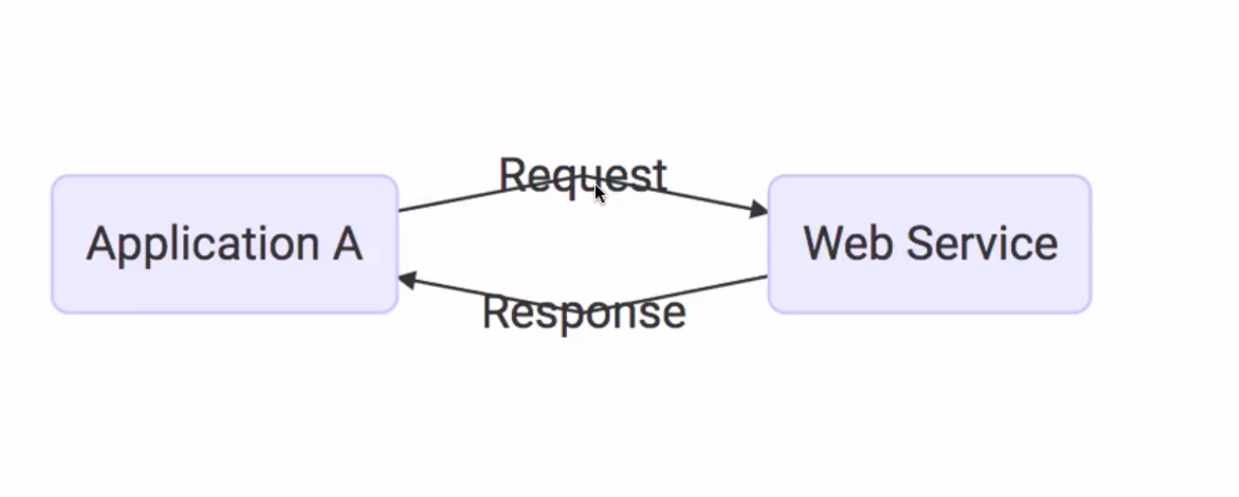
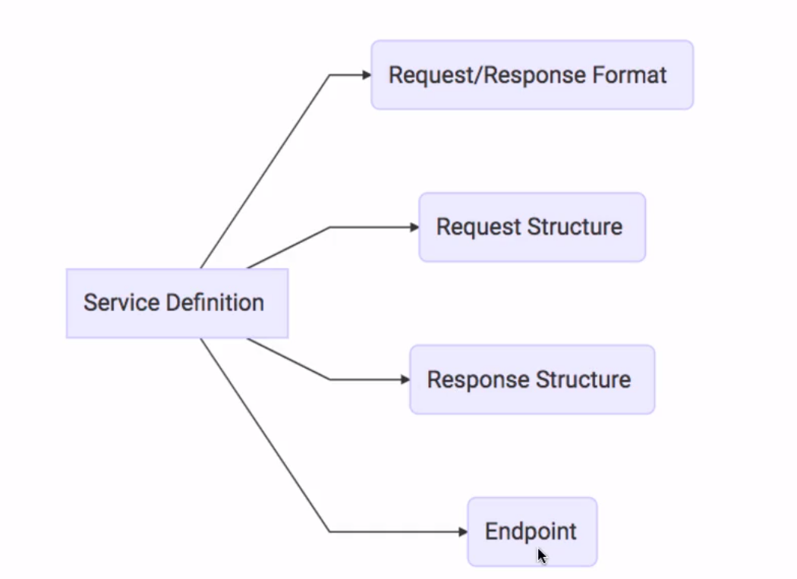
Web Services key terminology

Slide 23
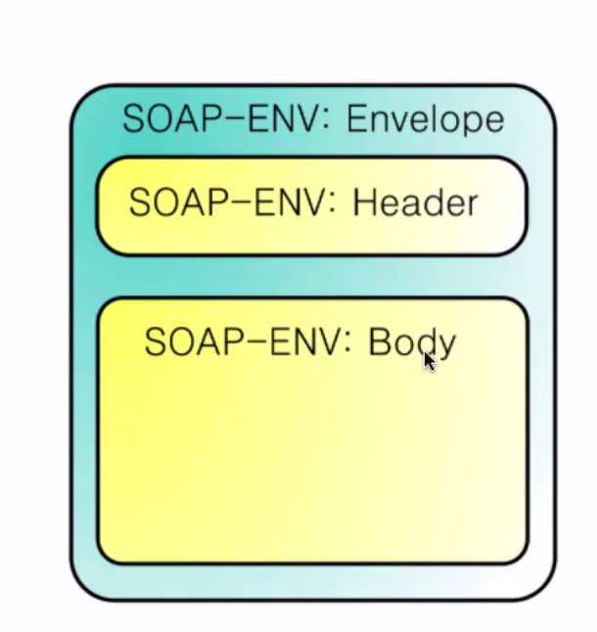
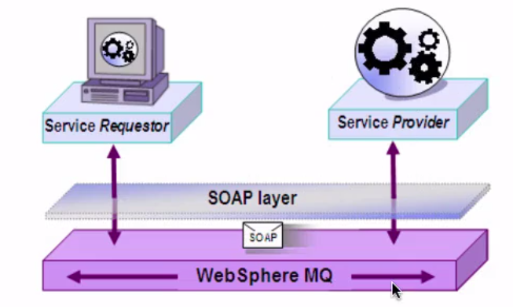
SOAP
Data exchange format
  SOAP XML request
  SOAP XML response
Transport
  SOAP over MQ
  SOAP over HTTP
Service definition :
  WSDL (Web Service Description Language)
s

Slide 24
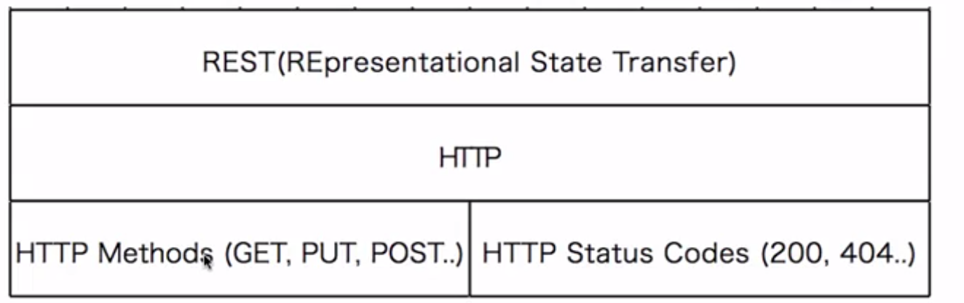
REST (Representational State Transfer)
Make best use of HTTP

Slide 25
REST (REpresentational State Transfer)
Key abstraction - Resource
Resource – identified by an URI (Uniform Resource Identifier)
  /courses
  /courses/1
  /students
  /students/1
  /students/1/courses
  /students/1/courses/1
A resource can have different respresentations:
  XML
  JSON
  HTML

Slide 26
REST (REpresentational State Transfer)
Create a student : POST /students
Delete a student : DELETE /students/1
Get all students : GET /students
Get one student : GET /students/1
Get all courses for a student : GET /students/1/courses
Add a course to a student : POST /student/1/courses

Slide 27
REST (Representational State Transfer)
Data exchange format
  No restriction
  JSON is a popular choice
Transport
  Only HTTP
Service definition :
  No standard. WADL/Swagger etc.

Slide 28
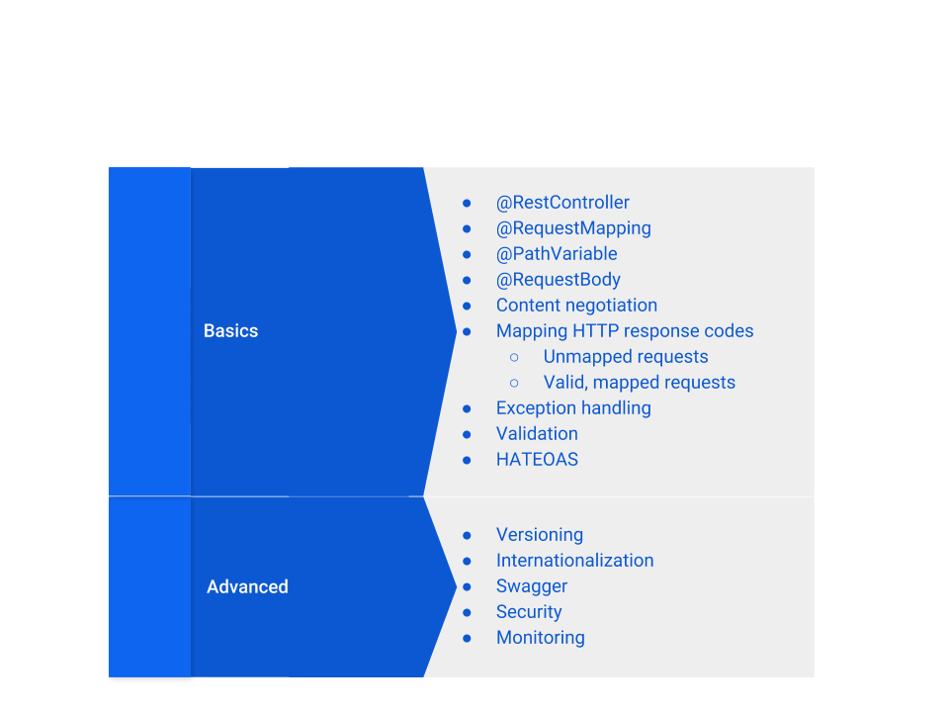
REST (Representational State Transfer)

Slide 29
REST (Representational State Transfer)
@RestController
@RequestMapping
    @GetMapping
    @PostMapping
    @PutMapping
    @D eleteMapping
@PathVariable
@RequestBody
@ResponseBody
Content types: produces and consumes
Content negotiation
HTTP status codes

Slide 30
REST (Representational State Transfer)
Exception handling
  @ResponseStatus on the exception
  Custom ResponseEntityExceptionHandler

Slide 31
REST (Representational State Transfer)
HATEOAS (Hypertext as The Engine of Application State)

Slide 32
REST (Representational State Transfer)
Validation using javax.validation

Slide 33
HATEOAS (Hypertext as The Engine of Application State)
  org.springframework.hateoas.Link
  import org.springframework.hateoas.Resource;
  org.springframework.hateoas.mvc.ControllerLinkBuilder
<dependency>
<groupId>org.springframework.boot</groupId>
<artifactId>spring-boot-starter-hateoas</artifactId>
</dependency>
REST (Representational State Transfer)

Slide 34
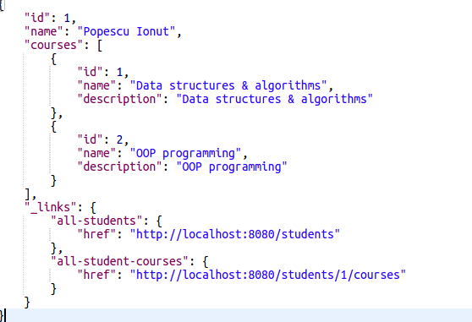
HATEOAS (Hypermedia as the engine of application state)
http://localhost:8080/students/1

Slide 35
REST (Representational State Transfer)
Versioning REST endpoints
  Different endpoints
  Version as header
  Version as request param

Slide 36
Internationalization
  LocaleResolver
    Default locale Locale.US
  ResourceBundleMessageSource
  messages.properties
  messages_*.properties
REST (Representational State Transfer)

Slide 37
Swagger
<dependency>
<groupId>io.springfox</groupId>
<artifactId>springfox-swagger2</artifactId>
<version>2.8.0</version>
</dependency>
<dependency>
<groupId>io.springfox</groupId>
<artifactId>springfox-swagger-ui</artifactId>
<version>2.8.0</version>
</dependency>
@Configuration
@EnableSwagger2
public class SwaggerConfiguration {
@Bean
public Docket api() {
return new Docket(DocumentationType.SWAGGER_2);
}
}
http://localhost:8080/v2/api-docs
http://localhost:8080/swagger-ui.html
REST (Representational State Transfer)

Slide 38
Security
Securing enpoints using Spring Security
    Implementing Basic Authentication with Spring Security
REST (Representational State Transfer)

Slide 39
Monitoring
Using Spring Boot actuator
<dependency>
<groupId>org.springframework.boot</groupId>
<artifactId>spring-boot-starter-actuator</artifactId>
</dependency>
http://localhost:8080/actuator
REST (Representational State Transfer)

Slide 40
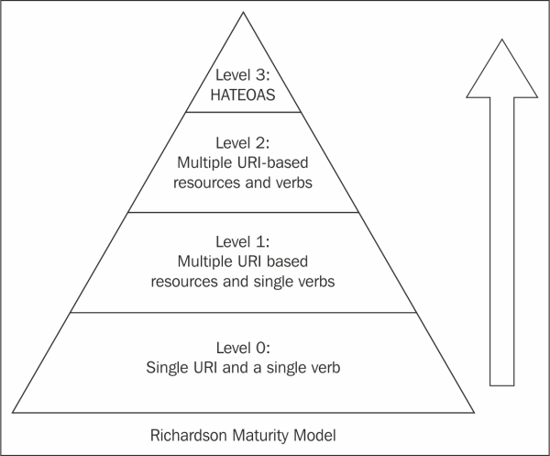
REST (Representational State Transfer)

Slide 41

“It always seems impossible until its done.” -Nelson Mandela

