Slide 1
Factory Pattern
creates objects without exposing the instantiation logic to the client
refers to the newly created object through a common interface (abstract class)
public class PizzaStore {
SimplePizzaFactory factory;
public PizzaStore(SimplePizzaFactory factory){
this.factory = factory;
}
public Pizza orderPizza (String type){
Pizza pizza = factory.createPizza();
pizza.prepare();
pizza.bake();
pizza.cut();
pizza.box();
return pizza;
}
}
public class SimplePizzaFactory {
public Pizza createPizza(String type){
Pizza pizza = null;
if(type.equals(“cheese”)){
pizza = new CheesePizza();
}
else if(type.equals(“pepperoni”)){
pizza = new PepperoniPizza();
}
else if(type.equals(“veggie”)){
pizza = new VeggiePizza();
}
return pizza;
}
}

Slide 2
Abstract Factory
Provides a way to encapsulate a group of individual factories that have a common theme without specifying their concrete classes.
public interface AbstractCollectionFactory<T, V> {
Set<T> makeSet();
Map<T, V> makeMap();
}
public class HashCollectionFactory<T, V> implements AbstractCollectionFactory<T, V> {
@Override
public Set<T> makeSet() { return new HashSet(); }
@Override
public Map<T, V> makeMap() { return new HashMap(); }
}
public class LinkedHashCollectionFactory<T, V> implements AbstractCollectionFactory <T, V>{
@Override
public Set<T> makeSet() { return new LinkedHashSet(); }
@Override
public Map<T, V> makeMap() { return new LinkedHashMap(); }
}

Slide 3
Singleton Pattern
restricts the instantiation of a class and ensures that only one instance of the class is created
public class EagerInitializedSingleton {
//create an object of EagerInitializedSingleton
private static EagerInitializedSingleton instance = new EagerInitializedSingleton();
//make the constructor private so that this class cannot be instantiated
private EagerInitializedSingleton(){}
//Get the only object available
public static EagerInitializedSingleton getInstance(){
return instance;
}
public void doTheLogic(){
System.out.println("I am doing object logic!!");
}
}

Slide 4
Builder Pattern
the intent of the Builder design pattern is to separate the construction of a complex object from its representation.
creates immutable objects with many parameters
public class Person {
private final String cnp;
private final String name;
private final String email;
private Person(Builder builder) {
this.cnp = builder.cnp;
this.name = builder.name;
this.email = builder.email;
}
public String getCnp() {
return cnp;
}
public String getName() {
return name;
}
public String getEmail() {
return email;
}
public static class Builder {
private String cnp;
private String name;
private String email;
public Builder cnp(String cnp) {
this.cnp = cnp;
return this;
}
public Builder name(String name) {
this.name = name;
return this;
}
public Builder email(String email) {
this.email = email;
return this;
}
public Person build() {
return new Person(this);
}
}
}

Slide 5
Prototype Pattern
Create objects based on a template of an existing object through cloning.
Used usually when:
  creating an object is an expensive operation and it would be more efficient to copy an object
  objects are required that are similar to existing objects.
public abstract class Item implements Cloneable{
private String title;
private double price;
public Item clone() {
Item clonedItem = null;
try {
clonedItem = (Item) super.clone();
clonedItem.setPrice(price);
clonedItem.setTitle(title);
} catch (CloneNotSupportedException e) {
e.printStackTrace();
}
return clonedItem ;
}
//setters and getters
}
public class Book extends Item{
//extra book stuff
}
public class CD extends Item{
//extra CD stuff
}
public class ItemRegistry {
private Hashtable<String, Item> map = new Hashtable<String, Item>();
public ItemRegistry() {
loadCache();
}
public Item createBasicItem(String type) {
return map.get(type).clone();
}
private void loadCache() {
Book book = new Book();
book.setTitle("Design Patterns");
book.setPrice(20.00);
map.put("Book", book);
CD cd = new CD();
cd.setTitle("Various");
cd.setPrice(10.00);
map.put("CD", cd);
}
}
public class Client {
…...
Item myBook = registry.createBasicItem("Book");
myBook.setTitle("Custom Title");
…
}

Slide 6
Proxy pattern
A proxy can be defined as a surrogate for another abject
Can simply forward calls to the real object, or can provide additional logic
Controls and manages access to protected resources
Can be used for caching when operations on the real object are resource intensive
public interface Image {
public void displayImage();
}
public class RealImage implements Image{
private String fileName;
public RealImage(String fileName) {
this.fileName = fileName;
loadImageFomDisk();
}
public void loadImageFomDisk() {
System.out.println("Loading " + fileName);
}
public void displayImage() {
System.out.println("Displaying " + fileName);
}
}
public class ProxyImage implements Image{
private RealImage image;
private String fileName;
public ProxyImage(String fileName) {
this.fileName = fileName;
}
public void displayImage() {
if(image == null) {
image = new RealImage(fileName);
}
image.displayImage();
}
}
class ProxyExample {
public static void main(final String[] arguments) {
final Image image1 = new ProxyImage("HiRes_10MB_Photo1");
image1.displayImage(); // loading necessary
image1.displayImage(); // loading unnecessary
}
}

Slide 7
Facade Pattern
Provide a unified interface to a set of interfaces in a subsystem.
Façade defines a higher-level interface that makes the subsystem easier to use.
public class HotelBooker {
public List<Hotel> getHotelFor(LocalDateTime from, LocalDateTime to) {
// returns hotels available in the particular date range
}
}
public class FlightBooker{
public List<Flight> getFlightsFor(LocalDateTime from, LocalDateTime to) {
//returns flights available in the particular date range
}
}
public class TravelFacade {
private HotelBooker hotelBooker;
private FlightBooker flightBooker;
public void getFlightsAndHotels(LocalDateTime from, LocalDateTime to) {
List<Flight> flights = flightBooker.getFlightsFor(from, to);
List<Hotel> hotels = hotelBooker.getHotelFor(from, to);
// process and return
}
}
public class Client {
public static void main(String[] args) {
TravelFacade facade = new TravelFacade();
facade.getFlightsAndHotels(LocalDateTime.of(2018, 3, 10, 5, 20), LocalDateTime.of(2018, 3, 30, 5, 20));
}
}

Slide 8
Adapter Pattern
Convert the interface of a class into another interface clients expect.
Adapter lets classes work together that couldn't otherwise because of incompatible interfaces.
public interface Adaptee {
public void doSomething();
}
public interface Adapter {
public void doSomethingElse();
}
public class AdapteeToClientAdapter implements Adapter {
private final Adaptee instance;
public AdapteeToClientAdapter(final Adaptee instance) {
this.instance = instance;
}
public void doSomethingElse() {
instance.doSomething();
//do other stuff here
}
}

Slide 9
Decorator Pattern
Allows for the dynamic wrapping of objects in order to modify their existing responsibilities and behaviours
public interface IEmail {
public String getContents();
}
class Email implements IEmail {
private String content;
public Email(String content) {
this.content = content;
}
public String getContents() {
// general email stuff
return content;
}
}
class ExternalEmailDecorator implements IEmail {
private IEmail originalEmail;
private String content;
public ExternalEmailDecorator(IEmail basicEmail) {
originalEmail = basicEmail;
}
public String getContents() { //
content = addDisclaimer(originalEmail.getContents());
return content;
}
private String addDisclaimer(String message) {
// append company disclaimer to message
return message + "\n Company Disclaimer";
}
}

Slide 10
Strategy Pattern
defines a family of algorithms,
encapsulates each algorithm
makes the algorithms interchangeable within that family.
public interface Operation {
public int doOperation(int num1, int num2);
}
public class OperationAdd implements Operation{
@Override
public int doOperation(int num1, int num2) {
return num1 + num2;
}
}
public class OperationSubstract implements Operation{
@Override
public int doOperation(int num1, int num2) {
return num1 - num2;
}
}
public class OperationMultiply implements Operation{
@Override
public int doOperation(int num1, int num2) {
return num1 * num2;
}
}
public class Context {
private Operation strategy;
public Context(Operation strategy){
this.strategy = strategy;
}
public int execute(int num1, int num2){
return strategy.doOperation(num1, num2);
}
}
public class StrategyPatternDemo {
public static void main(String[] args) {
Context context = new Context(new OperationAdd());
System.out.println("10 + 5 = " + context.execute(10, 5));
context = new Context(new OperationSubstract());
System.out.println("10 - 5 = " + context.execute(10, 5));
Context = new Context(new OperationMultiply());
System.out.println("10 * 5 = " + context.execute(10, 5));
}
}

Slide 11
Template Method Pattern
Defines the skeleton of an algorithm in a method, deferring some steps to subclasses.
Template Method lets subclasses redefine certain steps of an algorithm without changing the algorithms structure.
public abstract class FileReadTemplate {
public void readFile(String fileName) throws IOException {
InputStream is = new FileInputStream(fileName);
doTheReading(is);
is.close();
}
protected abstract void doTheReading(InputStream is) throws IOException;
}
public class TemplateMethodDemo {
public static void main(String[] args) throws IOException {
URL url = TemplateMethodDemo.class.getClassLoader()
.getResource("gigi.txt");
new FileReadTemplate() {
@Override
protected void doTheReading(InputStream is) throws IOException {
System.out.println(is.read());
}
}.readFile(url.getPath());
}
}

Slide 12
Observer Pattern
Defines the skeleton of an algorithm in a method, deferring some steps to subclasses.
Template Method lets subclasses redefine certain steps of an algorithm without changing the algorithms structure.
public abstract class FileReadTemplate {
public void readFile(String fileName) throws IOException {
InputStream is = new FileInputStream(fileName);
doTheReading(is);
is.close();
}
protected abstract void doTheReading(InputStream is) throws IOException;
}
public class TemplateMethodDemo {
public static void main(String[] args) throws IOException {
URL url = TemplateMethodDemo.class.getClassLoader()
.getResource("gigi.txt");
new FileReadTemplate() {
@Override
protected void doTheReading(InputStream is) throws IOException {
System.out.println(is.read());
}
}.readFile(url.getPath());
}
}

Slide 13
Inversion of Control
is a concept in application development
"don’t call me, I’ll call you"
one form is Dependency Injection (DI)

Slide 14
Dependency Injection
Hard coded:
public class Client {
private Service service;
Client() {
this.service = new ServiceExample();
}
public String greet() {
return "Hello " + service.getName();
}
}
Factory:
public class Client {
private Service service;
Client() {
this.service = ServiceFactory.getInstance();
}
. . .
}

Slide 15
Dependency Injection
Constructor Injection
public class Client {
private Service service;
public Client(Service service) {
this.service = service;
}
. . .
}
Setter Injection
public class Client {
private Service service;
public void setService(Service service) {
this.service = service;
}
. . .
}

Slide 16
IoC vs DI vs Factory
DI it is a specific type of IoC
The Factory pattern’s main concerns is creating
The DI’s main concern is how things are connected together
DI related to Factory and Strategy patterns, but mostly resembles to Build Pattern

Slide 17
Dependency Injection
Constructor vs setter
Constructor
mandatory dependencies
immutability
Setter
optional dependencies and default values
obvious names
auto inheritance

Slide 18
History
first released in June 2003
milestone releases in 2004 and 2005
Spring 2.0 (released Oct 2006)
Java 1.3+
AspectJ support, JPA
Spring 2.5 (released Nov 2007)
Java 1.4+
XML namespaces, annotations
Spring 3.0 (released Dec 2009)
Java 1.5+
REST support, SpEL, more annotations, JavaConfig
profiles
Spring 4.0 (released Dec 2013)
Java 8
groovy 2
websocket
conditional bean definitions
spring.io
SpringBoot
Spring 5.0 (released September 2017)
JDK 8+ enhacements
JDK 9 compatibility
Spring WebFlux
Kotlin support
support for Junit 5

Slide 19
Goals
make J2EE easier to use
make the common tasks easier
promote good programming practice
you can focus on the domain problems

Slide 20
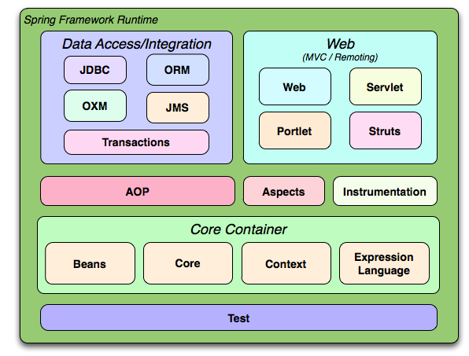
Spring modules

Slide 21
Core container
Core and Beans
provide the fundamental parts of the framework, including IoC and Dependency Injection features
Context
it is a means to access objects in a framework-style manner that is similar to a JNDI registry
Expression language
provides a powerful expression language for querying and manipulating an object graph at runtime
Data Access/Integration
JDBC
provides a JDBC-abstraction layer
ORM
provides integration layers for popular object-relational mapping APIs, including JPA, JDO, Hibernate and iBatis
Transaction
supports programmatic and declarative transaction management
Web
Web MVC
Spring’s model-view-controller (MVC) implementation

Slide 22
Application Lifecycle
Initialization
creating services
allocate resources
Use
process requests
99% of the time
Destruction
shuts down
release resources

Slide 23
Spring Ioc Container
ApplicationContext
represents the Spring IoC container
Bean
is an object that managed by Spring IoC container
BeanDefinition
describe a bean instance

Slide 24
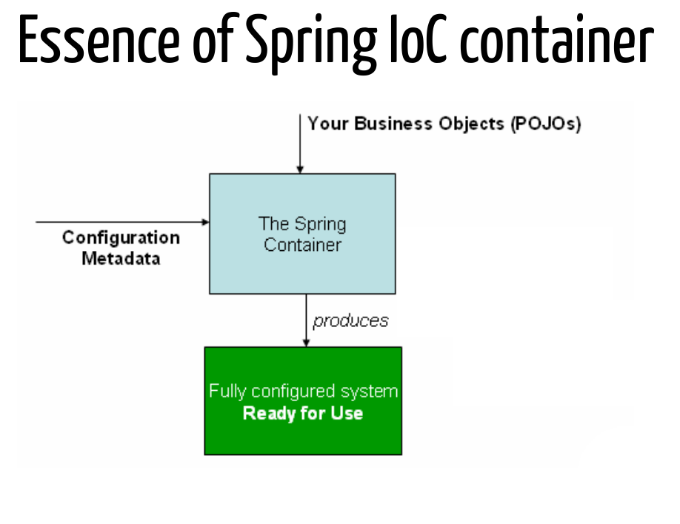

Slide 25
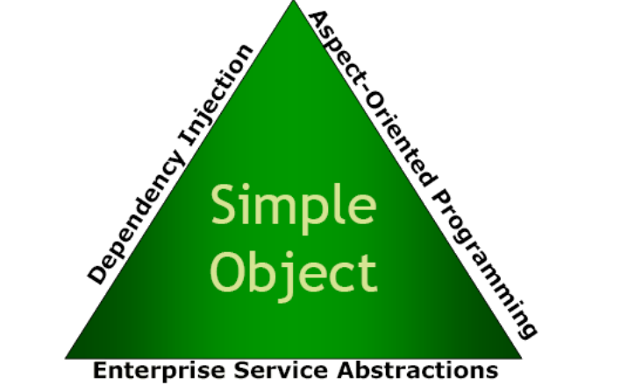
The Spring triangle

Slide 26
Bean scopes
singleton
Scopes a single bean definition to a single object instance per Spring IoC container.
prototype
Scopes a single bean definition to any number of object instances.
Web aware scopes:
request
Scopes a single bean definition to the lifecycle of a single HTTP request;
session
Scopes a single bean definition to the lifecycle of a HTTP Session.
global session
Scopes a single bean definition to the lifecycle of a global HTTP Session. Typically only valid when used in a portlet context.

Slide 27
Creating ApplicationContext
environments
standalone
web
JUnit
ClassPathApplicationContext
ApplicationContext context = new ClassPathXmlApplicationContext(
new String[] {"services.xml", "repositories.xml"});
// retrieve configured instance
CurrencyService currencyService = context.getBean("currency", CurrencyService.class);
AccountService accountService = context.getBean(AccountService.class);
FileSystemApplicationContext
AnnotationConfigApplicationContext
JavaConfigApplicationContext

Slide 28
Basic Annotations
spring
@Autowired
@Qualifier
@Value
jsr250
@Resource
@PostConstruct
@PreDestroy
context
@Scope
@Bean
@DependsOn
@Lazy
transactional
@Transactional

Slide 29
Annotations
Stereotypical
@Component
@Repository
@Service
@Controller
@Configuration

Slide 30
@Value
@Component("authenticationProvider")
public class EjbAuthenticationProvider {
/** The provider api connection url. */
@Value("${provider.api.url}")
private String apiUrl;
/** The provider api connection username. */
private @Value("${provider.api.username}") String apiUsername;
/** The provider api connection password. */
@Value("${provider.api.password}")
private String apiPassword;
}

Slide 31
@Autowired
@Service("accountService")
public class AccountServiceImpl {
@Autowired
private AccountRepository repository;
@Autowired
public AccountServiceImpl(AccountRepository repository) {}
@Autowired(required = false)
public void setRepository(AccountRepository repository) {}
@Autowired
public void populate(Repository r, OrderService s) {}
}

Slide 32
@Qualifier
public class ReportServiceImpl {
@Autowired
@Qualifier("main")
private DataSource mainDataSource;
@Autowired
@Qualifier("freeDS")
private DataSource freeDataSource;
}

Slide 33
Factory method component
@Component
public class CurrencyRepositoryFactory {
@Bean
@Lazy
@Scope("prototype")
@Qualifier("public")
public CurrencyRepository getCurrencyRepository() {
return new CurrencyMapRepository();
}
}

Slide 34
Java-based configuration
Standalone applications
simple
new AnnotationConfigApplicationContext(ExchangerConfig.class);
programmaticaly
context = new AnnotationConfigApplicationContext();
context.register(ExchangerConfig.class);
context.refresh();
scanning
context = new AnnotationConfigApplicationContext();
context.scan("org.exchanger.config");
context.refresh();

Slide 35
Java-based configuration
Instantiating for tests
@RunWith(SpringJUnit4ClassRunner.class)
@ContextConfiguration(classes = {PersistenceConfig.class, CoreConfig.class})
public class CoreDomainIntegrationTest {
...
}

Slide 36
Java-based configuration
@Configuration
public class ExchangerRepositoryConfig {
@Bean(name = "accountRepository", initMethod = "init")
public AccountRepository accountRepository() {
return new AccountMapRepository();
}
@Bean
public AuditRepository auditRepository() {
return new AuditMapRepository();
}
}

Slide 37
Conditional bean configuration
public interface Condition {
public boolean matches(ConditionContext context,
AnnotatedTypeMetadata metadata);
}
@Bean
@Conditional(WindowsCondition.class)
public EmailService windowsEmailService() {
return new WindowsEmailService();
}
@Bean
@Conditional(LinuxCondition.class)
public EmailService linuxEmailService() {
return new LinuxEmailService();
}

Slide 38
@Import
@Configuration
@Import({RepositoryConfig.class, ServiceConfig.class})
public class ExchangerConfig {
}
@Configuration
public class RepositoryConfg {}
@Configuration
public class ServiceConfig {}

Slide 39
@PropertySource
@Configuration
@PropertySource("classpath:jdbc.properties")
public class HelloConfig {
}
@Configuration
public class DatabaseConfig {
@Value("${jdbc.url}")
private String jdbcUrl;
}

Slide 40
Dependencies Injection
@Configuration
public class ExchangerServiceConfig {
@Autowired
private CurrencyRepository currencyRepository;
public @Bean CurrencyService currencyService() {
return new CurrencyServiceImpl(currencyRepository);
}
}
@Bean(name = {"orderBuilder", "builder"})
public OrderBuilder orderBuilder() {
return new OrderBuilder(currencyService(), accountService());
}

Slide 41
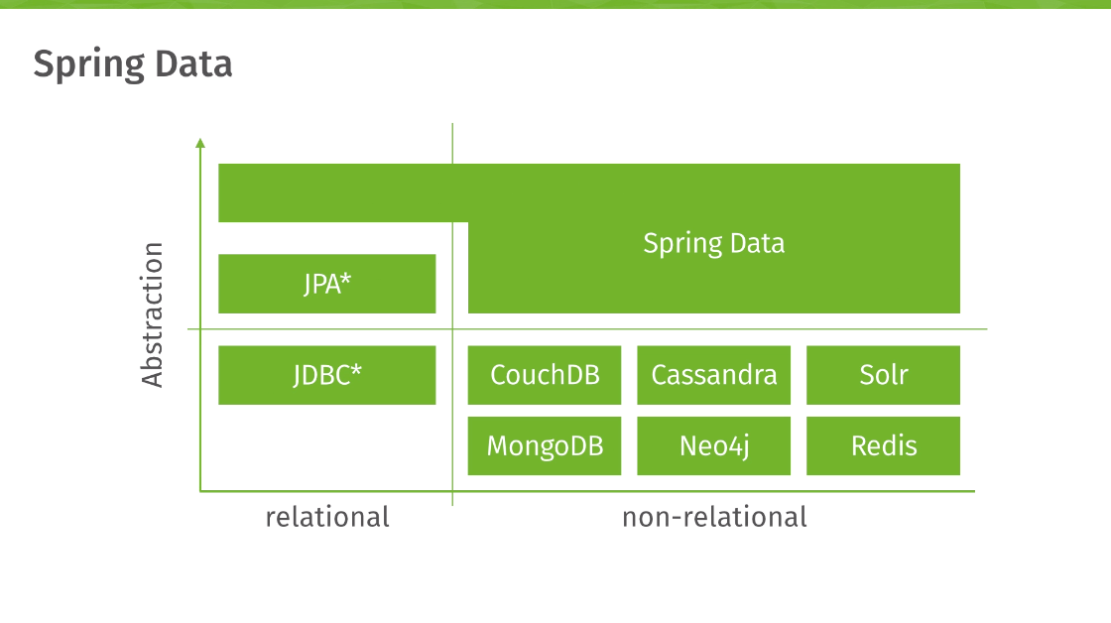
Data access/Integration
@Configuration
public class ExchangerServiceConfig {
@Autowired
private CurrencyRepository currencyRepository;
public @Bean CurrencyService currencyService() {
return new CurrencyServiceImpl(currencyRepository);
}
}
@Bean(name = {"orderBuilder", "builder"})
public OrderBuilder orderBuilder() {
return new OrderBuilder(currencyService(), accountService());
}

Slide 42
Handling exceptions
exceptions
checked
unchecked
SQLException
technology-specific
depends on DBMS
couple the DAO and API

