Slide 1
Spring Data
Data access layer for various persistence stores
Interface-based programming model
No implementation required
Queries derived from method names

Slide 2
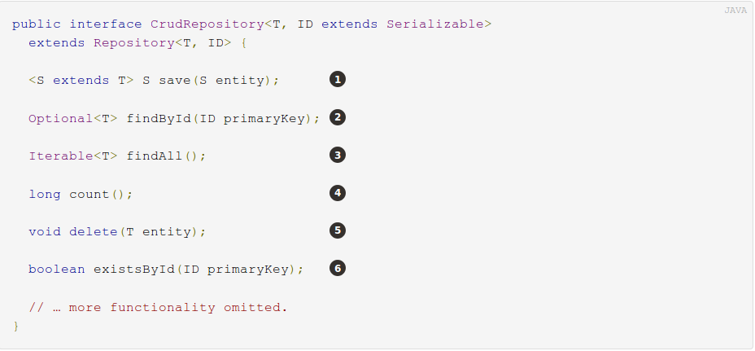
Spring Data
Repository
CrudRepository

Slide 3
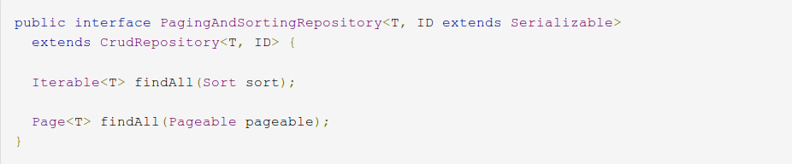
Spring Data
PagingAndSortingRepository
public interface UserRepository extends PagingAndSortingRepository<User, Long> {
}

Slide 4
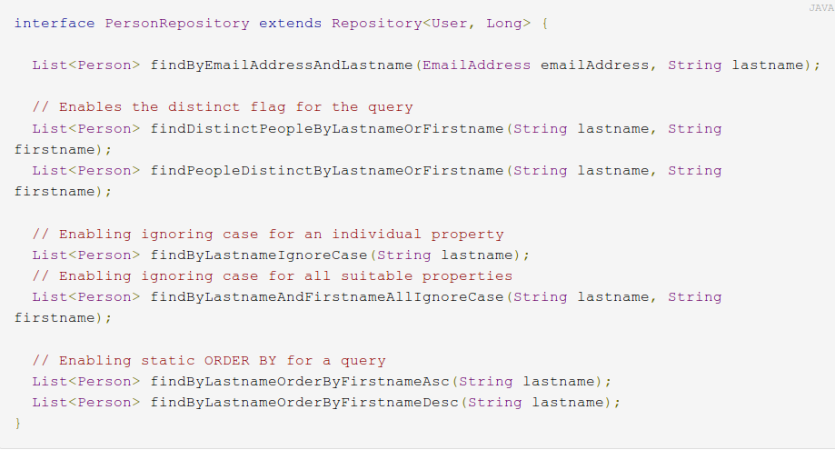
Queries derived from method names

Slide 5
Query creation
define conditions on entity properties and concatenate them with And and Or
stripes find…By, read…By, query…By, count…By, and get…By from the method
support for operators such as Between, LessThan, GreaterThan, Like for the property expressions

Slide 6
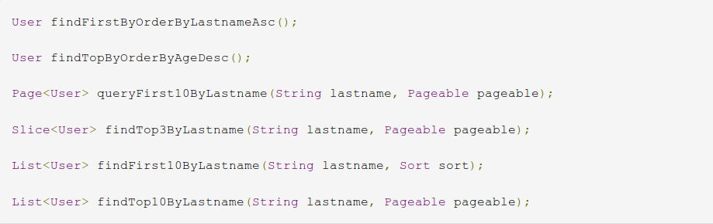
Limiting query results

Slide 7
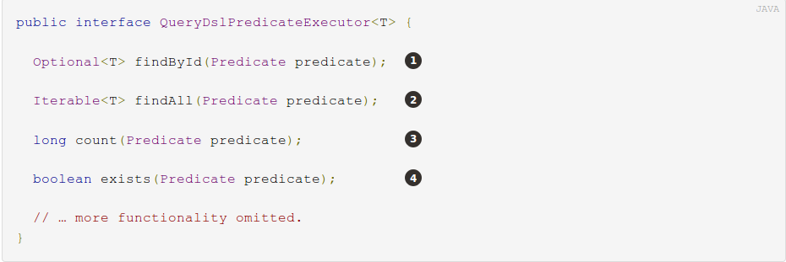
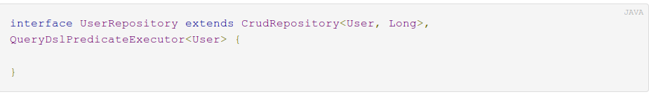
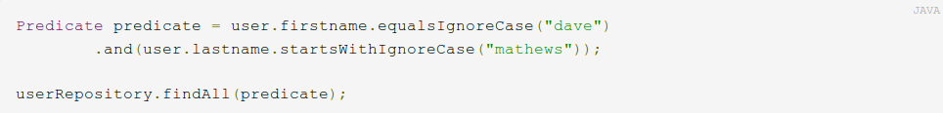
Querydsl Extension

Slide 8
Querydsl Extension
public class QUser extends EntityPathBase<User>{
public static final QUser user = new QUser();
}
QUser user = QUser.user;

Slide 9
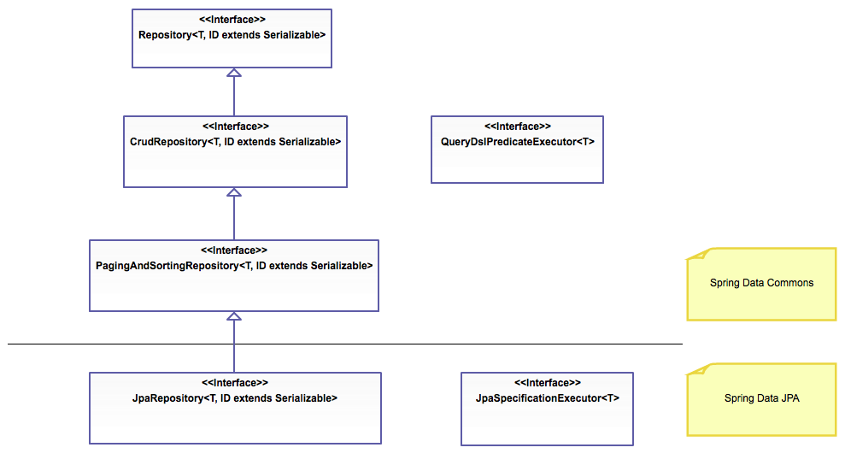

Slide 10
Spring Data JPA
@Configuration
@EnableJpaRepositories
@EnableTransactionManagement
public class PersistenceJPAConfig{
@Bean
public DataSource dataSource() {
EmbeddedDatabaseBuilder builder = new EmbeddedDatabaseBuilder();
return builder.setType(EmbeddedDatabaseType.HSQL).build();
}
@Bean
public LocalContainerEntityManagerFactoryBean entityManagerFactory() {
LocalContainerEntityManagerFactoryBean em = new LocalContainerEntityManagerFactoryBean();
em.setDataSource(dataSource());
em.setPackagesToScan(new String[] { "persistence.model" });
JpaVendorAdapter vendorAdapter = new HibernateJpaVendorAdapter();
em.setJpaVendorAdapter(vendorAdapter);
em.setJpaProperties(additionalProperties());
return em;
}
@Bean
public PlatformTransactionManager transactionManager(EntityManagerFactory emf){
JpaTransactionManager transactionManager = new JpaTransactionManager();
transactionManager.setEntityManagerFactory(emf);
return transactionManager;
}
}

Slide 11
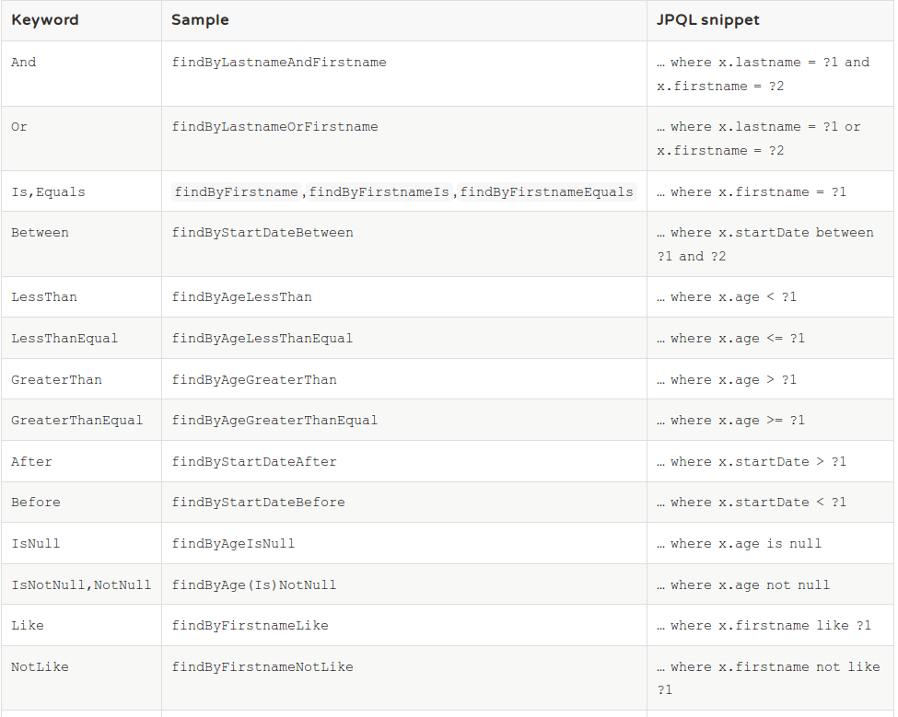

Slide 12
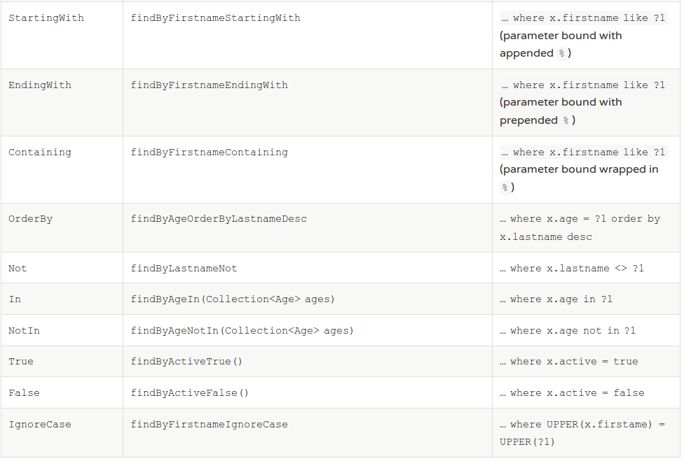

Slide 13
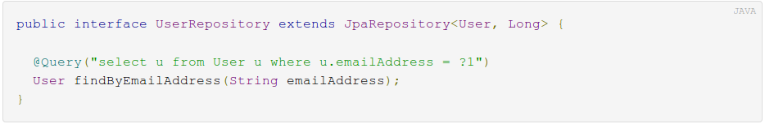
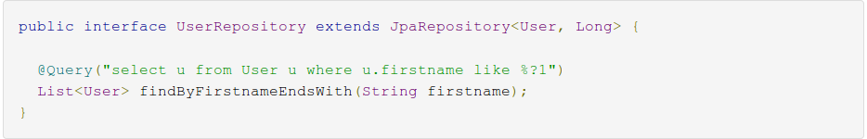
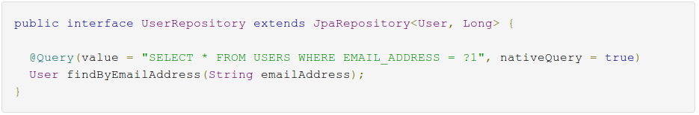
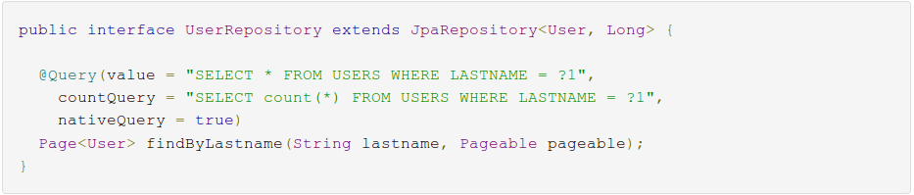
@Query

Slide 14
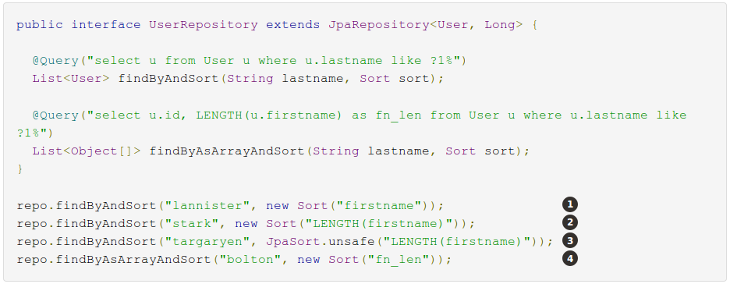
JpaSort
1 - Valid Sort expression pointing to property in domain model.
2 - Invalid Sort containing function call. Thows Exception.
3 - Valid Sort containing explicitly unsafe Order.
4 - Valid Sort expression pointing to aliased function.

Slide 15
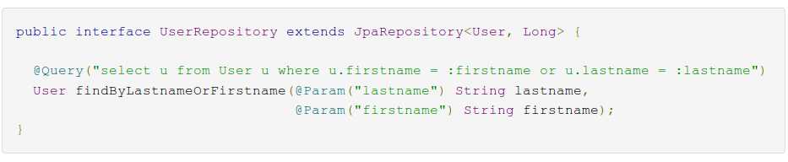
Named parameters

Slide 16
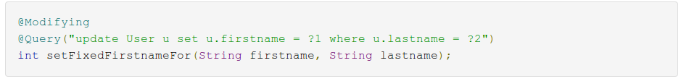
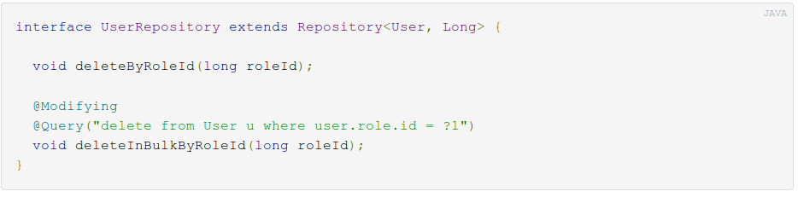
Modifying queries

Slide 17
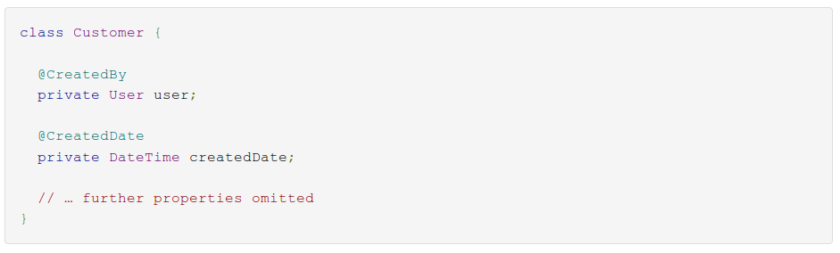
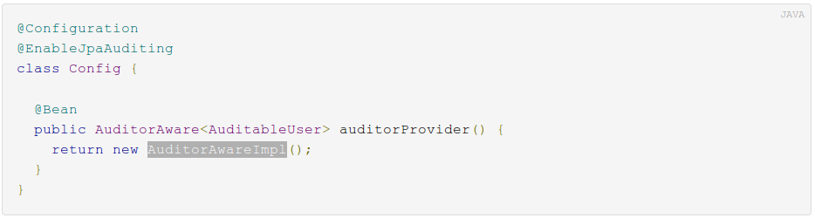
Auditing
@CreatedBy
@LastModifiedBy
@CreatedDate
@LastModifiedDate

Slide 18
Auditing
@Entity
@Table(name="CUSTOMERS")
@EntityListeners(AuditingEntityListener.class)
public class Customer {
@Id
@GeneratedValue(strategy = GenerationType.SEQUENCE, generator = "seq_customer_gen")
@SequenceGenerator(name = "seq_customer_gen", sequenceName = "customers_id_seq", allocationSize = 1)
private Long id;
@Column(name="first_name")
private String firstName;
private String lastName;
@LastModifiedDate
private LocalDateTime lastUpdate;
@ManyToOne
@JoinColumn(name="department_id")
private Department department;
protected Customer() {}
@Entity
………….
}

Slide 19
Timestamp/LocalDateTime converter
import javax.persistence.AttributeConverter;
import javax.persistence.Converter;
import java.sql.Timestamp;
import java.time.LocalDateTime;
@Converter(autoApply = true)
public class LocalDateTimeAttributeConverter implements AttributeConverter<LocalDateTime, Timestamp> {
@Override
public Timestamp convertToDatabaseColumn(LocalDateTime locDateTime) {
return (locDateTime == null ? null : Timestamp.valueOf(locDateTime));
}
@Override
public LocalDateTime convertToEntityAttribute(Timestamp sqlTimestamp) {
return (sqlTimestamp == null ? null : sqlTimestamp.toLocalDateTime());
}
}

