Slide 1
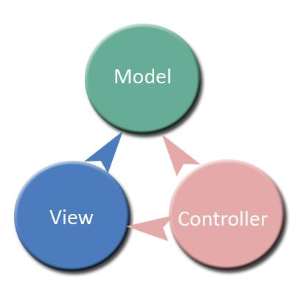
Spring MVC

Slide 2
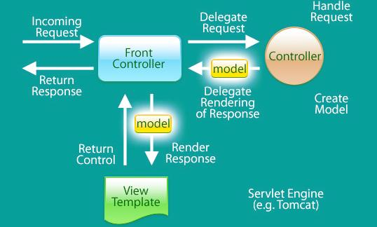
Spring MVC

Slide 3
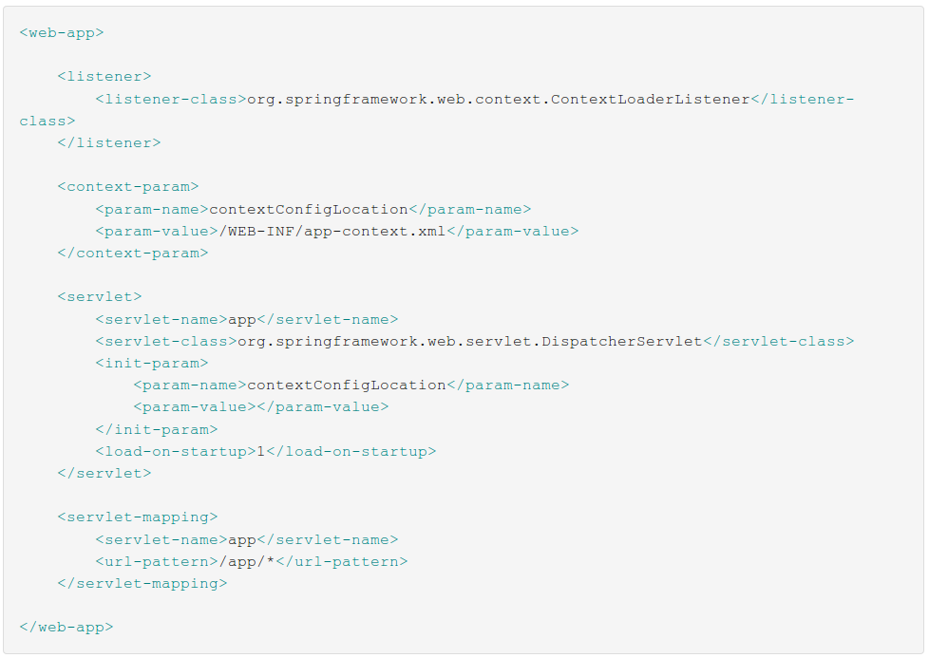
web.xml

Slide 4
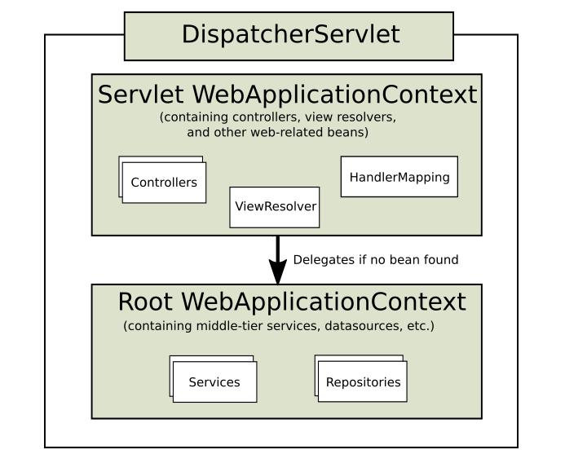

Slide 5
Controller
@Controller
@RestController
@RequestMapping
@RequestParam
@PathVariable

Slide 6
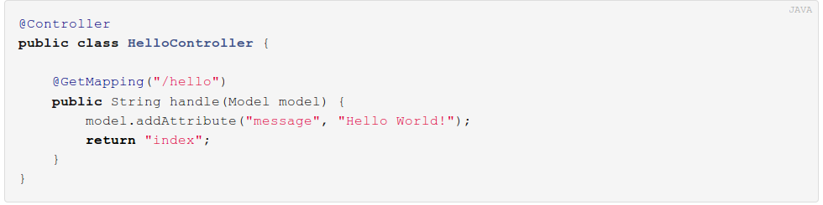
Controller

Slide 7
Controller Mapping
by path
@RequestMapping("/welcome")
by HTTP method
@RequestMapping(value = "/welcome", method=RequestMethod.GET)
@PostMapping
@GetMapping
@PutMapping
@DeleteMapping
@PatchMapping
by presence/value query parameter
@RequestMapping(params = {"find=ByMake", "form" })
by presence/value of request header
@RequestMapping(value = "/welcome", headers="accept=text/*")

Slide 8
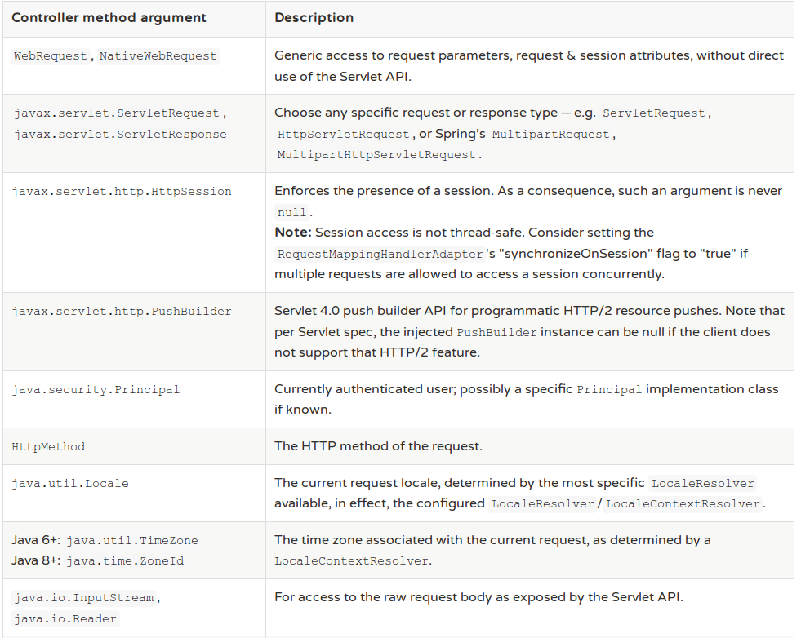

Slide 9
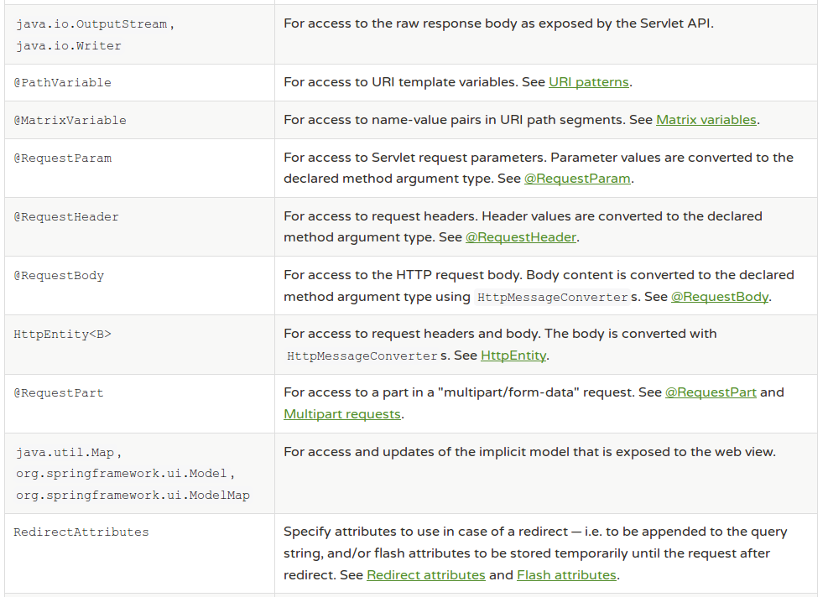

Slide 10
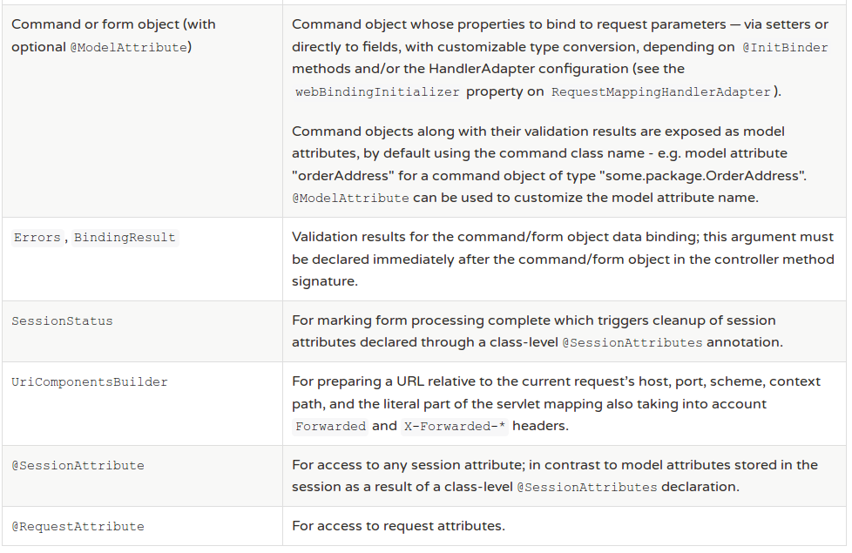

Slide 11
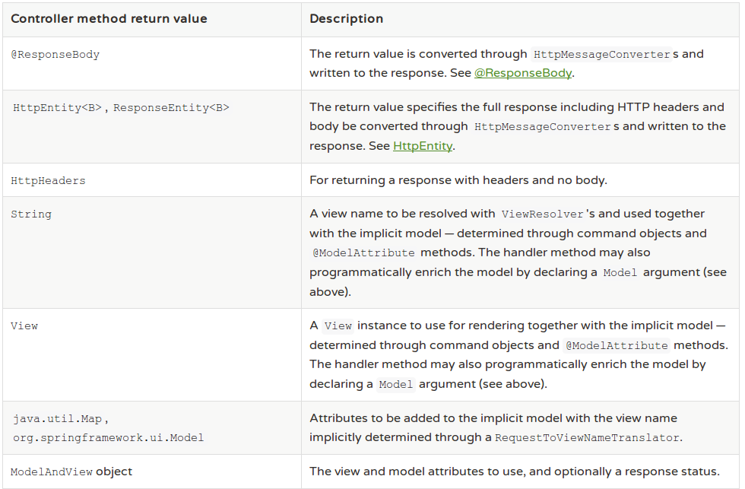

Slide 12
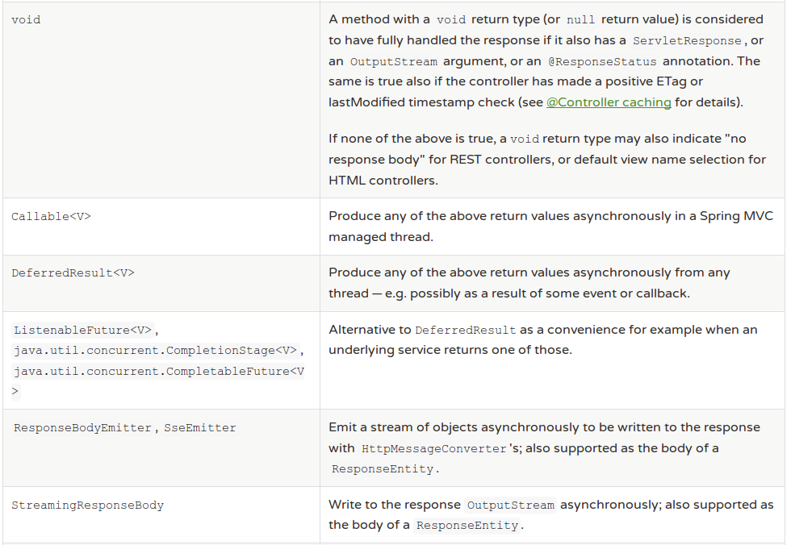

Slide 13
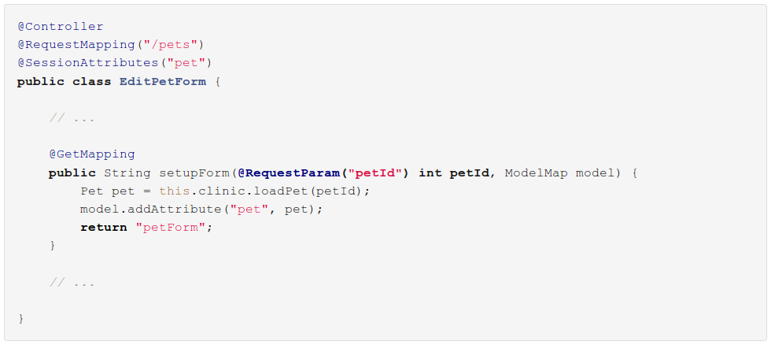
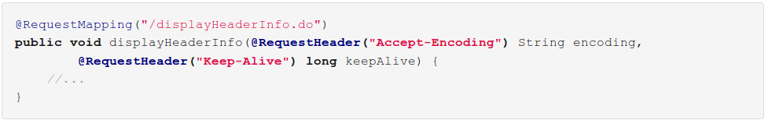
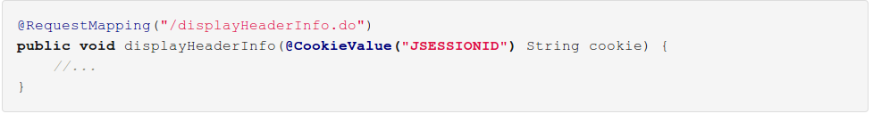

Slide 14
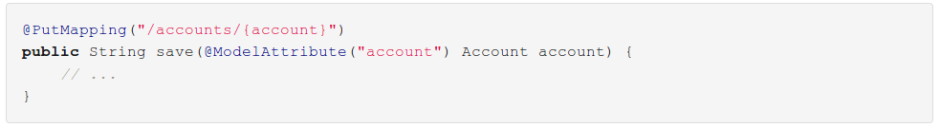
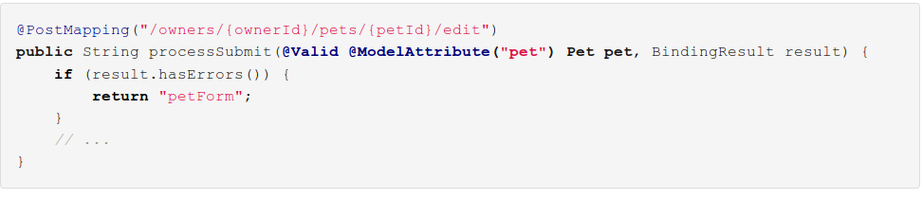
ModelAttribute

Slide 15
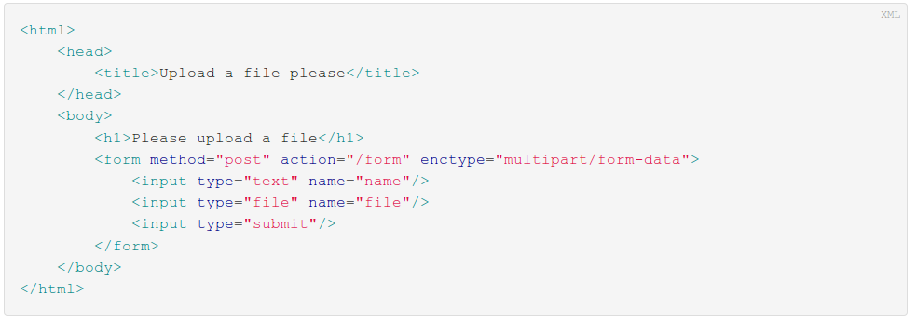
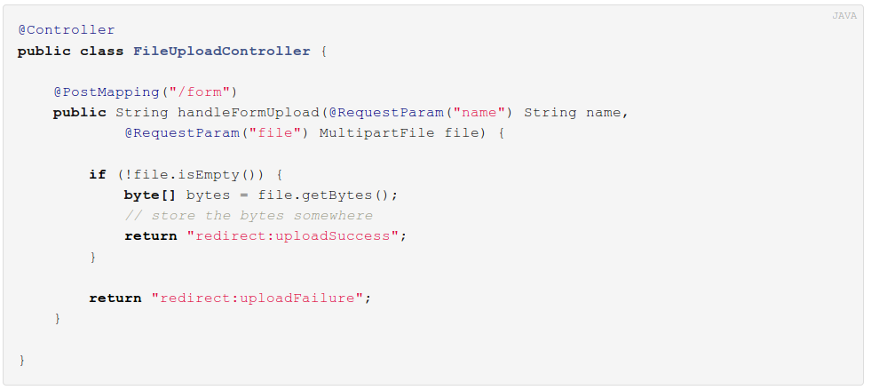

Slide 16
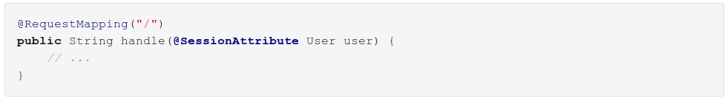
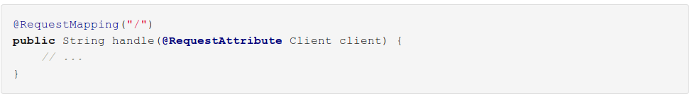
SessionAttribute/RequestAttribute
existing session attribute
existing request attribute (filter/interceptor)

Slide 17
HttpMessageConverters
reads the request body and writes the response
converters mapped to content types
registered by default if jar present in classpath
ByteArrayHttpMessageConverter - converts byte arrays
StringHttpMessageConverter - converts strings
FormHttpMessageConverter - converts form data to/from a MultiValueMap<String, String>
MappingJackson2HttpMessageConverter
etc.

Slide 18
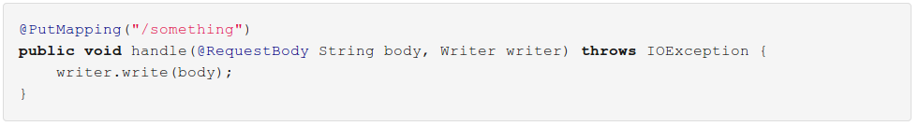
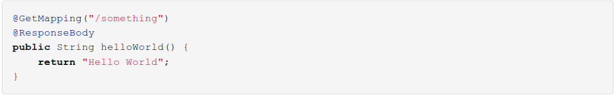
RequestBody/ResponseBody

Slide 19
Interceptors
public interface HandlerInterceptor {
/** Called before HandlerAdapter invokes the handler.
* @return true if the execution chain should proceed */
boolean preHandle(Request, Response, Handler) {}
/** Called after HandlerAdapter actually invoked the handler,
* but before the DispatcherServlet renders the view.*/
void postHandle(Request, Response, Handler, ModelAndView) {}
/** Callback after rendering the view. */
void afterCompletion(Request, Response, Handler, Exception) {}
}

Slide 20
Interceptors
@Configuration
@EnableWebMvc
@ComponentScan(basePackages="webapp.base.package")
public class WebApplicationConfig extends WebMvcConfigurerAdapter {
@Override
public void addInterceptors(InterceptorRegistry registry) {
registry.addInterceptor(new LoggerInterceptor()).addPathPatterns("/**");;
registry.addInterceptor(new AccessInterceptor()).addPathPatterns("/private/**");
}
}

Slide 21
Locales
LocaleResolver
AcceptHeaderLocaleResolver
CookieLocaleResolver
SessionLocaleResolver
LocaleChangeInterceptor
http://localhost:8080/carbase?lang=ro
@Bean
public LocaleChangeInterceptor localeChangeInterceptor() {
LocaleChangeInterceptor lci = new LocaleChangeInterceptor();
lci.setParamName("lang");
return lci;
}
@Bean(name = "localeResolver")
public CookieLocaleResolver localeResolver() {
CookieLocaleResolver localeResolver = new CookieLocaleResolver();
Locale defaultLocale = new Locale("ro");
localeResolver.setDefaultLocale(defaultLocale);
localeResolver.setCookieName("languagecookie");
localeResolver.setCookieMaxAge(3600);
return localeResolver;
}

Slide 22
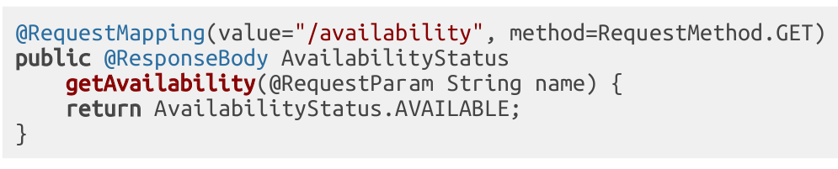
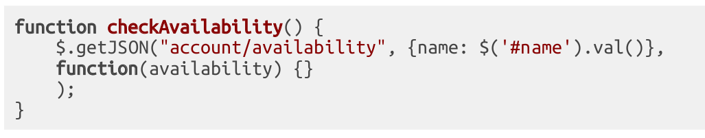
Get JSON
server
client

Slide 23
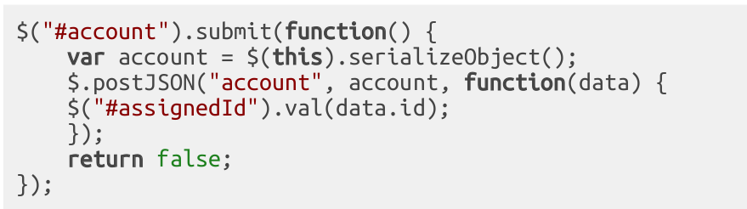
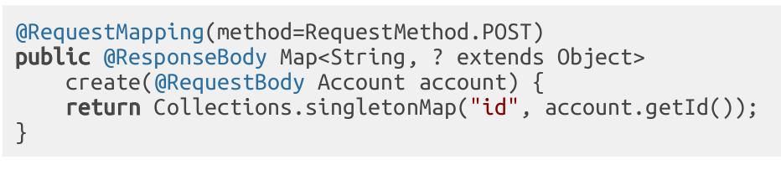
Post JSON
client
server

