Slide 1
Spring Security
a powerful and highly customizable authentication and access-control framework
build on top of Spring Framework
standard for securing Spring-based applications

Slide 2
Spring Security
principal
user that performs the action
authentication
confirming truth of credentials
authorization
define access policy for principal

Slide 3
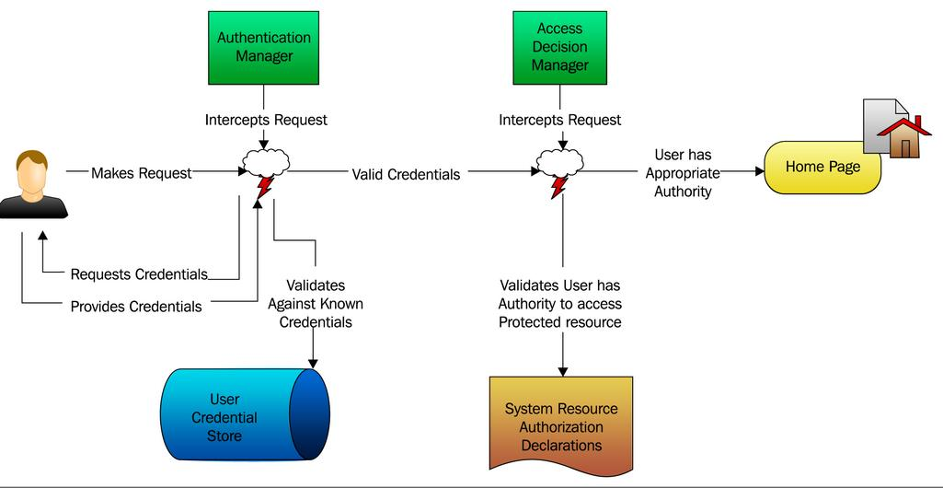
Spring Security

Slide 4
Spring Security
@EnableWebSecurity
@EnableGlobalMethodSecurity
<dependency>
<groupId>org.springframework.boot</groupId>
<artifactId>spring-boot-starter-security</artifactId>
</dependency>
Using default security password: dd46ab20-14d1-4794-9c8c-1834d5b72749
security.user.name
security.user.password

Slide 5
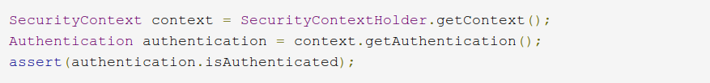
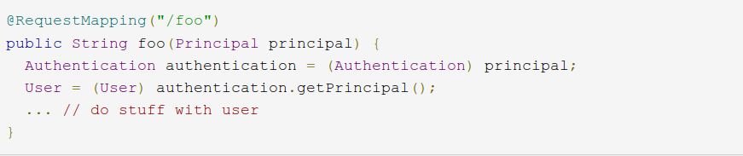
Current User

Slide 6
Security layers
WEB (URLs)
Servlet Filter
methods
Spring AOP
AspectJ
content
JSP tag

Slide 7
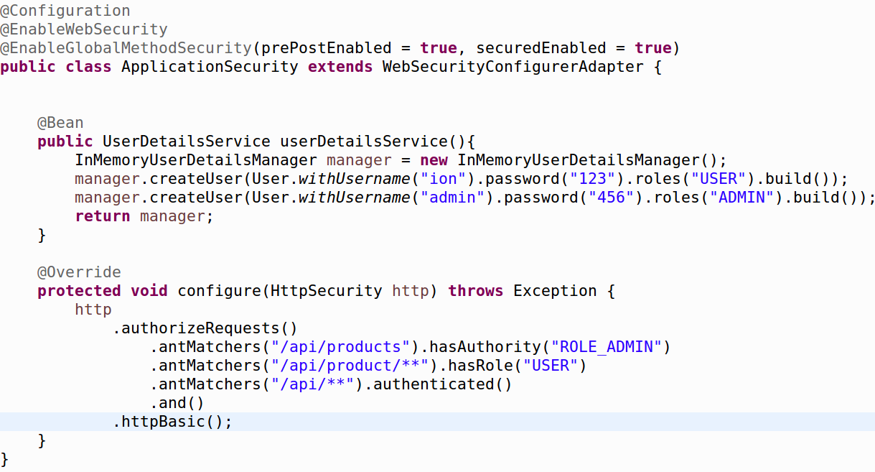
URL authorization

Slide 8
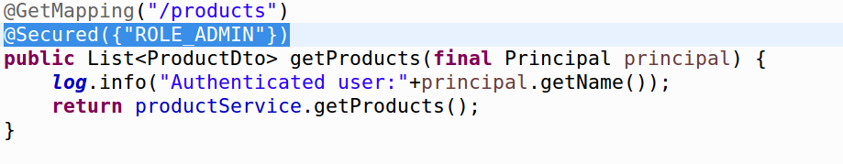
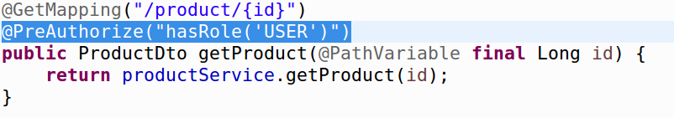
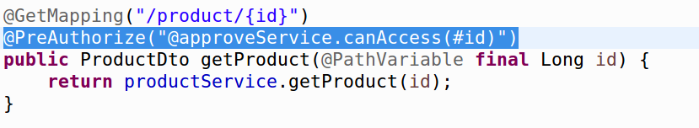
Method authorization

Slide 9
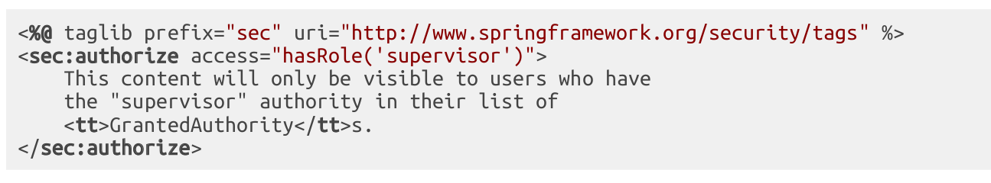
JSP tag

