Slide 1
Correlations in Changes of Stock Prices
Deliar & Soroush

Slide 2
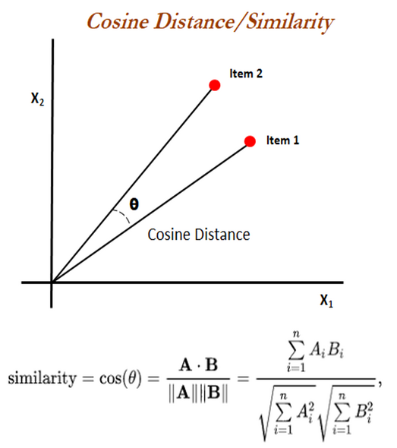
Recap
Nodes -> Stocks listed on the NYSE or NASDAQ.
Links -> Value in the range [-1, 1] that represents cosine similarity between two nodes.
Why?
Stock price prediction
Market forecasting
$$

Slide 3
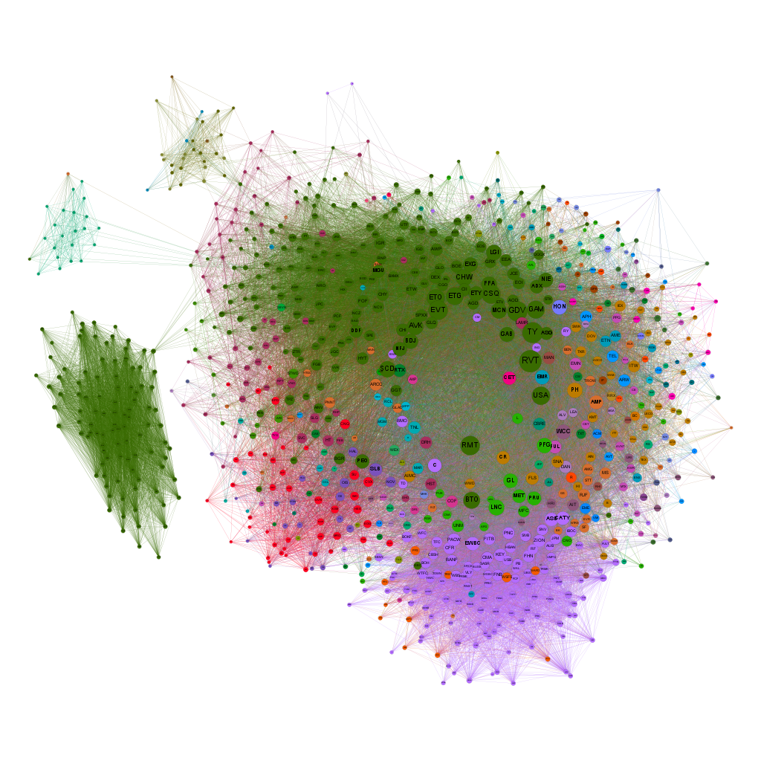
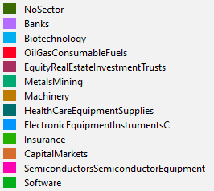
The Network
Nodes: 1898
Links: 100000
#Connected Components: 42
<k> : 66.19

Slide 4
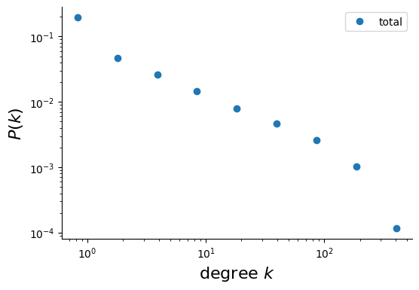
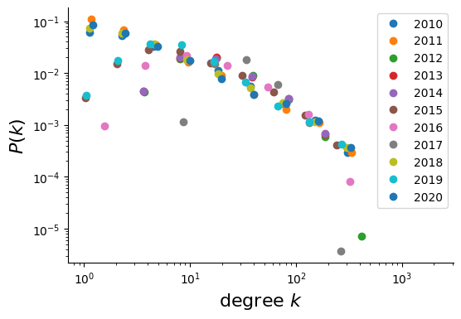
Degree Distribution
10 logarithmically spaced bins , Absolute weights/
Degree trends downwards : small number of hubs and lots of nodes with small degree/

Slide 5
Null Model Comparison
Attribute | Stocks Graph | ER | DP
Average Clustering coefficient | 0.667 | 0.062±0.0002 | 0.428±0.003
Average shortest path | 2.728 | 1.938±0.0002 | 2.189±0.002
Clustering Coefficient :
Our Graph tends to cluster together more, compared to null models.
Shortest Path Length:
Our Graph has a slightly longer Average shortest path, so nodes are slightly further away from each other.

Slide 6







RQ 1&2. Top and Bottom Market Movers
Top Stocks (2020):
HP(Hewlett-Packard), JPM (JPMorgan Chase)
8/75 Capital Markets
4/246 banks
Capital Markets 5.3%
Insurance 5.3%
Bottom Stocks(2020):
NVDA(Nvidia), AMZN(Amazon)
11/126 Biotechnology
5/75 Insurance
Biotechnology 8.7%
Insurance 6.6%
Top Stocks(2010-2020):
BMO (Bank of Montreal) ,
14/246 banks
8/75 Insurance
Machinery 5.8%
Insurance 9.3%
Bottom Stocks(2010-2020) :
AZN (AstraZeneca), NVDA(Nvidia), Ebay(eBay) …
9/246 banks
8/126 Biotechnology
Electronic Equipment, Instruments 7.6%
Biotechnology 6.3%

Slide 7
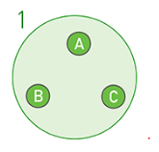
RQ 3. Intra-Sector Correlation
Highest:
Lowest:
Sector | Similarity
Multi-Utilities | 0.54096
Energy Equipment & Services | 0.48544
Road & Rail | 0.47879
Banks | 0.39211
Sector | Similarity
Biotechnology | 0.11529
Pharmaceutical | 0.12828
Personal Products(19) | 0.14164
Health Care Equipment & Supplies | 0.17026
Average Similarity Max: 0.540964
Avg: 0.308671
Min: 0.115291

Slide 8
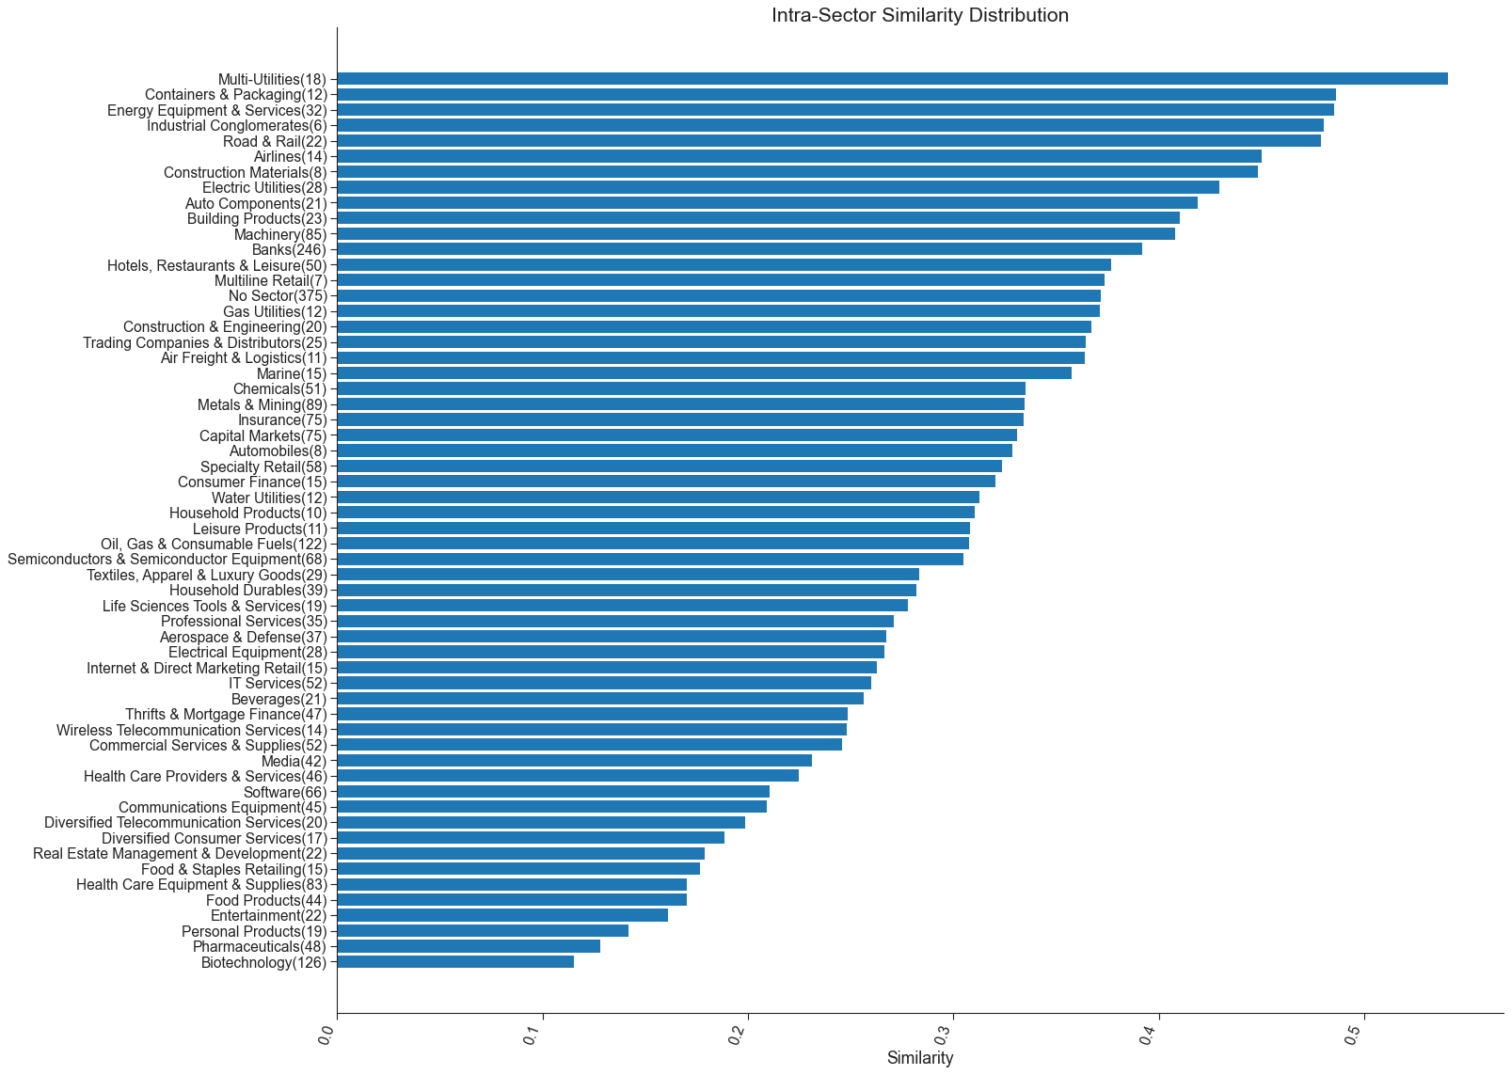

Slide 9
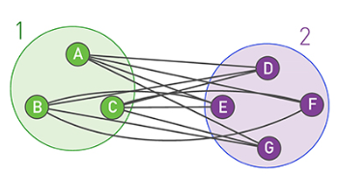
RQ4 .Inter-Sector Correlation
Sector 1 | Sector 2 | Similarity
Hotels, Restaurants & Leisure | Airlines | 0.33612
Machinery | Auto Components | 0.38629
Auto Components | Airlines | 0.33571178
Banks | Building Products | 0.314094218
Aerospace & Defense | Uranium | 0.82391 (outlier)
✅
Average Linkage Clustering (Used in Ravasz algorithm)
Max: 0.47632 Avg : 0.199434
Min: 0.03722
✅
❔
❔
❓❓❓

Slide 10
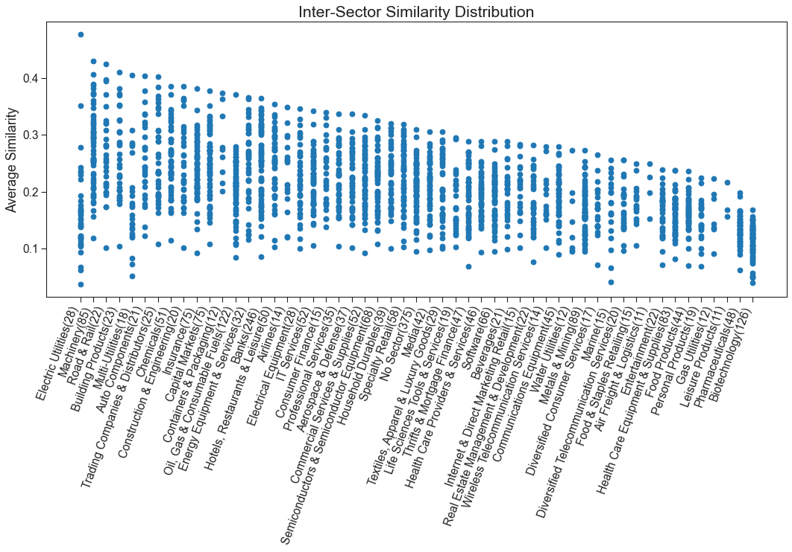

Slide 11
Limitations & Future Work
Did we answer all our research questions?
Yes, for the most part.
Some of our results are obvious, and were predicted beforehand.
Other results remain a mystery.
Still need to do:
Community Detection / Dive into results.
Assortativity/Influence/Homophily
For the Future:
Use more data points (Weekly, Daily, or Hourly).
Have better computers
We learned that there is a lot of non sensual data.
Due to complex nature of markets.
News, natural events, wars, pandemics & many more variables to consider.

Slide 12
Thank you

