Slide 1
Examining the Correlation Between Price Changes of Different Stocks - Part 2
Deliar & Soroosh

Slide 2
Recap
Nodes: The nodes in our graph are stocks listed on NASDAQ or NYSE.
Links: The correlation between the percentage change of two nodes. can range from -1 to 1 ( negative range to represent negative correlation)
We will be calculating these percentage changes ourselves from the raw data:
ex)
Stock A goes up 5% Stock B goes up 5% -> correlation = (5/5)=1.0
Stock A goes up 5% Stock B goes up 2.5% -> correlation = (2.5 / 5.0) = 0.5
Why?
So we can predict future price movements based on how correlated particular stocks are to each other.

Slide 3
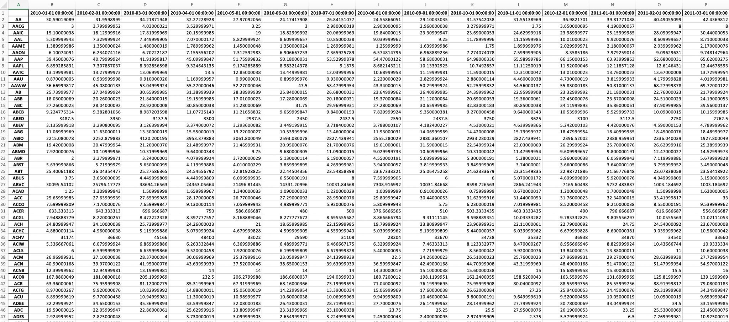
Raw Data
Ranges from Jan 2010 to Dec 2021. So there are 144 data points(months) per stock and ~ 3000 stocks.
Collected and cleaned all the data with Python, using the YFinance API. Removed stocks that were incomplete.

Slide 4
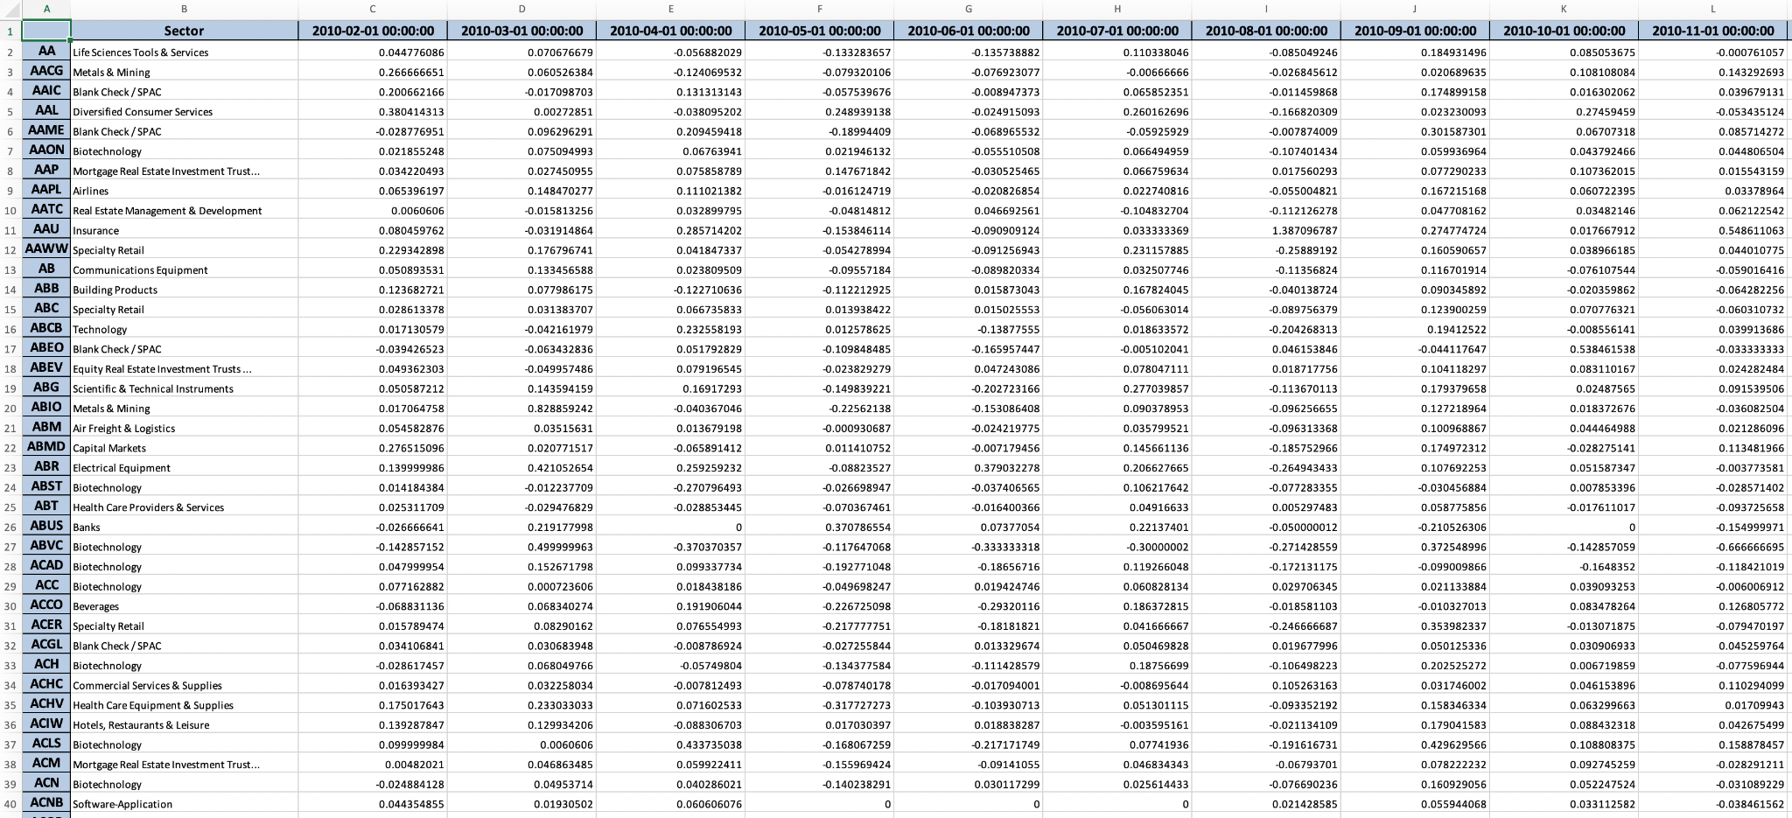
Processed Data
Converted all raw prices to monthly percentage change. Added Sectors for each stock.

Slide 5

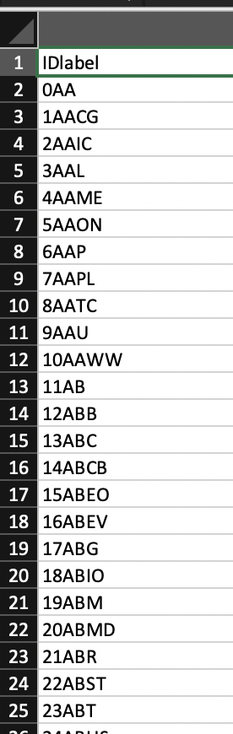
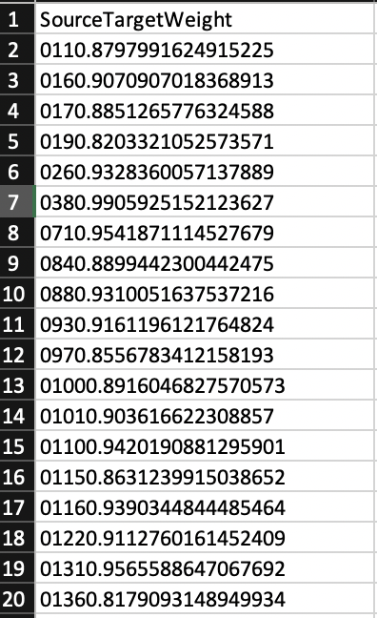
Constructing the Network
Turned data into csv format using Python alongside Pandas and the CSV library.
Calculated correlation values from each stock to every other stock and wrote those into links.csv O(n^2).
Imported the 2 csv’s (one for nodes, one for links) into Gephi:
stocks.csv
links.csv
—>
+

Slide 6
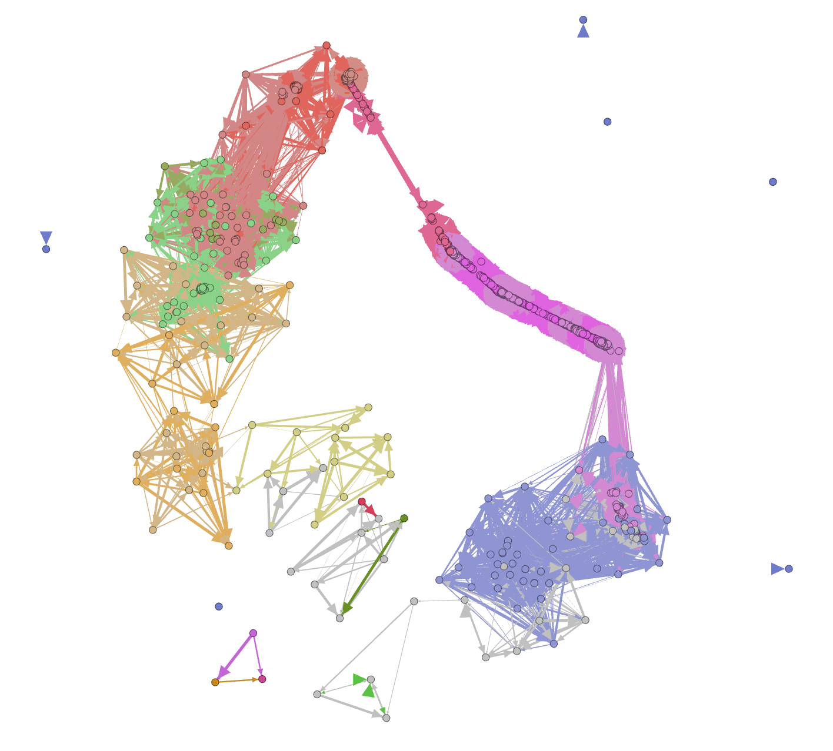

Slide 7
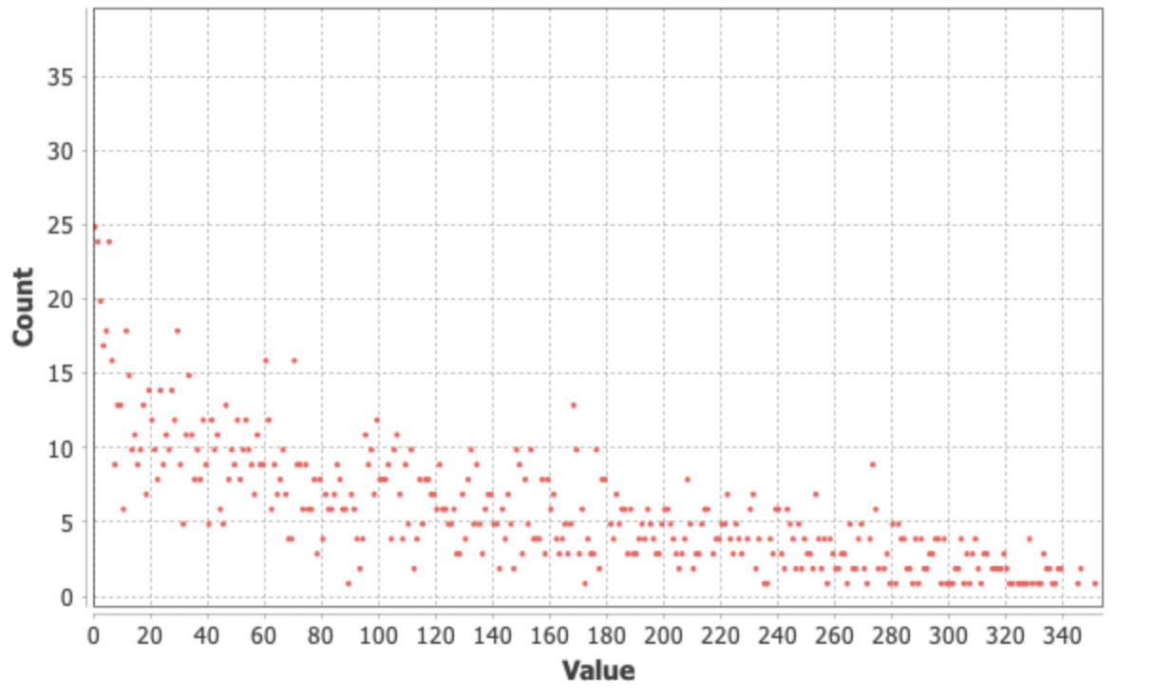
Degree Distribution
Obtained weighted in-degree & out-degree of our subgraph using Gephi.
Average Weighted Degree: 117.120
We expect this to smooth out as we increase the size of our network.
Threshold at 0.5 for correlation here.

Slide 8
Research Questions
Remained largely the same:
Are there any stocks that have significant effect on other stock prices?
ie) nodes with high degree.
Also called “Market Movers”.
Are there any stocks that are unaffected from price changes of other stocks?
ie) nodes with small degrees.
How strong are intra-sector relationships?
ie) links between members of a community.
How do energy/oil companies relate to other sectors and stocks?
Expecting strong sector-to-sector correlation here.

Slide 9
Thank you

