Slide 1



STRATEGY DAY 2027
Pillar 4 · Productivity and Operational Excellence
Supply Chain initiatives · ELT Lead: Pheakdey · LT Lead: Chandy
Notes:
Opening (30 seconds). I lead three of the Group 2 initiatives under Pillar 4: the regional distribution centre study, fleet cost-to-serve, and ISI Live Delivery. Chandy is the LT lead for all three. In the next 15 minutes: what we commit to, where we start, how we deliver each one, and what we need from you.

Slide 2
Three commitments for 2027
Each one cuts what it costs us to get steel to the customer, or how long the customer waits for it.
1.1
1.2
3.2
Regional distribution centres
Fleet cost-to-serve
ISI Live Delivery
≥10%
−5%
0 days
lower cost-to-serve per ton vs 2026
outbound transport cost per ton-km
from order capture to stock commit in SAP
11 branches to 2 DCs. Study and decision in 2027, savings from 2028.
Apr–Aug 2027 vs 2026. Fuel control, contracts, own fleet vs 3PL by lane.
Today 2 to 3 days. Plus ETA, live tracking and digital proof of delivery.
All three due Sep 2027. They feed the Pillar 4 KPIs: Net Profit $18m, Productivity Savings ≥$2m, Process Improvement ≥90%.
Notes:
Key message: three initiatives, one goal: lower cost and faster, more visible delivery. 1.1 is a study year: we decide on the 2 DC sites in 2027 and execute in 2028, so its 10% saving shows from 2028. 1.2 is the quick win inside 2027: 5% lower cost per ton-km between April and August. 3.2 is the customer-facing one: stock is committed in SAP the moment the order is taken, and the customer can see where their truck is. Term: cost-to-serve = total cost to store and deliver one ton to the customer. Ton-km = one ton carried one kilometre.

Slide 3
Where we start: 2026 baseline
11
2–3 days
Already live
Delivery Journey app: Gate In, Gate Out, 1 km arrival check, proof of delivery, two-way rating
Fuel Refill app: every refill with odometer and pump photo, reviewed
provincial branches served from the factory DC
lag from order capture to stock commit in SAP (manual cut-off)
Pre-work, initiative 1.1
Pre-work, initiative 3.2
17k–31k t
~24,000 L
Still missing
2026 cost per ton-km by lane, own fleet and 3PL
Cost-to-serve per branch
steel delivered per month from the SSK factory, Jan–Aug 2026
fuel per month, own trucks and forklifts (10,300 L logged in 13 days)
SAP MB51 goods issues
Fuel Refill records, 26 Sep – 8 Oct 2026
Baselines to be validated with Finance by Jan 2027
Notes:
Where we start. 11 branches are supplied from the factory distribution centre. SAP commits stock to an order 2 to 3 days after the order is taken, because of a manual cut-off. Monthly steel leaving the SSK factory ranged from about 17,000 to 31,000 tons in Jan to Aug 2026 (SAP MB51). Our own fleet uses roughly 24,000 litres of fuel a month, based on the first 13 days of the new Fuel Refill app. The digital base is already in place: the Delivery Journey app records every truck step and proof of delivery, and the Fuel app records every refill. What we still need is a Finance-validated 2026 baseline for cost per ton-km and cost-to-serve per branch; that is the first task in January.

Slide 4
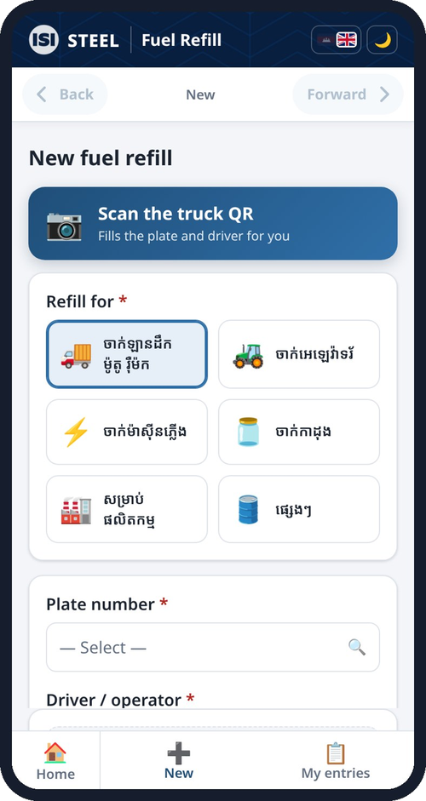
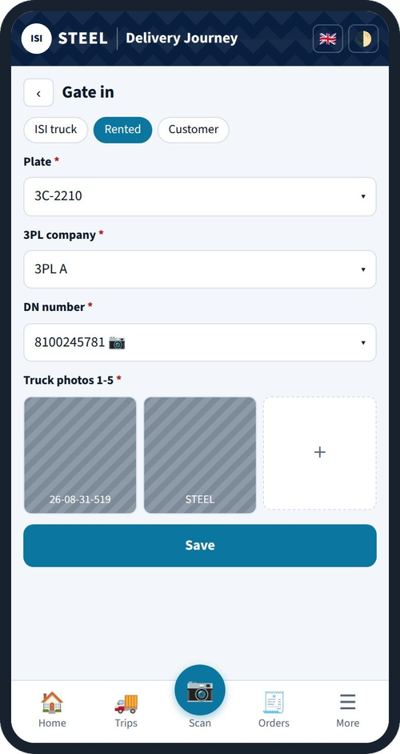
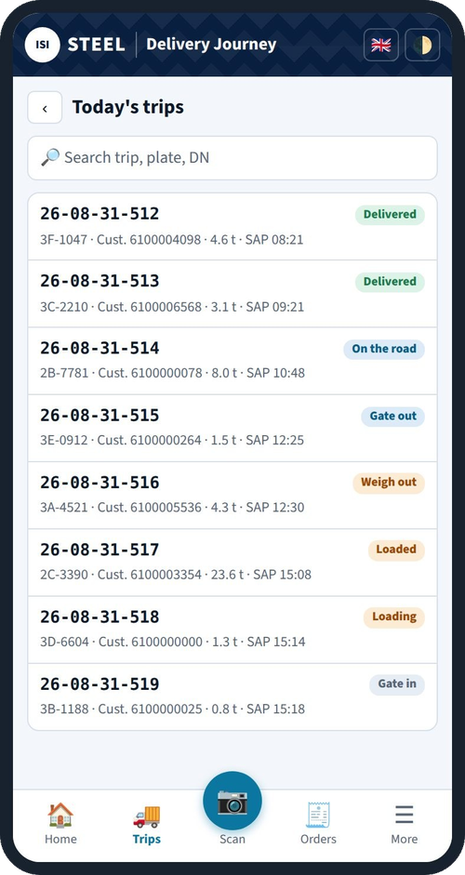
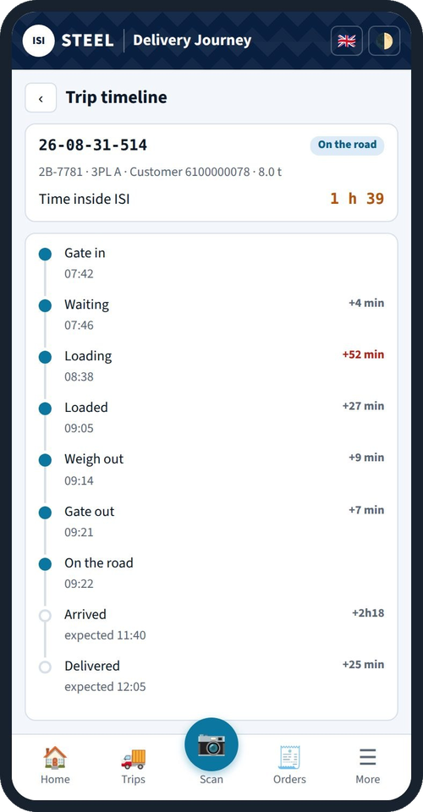
Already running: our own apps on every phone
Live
Live
Live
Live
Fuel refill: truck QR, odometer and pump photo
Gate In: plate, 3PL, DN and truck photos
Today's trips: every truck's status
Trip timeline: time spent at each step
Built in-house in 2026, free to run on Google Sheets. Screens shown with sample data.
Notes:
These are our own apps, built in-house this year and running on Google Sheets at no licence cost. Drivers record every fuel refill with the truck QR, odometer photo and pump photo. Security records Gate In with plate, 3PL company, DN number and truck photos. Logistics sees every trip of the day and the time each truck spends at every step, from Gate In to delivery. This is the data base for fleet cost-to-serve and for Live Delivery. The screens show sample data.

Slide 5
1.1 Regional DCs: 11 branches to 2 DCs
Why
2027 is study and readiness only. Execution in 2028.
Serving 11 branches one by one from the factory means many small, long trips
Two regional DCs next to the factory DC put stock closer to customers
Shorter lead time for customers, fuller trucks for us
Network study done
volume by province, cost-to-serve per branch, customer lead time
Feb
May
Decision gate
go or no-go with management
Jun
2 sites shortlisted
and recommended
Jul
Customer transition plan
approved; Sales co-owns
≥10%
Aug
SAP readiness
Regional DC 1 and 2 set up in SAP
lower cost-to-serve per ton vs 2026, in the Finance-validated business case. Realised from 2028.
2028
Execution
DCs open, customers move
Notes:
Initiative 1.1. Today all 11 provincial branches are supplied from the factory. The idea is two regional distribution centres (large central warehouses) next to the existing factory DC, so trucks run full to a regional hub and short trips go out from there. 2027 is study and readiness only: network study by February, a management decision gate in May, two sites recommended in June, customer transition plan in July with Sales as co-owner, and SAP set up for the two DCs by August. The physical move happens in 2028, so the 10% cost-to-serve saving is shown in the business case and realised from 2028. Note: the pre-work deadline says September; the last 2027 milestone is August, so September is the sign-off month.

Slide 6




1.2 Fleet cost-to-serve: four levers
Control fuel
Pay per km
−5%
Tender the fuel supply. Fleet card per vehicle with litre limits. Monthly check of card litres against GPS km.
Cost-per-km contract with an uptime SLA. Term and fleet size adjustable, signed after the own-fleet vs 3PL decision.
outbound transport cost per ton-km, Apr–Aug 2027 vs 2026
How we measure
Cost per ton-km = total outbound transport cost ÷ (tons delivered × km driven)
Right truck per lane
Manage 3PL
Cost per ton-km by route and vehicle. Lane-by-lane review: own fleet or 3PL, whichever is cheaper.
Re-tender 3PL on the cost-per-ton-km baseline. Monthly 3PL scorecard: cost, on-time, damage, customer rating.
Data comes from the Fuel app, Delivery Journey trips (tons and km) and Finance cost.
Notes:
Initiative 1.2, the 2027 quick win. Four levers. One: control fuel, by tendering the supply and giving each truck a fuel card with a litre limit, then each month checking the litres on the card against the kilometres from GPS. Two: pay per kilometre with an uptime guarantee (SLA = service level agreement), signed only after we decide own fleet vs 3PL. Three: for each delivery lane, compare cost per ton-km of our own trucks against 3PL and use the cheaper one. Four: re-tender the 3PL contracts against that baseline and score them monthly. Target: 5% lower outbound cost per ton-km between April and August 2027 compared with 2026. Term: 3PL = third-party logistics, outside transport companies.

Slide 7
Why fuel control comes first
What the first weeks of the Fuel Refill app already show (26 Sep – 8 Oct 2026)
1 in 6
100 / 150 L
35
refills had a fake odometer reading
fixed amounts, not full tank
trucks and drivers logging
0, 1, 100 or 123456 typed in. Without real km we cannot measure km per litre.
Drivers fill round numbers, so litres per trip cannot be checked against distance.
One record per refill with photos and GPS, reviewed daily. The data base for a fleet card check.
Fleet card + GPS km closes this gap: litres are capped per vehicle and checked against real distance every month.
Notes:
Evidence from our own data. The Fuel Refill app went live on 26 September. About one refill in six had a placeholder odometer reading such as 0, 1 or 123456, so we cannot yet calculate kilometres per litre reliably. Drivers fill fixed round amounts like 100 or 150 litres rather than a full tank, so litres cannot be matched to distance. The good news: about 35 trucks and drivers are already logging every refill with photos and GPS, and a reviewer checks them. A fuel card with a litre cap, matched every month with GPS kilometres, turns this into a control.

Slide 8





3.2 ISI Live Delivery: order-to-door visibility
The customer journey we will deliver by Sep 2027
Order captured
Loading
Gate Out
On the road
Arrival
Proof of delivery
SAP commits stock at once. Today: 2–3 days
Gate In, loading and DN scan in the app
Customer gets ETA by Telegram or SMS
Live map link, like a food-delivery app
GPS geofence confirms delivery
Digital POD with photo and signature
Build
Live
Build
Build
Partly live
Live
Head start: the Delivery Journey app already records Gate In, loading, Gate Out, a 1 km arrival check and proof of delivery. 2027 adds the SAP stock commit, customer messages and the live map.
Dependency: the truck flow platform must reach all sites by Apr 2027.
Notes:
Initiative 3.2, ISI Live Delivery. This is the customer's journey from order to door. Green steps are already live in our Delivery Journey app: Gate In, loading with DN scan, and digital proof of delivery. Blue is partly live: we already check the truck is within 1 km of the customer; a GPS geofence will make that automatic. Gold steps we build in 2027: SAP commits stock the moment the order is captured instead of 2 to 3 days later; the customer receives an ETA by Telegram or SMS at Gate Out; and premium customers can follow the truck on a live map. Dependency: the truck flow platform must be live at all sites by April 2027. Terms: DN = delivery note; ETA = estimated time of arrival; POD = proof of delivery; geofence = a GPS circle around the customer site.

Slide 9
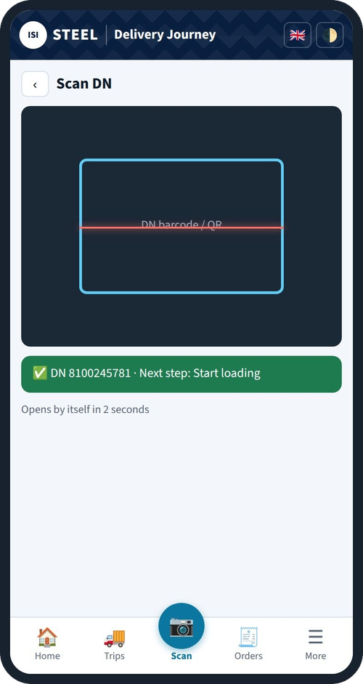
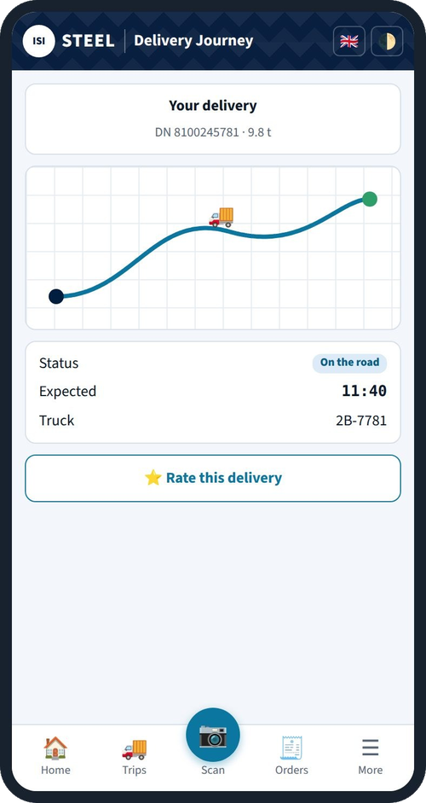
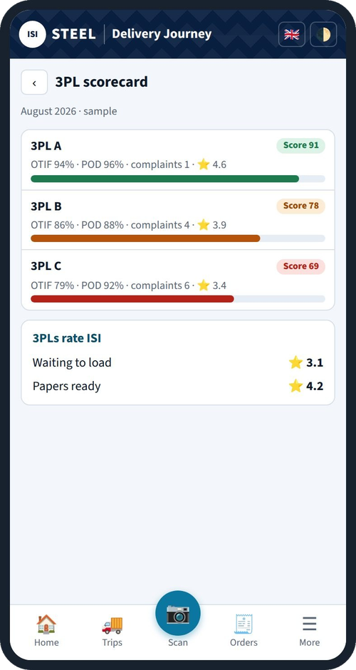
Next: what customers and 3PL will see
Live
2027
2027
Scan the DN: next step opens by itself
Customer tracking link with ETA (3.2)
3PL scorecard: OTIF, POD, complaints (1.2)
Notes:
What comes next, built on the same app. Scanning the delivery note already opens the next step by itself. In 2027 the customer receives a tracking link at Gate Out showing where the truck is and the expected arrival time; that is initiative 3.2. And each 3PL company gets a monthly scorecard: on-time in full (OTIF), proof of delivery rate, complaints and the customer's rating; that supports the 3PL re-tender in initiative 1.2. The 3PL scorecard numbers shown are a sample.

Slide 10
3.2 Live Delivery: how we will measure it
0 days
order capture to stock commit in SAP
from Jun 2027 (today 2–3 days)
100%
deliveries with digital proof of delivery
by Sep 2027
100%
deliveries send the customer a live tracking link at Gate Out
by Sep 2027
−50%
customer calls to Sales asking for delivery status
vs Q4 2026
Baseline for customer status calls to be counted by Sales in Q4 2026.
Notes:
The four measures for Live Delivery. Zero days between order capture and stock commitment in SAP from June 2027. 100% of deliveries with digital proof of delivery by September. 100% of deliveries send the customer a live tracking link at Gate Out by September. Half the number of customer calls to Sales asking where their delivery is, compared with Q4 2026. For that last one, Sales needs to start counting the calls in Q4 2026 so we have a baseline.

Slide 11
2027 roadmap
Jan
Feb
Mar
Apr
May
Jun
Jul
Aug
Sep
Oct
Nov
Dec
1.1 Regional DCs
Network study
Gate
Sites
Plan
SAP
Sustain, report monthly, prepare 2028 DC execution
1.2 Fleet cost
Baseline + fuel tender
Measure −5% (Apr–Aug)
Lane review: own vs 3PL
3PL re-tender, contract
3.2 Live Delivery
Platform to all sites
ETA + link
0-day SAP commit, 100% POD
All three initiatives due Sep 2027 (gold). Monthly progress review with Chandy.
Notes:
The year on one page. Jan to Mar: build the 2026 baselines with Finance, tender fuel, finish the DC network study, and roll the truck flow platform out to all sites. April to August is the measurement window for the 5% fleet saving; in parallel we run the lane review, the DC decision gate in May, site choice in June, transition plan in July and SAP readiness in August. ETA messages and tracking links go live from April, the zero-day SAP stock commit from June. September is the delivery month for all three. Q4: sustain, report monthly, and prepare the 2028 DC execution.

Slide 12




What we need from management
Finance
Validate the 2026 baselines (cost per ton-km, cost-to-serve per branch) by Jan 2027 and the DC business case
Key risks
No reliable 2026 baseline: we fix it in Q1 with Finance and app data
Drivers and 3PL slow to adopt apps: training, daily review, scorecard
SAP change takes longer: start the IT request in Jan
Sales
Co-own the DC customer transition; collect customer phone numbers for ETA messages; count status calls from Q4 2026
IT / SAP
Stock commit at order capture (Jun 2027) and SAP setup for Regional DC 1 and 2 (Aug 2027)
Procurement + budget
Fuel tender, fleet cards, GPS devices for own trucks, SMS cost, 3PL re-tender
Notes:
To deliver this, I need four things. Finance: validate the 2026 baselines by January and the DC business case. Sales: co-own the customer transition for the DCs, help collect customer phone numbers so we can send ETA messages, and start counting delivery-status calls now. IT and SAP: stock commitment at order capture by June and SAP setup for the two DCs by August. Procurement and budget: the fuel tender, fleet cards, GPS devices for our own trucks, SMS costs and the 3PL re-tender. The main risks are a weak baseline, slow adoption by drivers and 3PL, and SAP change lead time; each has a mitigation shown.

Slide 13
Lower cost to serve. Faster, visible delivery.
≥10% cost-to-serve per ton · −5% cost per ton-km · 0-day stock commit
Questions and discussion
Notes:
Close. Three numbers to remember: at least 10% lower cost-to-serve per ton from the DCs, 5% lower cost per ton-km in 2027, and zero days to commit stock to an order. Thank you, happy to take questions.

