Slide 1

DeliWer Shopping
B2B Reverse Auction Platform
TRANSPARENCY • EFFICIENCY • INNOVATION
📍 Dubai Airport Freezone

Slide 2

1
Opaque Pricing
Identical smartphone models quoted at vastly different rates without justification
2
Unreliable Suppliers
No verified, centralized platform to differentiate between reputable and opportunistic vendors
The Market Problem
3
Operational Risk
Transaction delays and increased risk for buyers without transparency
4
No Price Competition
Current live shopping models offer no real-time bidding or incentives for bulk orders
5
Low Buyer Engagement
Limited supply-side accountability and weak incentives for platform participation

Slide 3
Reverse Auction Marketplace Empowers Buyers with Real Market Leverage
1
2
3
4
Buyer Posts
Suppliers Bid
Live Inspection
Detailed requirements (models, grades, quantities)
Verified vendors compete in real-time for best price
Transparent video/chat validation before invoicing
Transaction
Secure fulfillment and payment processing
↓
↓
↓
📦 Spot Orders
🎯 Concierge Services
✓ Verified Suppliers
Ready-to-ship inventory from monthly warehouse stock for immediate fulfillment
Subscription-based sourcing support for streamlined procurement workflows
Curated network of trusted vendors with transparent track records

Slide 4
Dubai Airport Freezone Provides Unmatched Logistics and Trade Connectivity
🌏
Asia Connectivity
#1
World's Busiest Airport by International Passengers
Direct routes to India, China, and Southeast Asia - the world's largest electronics manufacturing hubs
🌍
MENA Gateway
Strategic hub for Middle East and North Africa with major re-export routes to Iraq and regional markets
55%
Of DAFZ Trade in Machinery & Electronics Equipment
✈️
US Market Access
Streamlined logistics routes connecting to North American markets and distribution centers
AED 90.4B
Total Electronics Trade Value (2019)
⚖️
Regulatory Benefits
100% foreign ownership, zero corporate tax until 2071, minimal regulatory burden for business operations

Slide 5

Multi-Channel Monetization Designed for Sustainable Scale
💰
📅
Per-Device Fee
Subscription Tiers
Charged for each device sourced through reverse auctions or spot orders
Monthly subscriptions for regular B2B buyers with sourcing concierge and premium auction access
$5 per device
Starting at $49/month
⭐
🔗
Supplier Visibility
Affiliate Program
Featured listing slots for verified vendors seeking enhanced reach and deal velocity
Performance-driven ecosystem enabling remote resellers and Shopify sellers to earn through referrals
Premium positioning
Revenue sharing model
Year 1 Revenue Projection (Q4):
$100,000
with 1,000 buyers and 20,000 devices

Slide 6
Grassroots Launch Targeting MENA Resellers with Rapid Scaling Potential
🎁
30-Day Free Trial
💬
Direct WhatsApp Outreach
Onboard 500+ MENA-based online resellers with full access to sourcing concierge and premium auction features
Peer-based messaging campaign reaching 20+ targeted wholesale groups to generate trust and virality
Target: 500+ early adopters
Focus: Reseller communities
🤝
Affiliate Engine
✓
Verified Buyer Campaign
Empower resellers to drive growth by earning through referrals and social content sharing
Spotlight trusted users in DAFZ to build marketplace credibility and establish social proof
Incentive: Performance-driven rewards
Location: Dubai Airport Freezone
Launch Strategy:
Lean, grassroots approach focusing on early adopter communities with high conversion potential, leveraging peer networks
Quick to Market
and incentive structures to drive rapid platform adoption and network effects.

Slide 7
DeliWer Combines Technological Innovation with Sustainability Leadership
🎯
First Real-Time Reverse Auction
🤖
AI-Powered Supplier Matching
First to apply real-time reverse auction system to refurbished electronics, giving buyers unprecedented price transparency and competition
Intelligent shopping agent matches buyer needs with verified suppliers and enables smart live inspections for transaction assurance
✓
Smart Live Inspections
🌱
Green Procurement Rewards
Advanced video and chat-based inspection process adds critical assurance layer for high-volume, high-value B2B transactions
Rewards buyers for sustainable sourcing and tracks lifecycle impacts to align with ESG standards and corporate responsibility
🌐
Strategic Partnerships for Global Scale
Designed for global scalability and operational resilience through strategic partnerships and integrated logistics networks

Slide 8
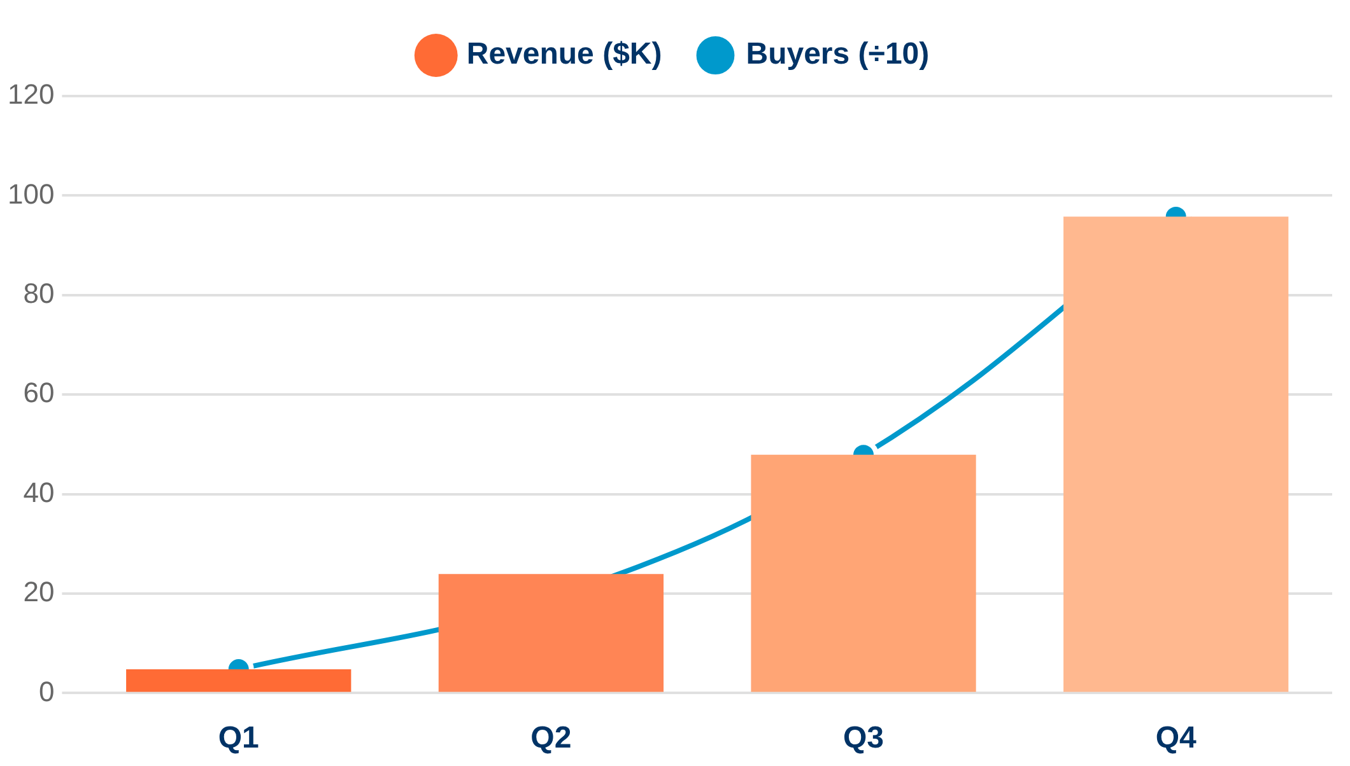
Conservative Year 1 Targets Show Strong Unit Economics and Network Effects
Q1 Targets
$5K
50 Buyers | 1,000 Devices
Q2 Targets
$25K
5x
200 Buyers | 5,000 Devices
Q3 Targets
$50K
2x
500 Buyers | 15,000 Devices
Q4 Targets
$100K
2x
1,000 Buyers | 20,000 Devices
Unit Economics: $5 per device sourced | Subscription revenue: $49+/month | Network effects drive exponential growth trajectory

Slide 9
Lean, Agile Team with Deep Expertise in Global Trade and Technology
RH
HJ
🛠
Rubab Hassan
Hassan Jawad
Development Agency
Founder & Sales Strategist
Operations & Fulfillment
Shopify-Certified Partner
Global trade expertise
Logistics optimization
Advanced CRM tools
B2B sourcing strategy
Platform architecture
AI-driven features
Market development
Hands-on execution
Live shopping agents
Vendor relationships
Operational scalability
eCommerce integration
Team Structure & Approach
Compact, agile team structure enables quick innovation and precision response to buyer and supplier needs. Combination of strategic vision, operational excellence, and cutting-edge technology ensures lean yet powerful execution in a rapidly evolving market.

Slide 10
DeliWer Seeks Technology and Investment Partners to Amplify Impact
Immediate Engagement Options
💰
Revenue-Sharing Models
Structured partnerships aligned with long-term incentives and mutual growth
✓ Live platform access via hosted PWA prototype
✓ Shopify-integrated auction hub for testing
✓ Direct validation of product-market fit
🤝
Sweat Equity Arrangements
✓ Real-time collaboration opportunities
Collaborate on platform development and operations with equity participation
Primary Contact
🔧
Technology Expertise
Hassan Jawad
AI/CRM enhancement, B2B platforms, live commerce, and eCommerce tech specialists
+971 50 944 6936
formatix@deliwer.com

Slide 11

The Future of B2B Electronics
Sourcing
Starts Here
DeliWer is transforming global supply chains through transparency, efficiency, and innovation in refurbished electronics sourcing.
🔍
⚡
💡
Transparency
Efficiency
Innovation
Real-time price visibility and verified supplier networks
Streamlined reverse auction process and instant fulfillment
AI-powered matching and smart live inspection technology
Ready to transform your electronics sourcing?
VISIT: www.deliwer.com | CONTACT: formatix@deliwer.com

