Slide 1
Hit Finding
Leonov Vladimir
13 September 2016

Slide 2
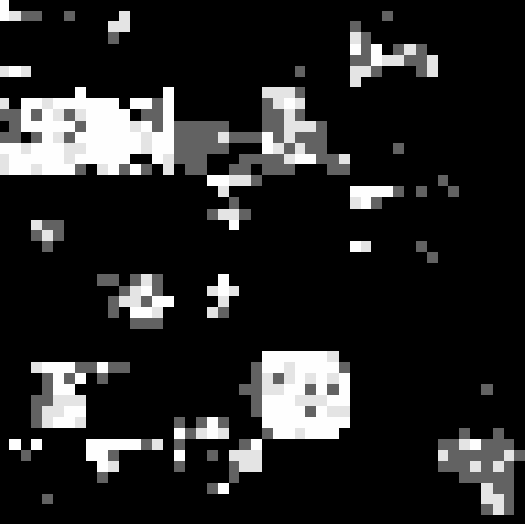
Formulation of the problem
Our main goal is recognised both single hit and the center of cluster
The image received from UBAT contains a lot of noise

Slide 3
Solution
Step#1
Remove all oversized clusters (more than matrix of pixel 3x3)
Step#1

Slide 4
Solution
Step#2
In the cleaned data distinguish the center of small cluster (it's not more than 3x3)
* Step#3 (probably)
To make further calculations for large clusters
Step#2

Slide 5

Solution
Step#4
Put the data in the datebase for further analysis

Slide 6
What already have done
Removing of big clusters
Designed database
Implemented algorithm of the center's search

Slide 7
About HF (hit finder)
Possibility:
Processing image of any size
(64x64, 256x256..)
Can setting filter parameter
Can analyze not only shape of cluster
but either its brightness
Technical overview:
Wrote in Python 3.4 with support ver. 2.5+
Any size
Any filter parameter

Slide 8
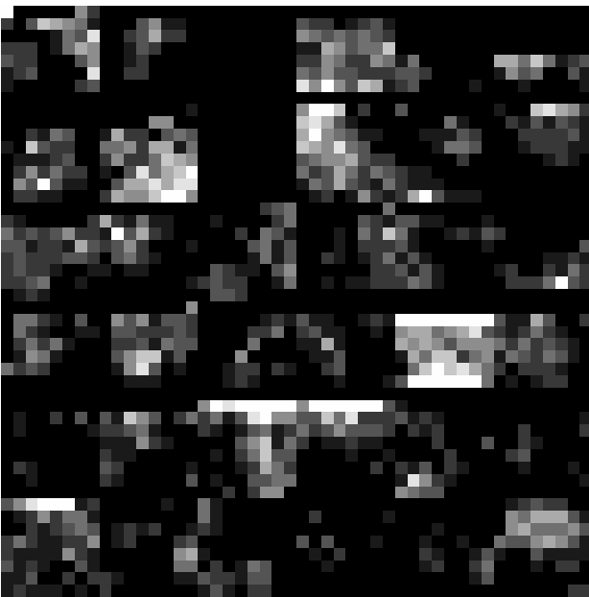
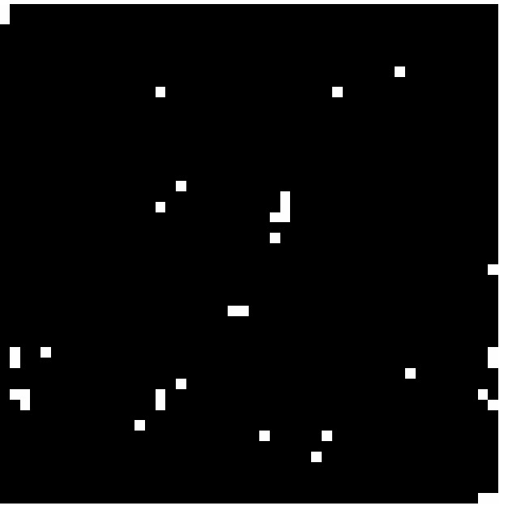
Processing of image by HF
BEFORE
AFTER

Slide 9
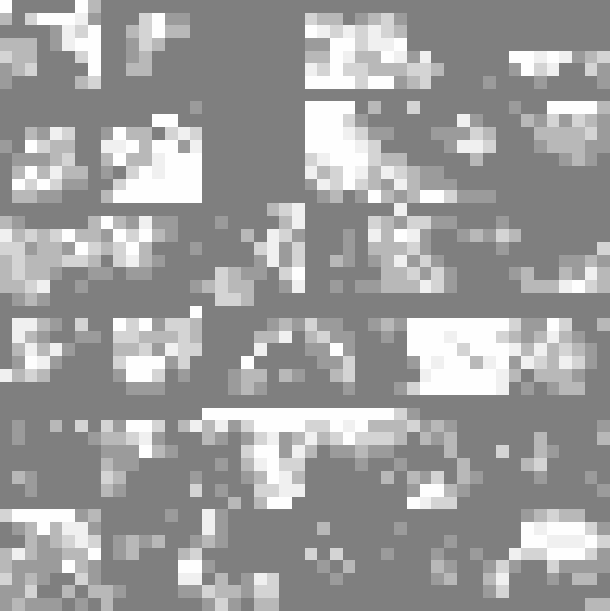
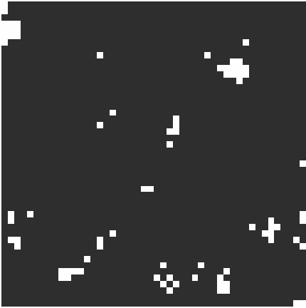
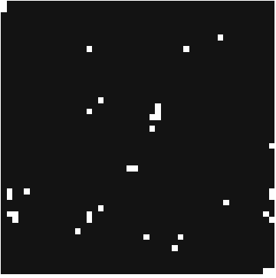
Different filters
No filter
Filter parameter = 20
Filter parameter = 8

Slide 10
Future Tasks
Create database to Statistics application
Develop the detection of cluster's center
Add user friendly interface
Add mask 4x4 and probably more
Consider both big cluster and brigthness of image

