Slide 2
How to create a web service step by step?
Creating a WebService from scratch
Step 1: Create an application. ServiceStack can be hosted in a few ways: console application, windows service, ASP.NET Web Form or MVC in IIS, etc. ...
Step 2: Install ServiceStack. ...
Step 3: Create your first webservice. ...
Step 4: Registering your web services and starting your application.

Slide 3
Introduction
This describes how to create a web service in ASP.NET and use it in a client application.

Slide 4
What is Web Service?
A Web Service is a reusable piece of code used to communicate among Heterogeneous Applications.
Once a web service is created and hosted on the server in the internet it can be consumed by any kind of application developed in any technology.

Slide 5
How to create a Web Service
Step 1
Go to Visual Studio then click on "File" -> "Website" -> "ASP.NET empty website template".
Then provide the website name (for example: WebServiceSample).

Slide 6
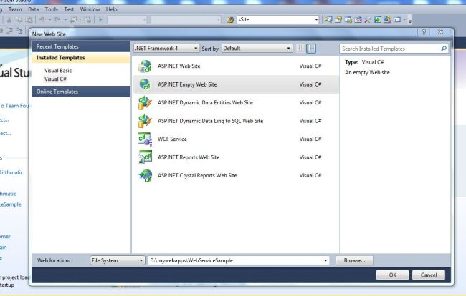

Slide 7
Step 2 Add a Web Service File
Go to Solution Explorer, then select the solution then click on "Add new item".
Choose the Web Service template.
Enter the name (for example: Airthmatic.cs) then click on "Add".

Slide 8
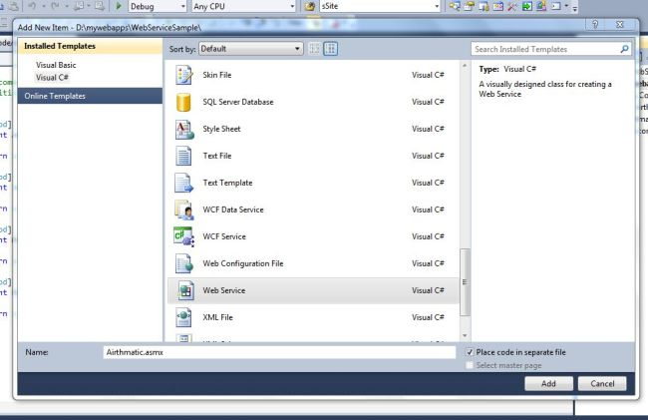

Slide 9
This will create the following two files:
Airthmatic.asmx (the service file)
Airthmatic.cs (the code file for the service; it will be in the "App_code" folder)

Slide 10
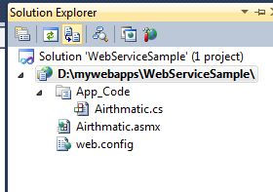

Slide 11
Open the file Airthmatic.cs and write the following code
using System;
using System.Collections.Generic;
using System.Linq;
using System.Web;
using System.Web.Services;
/// <summary>
/// used for Airthmatic calculation
/// </summary>
[WebService(Namespace = "http://tempuri.org/")]
[WebServiceBinding(ConformsTo = WsiProfiles.BasicProfile1_1)]
// To allow this Web Service to be called from script, using ASP.NET AJAX, uncomment the following line.
// [System.Web.Script.Services.ScriptService]

Slide 12
public class Airthmatic : System.Web.Services.WebService
{
public Airthmatic() {
//Uncomment the following line if using designed components
//InitializeComponent();
}
[WebMethod]
public int Add(int x, int y)
{
return x + y;
}
[WebMethod]
public int Sub(int x, int y)
{
return x - y;
}
[WebMethod]
public int Mul(int x, int y)
{
return x * y;
}
[WebMethod]
public int Div(int x, int y)
{
return x / y;
}
}

Slide 13
Attaching the WebMethod attribute to a Public method indicates that you want the method exposed as part of the XML Web service. You can also use the properties of this attribute to further configure the behavior of the XML Web service method. The WebMethod attribute provides the following properties BufferResponse
CacheDuration
Description
EnableSession
MessageName
TransactionOption

Slide 14
To see whether the service is running correctly go to the Solution Explorer then open "Airthmatic.asmx" and run your application.
Now you will find all the method names in the browser.

Slide 15
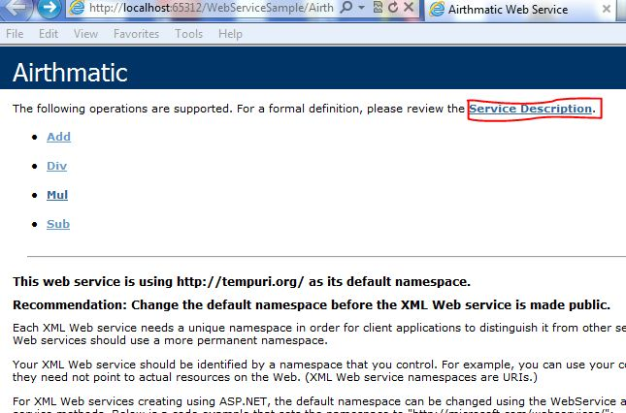

Slide 16
To see the WSDL format click on the service description link or add "?WSDL" to the URL.
Example
http://localhost:65312/WebServiceSample/Airthmatic.asmx?WSDL
It will show the WSDL.

Slide 17
To determine whether the functions are working, click on one of the functions (for example: "Add").
Now you will see two TextBoxes for checking. Enter the value for x and y and click on the "Invoke" button.
Now you will see the result in an open standard form (XML).

Slide 18
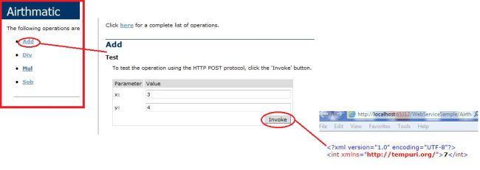

Slide 19
Now your service is ready for use.
Step 4 Creating the client application
Now create a website and design your form as in the following screen.

Slide 20
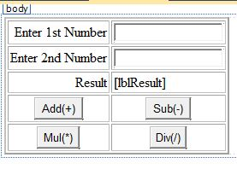

Slide 21
<body>
<form id="form1" runat="server">
<div>
<table border="2" cellpadding="2" cellspacing="2">
<tr>
<td align="right">
<asp:Label ID="Label1" runat="server" Text="Enter 1st Number"></asp:Label>
</td>
<td align="left">
<asp:TextBox ID="txtFno" runat="server"></asp:TextBox>
</td>
</tr>
<tr>
<td align="right">
<asp:Label ID="Label2" runat="server" Text="Enter 2nd Number"></asp:Label>
</td>
<td align="left">
<asp:TextBox ID="txtSno" runat="server"></asp:TextBox>
</td>
</tr>

Slide 22
<tr>
<td align="right">
<asp:Label ID="Label3" runat="server" Text="Result"></asp:Label>
</td>
<td align="left">
<asp:Label ID="lblResult" runat="server"></asp:Label>
</td>
</tr>
<tr>
<td align="center">
<asp:Button ID="btnAdd" runat="server" Text="Add(+)" OnClick="btnAdd_Click" />
</td>
<td align="center">
<asp:Button ID="btnSub" runat="server" Text="Sub(-)" OnClick="btnSub_Click" />
</td>
</tr>

Slide 23
<tr>
<td align="center">
<asp:Button ID="BtnMul" runat="server" Text="Mul(*)" OnClick="BtnMul_Click" />
</td>
<td align="center">
<asp:Button ID="btnDiv" runat="server" Text="Div(/)" OnClick="btnDiv_Click" />
</td>
</tr>
</table>
</div>
</form>
</body>

Slide 24
Step 5 Add a web reference to the Website
Go to Solution Explorer then select the solution then click on "AddWeb Reference" then within the URL type the service reference path.
(For example: http://localhost:65312/WebServiceSample/Airthmatic.asmx) then click on the "Go" button.
Now you will see your service methods. Change the web reference name from "localhost" to any other name as you like (for example: WebAirthmatic).
Click on the "Add Reference" button. It will create a Proxy at the client side.

Slide 25
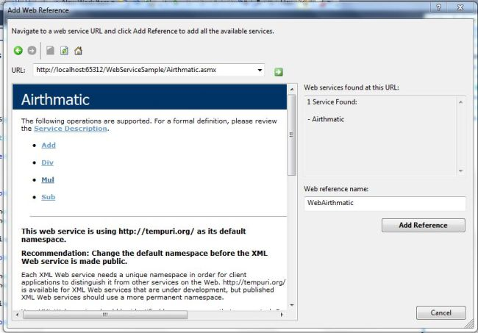

Slide 26
Now go to the cs code and add a reference for the Service.
Example
using WebAirthmatic;
Write the following code.

Slide 27
using System;
using System.Collections.Generic;
using System.Linq;
using System.Web;
using System.Web.UI;
using System.Web.UI.WebControls;
using WebAirthmatic;

Slide 28
public partial class _Default : System.Web.UI.Page
{
Airthmatic obj = new Airthmatic();
int a, b, c;
protected void Page_Load(object sender, EventArgs e)
{
}
protected void btnAdd_Click(object sender, EventArgs e)
{
a = Convert.ToInt32(txtFno.Text);
b = Convert.ToInt32(txtSno.Text);
c = obj.Add(a, b);
lblResult.Text = c.ToString();
}
protected void btnSub_Click(object sender, EventArgs e)
{
a = Convert.ToInt32(txtFno.Text);
b = Convert.ToInt32(txtSno.Text);
c = obj.Sub(a, b);
lblResult.Text = c.ToString();
}

Slide 29
protected void BtnMul_Click(object sender, EventArgs e)
{
a = Convert.ToInt32(txtFno.Text);
b = Convert.ToInt32(txtSno.Text);
c = obj.Mul(a, b);
lblResult.Text = c.ToString();
}
protected void btnDiv_Click(object sender, EventArgs e)
{
a = Convert.ToInt32(txtFno.Text);
b = Convert.ToInt32(txtSno.Text);
c = obj.Div(a, b);
lblResult.Text = c.ToString();
}
}

Slide 30
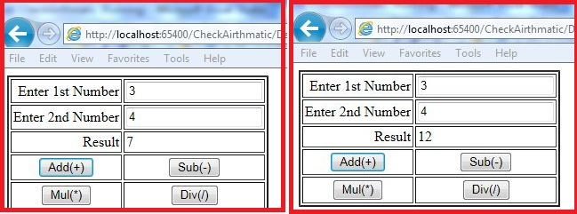
Now first run the Web service then the application.

