Slide 1
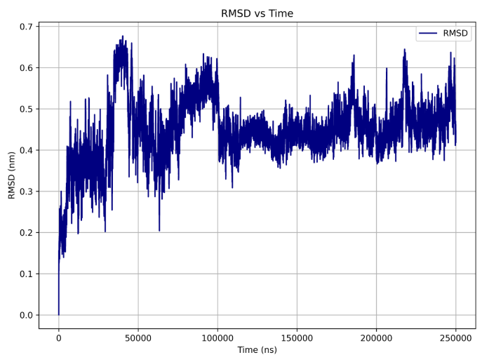
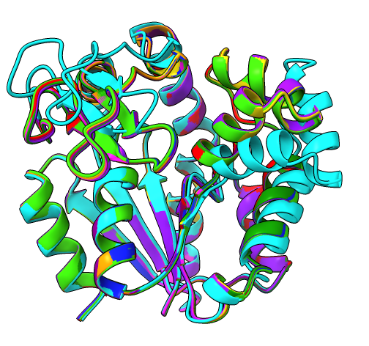
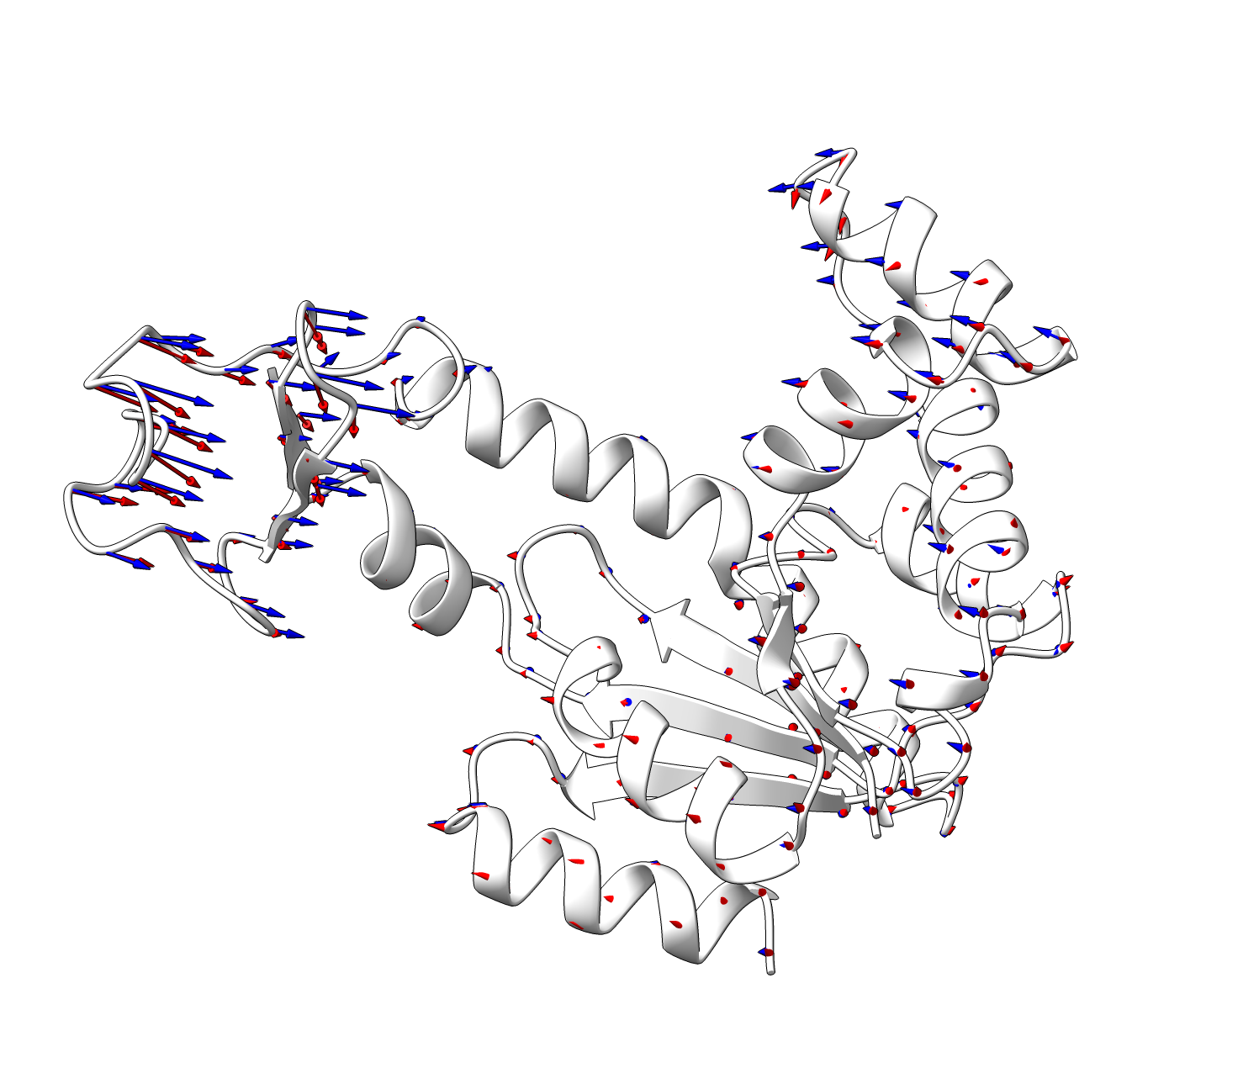
MRIILLGAPGAGKG…
MD Simulation
Days + $$$
Sequence
PCA
AlphaFold3
ChronoSort
Seconds

