Slide 1
Physics for Games
Lab1- Introduction
Prof Wen Tang
Ext: 6492
Email: wtang@Bournemouth.ac.uk
Office: P206

Slide 2
Exercise 1: indicate each of the following physics quantities as a scalar or a vector
Quantity | Category
30 m | Scalar
5 miles, forward | Vector
17 degrees Celsius | Scalar
10 metres per second to the South | Vector
20 cubic foot | Scalar
100 joules of energy | Scalar
2 minutes | Scalar

Slide 3
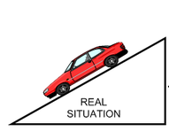
Exercise 2
Ignore ground frictions, is this a kinematics motion or a dynamic motion, why ?

Slide 4
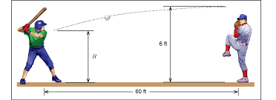
Exercise 3
Is this a kinematics motion or a dynamic motion, why ?

Slide 5
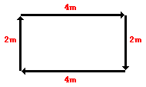
Exercise 4
A physics teacher walks 4 meters East, 2 meters South, 4 meters West, and finally 2 meters North.
What is her total distance travelled ? 12m
What is her displacement ? 0m
N
W
E
S

Slide 6
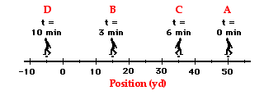
Exercise 5
The following diagram shows a football coach pacing back and forth along the sidelines at several positions at different times. At each marked time, the coach makes a u-turn and moves in the opposite direction
What is the coach's resulting displacement and distance of travel?
95yd, -55yd
Notes:
Distance = (35 yds + 20 yds + 40 yds) = 95 yards
Displacement = 55 yds, left

Slide 7
Exercise 6
A physics teacher walks 4 meters East, 2 meters South, 4 meters West, and finally 2 meters North. The entire motion lasted for 24 second
What is her average speed of travel? 0.5m/s
What is her average velocity of travel? 0
N
W
E
S
Notes:
0.50 m/s average speed

Slide 8
Exercise 7
A physics teacher walks 4 meters East, 2 meters South, 4 meters West, and finally 2 meters North. The entire motion lasted for 24 second. Write the general equations for your calculation.
s = d/t
N
W
E
S
Notes:
0.50 m/s average speed

Slide 9
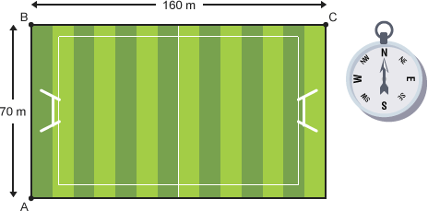
Exercise 8
During a rugby match, a spectator at A walks to C, the opposite corner of the ground, by walking from A to B to C as shown in the diagram. What is the final displacement of the spectator ?
175 m at 66 degrees East of North
210 m at 72 degrees East of North
228 m at 66 degrees East of North
Notes:
use Pythagoras' Theorem to calculate the magnitude of the displacement. The bearing can be found using a scale drawing or the inverse tan function. The magnitude of the displacement is , while the bearing is given by tan^-1 (.
175 m at 66 degrees East of North

Slide 10

Exercise 9
Using float in C/C++ to define the following variables
30 m
5 m 0 degree of East
40 kg
1 m 45 degrees of East of North
+
Y
-
+
float d = 30.0;
float w = 40.0;
float v1[2] = {5.0, 0.0};
float v2[2] = { 0.707, 0.707};
float v3[2] = { 5.707, 0.707 };
glm::vec2 v1(5.0, 0.0);
glm::vec2 v2(0.707, 0.707);
glm::vec2 v3 = v1 + v2;
X
-

Slide 11
Exercise 10
During a rugby match, a spectator at A walks to C, the opposite corner of the ground, by walking from A to B to C as shown in the diagram. If the spectator takes 100s to complete the walk, what is the size of the resultant velocity?
Notes:
1.75 m/s

Slide 12
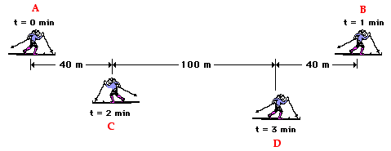
Exercise 11
Use the diagram to determine the average speed and the average velocity of the skier during these three minutes.
180
320
420/180
=2.3r m/s
140/180
=0.7r m/s
Notes:
The average speed =
(420 m) / (3 min) = 140 m/min
The average velocity =
(140 m, right) / (3 min) = 46.7 m/min, right

Slide 13
glm - OpenGL Mathematics library C++
https://www.opengl.org/sdk/libs/GLM/
https://openframeworks.cc/documentation/glm/
http://www.c-jump.com/bcc/common/Talk3/Math/GLM/GLM.html

Slide 14
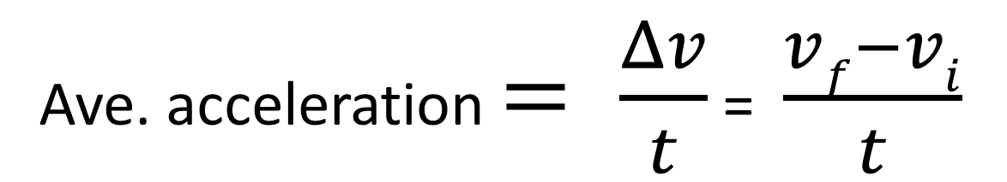
The average acceleration
The average acceleration (a) of any object over a given interval of time (t) can be calculated using the equation
Ave. acceleration $= \frac{Δv}{t}$ = $\frac{vf−vi}{t}$

Slide 15
Exercise 12
The following two tables describe two motions
Determine the acceleration of each motion
Which motion has a constant acceleration ?
Time (s) | Velocity (m/s)
0 | 0
1 | 4
2 | 8
3 | 12
4 | 16
Time (s) | Velocity (m/s)
0 | 0
1 | 1
2 | 4
3 | 5
4 | 7

Slide 16
Exercise 13
The following two tables describe two motions
Determine the acceleration of each motion
Positive or negative acceleration?
Time (s) | Velocity (m/s)
0 | 8
1 | 6
2 | 4
3 | 2
4 | 0
Time (s) | Velocity (m/s)
0 | 0
1 | -2
2 | -4
3 | -6
4 | -8
Notes:
Both are negative accelerations, what is the meaning of negative accelerations ?

Slide 17
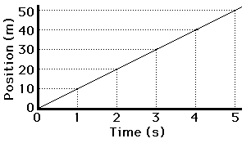
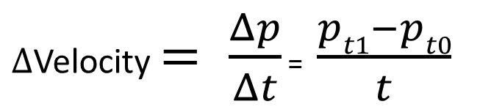
Exercise 14
Look at the following position vs time graph (p-t graph).
What does a straight line of the p-t graph describes ?
Time (s) | Position (m)
0 | 0
1 | 10
2 | 20
3 | 30
4 | 40
5 | 50
$Δ$Velocity $= \frac{Δp}{Δt}$ = $\frac{pt1−pt0}{t}$

Slide 18
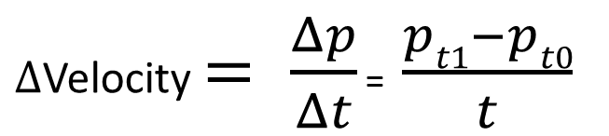
Exercise 15
Plot the motion described in the following table on a position-time graph (g-t graph)
Explain the meaning of the shape and the slop of the g-t graph
Time (s) | Position (m)
0 | 0
1 | 2
2 | 8
3 | 18
4 | 32
5 | 50
$Δ$Velocity $= \frac{Δp}{Δt}$ = $\frac{pt1−pt0}{t}$

Slide 19
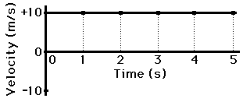
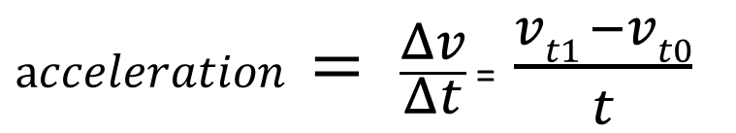
Exercise 16
Plot the motion described in the following table on a velocity-time graph (v-t graph)
Explain the meaning of the shape and the slop of the v-t graph
time | position
0 | 0
1 | 10
2 | 20
3 | 30
4 | 40
5 | 50
time | velocity
0 | 10
1 | 10
2 | 10
3 | 10
4 | 10
5 | 10
$acceleration = \frac{Δv}{Δt}$ = $\frac{vt1 −vt0}{t}$
Notes:
The shape of this velocity vs time grah, The slope of this v-t graph is 0, meaning the acceleration is zero.
ph is a straight line with a zero slope

Slide 20
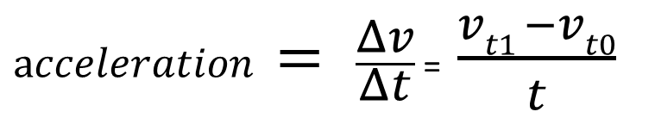
Exercise 17
Plot the motion described in the following table on a velocity-time graph (v-t graph)
Explain the meaning of the shape and the slop of the v-t graph
Time (s) | velocity (m/s)
0 | 0
1 | 4
2 | 8
3 | 12
4 | 16
5 | 20
Time (s) | Acceleration (m/s²)
1 | 4
2 | 4
3 | 4
4 | 4
5 | 4
$acceleration = \frac{Δv}{Δt}$ = $\frac{vt1 −vt0}{t}$
Notes:
The shape of this velocity vs time graph is a straight line with a slope 4 m/ss, meaning a constant acceleration.

Slide 21
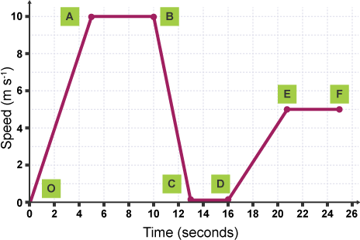
Exercise 18
A bus travels with a changing speed during a journey. Look at each of the sections on the graph and describe the motion of the bus.
Calculate the total distance the bus has travelled

Slide 22
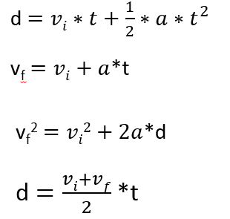

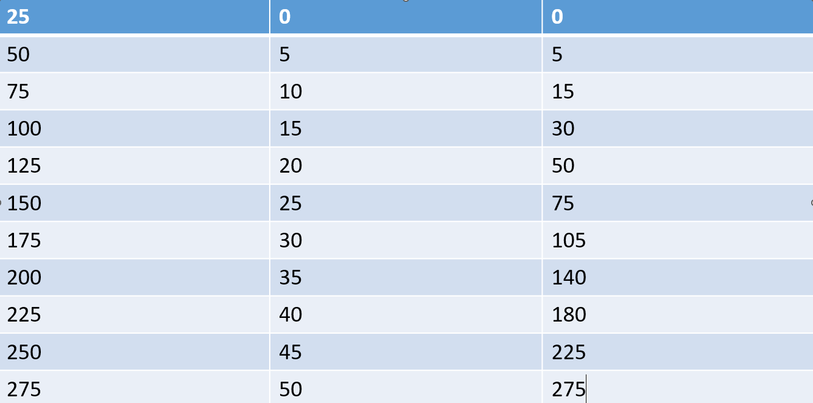

Exercise 19: Cops and Robbers
A car speeding at 25m/s passes a stationary police car in wait which starts from rest as the speeding car passes and accelerates at a constant rate of 5m/s2
When does the police car catch the speeding car?
How fast is the police car travelling when it catches the car?
Speeding car
Police car
V_{f} = ?
t = ?

Slide 23
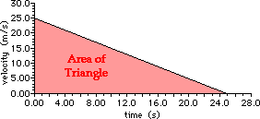
Quiz
A car is driving through town at 25.0 m/s and begins to accelerate at a constant rate of -1.0 m/s². Eventually it comes to a complete stop.
Represent the car's accelerated motion by sketching a velocity-time graph. Use the velocity-time graph to determine this distance.
Use kinematic equations to calculate the distance that the car travels while decelerating.
Notes:
Area = 313 m

