Slide 1
MOBILE PRICE PREDICTION

Slide 2


Probelm Statement :
In this Project,on the basis of the mobile specification like Battery power, 3G enabled , wifi ,Bluetooth, Ram etc we are predicting Price range of the mobile.

Slide 3
Considered features for Price Prediction
1.fc:Front Camera mega pixels
2.four_g:Has 4G or not
3.int_memory:Internal Memory in Gigabytes
4.m_dep:Mobile Depth in cm
5.mobile_wt:Weight of mobile phone
6.n_cores:Number of cores of processor
7.pc:Primary Camera mega pixels
8.px_height:Pixel Resolution Height
9.px_width:Pixel Resolution Width
10.ram:Random Access Memory in Megabytes
11.sc_h:Screen Height of mobile in cm
12. sc_w:Screen Width of mobile in cm
13. battery_power:Total energy a battery can store in one time measured in mAh
14. blue:Has bluetooth or not
15. clock_speed:speed at which microprocessor executes instructions
16. dual_sim:Has dual sim support or not
17. talk_time:longest time that a single battery charge will last when you are
18. three_g:Has 3G or not
19. touch_screen:Has touch screen or not
20. wifi:Has wifi or not

Slide 4
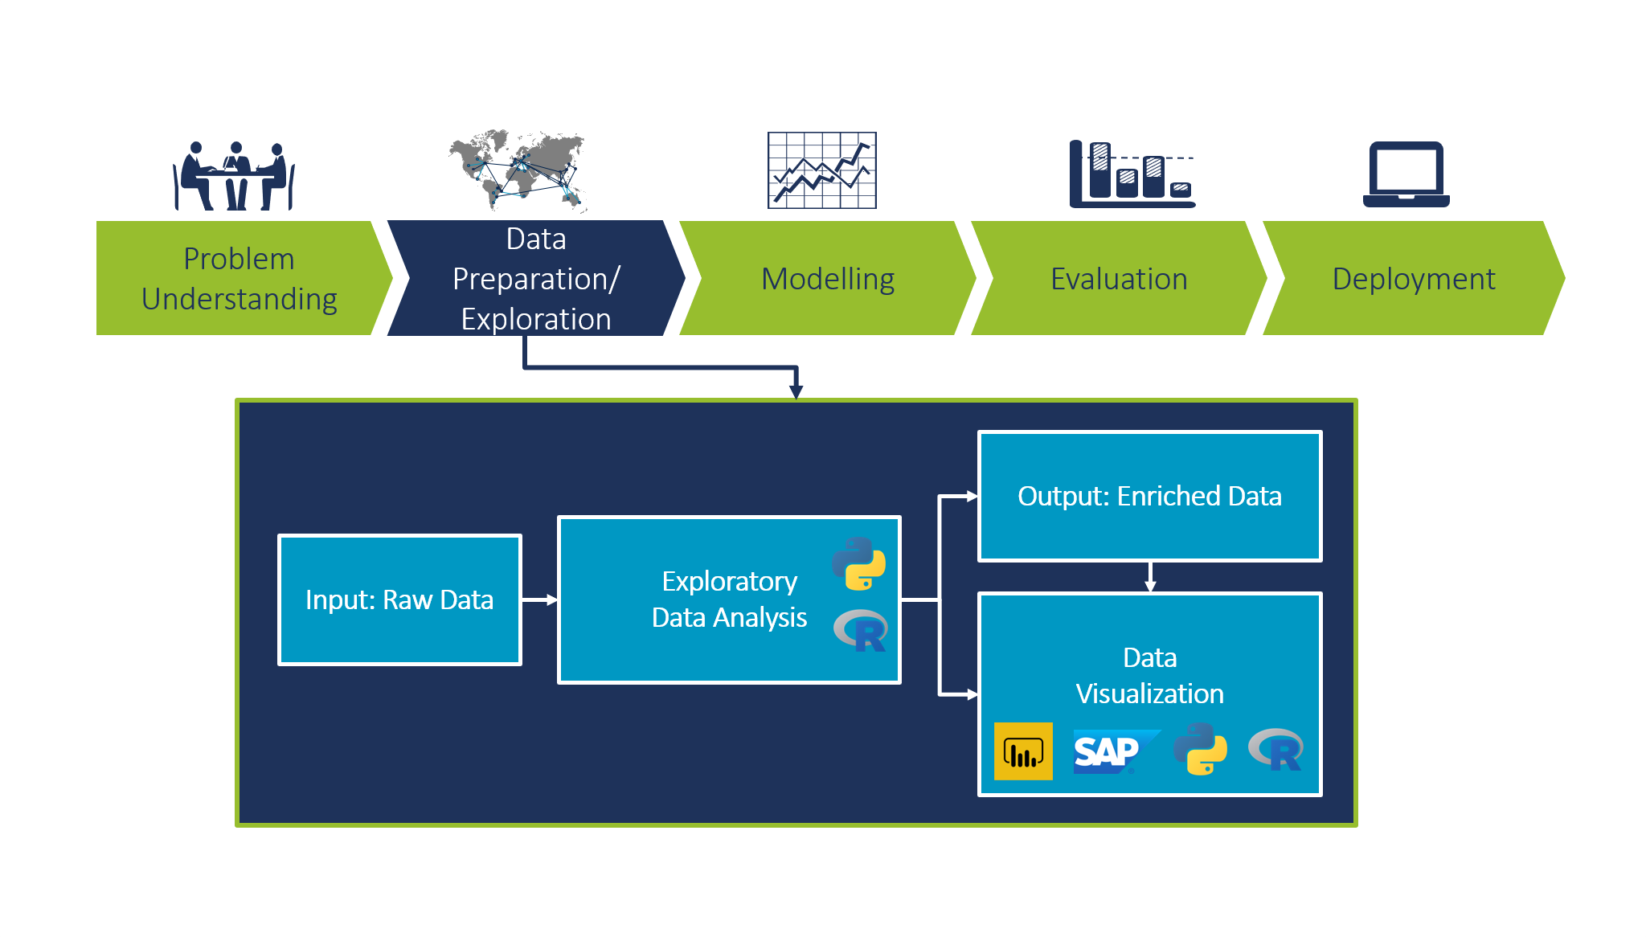
Exploratory Data Analysis:
Replace Missing values
1
Replace numerical data with mean/median values.
Replace categorical data with mode.
2
Removing Duplicates and very less correlated features with price_range
3
Applying Encoding Techniques
since types of objectives are more Labeling encoding is used
4
Removing Outliers
Using Inter-Quartile range

Slide 5
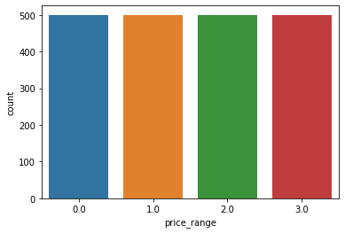
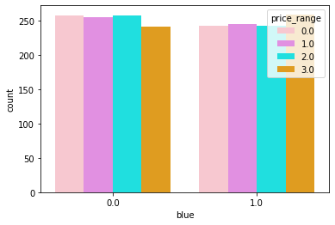
Data Visualization
Balanced data
Bluetooth count according to price_range

Slide 6
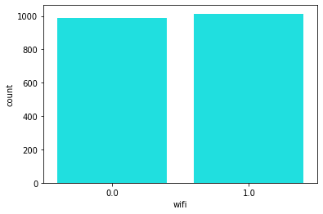
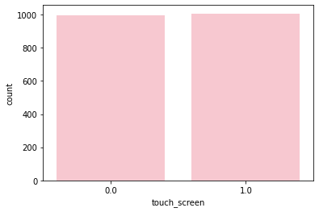
1.0 : 1014
0.0 : 986
touch_screen -
1.0 : 1006
0.0 : 994
wifi-
986 mobiles didnt have internet connection means they must be keypad phones without wifi
1006 are smart phones and 994 are keypad phones
994-986=8 phones are keypad phones with wifi like jio phone etc

Slide 7
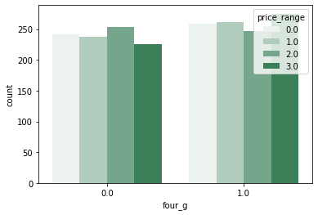
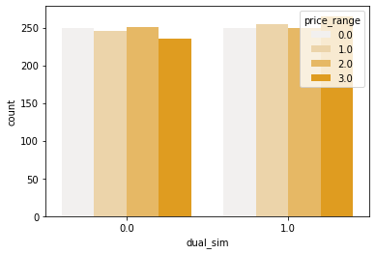
Countplots for features ‘four_g’ and ‘dual_sim’ according to price_range
VESTIBULUM ANTE IPSUM PRIMIS IN FAUCIBUS ORCI LUCTUS ET ULTRICES POSUERE CUBILIA
Mobiles which support 4G and belong to price_range of class-3 are more in number which is opposite in mobiles which support 4G
Mobiles which have dual sim and belong to price_range of class-3 are more in number which is opposite in mobiles which doesnt have dual sim

Slide 8
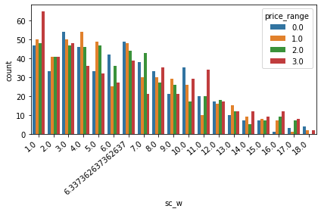
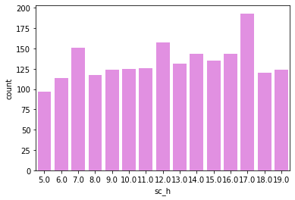
Count plots for screen width and screen height
Smart phones have large screen height compared to keypad ones,as we seen above that smart phone count is high.From the
above graph we can say that larger screen height phones are more in count
most of the mobiles have screen width of 1cm

Slide 9
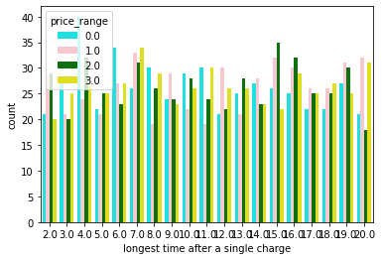
Count plot for talk_time

Slide 10
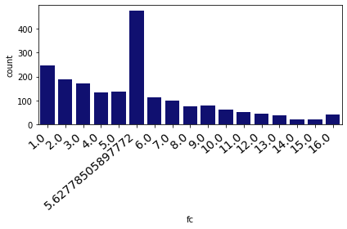
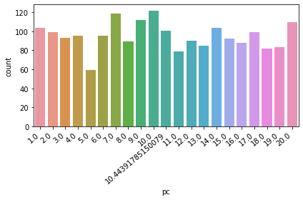
Countplots for the features Primary camera pixels and front camera pixels

Slide 11
Algorithms Evaluation

Slide 12
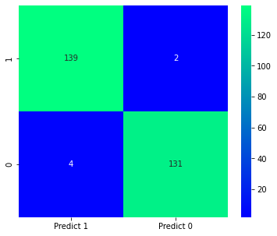
Confusion Matrix for LogisticRegression:
precision=TP/TP+FP. recall=TP/TP+FN.
if precision=recall only when FP=FN.
Accuracy = 95
Recall = 95.34
Precision = 95
Conclusion:
This means that our algorithm ability to correctly classify positive samples is same as its ability to correctly classify negative samples.

Slide 13
THANK YOU

