Slide 1
Alignment
CIT 230

Slide 2
Background about ‘Alignment’
Alignment is one of those things that comes hand-in-hand when working with grid systems.
We employ alignment to improve our designs.
Proper alignment in your designs will make them visually more appealing and will also make it easier for users to scan over a page, sub-consciously also offering a calmer reading experience.
All of the elements in your design will have to be aligned in some way.

Slide 3
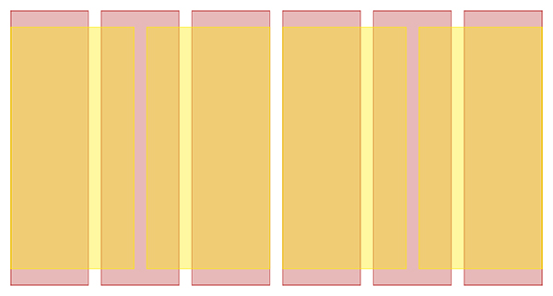
Should Every Element Align?
Not everything on your website design has to align.
Sometimes, depending on your design or the way that you work, this really can stifle creativity.
Mixing alignments also means that you can play with layouts and grids a little more.

Slide 4
Aligning Main Design Elements
The main alignment options you have for your text are very similar to the options available in CSS: left, right, centred or justified
1 2 3 4 | .content { direction:rtl; text-align: right; }

Slide 5
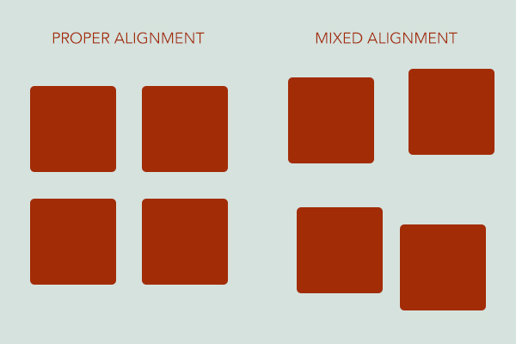
Images
Aligning images can be difficult, because the alignment that you should use for each image is relative to the size of the image.
You have two options; either place your images outside of the content flow (for example, between paragraphs or at the beginning or end of your content), or you can work out a way to slot your images into your grid.

