Slide 1
MonoGame
Write Once, Play Everywhere
Dean Ellis
Where we are and where we’re going

Slide 2
What is MonoGame?
Open Source XNA 4.0 API
2D SpriteBatch API
Support for XNA Content Pipeline
Can consume .xnb files
Sound and Music
Input
Effects
Supports 5 Platforms
Very high code reuse

Slide 3
How MonoGame has Grown

Slide 4

BETA
3.0

Slide 5
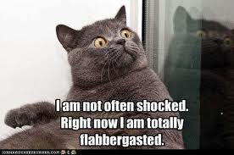
Where we are....
MonoGame 3.0 (Beta)
3D Support !
Completely reworked codebase
Custom Effects
Improved Sprite Batch Performance
Added Windows 8 Support
Content Pipeline Processors

Slide 6










Supported Platforms

Slide 7







Under the Hood
Platforms
Game API
Graphics/
Sound
Runtime

Slide 8
Easier to get started
Binary installer for Windows Developers
Installs assemblies for Windows/Windows8/Linux and Android
Installs the MonoGame Content Pipeline extensions
Installs the Project and Content Project Templates

Slide 9
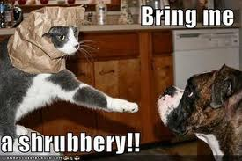
Easier to get started
AddIn for MonoDevelop
Installs the Project Templates
http://www.infinitespace-studios.co.uk/monodevelop/main.mrep
Works on Windows/Mac and Linux

Slide 10
Demo
Installing MonoGame

Slide 11
Content Pipeline Processors
Allows optimized compiled assets (.xnb) for a particular platform
PVRTC texture support for iOS.
Converts .fx shaders to DX11 and OpenGL
Song Processor
SoundEffect Processor for iOS.

Slide 12
Demo
XNA->MonoGame Conversion
NetRumble
Catapult Wars
Reach Mix 10 Demo

Slide 13

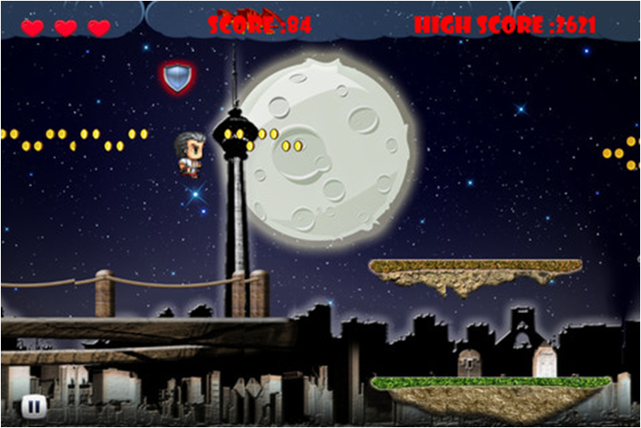

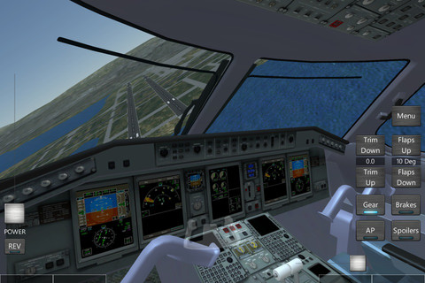
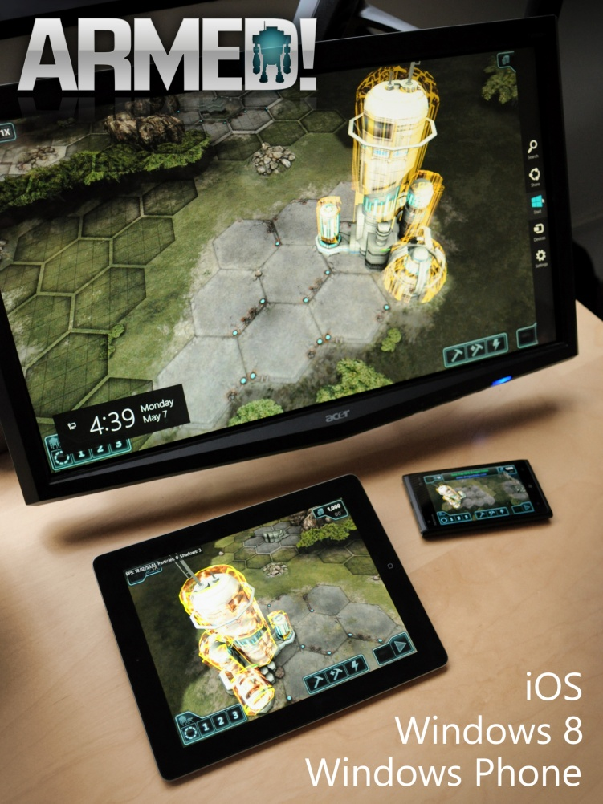



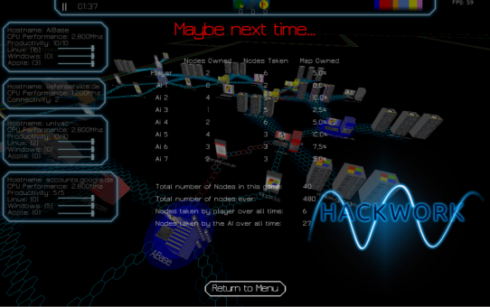
Games

Slide 14
Where are we going?
Enhancements and fixes
Content Pipeline
Visual Studio Integration
MonoDevelop Integration
Better documentation
Getting Started Guides
Platform specific best practices
More Video tutorials

Slide 15
Where are we going?
DirectX11 backend for Windows
In addition to OpenGL backend
Extend API beyond just XNA
Networking
Windows 8 and Playstation Mobile
Advertising Support

Slide 16




New Platforms
PlayStation Mobile
Already in progress
Google Chrome
From Super Giant Games
Raspberry Pi
Already in progress
OUYA

Slide 17
Demo
Raspberry Pi

Slide 18
Contributors
Jfernandezrodriguez
Alexandre Zollinger Chohfi
Oliver Brown
Tophathacker
Dean Ellis
Koda
Turtle Games
Elisée Maurer
David Lively
Tom Spilman
Carl Ådahl
John Lyon-smith
Clancey
Marshall Ward
Niel
Grapes
Vincent Labreche
Nezz
Randolph Burt
Espes
Danzel
Javier Fernandez
Christian Schwarz
Nicolas Coderre
Makeout
Thiago Pastor
Adrian Batzill
Inverness
Jonas Holland
Edward Rudd
Akshay Arora
Scott Dancer
Andre Esteve
Raistlinthewiz
David Leaver
Jeff Johnson
F.Fischer
James Lupiani
Christian Zangl
Jorge Cantón Ferrero
Scottmm
Mgroves
Dan Rigby
Steve 'Sly' Williams
Geoff Norton
Jordan Phillips
Lance
Tom Gooding
Dominique Louis
Jamesford42
Taskbit
Aranda Morrison
Tapani Värjölä
Jeremy Bell
Deathcradle
Daniel Sor
Lukas
Jadaml
Ádám L. Juhász
Ray Batts
Mrusiniak
Renaud Bédard
Nicolas Leonard
Jhllnd
Kenneth Pouncey
Andrew Gits
Clcrutch
Christopher Chambers

Slide 19



Special thanks to..

Slide 20

Questions?
www.monogame.net
@MonoGameTeam

