Slide 1
M2MIMud
February 11, 2005
Robert Whitcomb
Committee: Pr. Alan Kaminsky
Pr. Hans-peter Bischof
Pr. Andrew Phelps

Slide 2
Table Of Contents
Background: MUDs and ad hoc networks
Brief overview of architectures
Design
Implementation
Summary
Questions

Slide 3
MUDs
Text-based online role-playing games
Connect through telnet or other clients
Players play in a grid-based world where one tile corresponds to a room
Predecessor to MMORPG’s
Examples

Slide 4
Ad Hoc Networks
Target area: ad hoc network of small wireless devices such as PDAs, cell phones, and laptop computers
Highly mobile
Data is done as point-to-point transmission
Temporary: formed as needed and disbanded just as quickly
No central server

Slide 5
M2MI
Distributed object system API developed at RIT
Object implements interfaces
Methods invoked on handles
Broadcast transmission
http://www.cs.rit.edu/~anhinga

Slide 6
Background
Client server architecture: MUDs, MMORPGs
Real time strategy games: Microsoft’s Age of Empires

Slide 7
Some Terms
World: State and Layout
Players
Mobs
NPCS
Combat PvE and PvP

Slide 8
M2MIMud
MUD type application design to run in an ad hoc environment on devices running M2MI
Goals:
1.) No central server
2.) Atomicity
3.) Assumed safe
4.) Simple!

Slide 9
M2MIMud Architecture
Based on RTS games
Players play in sessions
Once processed, commands are sent to all other users
Global state is created by the sum of all the local states

Slide 10
State Maintenance
Network partitioning
State maintenance done in several places
Commands: update state and basic error checking
State broadcasts
Broadcasts are also how users find games

Slide 11
Game Data
No central server!
Data must be stored on the user’s client
Hacking: safe data?
Proprietary storage
No databases

Slide 12
Design
Two things:
1.) Message delivery is mostly reliable
2.) Message from groups are secure

Slide 13
Considerations
Only the device that controls the users can make changes (almost)
No group based combat
PvP combat
Quests (or lack thereof)
Economy (very difficult!)

Slide 14
Packages
Command: concerned with parsing user’s input and creating command object
Communication: deals with M2MI interfaces
State: world, room, mobs, tools to modify them
Game: primary package, GameSystem and GUIs

Slide 15
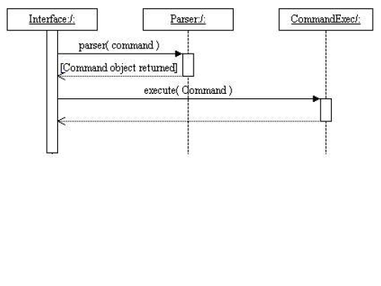
Basic Interaction

Slide 16
Other Examples
Joining a game
Moving around
Attacking a monster

Slide 17
Joining a Game
Users can create their own map to use
Load a world/state
Create/load a character
Start a session
Find a session
Joining a session: ad processing and broadcast information

Slide 18
GameSystem Object
Large object (largest overall)
Primary controller
All communications dealt with
Commands processor
notifyAll(), wait() (lock/unlock scheme)

Slide 19
Partitions
What a partition is
How they are handed
Broadcasts
Emergency reports and error detection
Player timeout

Slide 20
Implementation
Done in java
Atomicity
Item and mob data: database like objects

Slide 21
Future Work
Game data: encryption?
Improvements command processing.
Smarter message passing?
More game elements added to the project!
More spells, classes, mobs, weapons, etc.
Quests: scripting capacity to customize quests for a world?
Economy?

Slide 22
Summary
First game, first ad hoc application
Challenging
Fun
First significant experience with java
Questions?

