Slide 1
Addressing Crime in San Francisco

Slide 2
Table of Contents
Introduction
Context & Methodology
Crime Trends & Data Insights
Recommendations
Notes:
Most profitable/highest gross per genre
Which studio is the most successful
Which genre/movie is profitable from 2007-2011
Compare profits to tomato score/audience score

Slide 3

Introduction

Slide 4

Who is C474-Wayne’s Pod…
C474 was tasked to analyze the City of San Francisco’s crime data to uncover patterns & determine solutions to reduce incidents in vulnerable areas.

Slide 5
Group Members
Del Cruz
Sabrina Mehu
Tabriya Joseph
Joseph Bargallo
Laurianne Apollon
]

Slide 6

Context & Methodology

Slide 7
Executive Summary
We found that Larceny is the highest reported crime in San Francisco. The crime rates on weekends, noon, 2pm, 6pm, midnight, and fall to summer months tend to be peak crime times.
Crime is highly concentrated in the Northeast SF area with Central District being the highest.
We are proposing reformation initiatives including Property Registration, Environmental Redesign, Restorative Justice Programs and an Expanded Investigative Task Force.

Slide 8
San Francisco Background
Population of 808,437
San Francisco has one of the highest crime rates in America compared to all communities of all sizes
Crime rate of 67 per one thousand residents
Ranked number one for property crimes among major cities

Slide 9
The Team Process: Asking Questions
Where does crime happen?
Which neighborhoods have the highest or lowest crime counts (top 5)?
What crimes are occuring?
What are the top 5 incident/crime categories? Sub Categories?
When is crime happening?
Is there a certain time frame when crime is higher?
What is the ratio of Open/Active vs Closed/Cited cases?

Slide 10
The Team Process: Methodology
The city of San Francisco Crime data provided a comprehensive breakdown of crime data including time, location, crime type, resolution type and incident markers
Considered the type of crime & location very heavily
We had to consider…
If Suicide was a crime
Whether to consider non-criminal incidents in analysis
Whether neighborhood or police district was an accurate area to measure
Most cases are usually open for 3 years until closed/cold
Notes:
Suidice is a felony according to California Penal codes… so we included it:(
We did include a few “non-criminal” cases that included child sexual assault. The data had these incidents sorted into an inappropriate category.
police districts accounted for every piece of data cited while neighborhood was not.
because of unincorporated areas
we have to consider the validity of the idea of an open & cited case.
cited cases may not have caught the real perp.
Open cases can be active for up to 3 years… not a good metric for indicating activity.

Slide 11

Crime Trends & Data Insights

Slide 12
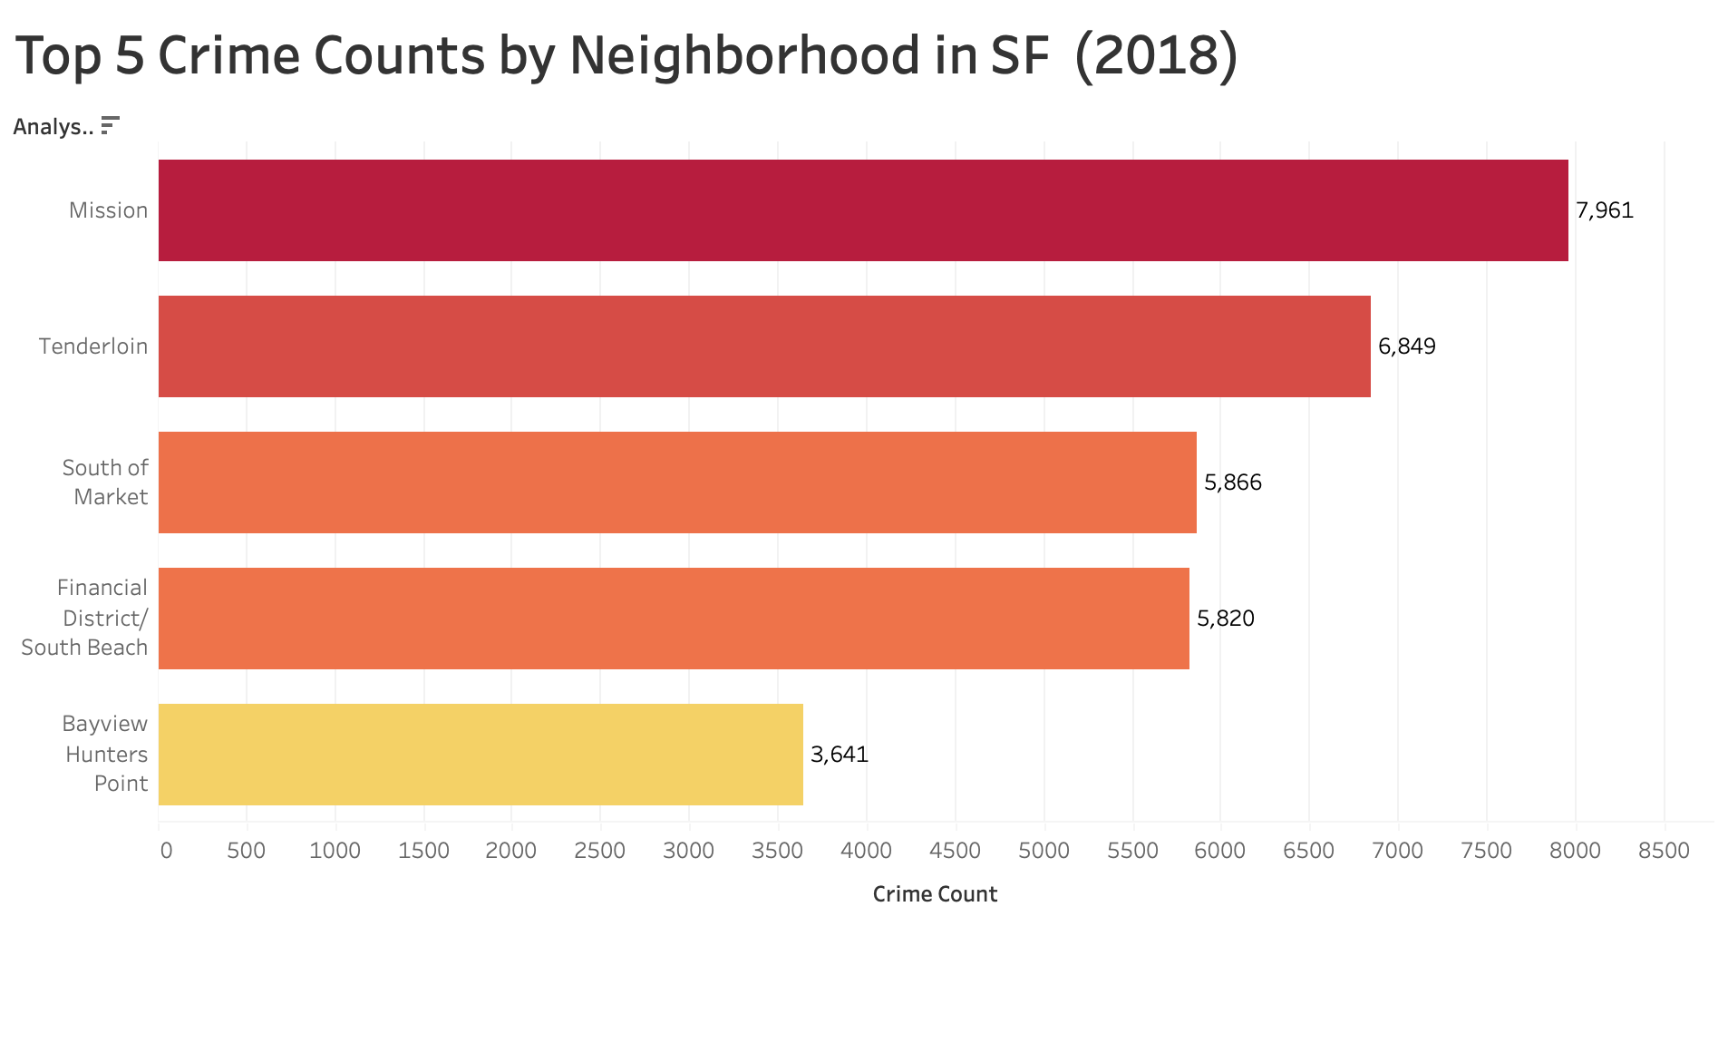
Counts in high-crime neighborhoods, for example, Mission and Tenderloin, are about 56.7X higher than low-crime areas such as Treasure Island and Seacliff, driven by denser populations and socioeconomic challenges

Slide 13
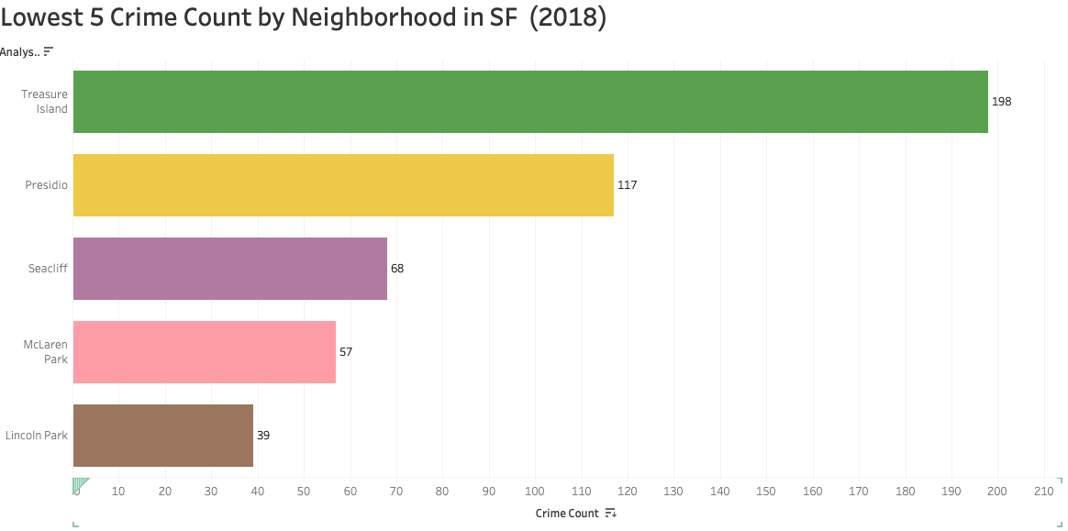
The top 5 lowest-crime neighborhoods, like Treasure Island and Seacliff, have crime rates that are 56.7X lower than high-crime areas like Mission and Tenderloin, reflecting their smaller populations and more affluent residential nature

Slide 14
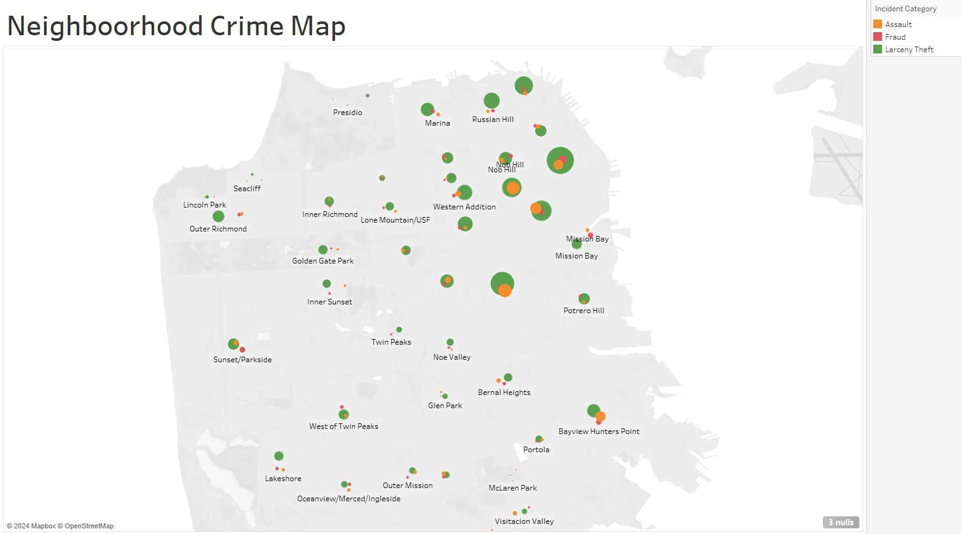
The North East is where most crime is condensed

Slide 15
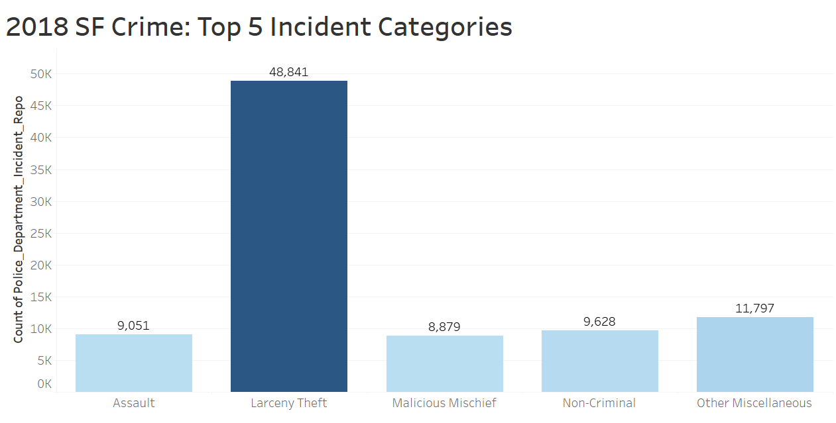
Larceny Theft is roughly 3x higher than others in top 5

Slide 16
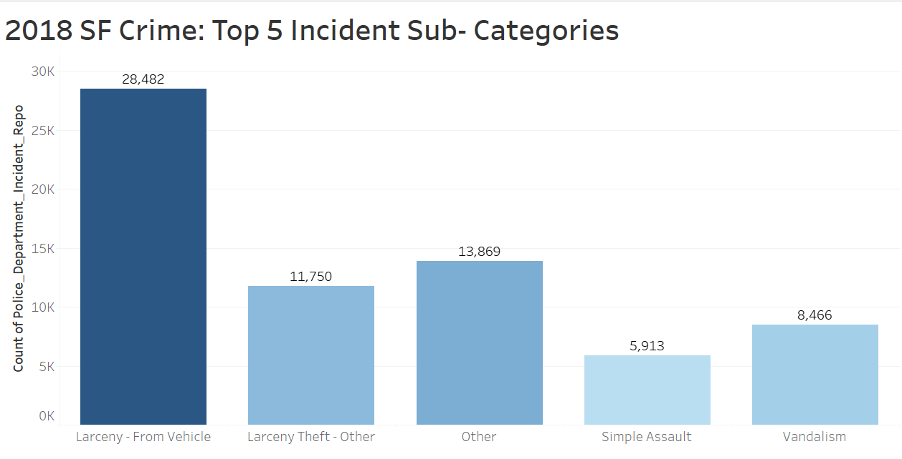
Theft from vehicle accounts for more than half of the larceny theft incidents

Slide 17
Larceny Theft
What is it? Stealing of any property or article that is not taken by force and violence or by fraud
Highest Incident category, specifically from vehicle theft
In San Francisco, your chance of becoming a victim of a property crime is one in 17, which is a rate of 60 per one thousand population
Highest rates of motor vehicle theft in the nation is in San Francisco has one of the according to FBI crime data
Chances of getting car stolen in San Francisco is one in 127

Slide 18
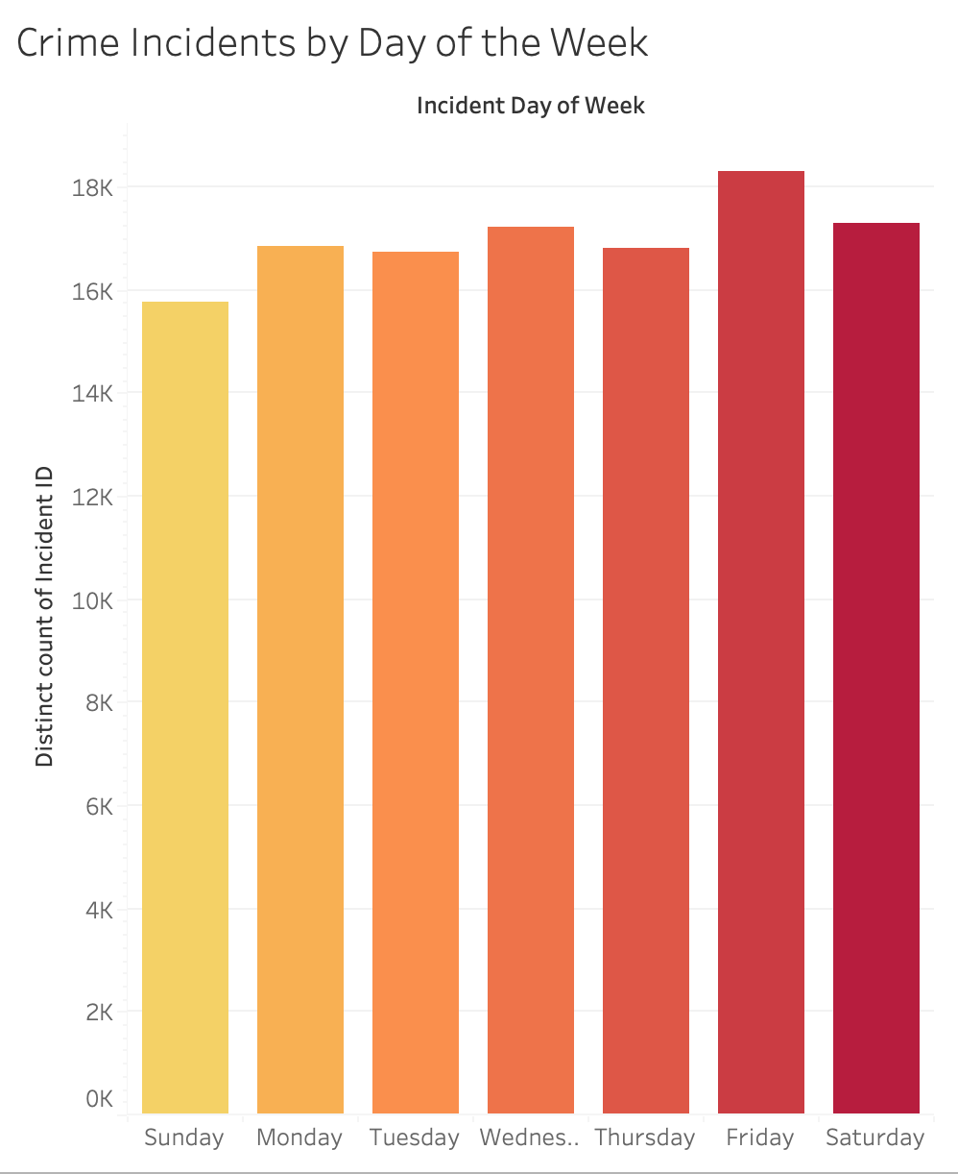
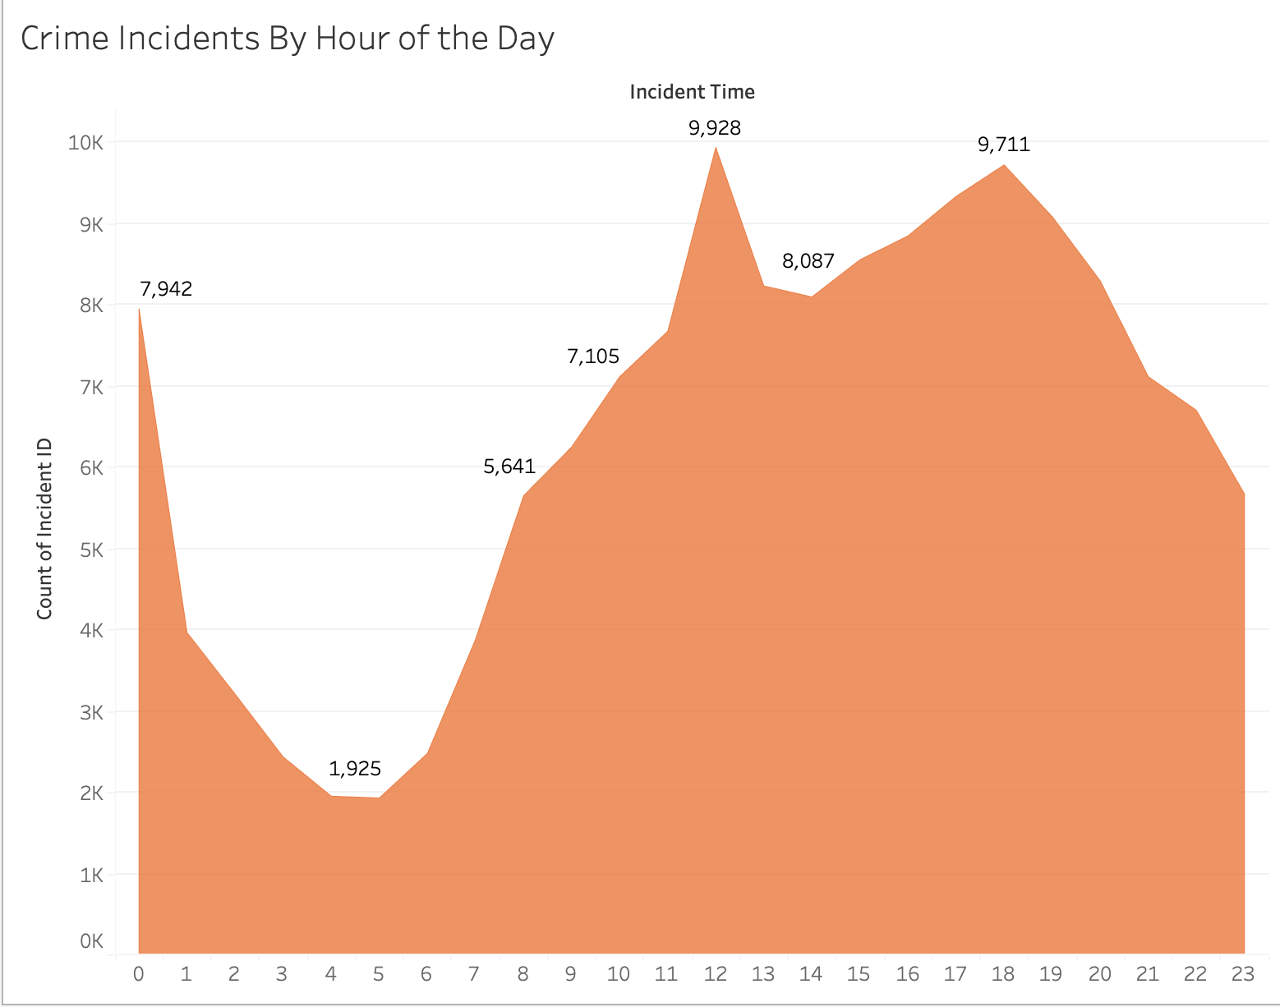
When is crime committed?
Crime spikes at 12pm, 2pm, 6pm and 12am and on Fridays ,Saturdays & Wednesdays

Slide 19
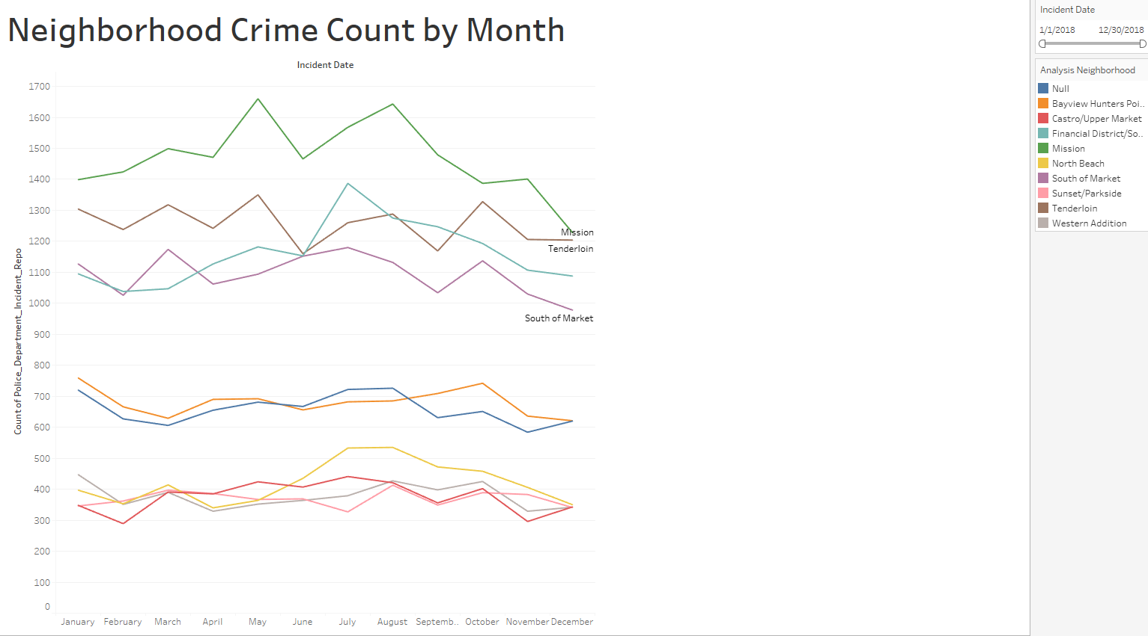
Summer into Fall shows to have the highest crime rates

Slide 20
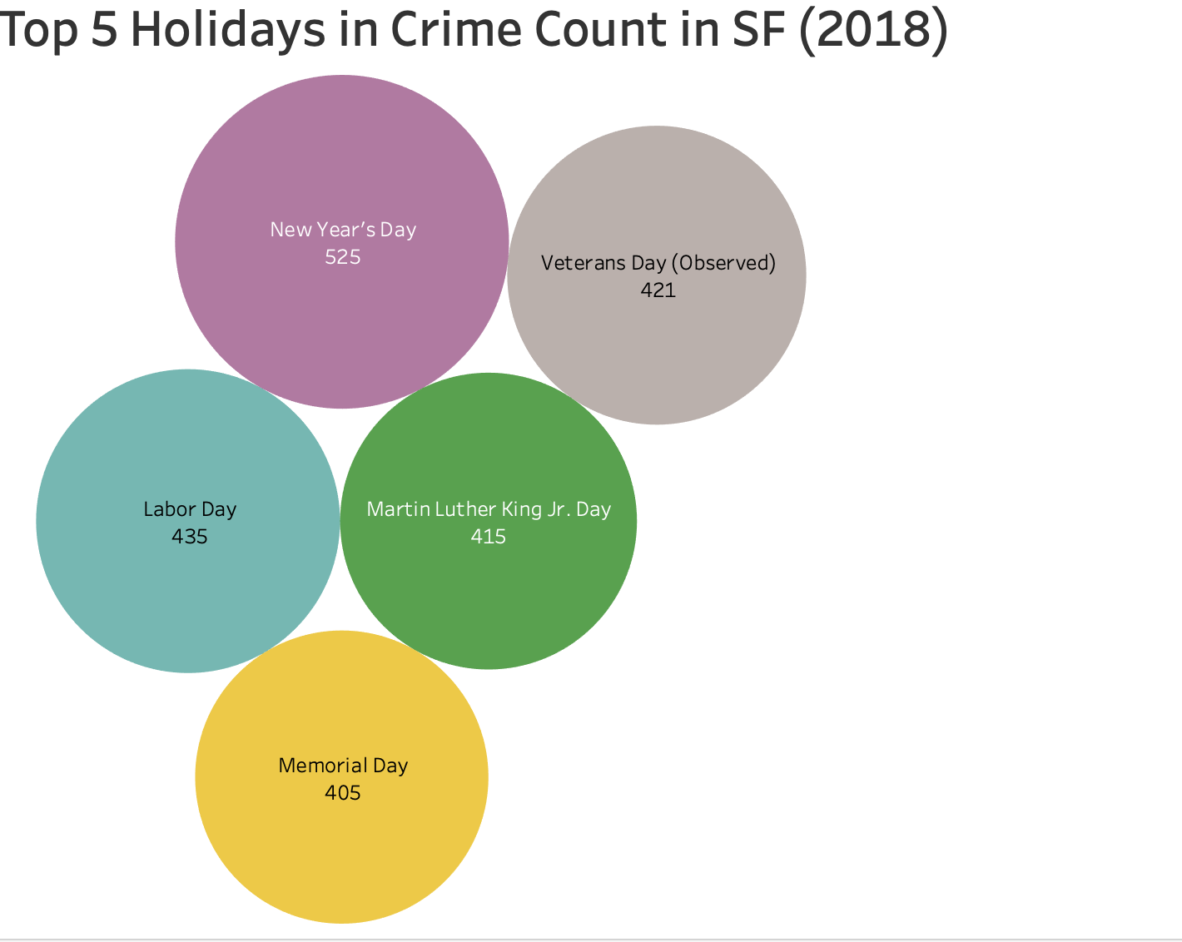
The 2018 San Francisco crime data shows spikes in criminal activity on major holidays like New Year's Day, Labor Day, and Veterans Day (observed), with crime rates 1.26X higher than other holidays, indicating that public celebrations contribute to increased crime

Slide 21
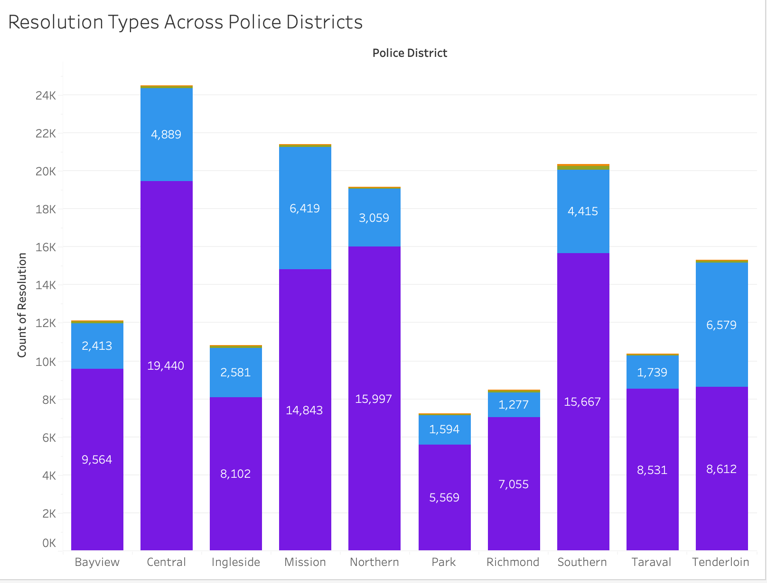
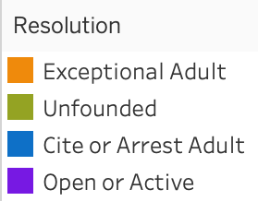
Open/Active cases account for more than half of all cases in ALL police districts
Exceptional Adult: offense is cleared without arresting or charging an offender due to circumstances beyond the agency's control
Notes:
Central
Highest Open/Active cases total
Open/Active Cases account for 79% of total cases for Central District.
Northern
Fourth highest Open/Active Case load
BUT highest rate of Open/Active Cases at 83.4%

Slide 22

Funding Allocation Recommendations

Slide 23
Recommendations
Environmental Design (CPTED): Invest in urban planning strategies that reduce opportunities for larceny, such as improving lighting in parking lots and public spaces and designing spaces that enhance visibility
Expanded Investigation Team: Crimes are being committed faster than they are solved. Introducing a highly skilled investigation team that can increase resolved cases quicker can potentially ward crime
Restorative Justice Programs: Support initiatives that focus on healing for victims and offenders, promoting accountability and reducing recidivism
Property Registration Programs: Create initiatives that encourage residents to register valuable items, making it easier to recover stolen property and deterring theft through public awareness

Slide 24
Sources and Additional Data
San Francisco, CA - Profile data - Census Reporter
FBI Larceny Theft Definition
https://www.neighborhoodscout.com/ca/san-francisco/crime#description
https://data.sfgov.org/Public-Safety/Map-of-Police-Department-Incident-Reports-2018-to-/jq29-s5wp
https://www.sanfranciscopolice.org/stay-safe/crime-data/crime-dashboard
https://www.sfchronicle.com/projects/2022/fixing-san-francisco-problems/crime

Slide 25
THANK YOU

