Slide 1
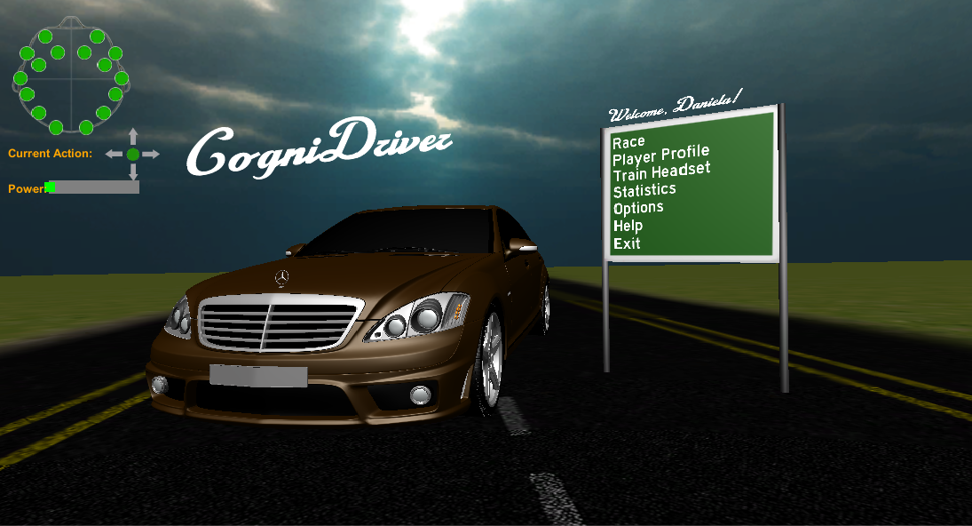
Supervisor: Author:
Toby Howard Daniela Florescu

Slide 2
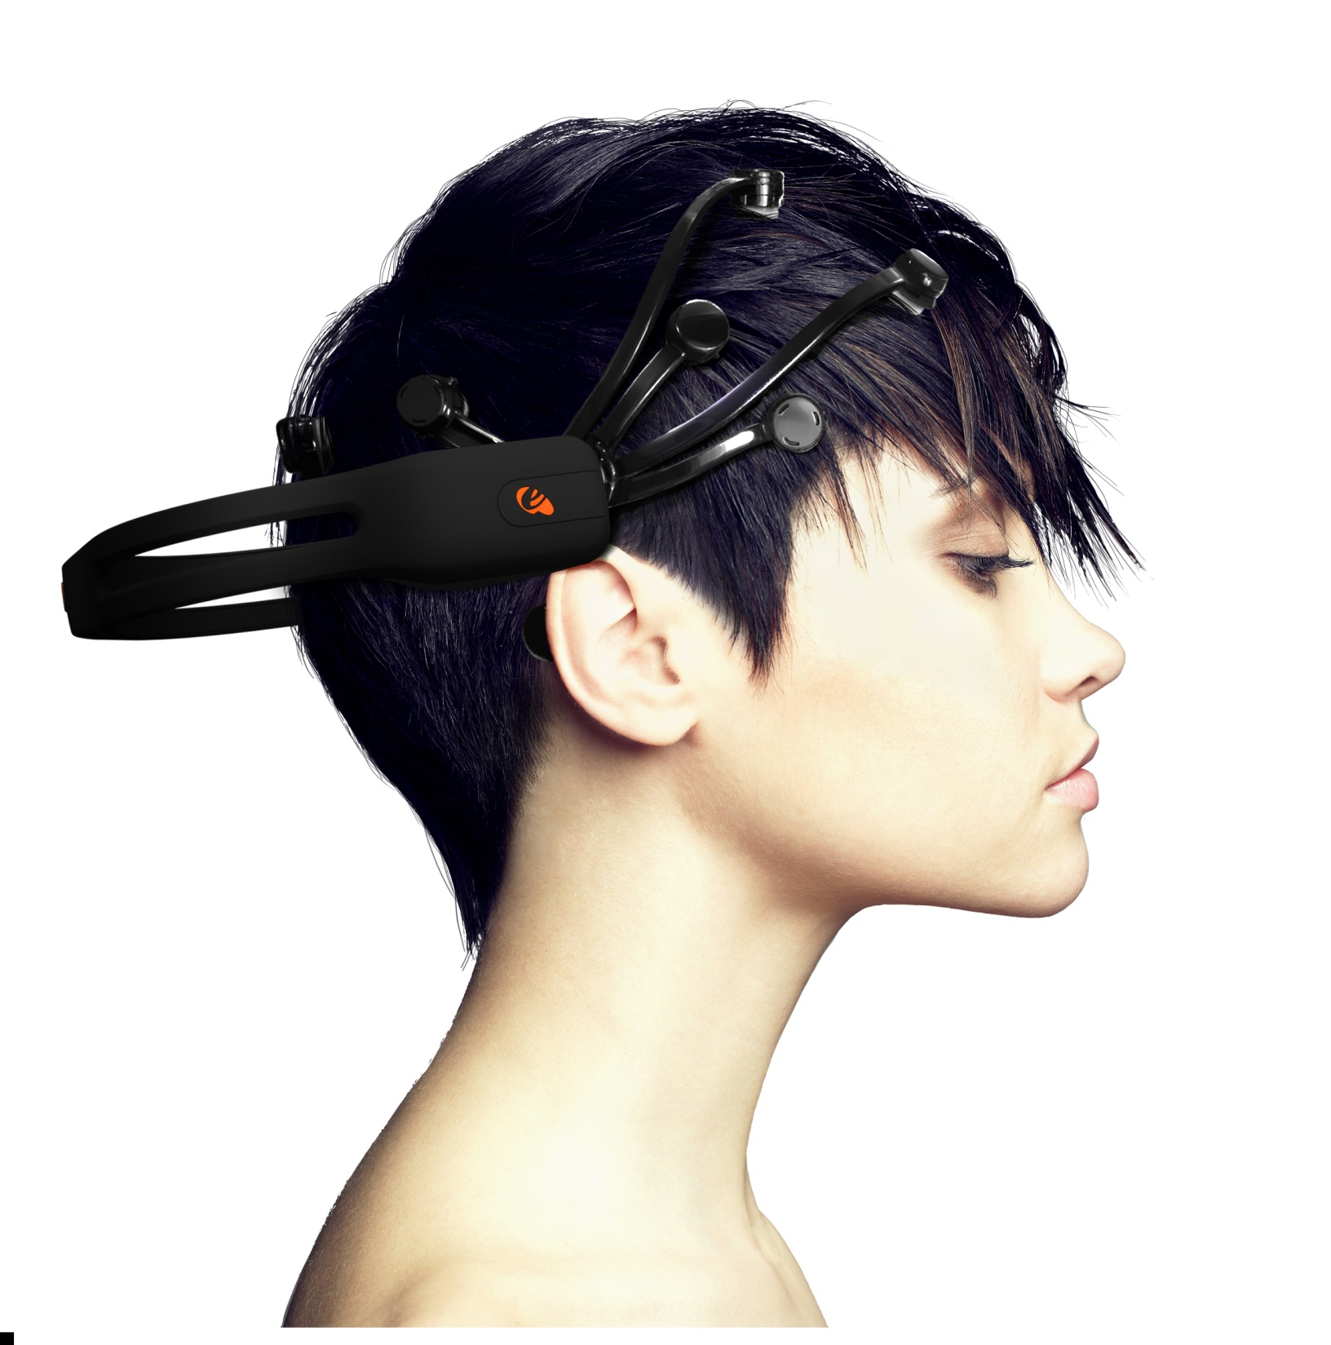
Image credit: Emotiv

Slide 3


Slide 4
