Slide 1
JEV SOFTWARE ENGINEERS
EMPLOYEE TIME CLOCK
Team 9

Slide 2
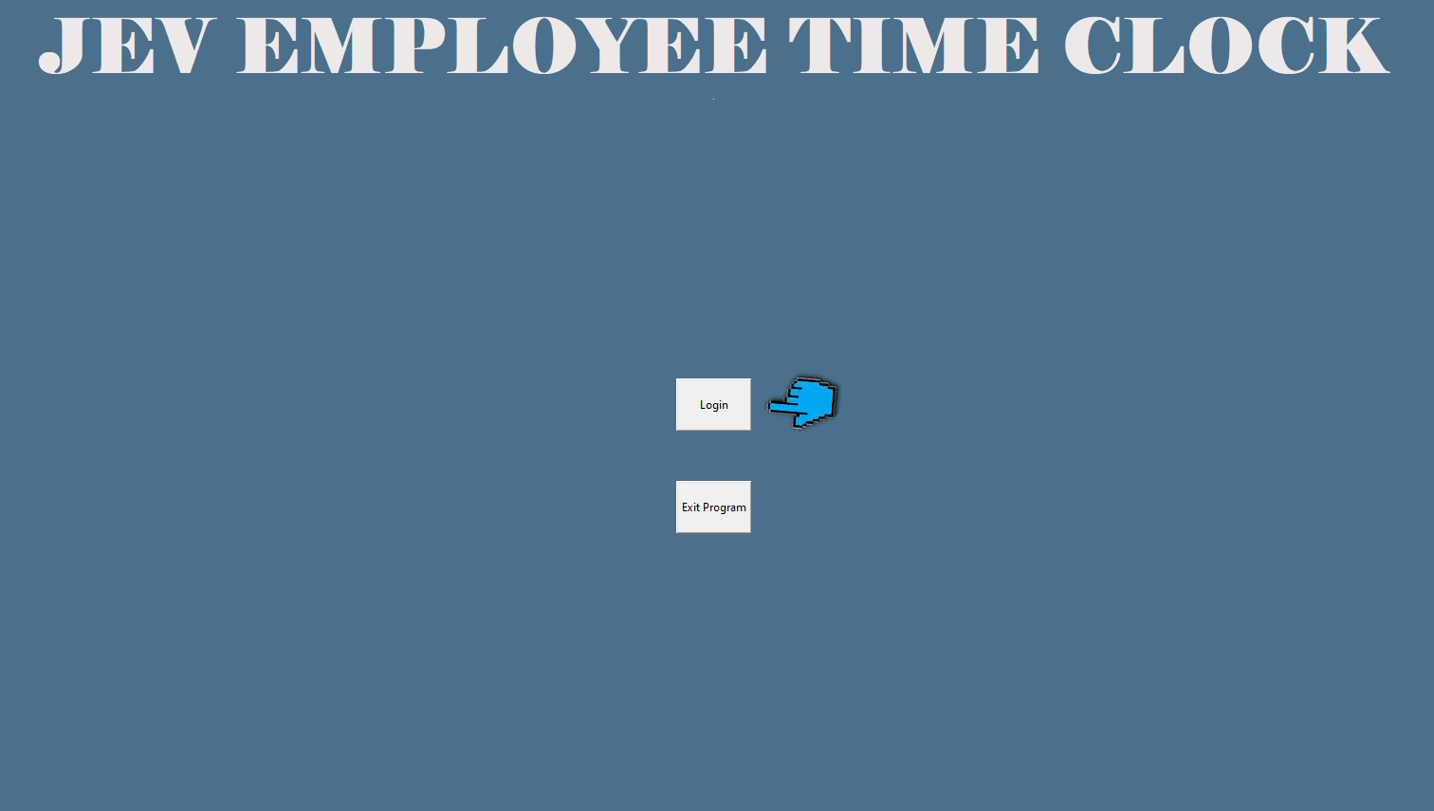
Click login .

Slide 3
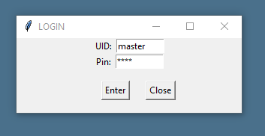
Log in with UID: master and pin: 4321

Slide 4
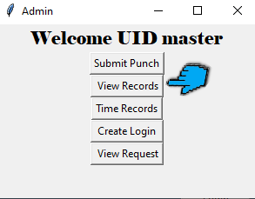
Click View Records.

Slide 5
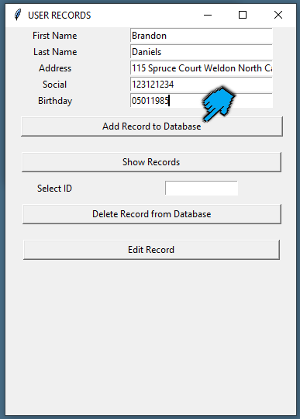
Fill in the brief form and then click Add Record to Database (Do this twice).

Slide 6
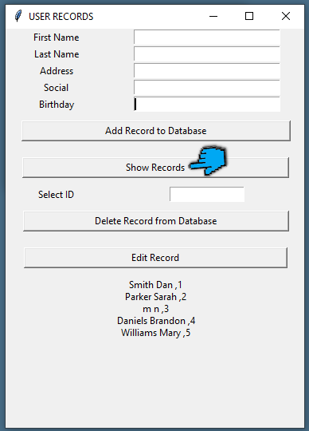
Click Show Records: In this table, when you view Records, you will see the employees first name, Last name and an OID number.

Slide 7

OID

Slide 8
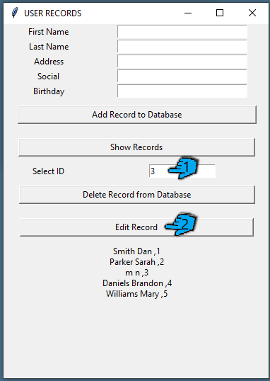
One of your employees information is incorrect. Correct it by Typing their OID number (located by their name), in the field where you see Select ID. Click Edit Record.

Slide 9
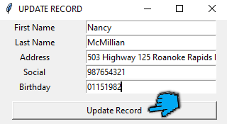
You will see a new window pop up. Edit any field, but also their first or last name to see the update later in this tutorial, but make sure to click update.

Slide 10
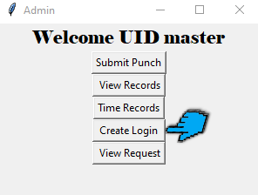
Exit the user Records Screen and let’s go to Create Login.

Slide 11
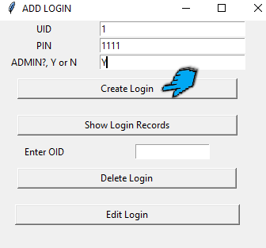
Enter Login credentials for your two employees. Make sure you enter their OID as their UID. Also, make sure you give one of them Amin privileges by typing a capital Y

Slide 12
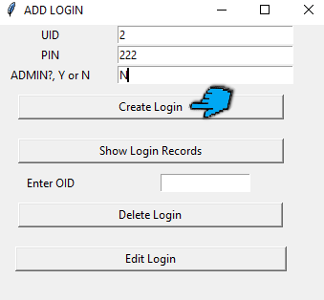
for the other Type a capital N. Use credentials you can remember.

Slide 13
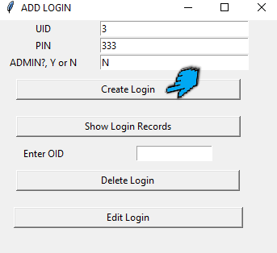
Add a third set of credentials carelessly.

Slide 14
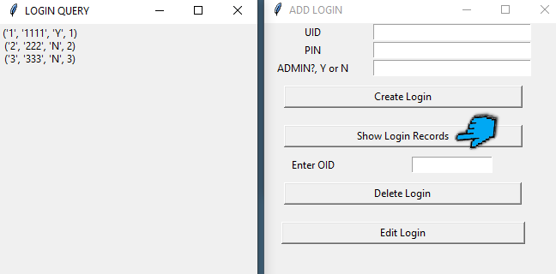
Click show records, and you should see your two new user’s credentials, as well as the third set that you mistakenly added. Leave this window open.

Slide 15
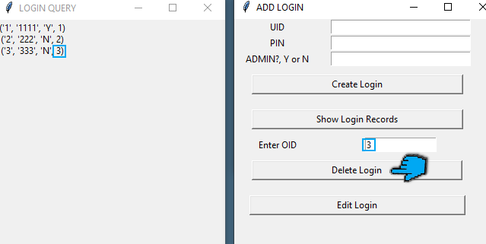
Enter the OID ( the last number beside any of your user credentials in the login query window) of the user account you mistakenly created in the box, but make sure you leave one admin and one standard user remaining. Click Delete Login.

Slide 16
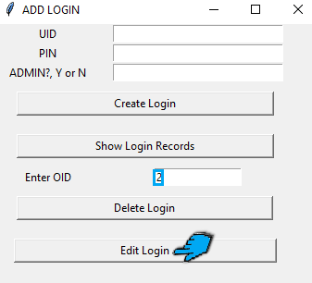
Lets Edit the password for one of the remaining Users. Enter the OID in the box Near the text, Enter OID.
Click Edit Login, which is the last button in this window.

Slide 17
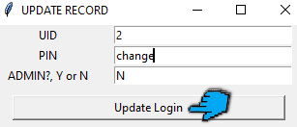
Make a change and select Update Login.

Slide 18
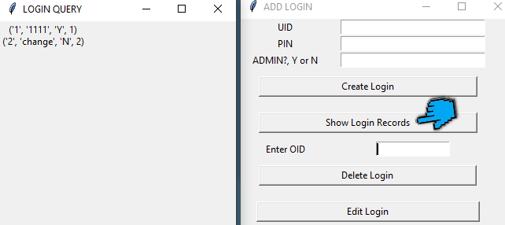
Click Show Login Records to make sure all of your changes have been submitted.

Slide 19
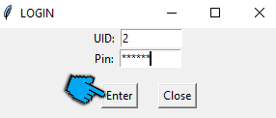
Exit out each window but not the login screen.
Log in with your standard user. That is the user that you marked capital N for Admin privileges.

Slide 20
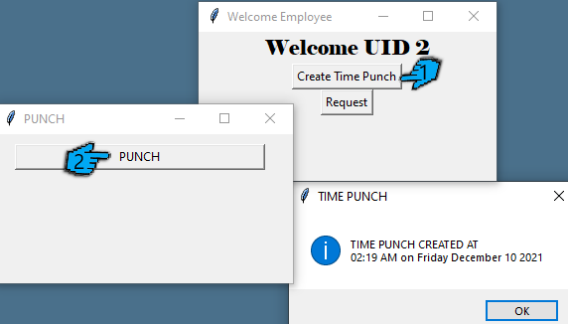
Click Create Time Punch and then click punch. You should see a message box displaying the time of your punch.

Slide 21
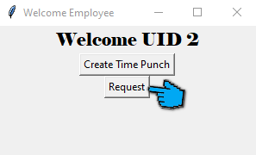
Exit those windows until you see Request. Click on Request.

Slide 22
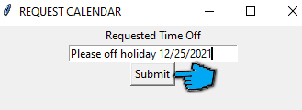
Type a message and date to send to the administrative user. Like “Can I have Christmas off?”.
Press submit and close the Welcome employee window. But leave the login screen open.

Slide 23
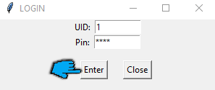
.Log in with the admin account you created. (Do not log in with the master account).

Slide 24
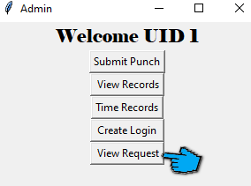
Click on View Request.

Slide 25
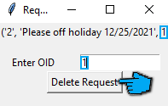
You will see every undeleted message sent, the employee id, and an OID number.
Enter the OID in the box. It should be the number 1. Select Delete Request

Slide 26
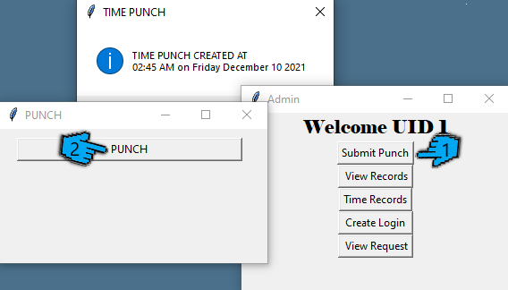
Now click submit punch on the welcome Admin screen. It’s the top button. hit punch, and you should see a confirmation with a timestamp for this user. Hit the button a second. (You should see a second TIME PUNCH message).

Slide 27
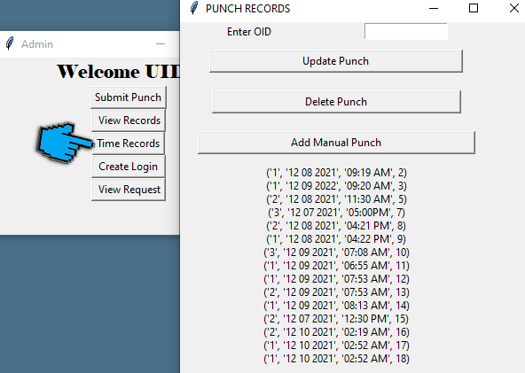
Click time records, where you should see a query with at least 3 punches.

Slide 28
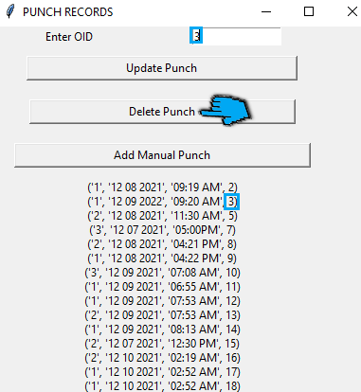
Look at the OID on the far right.
Enter the third one in the empty box and click delete punch.

Slide 29
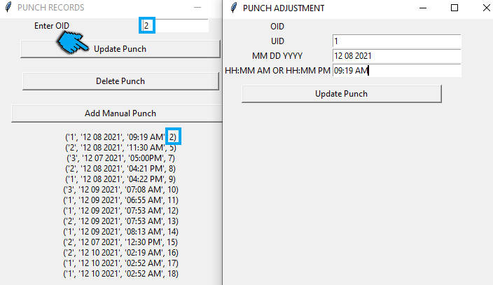
Update the second punch record by typing the number 2 in the field box and selecting update punch.

Slide 30
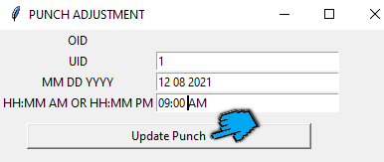
Make a change and click update punch.

Slide 31
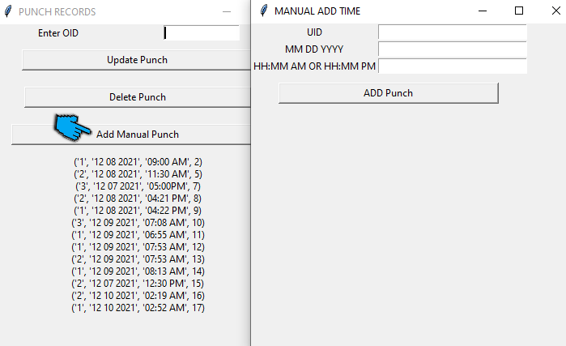
Click add Manual Punch.

Slide 32
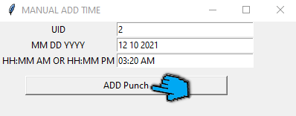
Type in employee’s UID a 2-digit month, 2-digit day and 4-digit year to keep things neat. Add the time in the format as well. So, two digits for the hour a colon two digits for the minute, and then a space followed by AM or PM and click ADD Punch

Slide 33
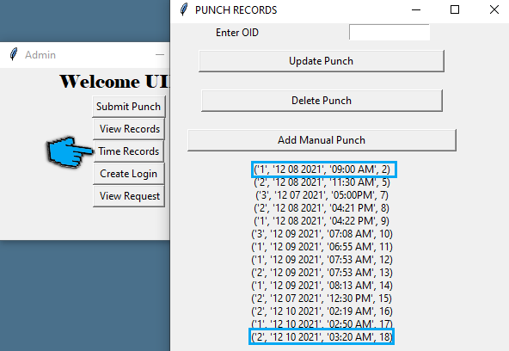
Exit both windows, leaving the admin window up.
Click on Time Records, and you should see that all of your changes updated.

Slide 34
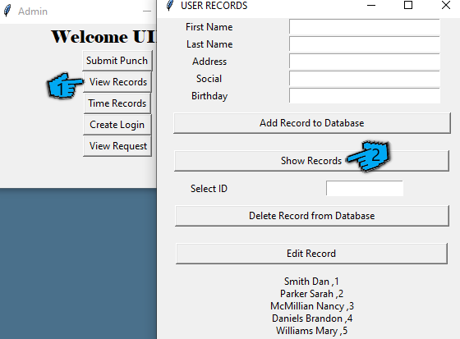
Now it’s time to remove an employee. Click View Records and show records to display your employees’ OID.

Slide 35
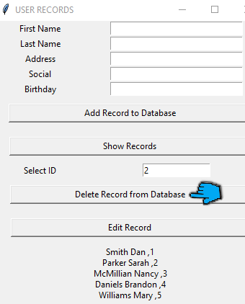
Enter the OID in the field near Select Id and click Delete Record from database.
Let’s delete the employee’s Log in credentials next.

Slide 36
Exit the user Records Screen and let’s go to Create Login.

Slide 37
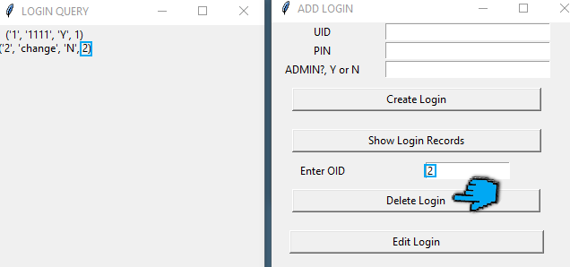
Click Show Login Records and look at the OID for the employees UID. The UID is the first number. and the OID is the last number. Type the OID and click Delete Login.

Slide 38
Thanks for watching and participating in this demo!
- JEV

