Slide 1


JET TEXT EDITOR
Created by Jerrica Deloatch Taysha Bender Ethan Jalca

Slide 2

Why a text editor?
Many technology users discover that they want to create and modify basic text files in their daily lives, and some even want to save their modifications.
As a result, JET has begun developing a text editor to assist users in doing completing these tasks.

Slide 3
Purpose of this software
Text editors allow users to create new files, open and close files, and save modifications to files. The shortcuts menu contains keyboard shortcuts used for cutting, copying, pasting text, and selecting all text.
Notes:
Talk about product functionality

Slide 4
Operating Environment
Hardware: PC
Operating System: Windows, macOS, and Linux
Versions: Windows 7 and newer, Mac OS X 10.11 or higher, Linux: RHEL 6/7

Slide 5
Design and Implementation Constraints
Hardware Constraints: Minimum 1GB Ram
Device Constraints: Designed only for PC
Language Constraints: Only in Python
Time Constraints: Three months

Slide 6
Functions and features
Users' fundamental keystrokes, such as symbols, alpha letters, and numerals, will be accepted by our text editor.
Users will also be able to open and edit text files.
Users can save their files to make their modifications permanent.

Slide 7
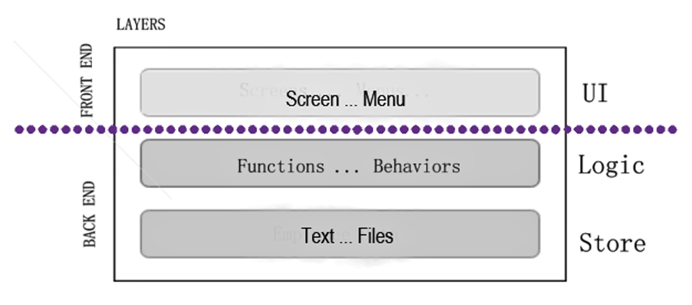
Layered Architecture Plan
Our team has chosen a layered architectural pattern, which consists of one screen and a toolbar that users will interact with in order to use the back-end functionality and features.

Slide 8
Software Quality Attributes
Usability: This application will be designed for ease of use to accomplish desired tasks. Users will have access to support provided with the system.
Functionality: This application will work as intended. Appropriate responsibilities will be assigned to congruent architectural elements.
Learnability: This application will have clear and concise user instructions and user manuals. Application will require minimal time and training for user’s use.
Notes:
These are just the most important

Slide 9

Test Specification
File displays drop down list
Shortcuts displays drop down list
Help displays drop down list
“New File“ presents a blank document
“Open...“ displays window to open and then opens document – except word docs
“Save“ saves document
“Save As“ displays window to save document and then saves document
“Exit” exits program

Slide 10
User Guide
Using the Menu Bar
File
Select File – New File to create new document.
Select File – Open… to open document. Select document from directory.
Select File – Save to save document to current directory as current file name.
Select File – Save as… to save document in directory. Chose a file name.
Select File – Exit to end program.
Shortcuts
Contains useful keyboard shortcuts for this text editor.
For Undo(Ctrl + Z), Cut(Ctrl + X), Copy(Ctrl + C), and Paste(Ctrl + V), simply select text and press keyboard shortcut buttons simultaneously.
For Select All(Ctrl + A), simultaneously press keyboard shortcut buttons.
Help
About JET contains information about this product version
Help includes Jet – Text Editor’s user manual.

Slide 11
EXECUTIVE SUMMARY

Slide 12
REFERENCES
https://www.vadimbulavin.com/layered-architecture-ios/
https://www.youtube.com/watch?v=8UlLgOf20Ho&list=PL4JxLacgYgqTgS8qQPC17fM-NWMTr5GW6
https://www.chegg.com/homework-help/questions-and-answers/example-21-project-selection-model-capstone-design-assume-part-capstone-design-team-opport-q30079756
https://www.studytonight.com/tkinter/text-editor-application-using-tkinter
https://studymoose.com/project-rationale-essay
https://www.scribd.com/document/459786189/SRS-docx
https://www.lce.com/Team-Charters-What-are-they-1219.html
https://pythonguides.com/python-tkinter-text-box/

